Slide 2
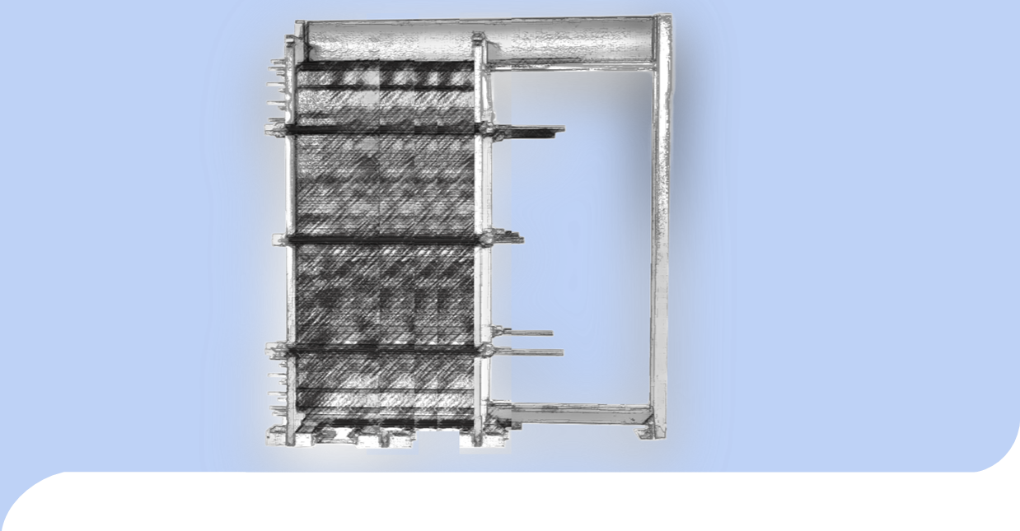
Plate Heat Exchangers in the HVAC Industry
Omar V. Feliciano, Sales Manager
Energy Division- HVAC
West Region
“Optimizing the Design”

Slide 3
Safety Message
Please stay safe and follow all Guidelines regarding Covid-19.
Our priorities at Alfa Laval are the health and safety of our employees – as well as our customers. At the same time, we’re focused on business continuity – continuing to meet and exceed your expectations. We’ve also taken several proactive steps to ensure the well-being of our teams, while continuing to provide high levels of customer service.

Slide 4

Alfa Laval
Alfa Laval is a leading global provider of specialized
products and engineered solutions.
A global company, founded in 1883 by Gustav de Laval
Highly engineered products
Global market leadership
Large customer and geographical diversification
Large base of installed products

Slide 5

We serve Most Industries
Biofuels
Biotech and pharmaceutical
Chemicals
Engine and transport
Fluid power
Food and beverages
HVAC
Industrial fermentation
Latex
Machinery
Marine and diesel
Metal working
Mining and mineral processing
Oil and gas
Oil refinery
Power
Pulp and paper
Refrigeration and air-conditioning
Semiconductor systems
Steel and coke oven gas
Sugar
Wastewater treatment

Slide 6
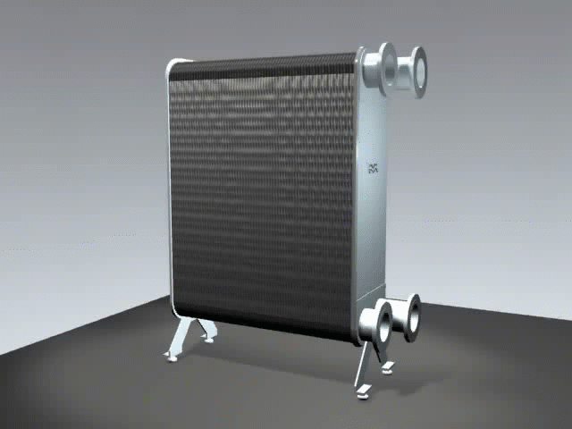
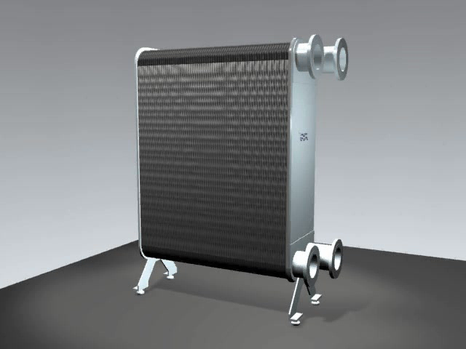
Brazed Plate and Fusion Bonded HE
Options:
Brazed Plate- Copper Brazed.
Fusion Bonded- 100% SS.

Slide 7
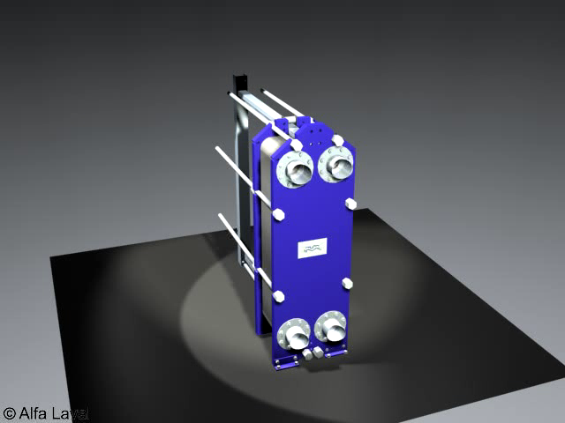
Gasketed Plate and Frame Heat
Heat Exchangers

Slide 8
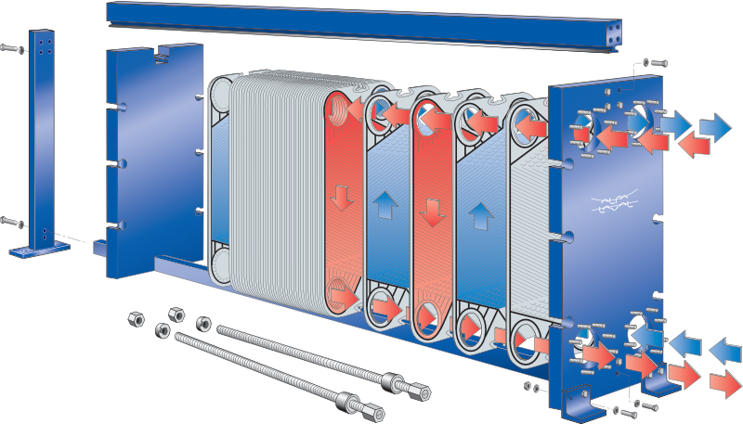
GPHE Components
Carrying bar
Pressure
plate
Frame plate
Plate pack
Tightening bolts

Slide 9
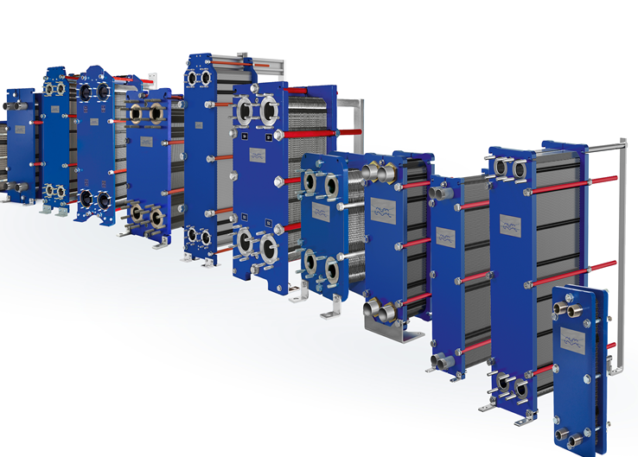
GPHE Line
HVAC Markets
AQ models contain AHRI certification.

Slide 10
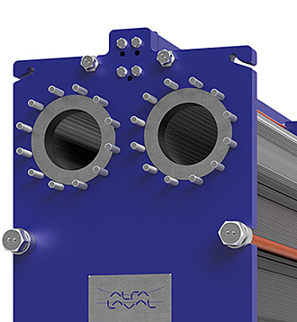
Introducing T-Series
The world’s most modern gasketed plate heat exchangers
Your business demands more than the status quo.
You demand higher efficiency, better reliability and greater serviceability
Don’t settle for less

Slide 11


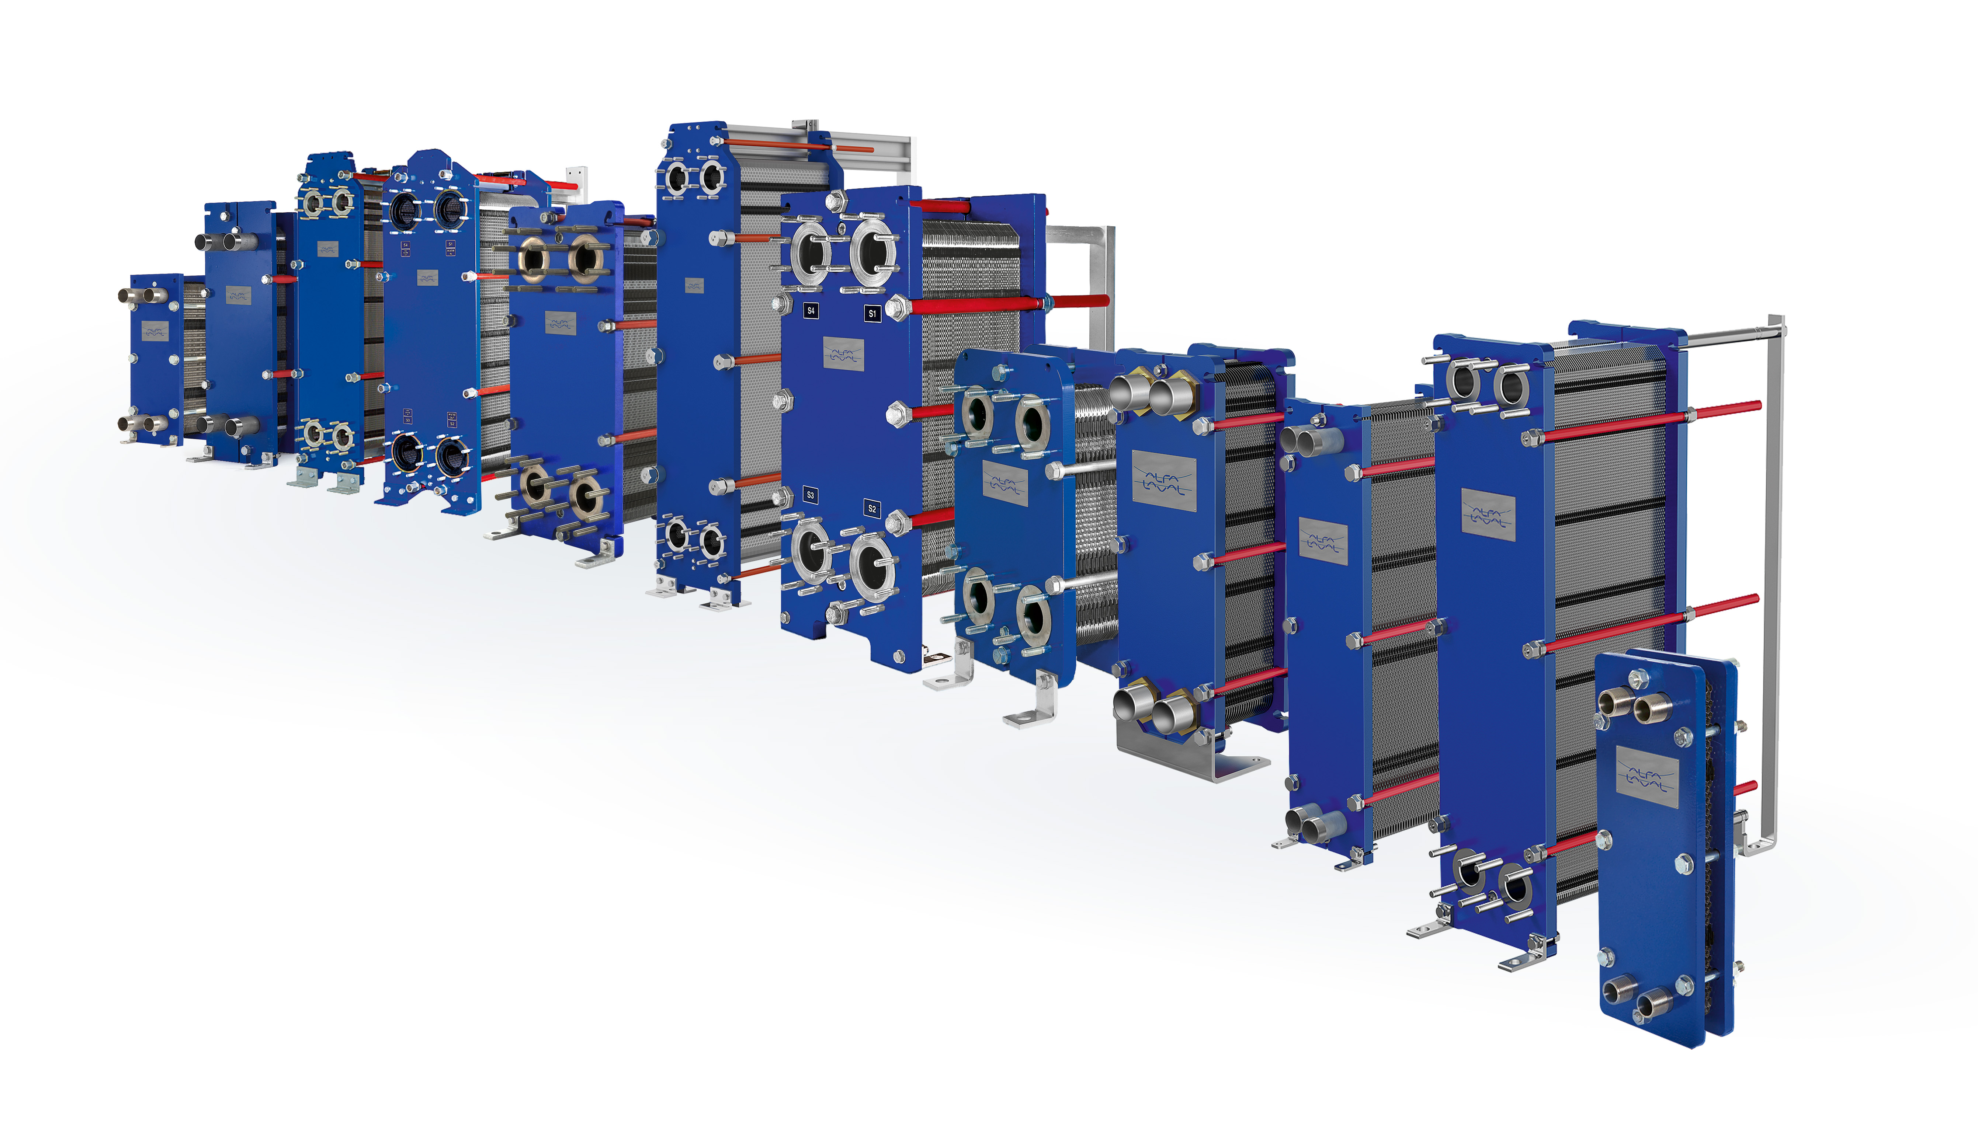






The features that make the difference
CurveFlow™
Improves media flow and minimizes risk of fouling
T-bar roller design
Provides a lower unit that is
easy to service
Offset gasket grooves
Ensures plate utilization for
maximum heat transfer efficiency
Five-point alignment
Secures reliable performance
with easy serviceability thanks
to perfect positioning
ClipGrip™
Ensures perfect seal and
trouble-free maintenance
Bearing boxes
Guarantees an easy-to-open unit for smoother, more efficient maintenance
PowerArc™
Improves plate rigidity for
longer lifetime
OmegaPort™
Enhances media flow and thermal efficiency

