Slide 1

Welcome to Hurley Engineering-Tualatin

Slide 2




Grundfos ASP-Pacific Northwest

Slide 3








Service All Major Brands of Pumps

Slide 4
DOE PEI / HI ER Overview
NAMREG Business Development

Slide 5

Agenda
DOE Regulation Overview
  Scope
  What is PEI?
  How should I apply PEI?
  Potential Issues with PEI
HI Energy Rating Overview
  What is the HI Energy Rating
  How does it relate to PEI?
  How should it be applied?

Slide 6

DOE Energy Conservation Standard for Pumps
Ultimate goal of the Energy Conservation Standard is to reduce power consumption, with an estimated 0.27 quadrillion BTU’s saved over a 30 year implementation period
Pumps within scope of new DOE regulations will need to meet minimum efficiency standards by January 27, 2020
All pumps sold after 2020 must be labeled with a Pump Energy Index (PEI)
25% of pumps currently sold on the market today will not comply with the new standards
Notes:
Expected lifetime energy savings over 30 year period amounts to 0.27 quadrillion Btu (quads)
Represents a savings of one percent relative to the energy use of these products without the new standards
DOE estimates that the cumulative reduction in CO2 emissions through 2030 amounts to 2.7 Mt, which is equivalent to the emissions resulting from the annual electricity use of more than 0.37 million homes.
Estimated cost of the standards in this rule is $17 million per year in increased equipment costs, while the estimated annual benefits are $58-$78 million in reduced operating costs, $30 million in CO2 reductions, and $3.7 – $5.4 million in reduced NOX emissions
The net benefit amounts to a range between $74 and $96 million per year

Slide 7
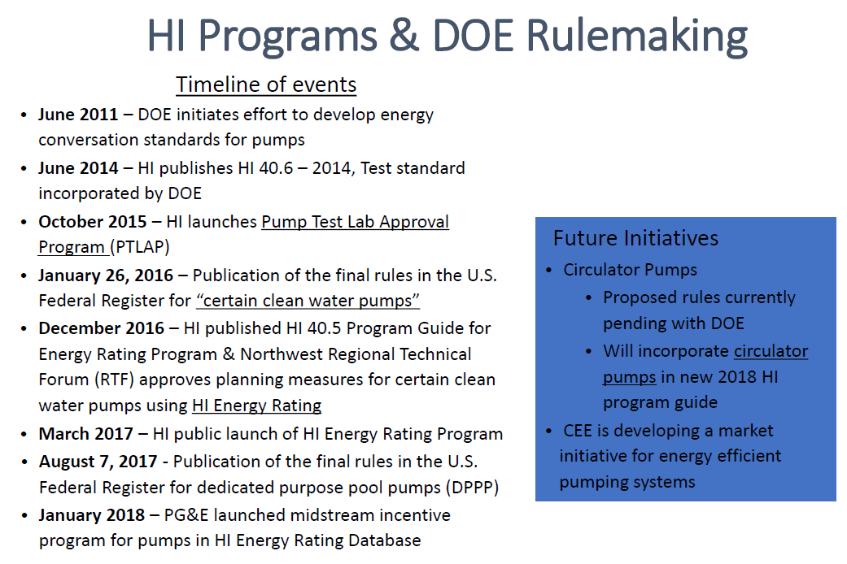
Notes:
Consortium for Energy Efficiency

Slide 8
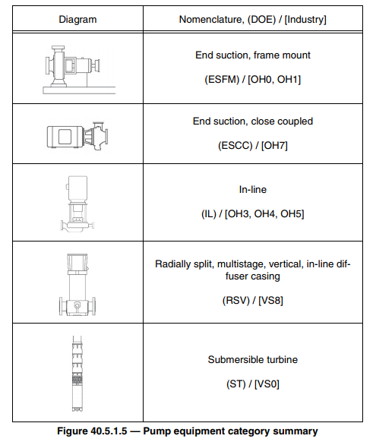
DOE Scope – What's In, what’s out?
Included
1 – 200 HP BEP
BEP Flowrate 25 GPM and above
BEP TDH below 460’
Temp Range: 14 – 248 F
Nominal Speeds Only (+/- 20%)
    1800 (1440 – 2160) RPM
    3600 (2880 – 4320) RPM
Excluded
Fire Pumps
Self-priming Pumps
Prime-assist Pumps
Magnet Driven Pumps
Nuclear controlled
Submersible Turbines above 6’’ discharge
Separate Rulemaking
Circulators
Pool Pumps
Grundfos Pumps
PACO LC/LCV/LCS/LCSE/LF, VL/VLS/VLSE/VLC/VLSC
Peerless F&C, PV, VTS
Grundfos CR/CRE, TP/TPE, SP
Notes:
Chart on left shows type of pumps included in DOE Scope
ES – PACO LC/LCS/LCV/LF, Peerless F&C
Inline – PACO VL/VLS, Peerless PV, TP/TPE
RSV – CR/CRE
Submersible – Peerless VTS
Excluded
Fire Pumps
Self-priming Pumps
Prime-assist Pumps
Magnet Driven Pumps
Nuclear controlled
Submersible Turbines above 6’’ discharge

Slide 9
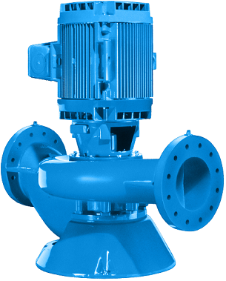
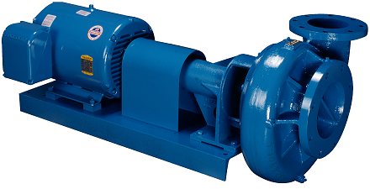
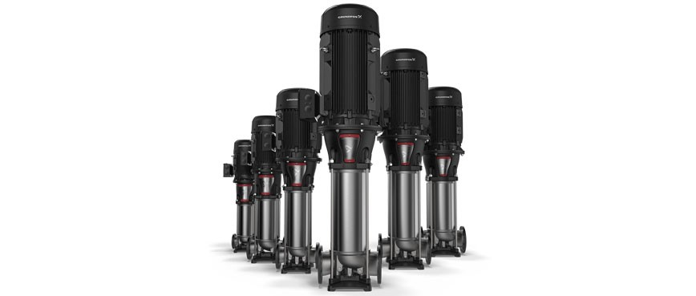
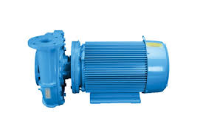
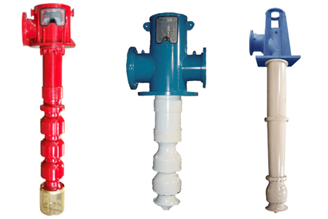
EXAMPLES

Slide 10


PEI – Pump Energy Index
PEI is the pump efficiency rating (PER) for a pump, divided by a calculated minimally compliant PER for the given pump model.
PER is defined as a weighted average of the electric input power (HP) supplied to a pump over a specified load profile
A PEI Rating greater than 1.0 indicates that a pump is not compliant, and can not be sold in the United States after January 27, 2020
PEI will be available for 3 different configurations
  bare pump
  pump + motor
  pump + motor + controls
Two types of PEI
  Constant Load
  Variable Load
Notes:
PEI is defined as the pump efficiency rating (PER) for a given pump model (at full trim), divided by a calculated minimally complaint PER for the given pump model
Emphasize same similar construction is same discharge size, suction size, nominal impeller diameter
Lower the PEI rating, the more efficient the pump (Opposite of HI Rating)

Slide 11
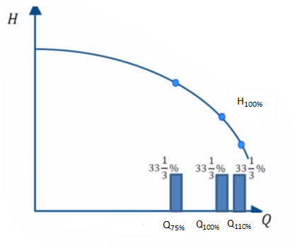
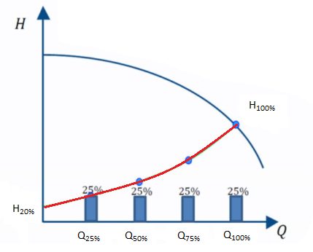
CL vs VL Test Methods
Constant Load
Variable Load
  Weighted average for constant load is taken at 75%, 100% and 110% of BEP flow rate
  Weighted average for variable load is taken at 25%, 50%, 75% and 100% of BEP flow rate

Slide 12

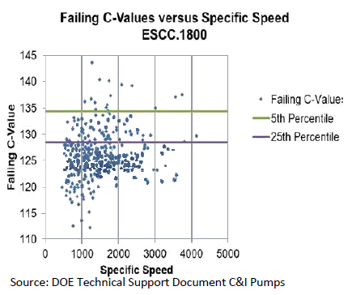
20+ Manufacturers submitted data on 5 pump types
3,000+ Unique Pumps
Pump Data Included:
  Flow, Head, Power and Efficiency
  DOE used this data to determine Standards Level and conduct the LCC analysis
Notes:
How do they define minimally compliant pumps? They’ve taken 20+ manufacturers data and plotted them by specific speed and a C value that correlates to efficiency. All C values that lie above the 25th percentile in the chart represent pumps that will no longer be saleable in 2020.

Slide 13
PEI - Calculations
Pump Energy Index (PEI) is the constant load (CL) or variable load (VL) PER divided by the standard (STD) PER.
Standard PER is calculated using the minimally compliant C value
The test procedure contains methods to determine the appropriate index using either calculation-based methods and/or testing-based methods
  Calculation method uses Industry standard loss calculations for a driver or driver and controls that are applied to bare pump test data
  Testing based method measures wire-to-water power consumption inclusive of the driver and controls, when applicable
Notes:
Calculation method uses NEMA industry standard efficiencies. If you have differentiated technology (example ECM) then you will need to test the variable load PEI with that motor, it can’t be calculated.
One method showing constant load (measurements taken at 75, 100, 110% BEP by throttling back a valve)
One method showing variable load (measurements taken at 25, 50, 75 and 100% BEP using a quadratic curve that reduces head as flow reduces)

Slide 14
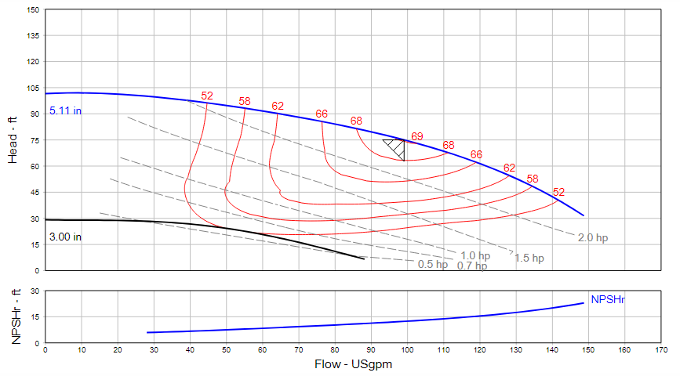
PEI – Max Trim / Max HP
PEI is based on the max trim with a non-overloading motor
All lower trim, lower HP variants will fall under the max trim, max HP PEI
The exception to this rule is if you have a non-nema premium motor

Slide 15
PEI - Summary
Pump Energy Index (DOE)
Ratings available for 3 different configurations and two speeds (constant or variable load)
  Bareshaft (PEI_{CL})
  Pump and Motor (PEI_{CL})
  Pump + Motor + Continuous Controls (PEI_{VL})
PEI values above 1.00 do not comply – the closer the value is to 0, the more efficient the pump
All pumps within scope sold after January 27, 2020 will be required to have the PEI labeled on the pump nameplate
Notes:
Summarize PEI before introducing HI Energy Ratings next

Slide 16
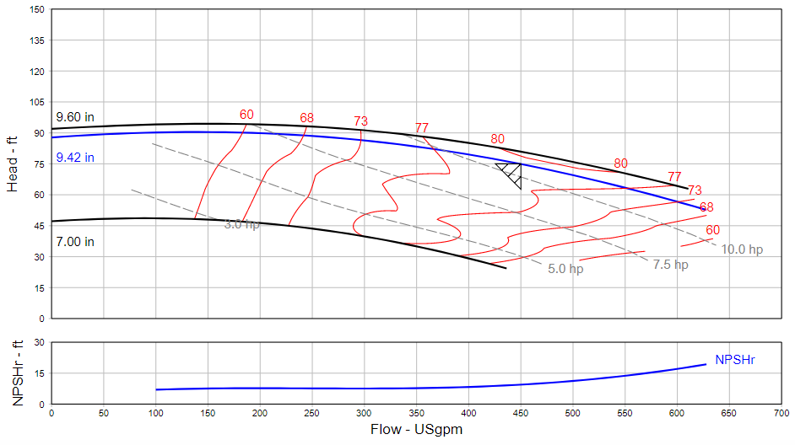
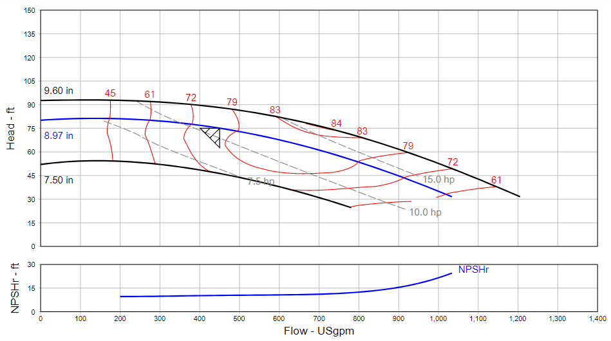
Constant Load PEI Comparison
LCS 30957 - 400 GPM @ 75’ TDH
Brake Horsepower: 10.75 BHP
Mechanical Eff: 79.15%
PEI: 0.98
LCS 40957 – 400 GPM @ 75’ TDH
Brake Horsepower: 11.09 HP
Mechancial Eff: 76.98%
PEI: 0.95
Notes:
Showing Constant Load PEI (40957 has better PEI value than 30957)
30957 has much lower BHP and much higher Efficiency – Proving pump selection matters much more than PEI values
Based on PEI, the 40957 should have a higher HI Energy Rating than the 30957, meaning it’s a more efficient pump.
Constant Load PEI based on 75%, 100%, and 110% BEP BHP

Slide 17

PEI Scope Limitations – Speed-Efficiency relation
Hbep | Speeds [RPM] for highest efficiency (nspec.= 2065) at different flows (Qbep)
[ft] | [GPM] | [GPM] | [GPM] | [GPM] | [GPM] | [GPM] | [GPM]
 | 88 | 132 | 440 | 880 | 1320 | 2200 | 4400
33 | 3395 | 2772 | 1518 | 1074 | 877 | 679 | 480
66 | 5710 | 4662 | 2554 | 1806 | 1474 | 1142 | 807
98 | 7739 | 6319 | 3461 | 2447 | 1998 | 1548 | 1094
131 | 9603 | 7841 | 4294 | 3037 | 2479 | 1921 | 1358
164 | 11352 | 9269 | 5077 | 3590 | 2931 | 2270 | 1605
197 | 13016 | 10627 | 5821 | 4116 | 3361 | 2603 | 1841
$$n_{bep}= n_{spec.}∙\frac{{H_{bep}}^{\frac{3}{4}}}{{Q_{bep}}^{\frac{1}{2}}}$$
Motor speeds to attain theoretical highest efficiency
Limited motor scope for DOE (2 and 4 pole)
PEI is a comparative measure, not absolute, so the full story about the efficiency of the pump cannot be captured using just PEI as its highly influence by specific speed
Notes:
Table shows the speeds needed to run at theoretical highest efficiency for a pump with a specific speed of 2065 for the given flow and head.
The point we’re trying to make here is that you’re not always going to get the most efficient pump for your application if you only use pumps that are within scope of the PEI/ER programs. (Limited to 1800 and 3600 RPM +/- 20%)
The TPE3 is a perfect example, we’re running at 5500 RPM (out of scope), and look at the efficiency comparisons compared to a PACO VL below.
TPE3 40-240-S operating at 80 GPM @ 70’ – 2 HP 5500 RPM, 72.7% EFF (NPSH 9.57’)
VL 12707 operating at 80 GPM @ 70’ – 3 HP, 3600 RPM, 49.12% EFF (NPSH 20.2’)
TPE3 40-200 operating at 50 GPM @ 72’ – 1.5 HP, 5000 RPM, 62.3% EFF (NPSH 5.53’)
VL 12707 operating at 50 GPM @ 72’ – 2 HP, 3600 RPM, 51.57% EFF (NPSH 16.24’)

Slide 18
Potential Issues using PEI
Limited scope for motor speed – most efficient solution won’t always have PEI rating
  DOE only considers 2 and 4 pole (No PEI rating for speeds lying outside this range)
PEI describes weighted average performance
  Ok to use as baseline, but won’t always be the most efficient product for your application
  Advanced control logic for variable load applications can deliver more savings over estimated HI label ratings
Pump PEI is required by DOE, not system PEI
  Load profile and pump selection is critical
Notes:
Why do we still limit ourselves to 2 and 4 pole?
Once we can get the testing done for DOE, we can publish our PEI ratings here vs B&G to show we aren’t saying there are issues because our pumps don’t’ have great PEI, just that choosing the right pump or system for your application matters even more than a PEI rating does

Slide 19

HI Energy Rating Program
The HI Energy Rating (ER) Label is designed to predict power savings obtained from pump system upgrades
  Program is voluntary
Savings are calculated over the baseline established by the US DOE according to HI Performance Test Standards
Public Utilities and Power companies use the ER label for incentive programs and rebates
Manufacturers use the ER label to differentiate products by power consumption
ER represents the percent power savings over the base case
Distributors will be able to use the HI database to create their own variable load ratings if adding their own VFD / Controls to a pump

Slide 20
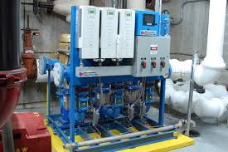
IS THIS DOE COMPLIANT?

Slide 21
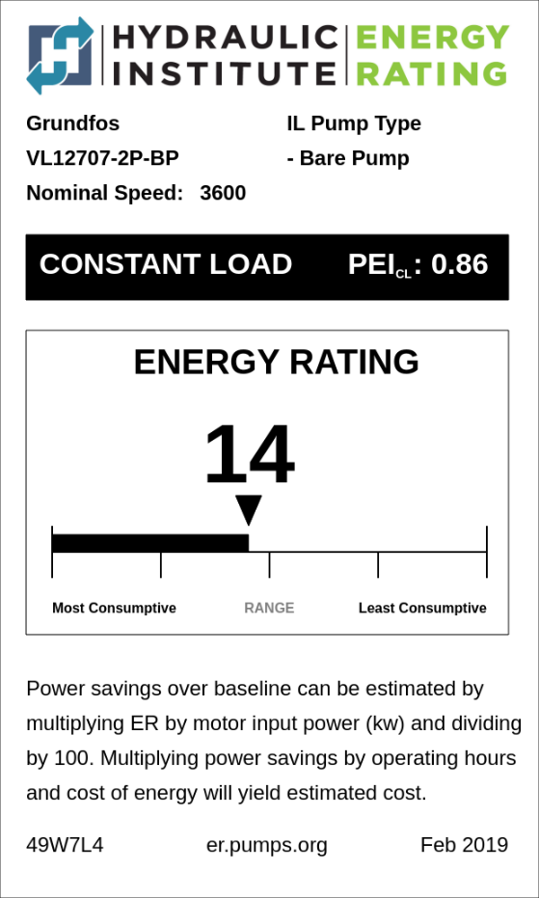
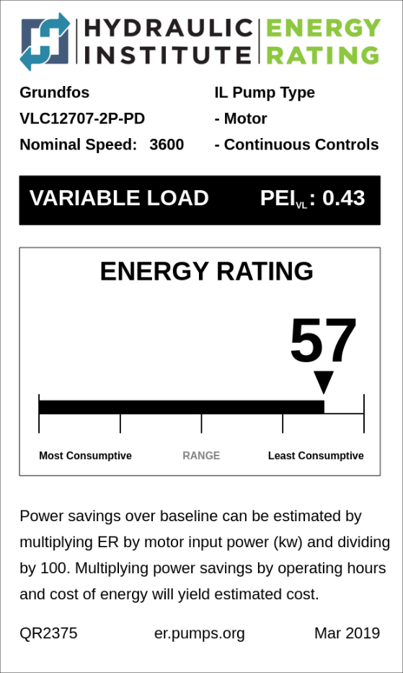
PEI - ER
PEI to ER Calculation: ER = (PEI_{Baseline} – PEI_{CL}/PEI_{VL}) * 100
Constant load: ER = (1.00 – 0.86) *100 = 14
Variable load: ER = (1.00 – 0.43)*100 = 57
Notes:
Calculating ER from PEI.
Energy Rating = the Baseline PEI value for either constant load or variable load times 100

Slide 22

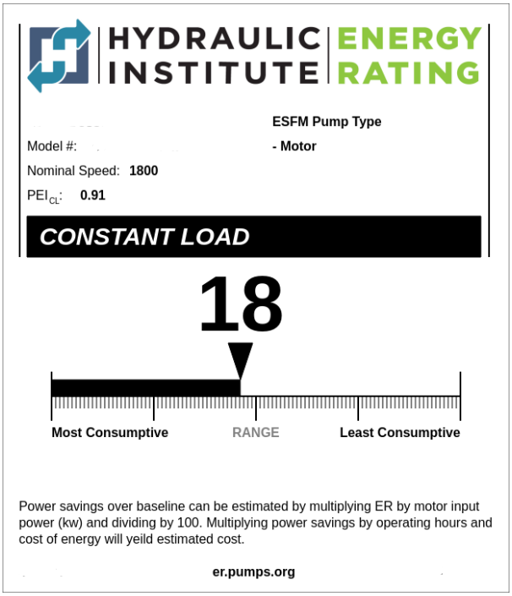
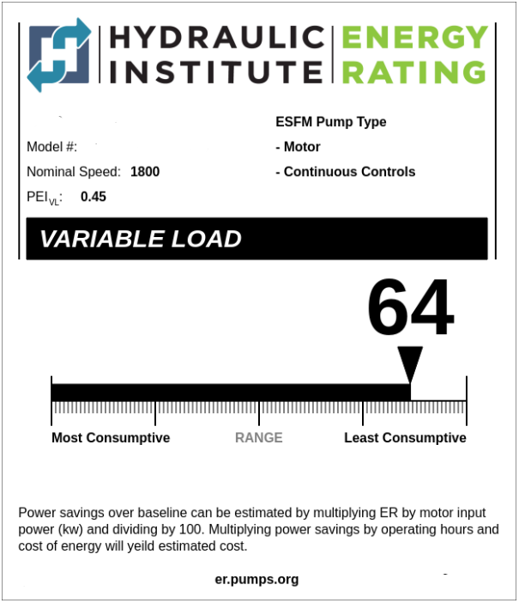


Annual Savings Calculation
50 HP ESCC Pump and Motor
(Assuming a 50 HP motor running 4,000 hours at $0.15 kwh)
50 HP ESCC Pump and Motor and VFD
(Assuming a 50 HP motor running 4,000 hours at $0.15 kwh)
Estimated Annual Energy Savings:
6.7 kw * 0.15 kwh * 4000 hours = $4,020
Estimated Annual Energy Savings:
24.6 kw * 0.15 kwh * 4000 hours = $14,760
Notes:
Using the label to calculate annual energy savings over the baseline value

Slide 23

Energy Rating – Predicting Annual Savings
Comparing Constant Speed vs Variable Load
Estimated Annual Energy Savings:
17.1 kw * 0.15 kwh * 4000 hours = $10,260
Notes:
Use label to calculated power savings between two models

Slide 24
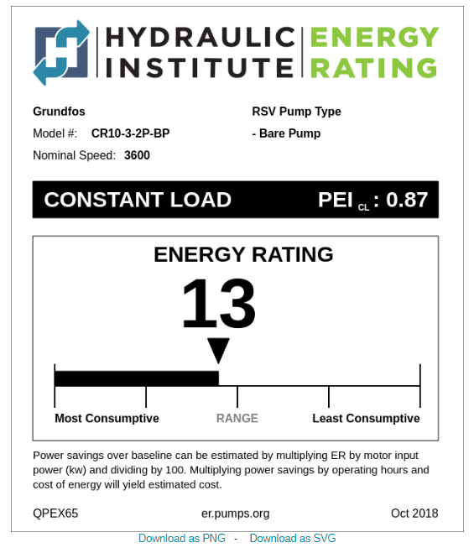
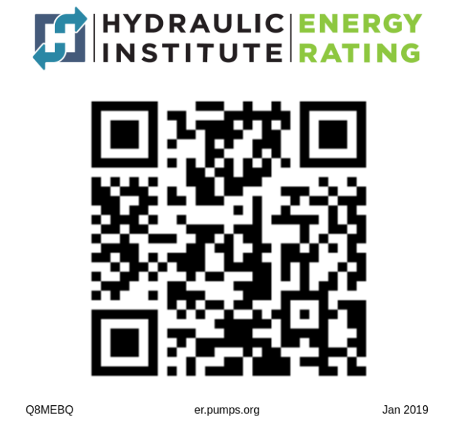
Nameplate and Labeling Requirements
DOE PEI Requirements (Nameplate)
  Basic Model Number
  PEI Rating (CL or VL)
  Impeller Trim
HI ER Requirements
  Voluntary
  ER Label or Bar Code

Slide 25
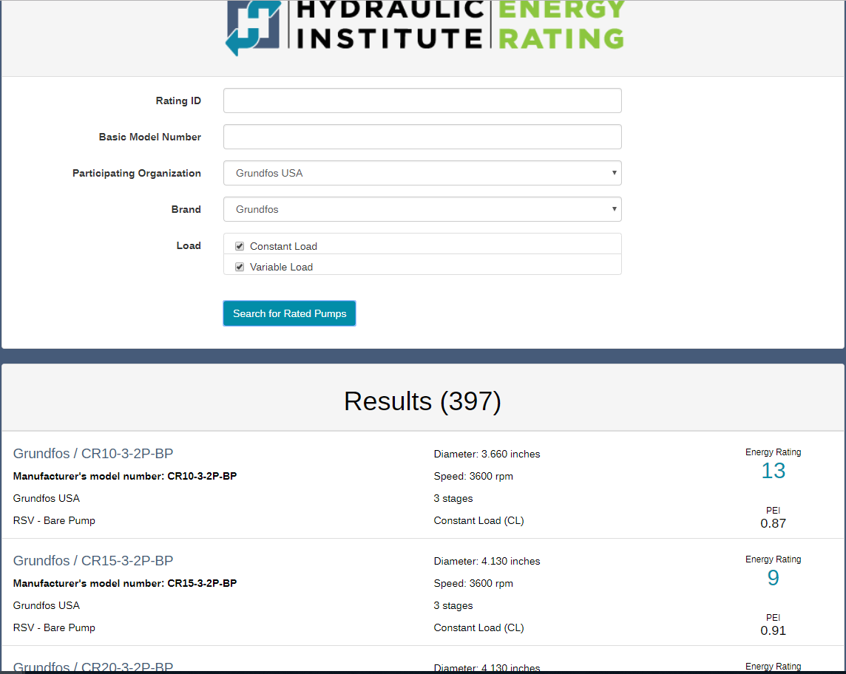
HI Energy Portal Listings
Currently have 397 Listings in the HI Energy Portal
  90% of PACO Single Stage Constant Load
  All PACO Inline C Products
  All CR Constant Load
  All TP Constant Load
Expect to have uploaded this month
  CRE Variable Load
  TPE Variable Load

Slide 26
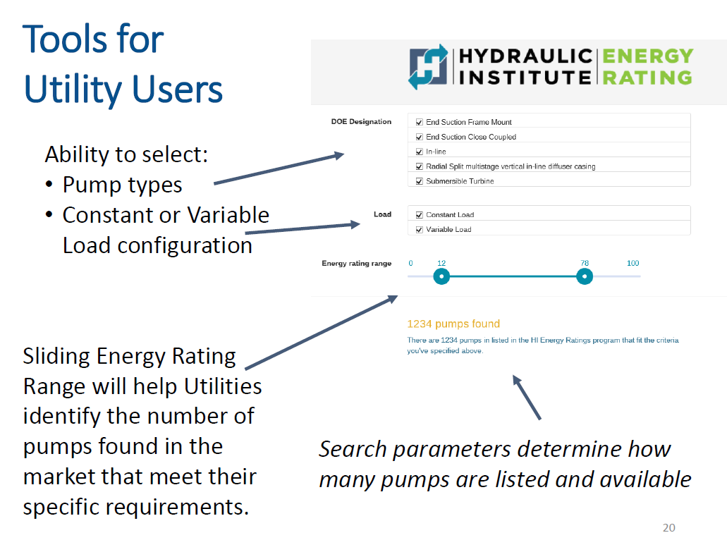
HI Energy Rating Portal
Notes:
Tool for users to search by pump type and Energy Rating.
Note – the intent of this tool is not to become a selection tool

Slide 27
Utility Rebate Programs
NEEA
  Northwest Energy Efficiency Alliance (NEEA) is partnering with utilities to develop midstream intervention approach that will provide:
    Consolidated and standardized incentive process that is easy to access, use, and understand in order to streamline incentive process for pumps
    Working with software developers to create an online marketplace where all certified products can be listed and energy efficiency program can list the features and details of their programs.
    HI Energy Rating database will feed into XMP Marketplace
CEE
  Developing a market initiative draft for energy efficient pumping systems for their members to consider
  CEE would like to utilize the HI Energy Rating Database to help assess actual product availability in the market.
  Currently, CEE is basing their programs off of PEI and not ER
Notes:
NEEA – Northwest Energy Efficiency Alliance
3rd party companies developing their own databases using HI ER Database

Slide 28

HURLEY ENGINEERING WEBSITE

Slide 29
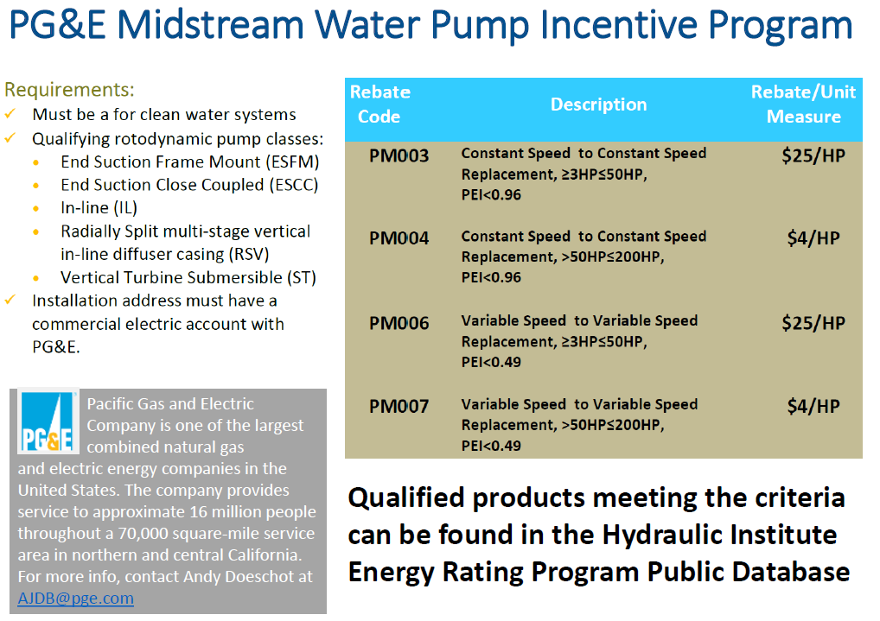
Notes:
PG&E already issuing rebates based on PEI (only one we know of in the country so far)

Slide 30
Competitor Update
Competitors in HI Energy Portal (# of Listings)
  Crane Pumps & Systems
    Weinman (146)
    Burks (58)
    Deming (22)
    Barnes (3)
  Taco (287)
  Armstrong (290)
  Xylem
    B&G (562)
    Marlow (415)
    Goulds (237)
Competitors with compliance issues
  Aurora – announced to customers that current end suction line will not meet DOE compliance, new product line will be more expensive and not dimensionally interchangeable
  Armstrong? – only publishing Variable Load
  TACO –have made a general statement that many pumps will need to be redesigned so an exact flange-to-flange replacement may not be available in their FAQs on DOE compliance

Slide 31
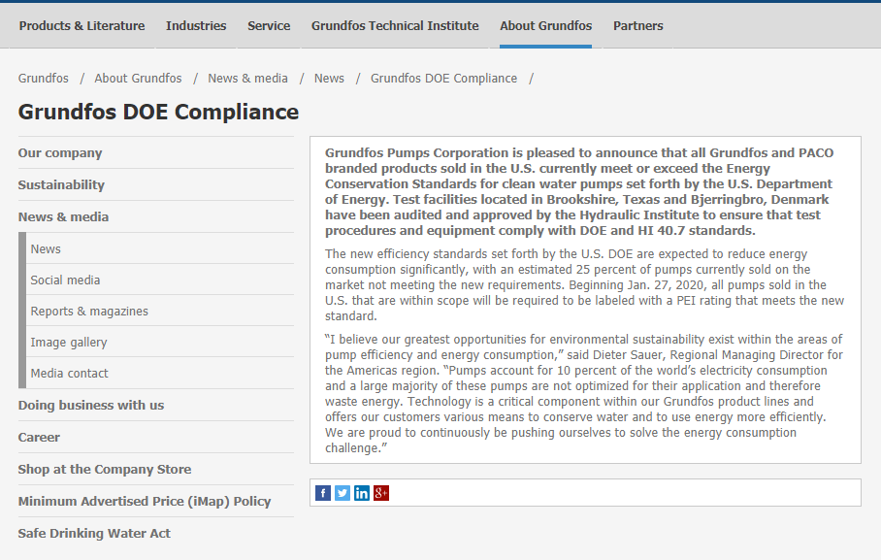
Grundfos Compliance
Announced last year that all Grundfos and PACO products comply with upcoming regulations
https://us.grundfos.com/about-us/news-and-press/news/grundfos-doe-compliance.html
Competitors with statements on full compliance
  B&G

Slide 32
Training / Marketing
DOE Requirements for literature
  Everywhere performance data is published, PEI will need to be published (curves, databooks, etc)
  All selection programs will contain PEI (GPC, GXS)
Formalizing Lunch and Learn Presentation for Sales
  Will also be product focused
Working on accredited course with training team for Engineers to get CPE credits
  Non-product focused
Marketing brochure outlining DOE regulations and HI Energy program as it pertains to Grundfos Products, as well as FAQs
Document outlining Grundfos PEI ratings vs Competitors
Marketing Memo Blast on products in the HI Database
CSI Spec outlining DOE compliance
Other training / marketing material needed?
What are we missing in go to market strategy?

Slide 33
Our NEEA Friend Sarah

Slide 34
Future Training Opportunities:
Laser Alignment Training Mark Carroll-Hurley Engineering
DOE Pump Regulation Training Chris Ireland-Grundfos Pumps
Motor Basics-Best Practices Sizing and Repair Robert Stuart-ABB Baldor
Cooling Tower-Fluid Cooler Best Practices Eric Chapman-Delta Cooling
Booster & HVAC Skid 101 Chris Ireland-Grundfos
Water Filtration-Legionella Prevention Patrick Verwys-Triple Clear
Bladder Tank, Air Separators, Hydraulic Sep.s BP 101 Rob Warnell-Global Flow
Submersible Lift Station and Pump Maintenance-Hands On Mark Carroll-Hurley Engineering
Heating and Cooling System Best Practices Jim Schlachter-Envirosep
Boiler Turn Down, Venting, Combustion Best Practices Dave Connors-Patterson Kelley

Slide 35

Tech-A-Minute
Lab Use:
Contractors
Engineers
Training Videos
Tech Talks
Property Owners
NEEA
OET
Factory Training
Contractor Authorized Start Up Certification

