Slide 1
Intelligent Pumping Systems
Commercial Buildings

Slide 2

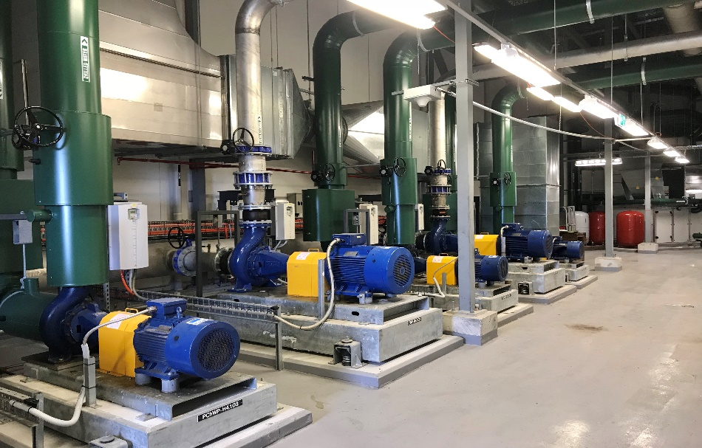
We’ll learn about…
Efficient motors
Hydraulic Optimization
What to look for in a controller
Why packaged solutions
Booster energy checks
Where are your energy savings opportunities
Notes:
When specifying pumps you are not always thinking about the finer details: control, efficiency, communication; you need to get pumps onto a schedule and make sure the hardware is there to cover the intent of the design (pumps, drives, energy creators…). [Click] ADD FOR SAVING ENG MONEY

Slide 3



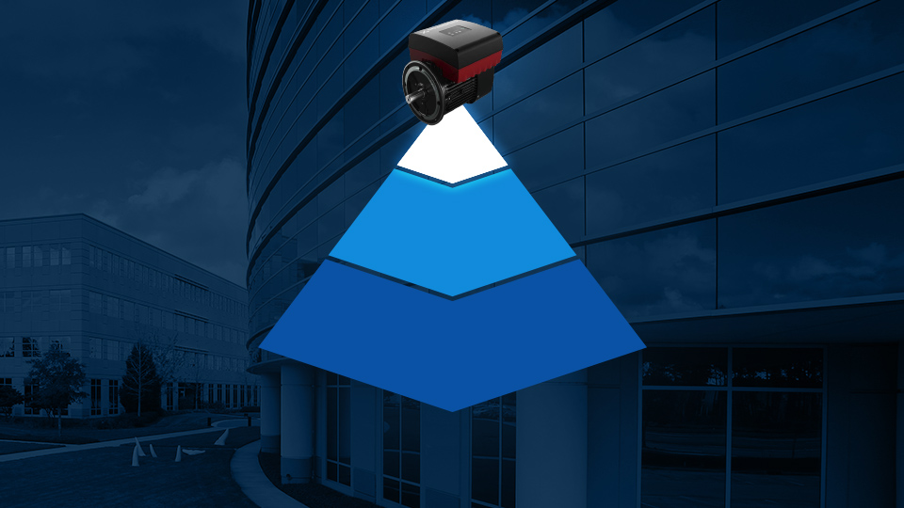
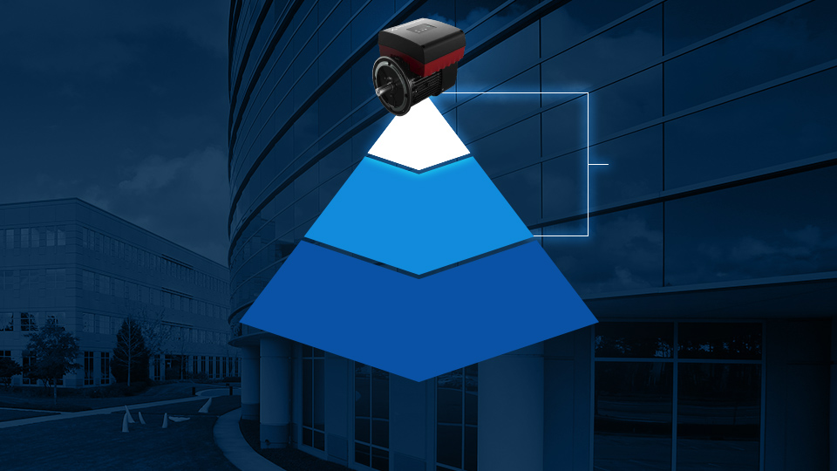
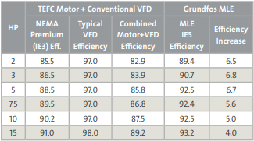
Highly Efficient: Reduced Energy Consumption
UP TO
10%
ADDITIONAL
ENERGY
SAVINGS
Grundfos
MLE Motor
Meets IE5
Super Premium Efficiency / IE4
Industry Standard
IE3 / NEMA Premium
Notes:
It all starts with the motor … Permanent Magnet Motors don’t require induction to drive the motor and are able to maintain the highest part load efficiencies in variable volume pumping systems.
[CLICK] As far as motor efficiency is concerned, IE3, or NEMA Premium as we call it in here in the US, is the industry standard.
[CLICK] IE4 or Super Premium, gains efficiency through more robust stator windings (more copper) than NEMA Premium and in some cases, use permanent magnet rotors, typically though less rotor magnets are used.
[CLICK] The Grundfos MLE motor meets the Grundfos MLE motor meets the strictest IE5 criteria, built for maximum efficiency in full and part-load conditions. [CLICK] Saving you up to 10% in additional energy costs.

Slide 4
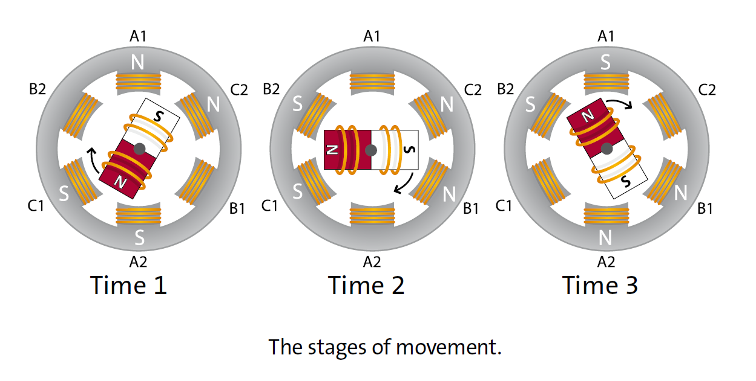
Asynchronous Motor Movement
Notes:
In an asynchronous motor, both the rotor (rotating element) and the stator (stationary element) need to be energized. The stator is energized via direct connection to power supply. The rotor is energized via induction, this process has losses and has a major effect on a motor’s efficiency. As the rotor’s magnetic field is energized by induction, it will begin to rotate past the windings of the stator. The polarity of the windings alternate to oppose the polarity of the rotor and the rotor spins. The key here is the space between the windings or “slip”. The amount of space or slip will determine, the torque and momentum with which the rotor spins. [CLICK]

Slide 5
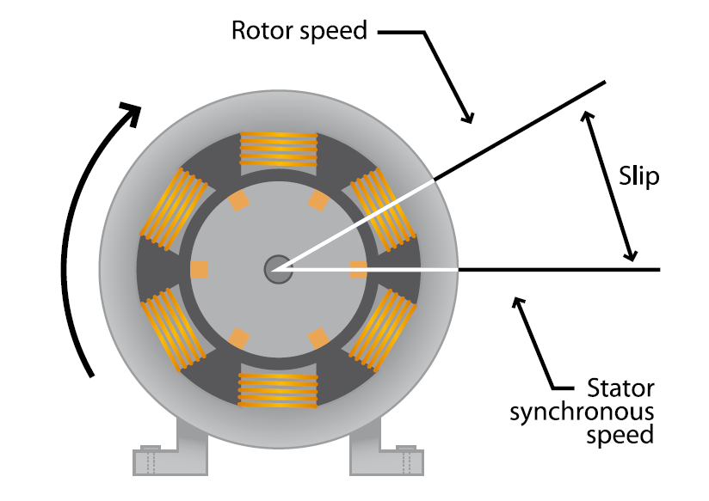
Asynchronous Motor Slip
Notes:
This mechanical commutation has inefficiencies, eddy currents and losses occur as the rotor passes from one pole to another and “slip” occurs. As I mentioned earlier, slip is a necessary component of a mechanically commutated motor, it provides torque and momentum for the rotor to spin. As the motor approaches full speed (the speed it was designed for), the slip is low and the motor is operating at it’s most efficient point. As the motor reduces in load, the slip (and inefficiencies grow). [CLICK]

Slide 6
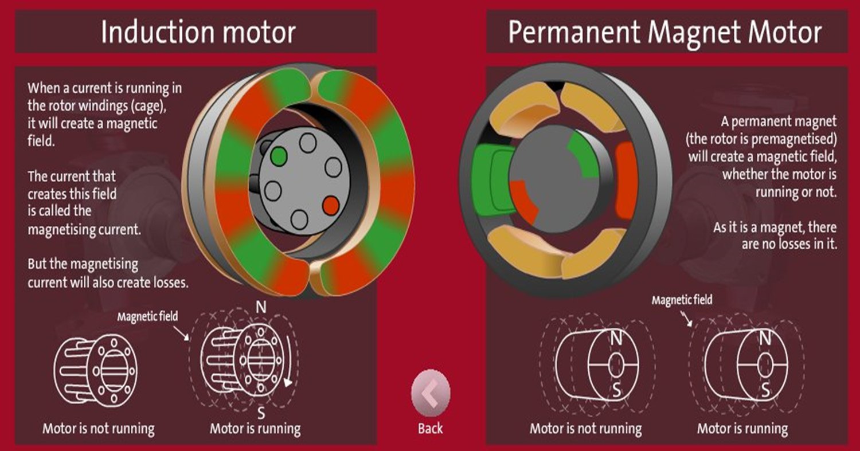
ECM Motors – Higher Efficiency

Slide 7

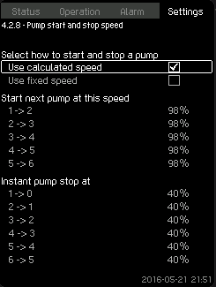
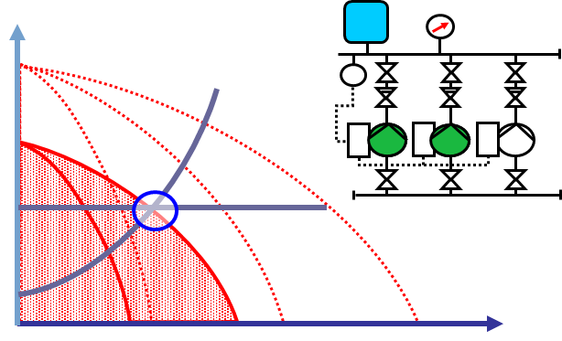
Cascade Control
Methods used in industry:
Based on pressure
Based on pump speed
Based on power
Based on flow sequencing
Based on pump efficiency
Calculated speed will use most efficient operation – lowest specific energy.
Note: Flow rate, pressure, power AND pump curve data must be measured/known to stage on efficiency.
Notes:
Thank you for your attention
7

Slide 8
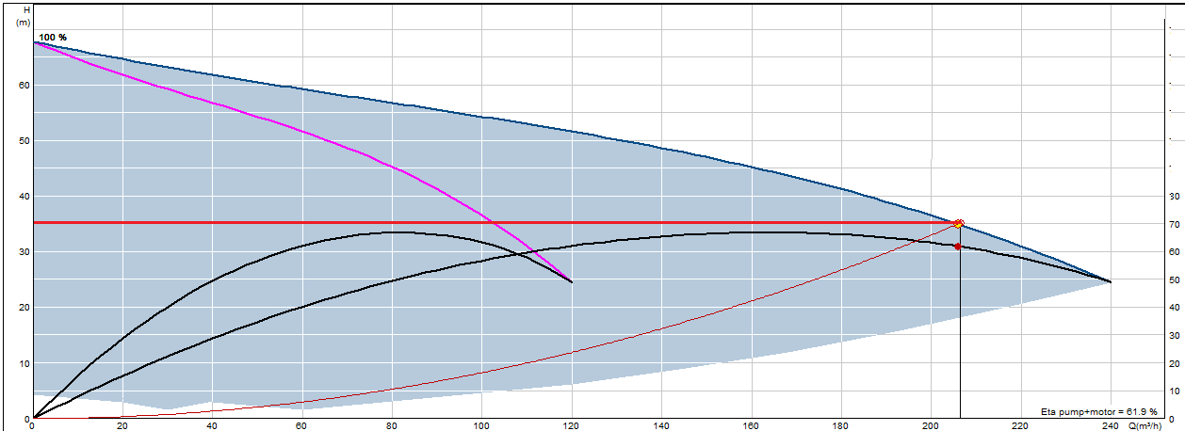
ENERGY OPTIMIZATION
In below picture two pumps in parallel is shown (blue and purple curve).
The Y-axis on the left side shows the Head of the Pumps. The Y-axis on the right
Side shows the efficiency. The X-axis show the flow.
The two black lines below the pump curves, show the efficiency for one pump
running alone and for two pumps running together
H
ETA
Q
Notes:
Thank you for your attention
8

Slide 9
ENERGY OPTIMIZATION
For a duty point, that can be covered with both one pump running or two pumps
running, there is a difference in efficiency whether it is covered with one or two
pumps.
In this case the efficiency is highest if one pump are running -even though the
flow requirement could also be covered with two.
H
Duty Point
Efficiency
for one
pump
running
Efficiency
for two
pumps
running
With one pump:
62%!
ETA
With two pumps 50%!
Q
Notes:
Thank you for your attention
9

Slide 10
Where do our systems operate?
Consider part-load selections
Notes:
When you evaluate the amount of time spent at part-load conditions, shouldn’t you consider making the best selection based on part load performance? Pumps have a limited turn down ratio. A pump sized for 100% of a load that we spend 1% of it’s operation time, will not perform well at 25% or 50% of it’s load. Typical systems spend almost 60% of their time operating at 50% of design flow or less. Almost 90% of their time at less than 60% of the load they were designed for. Pumps should be selected for 50% of the design load, or less. Properly selected multiple, smaller pumps will deliver long term efficiency.

Slide 11
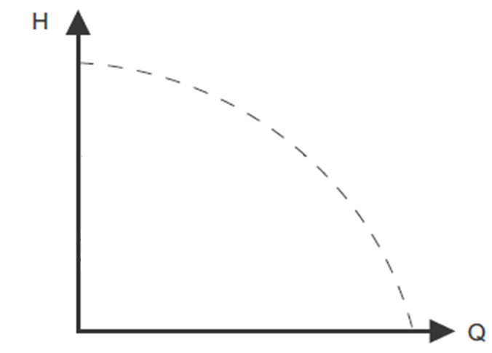
Proportional Pressure Control

Slide 12
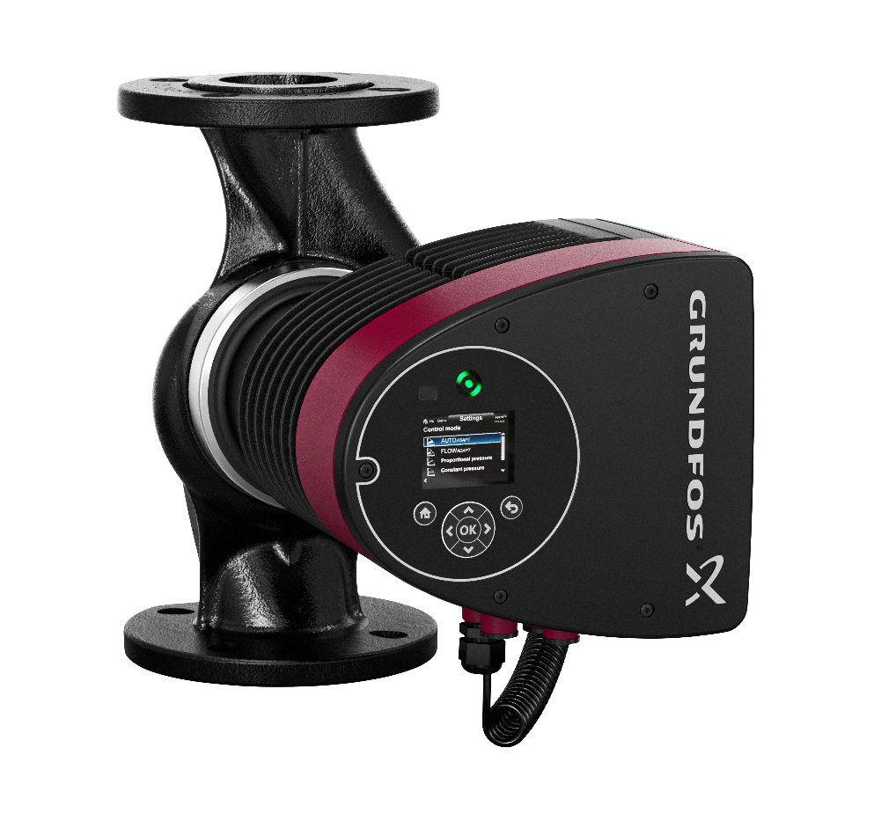
Smart Circulators and Smart Pumps
Best Hydraulic Design
ECM Motor Efficiency
Onboard Controls for a Variety of Control Logic: Temperature, Proportional Control, Constant Speed, Constant Pressure.
All in one SYSTEM

Slide 13
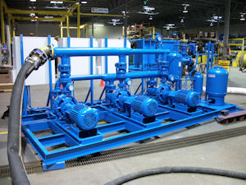
Traditional Package Systems
Extremely Large Footprint
Multiple Vendors or Manufacturers.
VFD and Pump Manufactures are Typically Different.
Controls Strategy DOES NOT integrate with Hydraulic BEP Curves & System Curves.

Slide 14
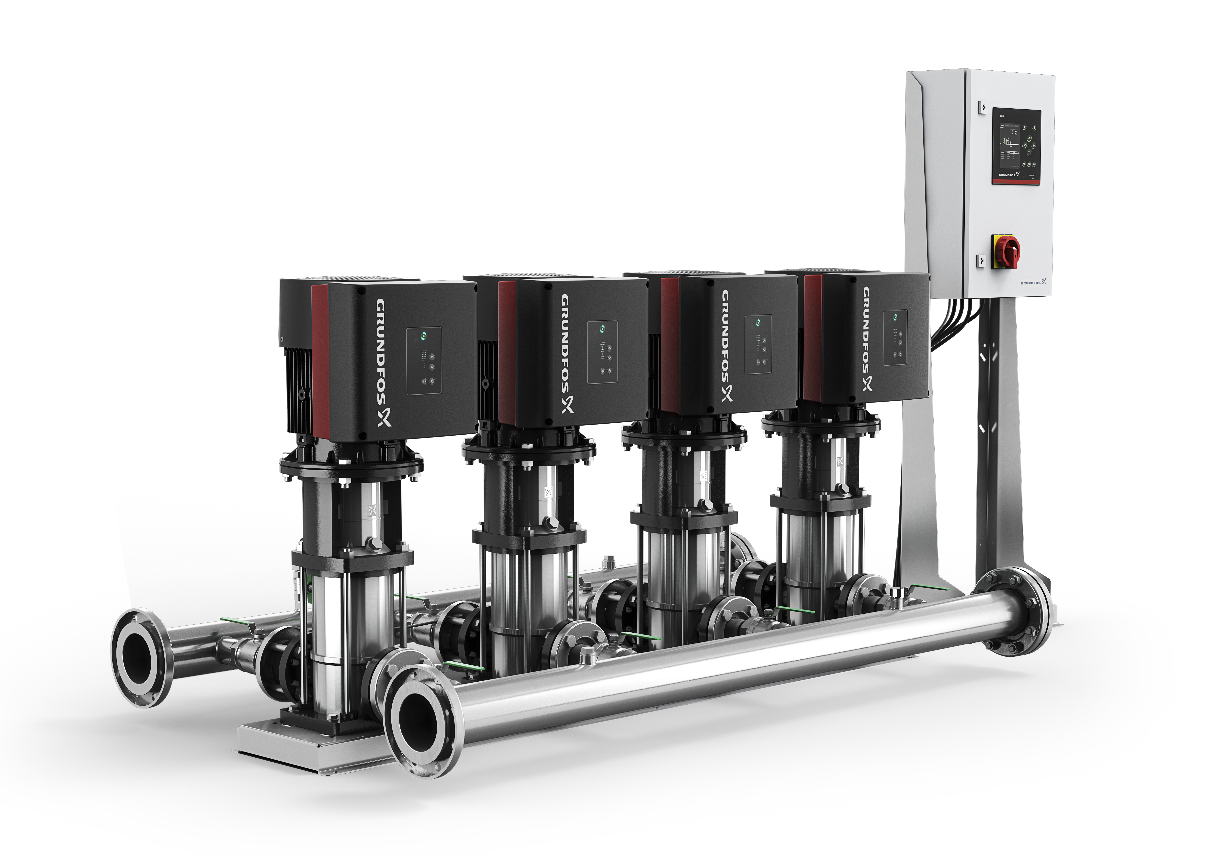
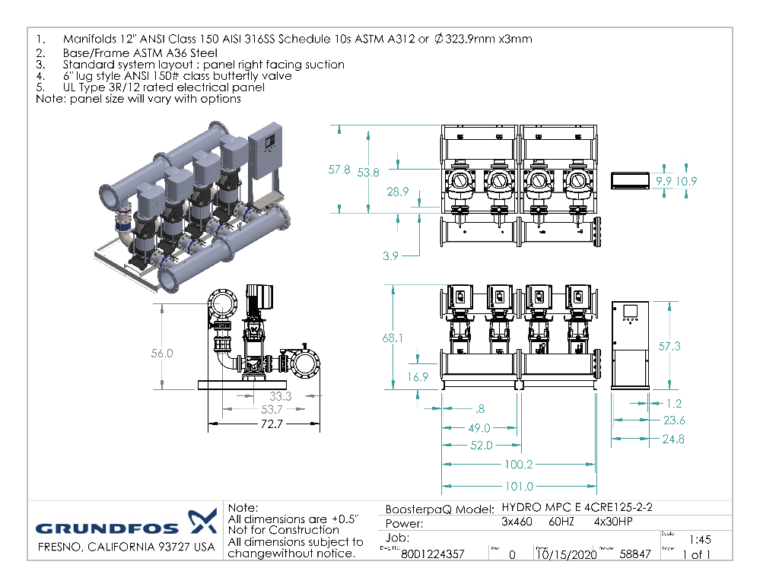
Package Systems Re-Configured
System Features
-Single source supplier
-Modular design options
-CR/CRE pumps
-Advanced permanent magnet motor
-Efficiency based sequencing
-SCADA via CIM expansion card
-Built-in logging capability
-Secondary (fallback) sensors
-One housekeeping pad and no grouting
-No suction diffusers
-Single power connection
-Pre-piped, pre-wired and pre-tested
-No on-site assembly
-No alignment

Slide 15

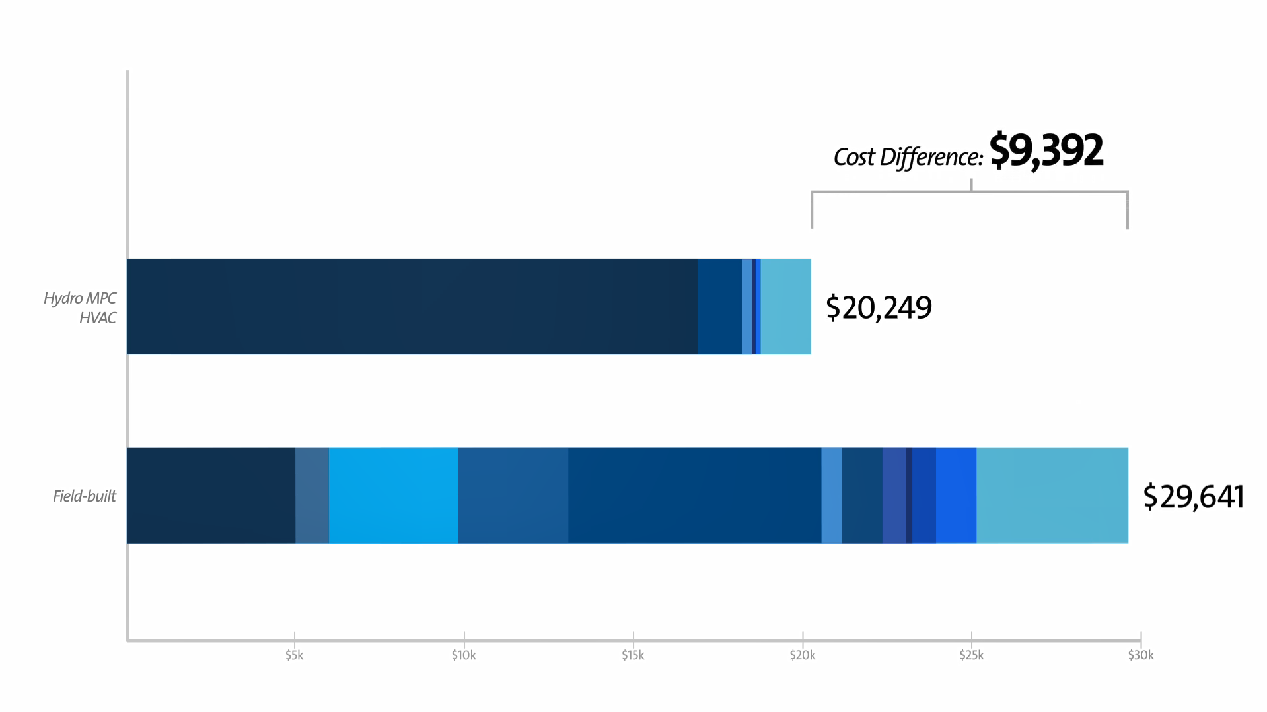

Notes:
You might think this is going to cost you an arm and a leg, but it’s not. I challenge you to build a cheaper system when you actually start to consider the components outside the pump.…

Slide 16


Slide 17
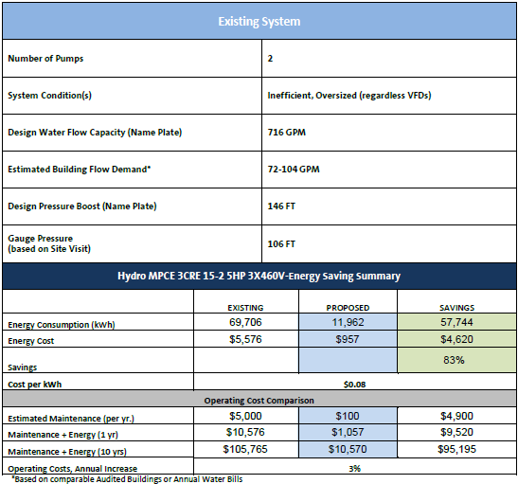
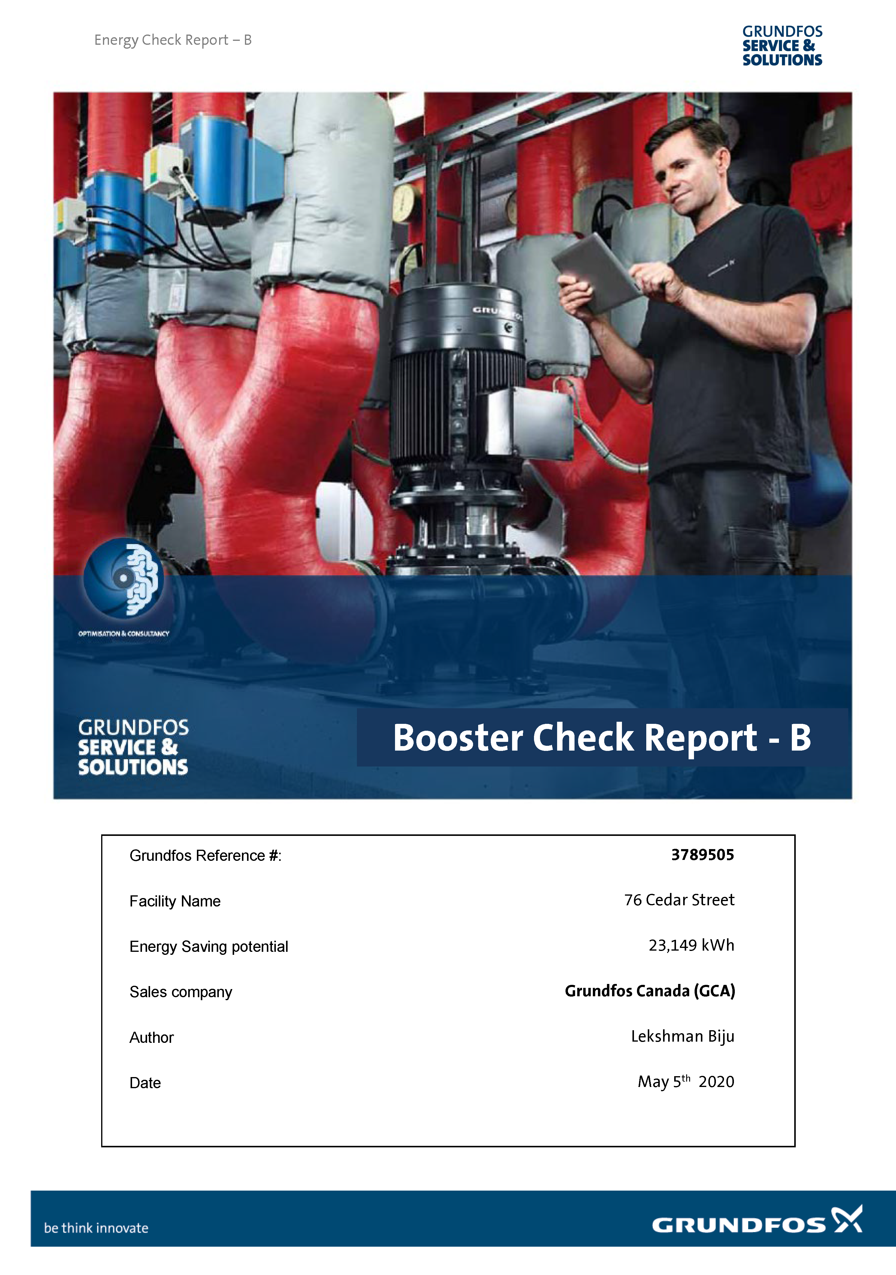
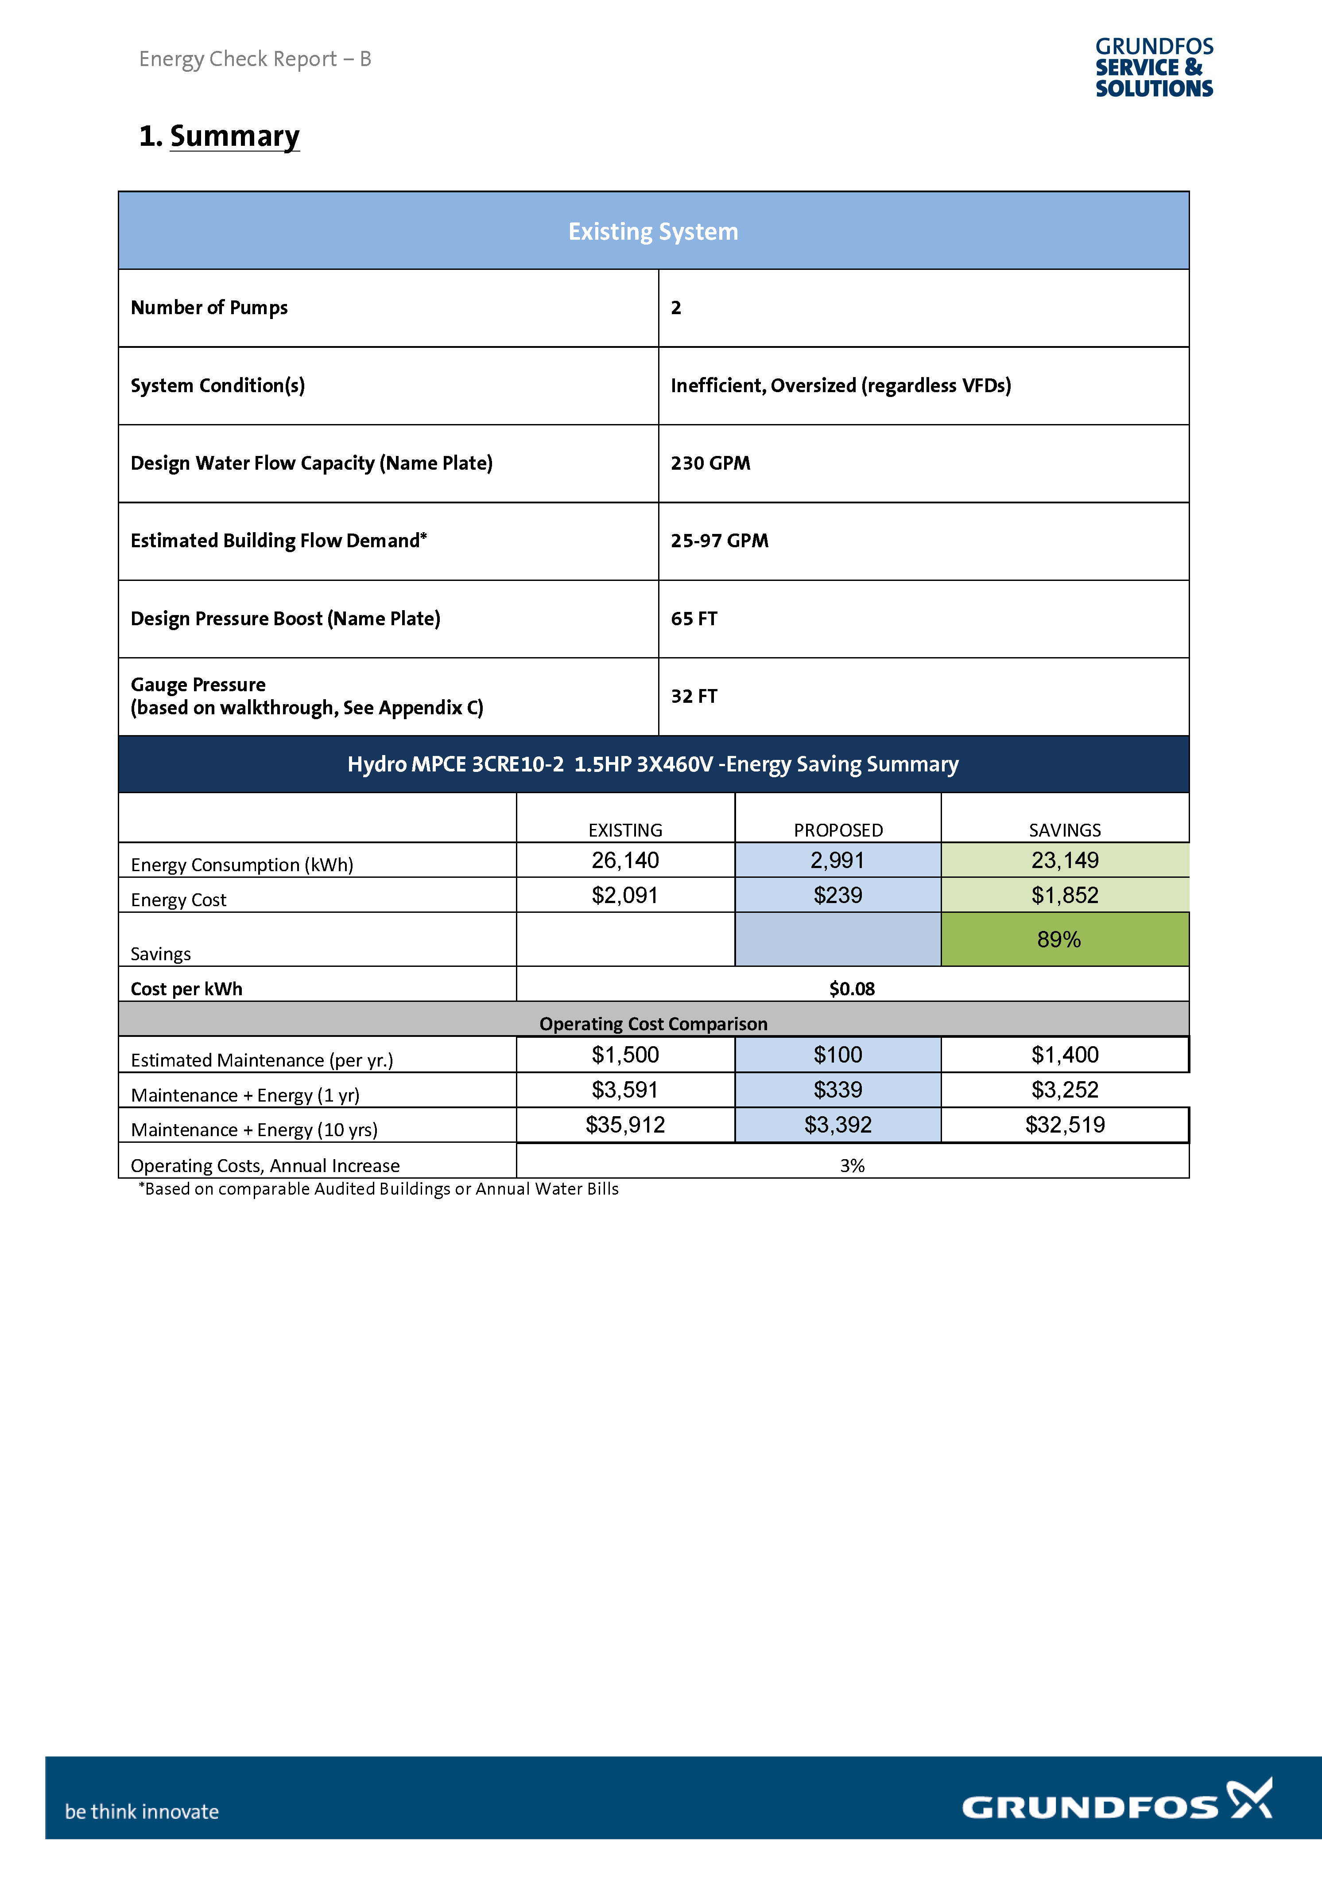
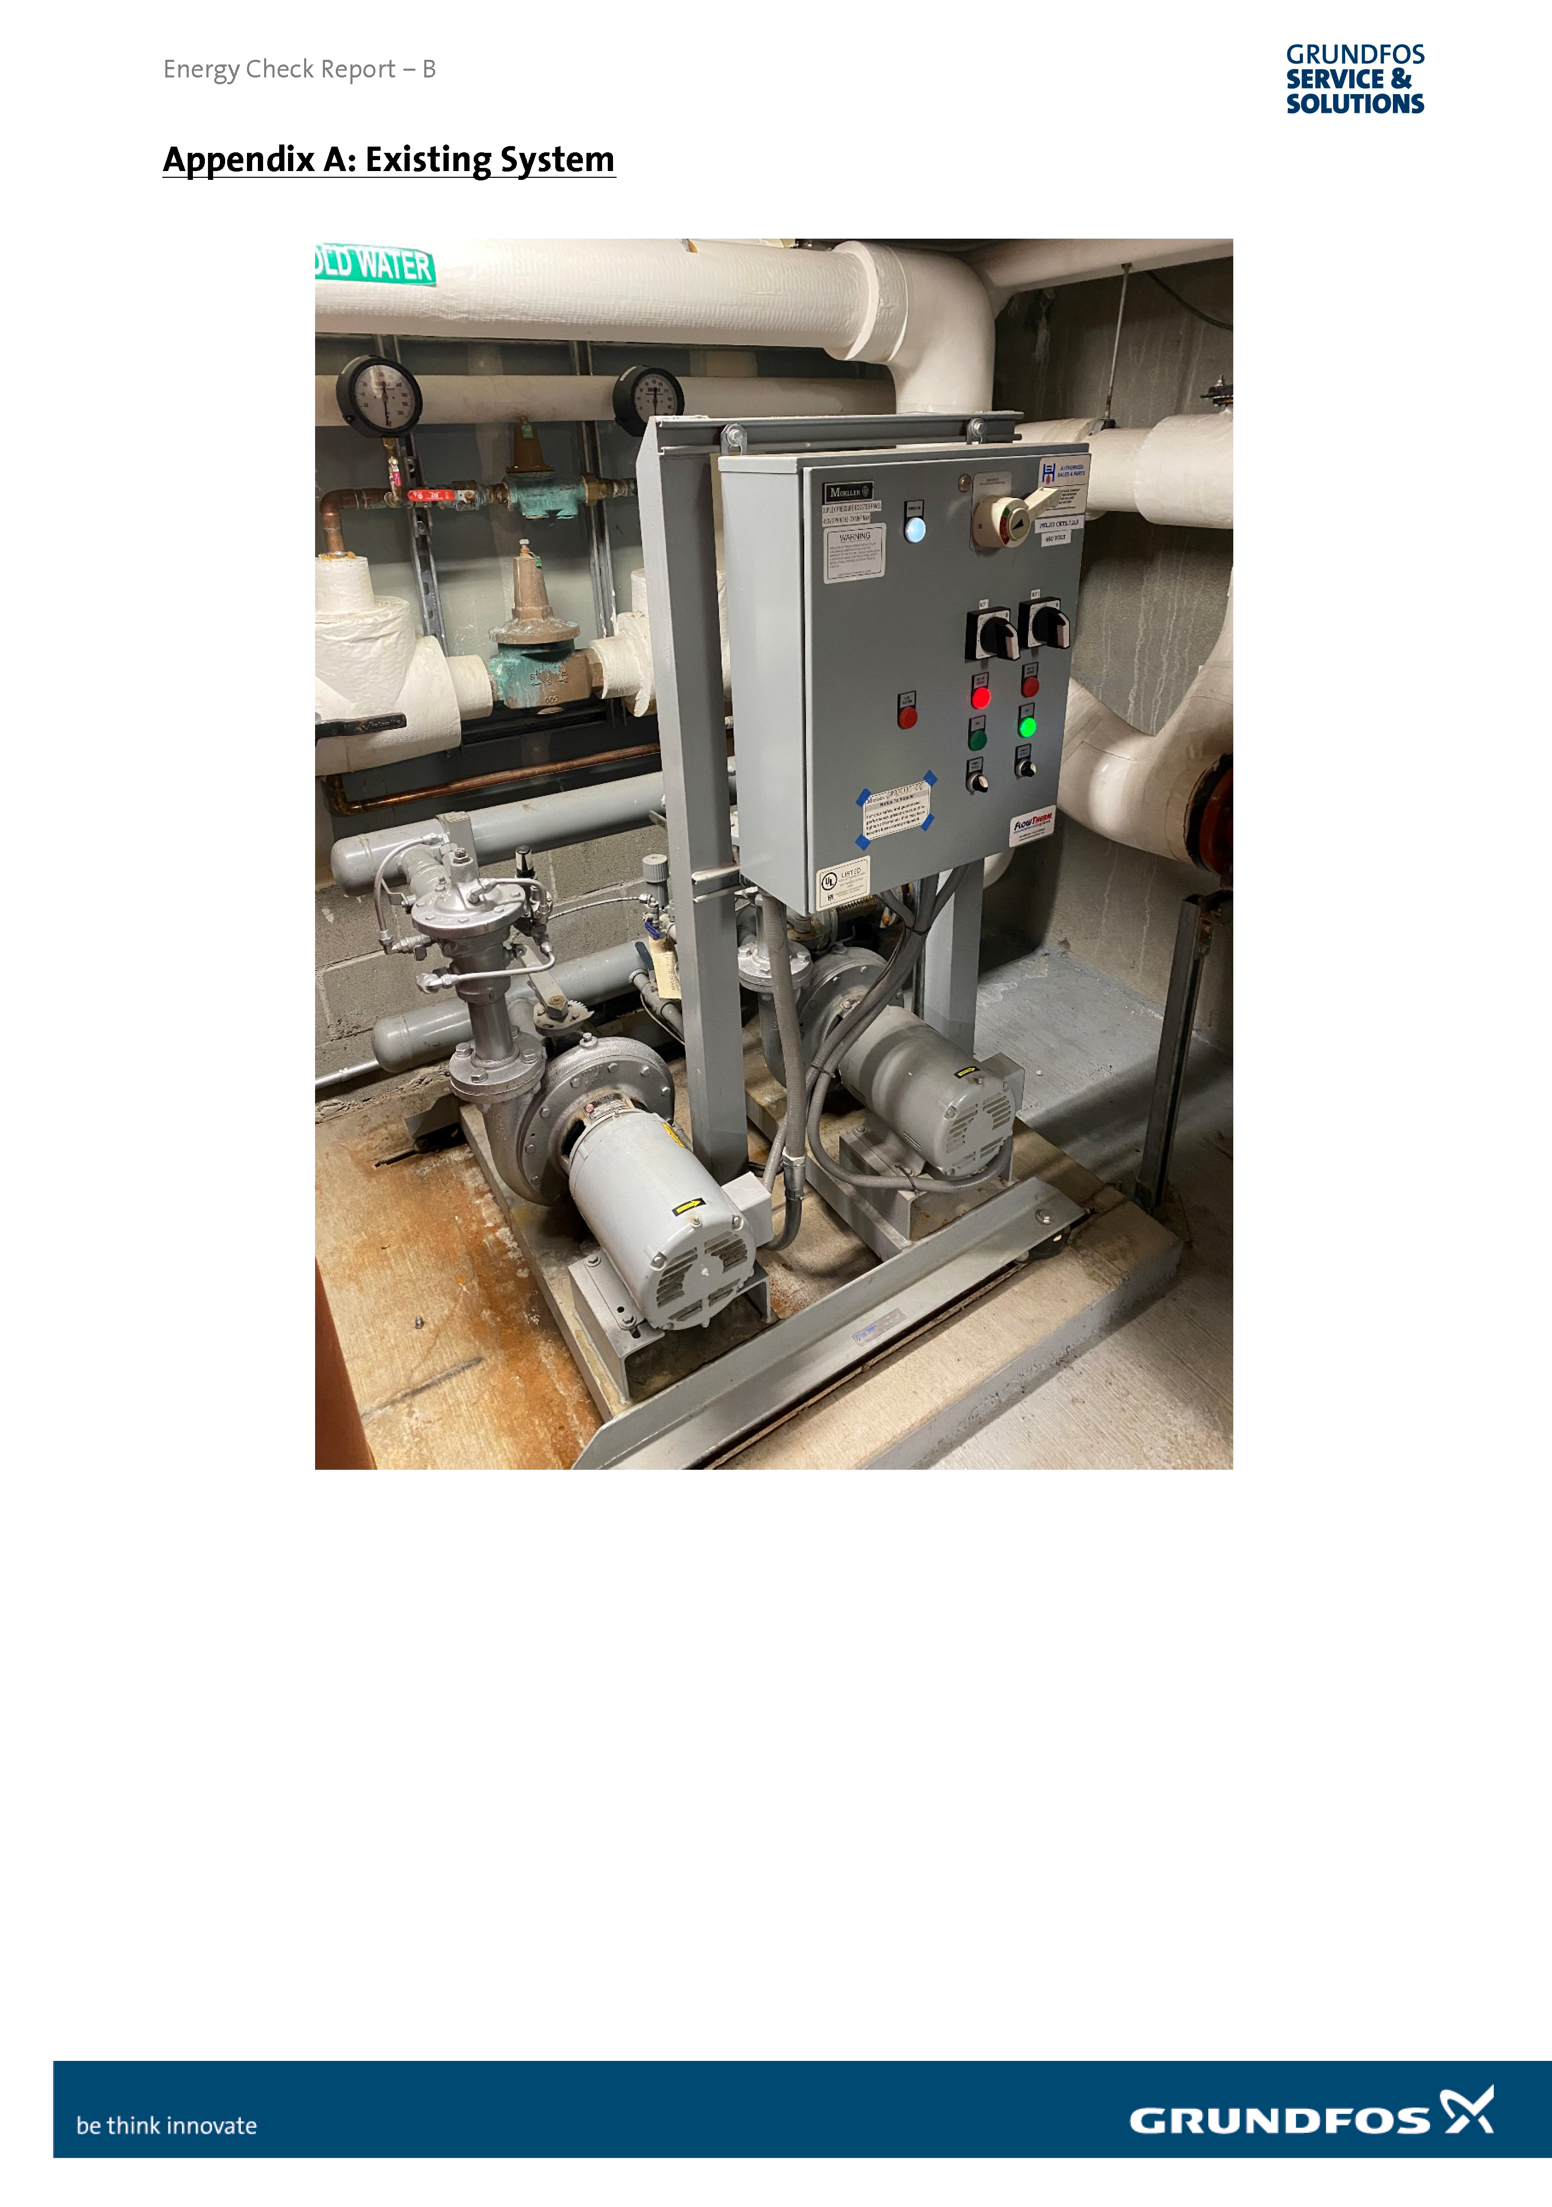
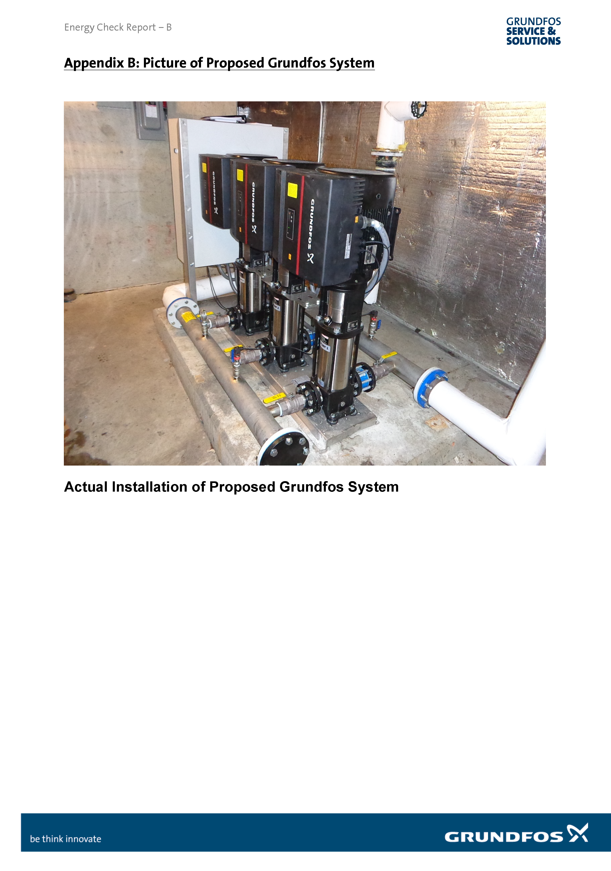
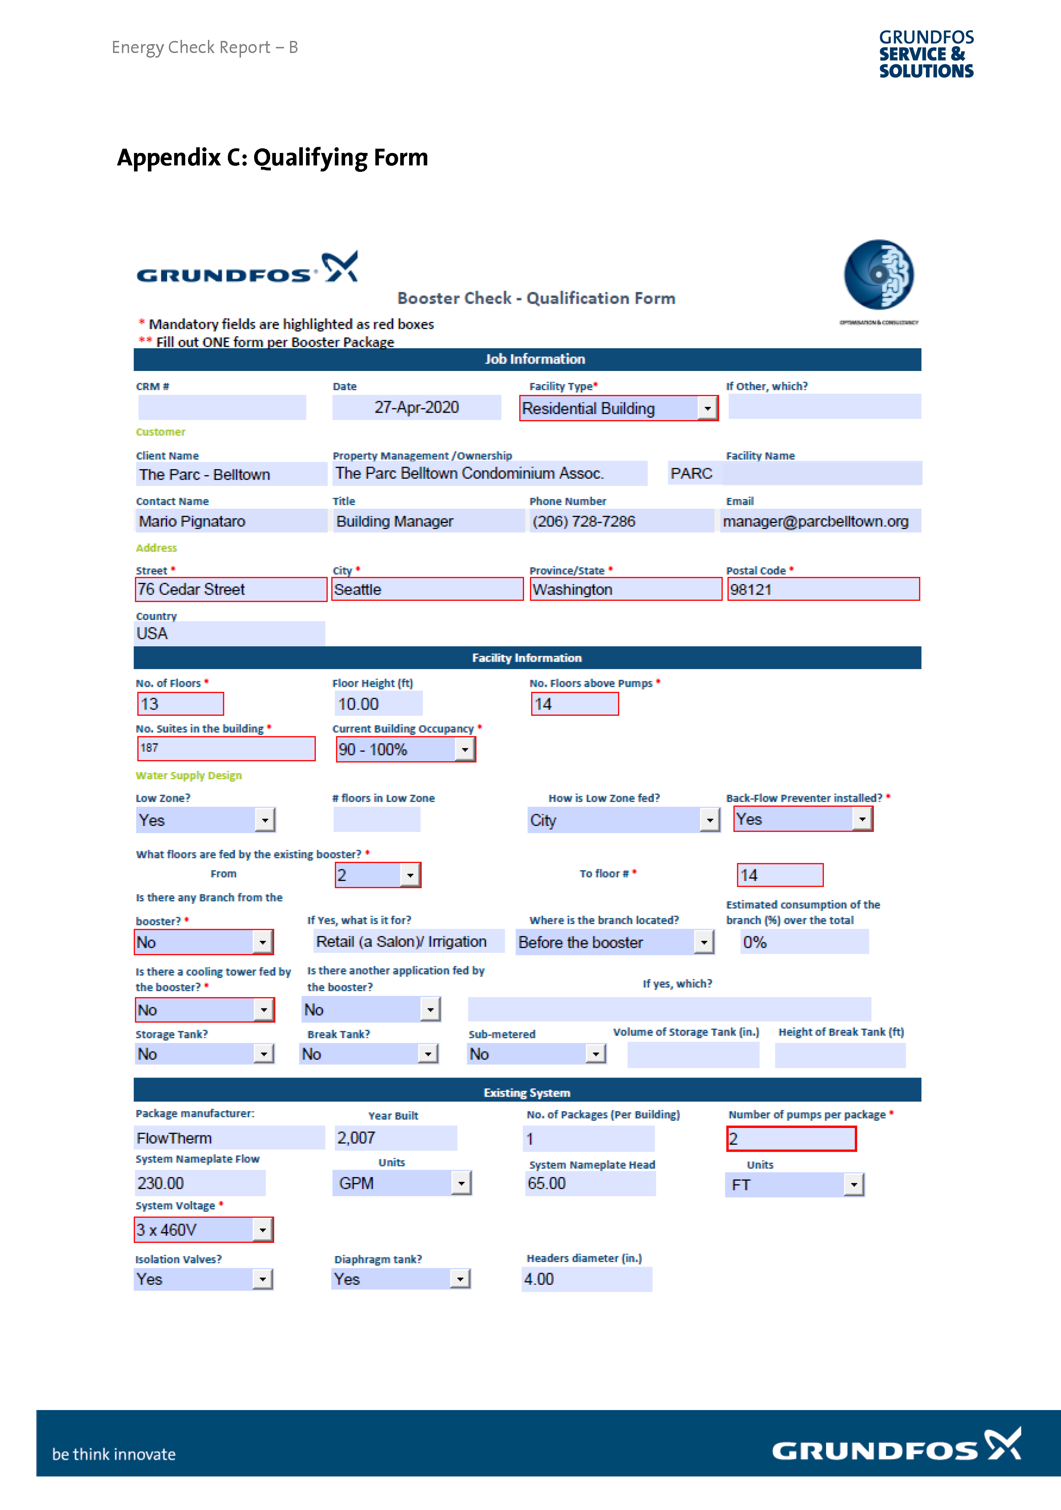
Grundfos Booster Check & Booster Audits
Commercial building boosting systems Evaluations

Slide 18


Notes:
Creating solutions that address your needs proactively is what Grundfos does.
We innovate on your behalf because we see you as partners, not customers.
[CLICK TO NEXT SLIDE]

