Slide 1
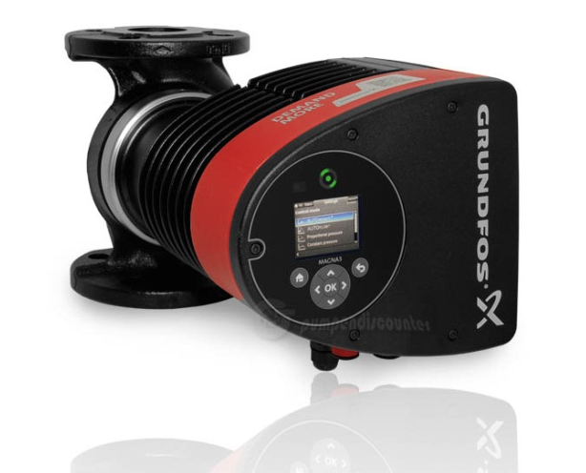
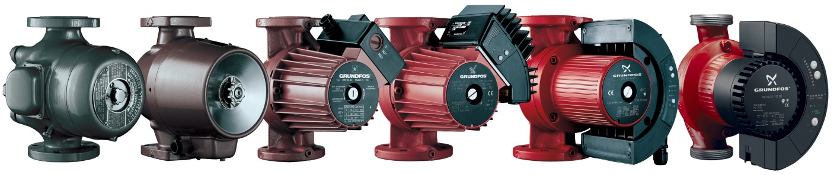
MAGNA3 – “built on a proven foundation”
1950 -- 1991 1995 2001 2005

Slide 2

Grundfos has been selling circulators for 65 years.
There are more than 3 million Alphas and Magnas installed globally.
The warranty rate on Magna in North America has been less than 0.5%
Notes:
How long has Grundfos manufactures and sold circulators? 65 years
How many Alphas/Magnas installed? Over 3 million…
What is the percentage warranty rate on Magna? Less than 0.7% globally (0.2% US).
Why so successful? Development Process, Experience, Testing
When was the project for Magna3 started? 2008
How many hours have the Magna3 been tested? Over 1 million test hours
Intelligence – 65 years of Grundfos Experience designed into the products

Slide 3
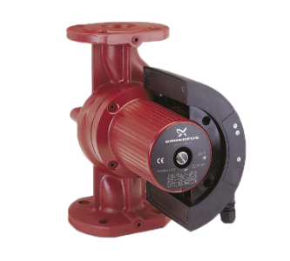
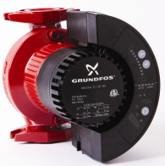
We already have Magna - Why MAGNA3?
Notes:
Current Magna
230V
5 Models
35F-230F

Slide 4
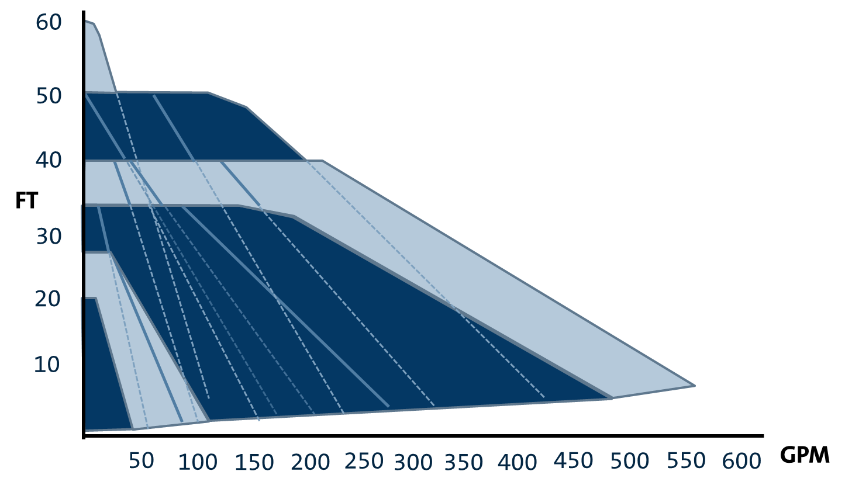
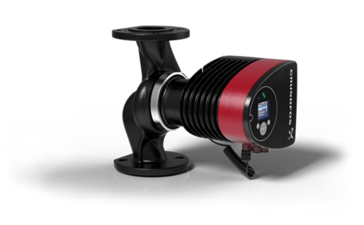
MAGNA3 offers the broadest range
14 Models
11 Single head
3 Twin head
Voltage variants increased
115V up to 1HP
  208-230V all
Liquid Temperature range expanded
  14F to 230F
Cast Iron and Stainless (single head only)
Notes:
Greatly expanded hydraulic coverage
Can now handle Cold Water and Geothermal Applications
Current Magna
230V
5 Models
35F-230F

Slide 5
The MAGNA3 saves more energy than any other circulator
Hydraulic Efficiency
10-15%
Electric Efficiency
10-20%
Logic & Control
CP 30%
PP 55%
AA 65%
FLOWADAPT ..
Installation &
Persistence
Continuous Improvement for Actual System Needs

Slide 6
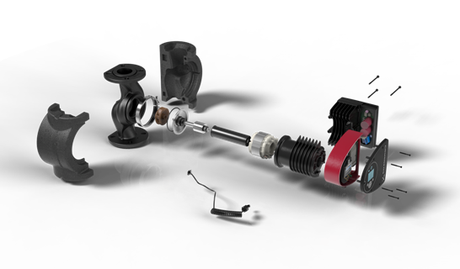
Efficiency - “Leave no stone unturned”
Optimized 3D Hydraulic Design
Permanent Magnet Rotor – Stronger Magnets
Insulation Shell reduces heat loss through pump housing
Compact Stator – reduces copper and resistance losses
Composite Rotor Can – reduced magnetic losses
Intelligent control sizes pump for demand
Intelligent Monitoring
provides system performance
Integrated Grundfos Sensor, Diff. Press & Temperature
Notes:
Starts and Ends with Measuring
Integrated Sensor provides direct Measurement of pressure and temperature
Hyrdaulic design has been optimized using the latest 3D designs
The Motor efficency has been further improved through the use of stronger magnets, reduced copper in the stator, and a composite rotor can.
New intelligent control modes have been added
The pump monitors system variables which can be analyzed for further system improvement – persistence.

Slide 7
A Few Comments on Curves
Notes:
Pump Head Decreases as Flow Increases
System Head Increases Proportionally as Flow Increases
Pumps are selected for Design Point – Maximum Flow at Maximum Head
There oversizing in the way pumps are sized and selected.
How often does Design Point occur?
Affinity Laws
Why do MAGNA curves look funny?
White board it

Slide 8
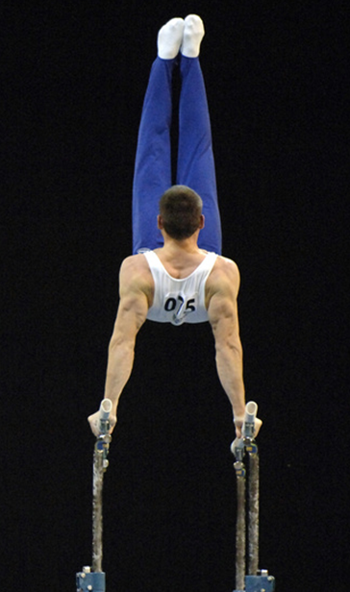
The MAGNA3 offers the most flexibility with
Intelligent Control Modes.
Constant Curve
Constant Differential Pressure
Proportional Differential Pressure
AUTOADAPT
FLOWADAPT
Constant Temperature
Constant Differential Temperature

Slide 9
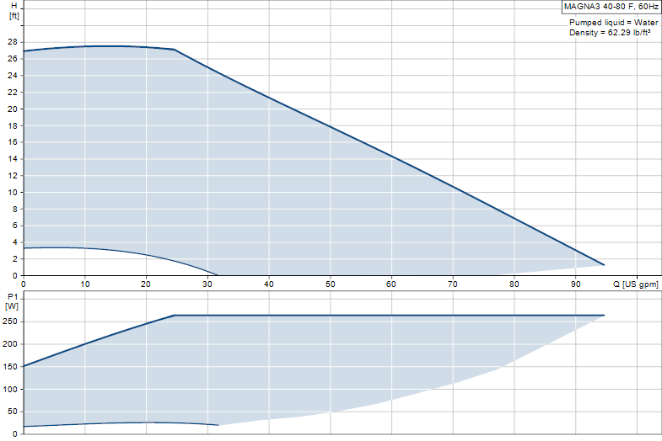

Electronically “Trim” pump performance
Notes:
Ideal for installation with external control of the pump.
Suited for applications with constant load

Slide 10
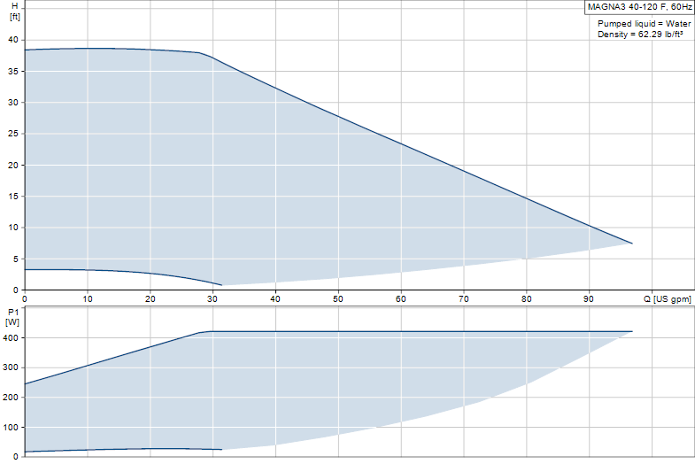
Maintain constant head across the system independent of flow in the system.
Constant Curve
Constant Pressure
Notes:
Applications for Constant Pressure:
All applications for circulators
Ideally suited for header pump applications where the friction loss in the distribution piping in minimal.
In systems with relatively small pressure losses in the distribution pipes.
• Two-pipe heating systems with thermostatic valves and
– dimensioned for natural circulation
– small pressure losses in those parts of the system through which the total quantity of water
flows (for example boiler, heat exchanger and distribution pipe up to the first branching) or
– modified to a high differential temperature between flow pipe and return pipe (for example
district heating).
• Underfloor heating systems with thermostatic valves.
• One-pipe heating systems with thermostatic valves or pipe balancing valves.
• Primary circuit pumps in systems with small pressure losses in the primary circuit.

Slide 11
Reduce unneeded pressure as flow decreases.
Proportional Pressure
Constant Pressure
Constant Curve
Notes:
Applications for Proportional Pressure:
All applications for circulators
Ideally suited for header pump applications where the friction loss in the distribution piping is relatively large.

Slide 12
Default setpoint with more aggressive reduction in pressure at low flow
AUTOADAPT
Constant Curve
Proportional Pressure
Constant Pressure
Notes:
Simply Proportional Pressure with the following additions:
More aggressive reduction at head at low flow.
No user setpoint – default is ½ of maximum head, the pump then adjusts setpoint lower when it sees a lower head a maximum performance.

Slide 13
Adapts setpoint to system
AUTOADAPT
Constant Curve
Proportional Pressure
Constant Pressure

Slide 14
AUTOADAPT with user defined flow limit
AUTOADAPT
Constant Curve
Proportional Pressure
Constant Pressure
FLOWADAPT
User Defined Flow Limitation
Notes:
Reduce head across the system proportional to reduced flow in the system.
Adapts setpoint based on flow limit

Slide 15
Adapt setpoint to system based on flow limit
AUTOADAPT
Constant Curve
Proportional Pressure
Constant Pressure
FLOWADAPT
Flow Limitation

Slide 16
Maintain Constant Temperature in flow pipe
Constant Temperature
Constant Curve
Proportional Pressure
Constant Pressure
Notes:
Constant Temperature
Internal Sensor – maintain constant fluid temperature in flow pipe. Example is pump installed on return line of domestic hot water.
External Sensor – maintain constant fluid temperature in pipe with external sensor. Requires Grundfos GO to adjust Kp and Ti values for specific system.

Slide 17
Maintain Constant Temperature Delta across load
Differential Temperature
Constant Curve
Constant Temperature
Constant Pressure
Notes:
Differential Temperature
Requires use of an external sensor. Maintain constant delta temperature between internal sensor and external sensor. Requires Grundfos GO to adjust Kp and Ti values for specific system.

Slide 18
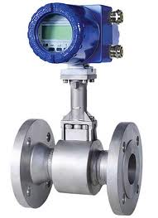
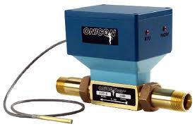
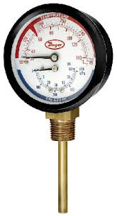
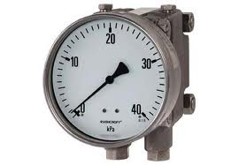
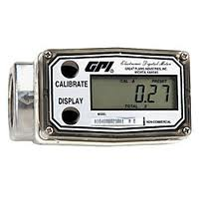
MAGNA3 is much more than a pump
  Temperature
  Speed
  Flow
  Power
  Head
  Energy
  BTU
  History
Notes:
More than just a pump!
Built in sensor and estimators provide all the data you could want without the cost of installing additional equipment.

Slide 19
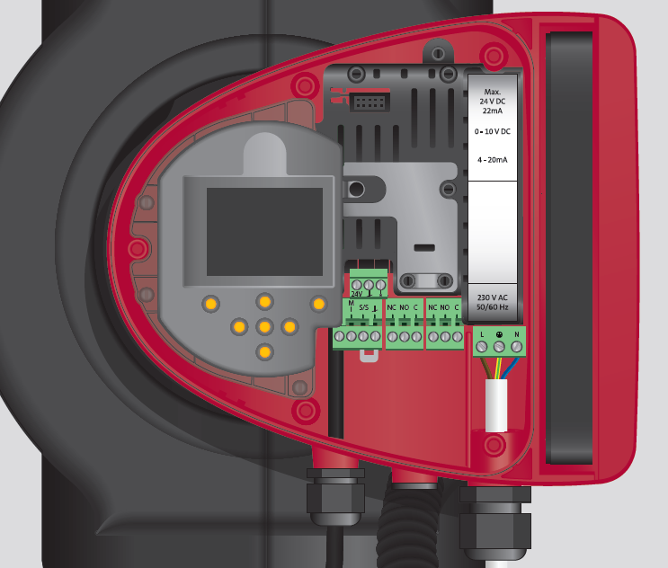
MAGNA3 saves $$$ by eliminating the need for additional monitoring equipment and data point integration
Operating Mode
Setpoint
Control Mode
Alarm/Warning
Power and Energy
Pressure Head
Flow
Speed and Frequency
Digital Input/Ouput
Motor Current
Liquid Temperature
Operating Hours
Total On Time
Number of Starts
Return Temperature
BTU
BTU/hr
Differential Temperature
and more…..
CIM Accessory delivers all of this data from the pump to the BMS System
  Bacnet
  Lonworks
  Modbus
  Profibus

Slide 20
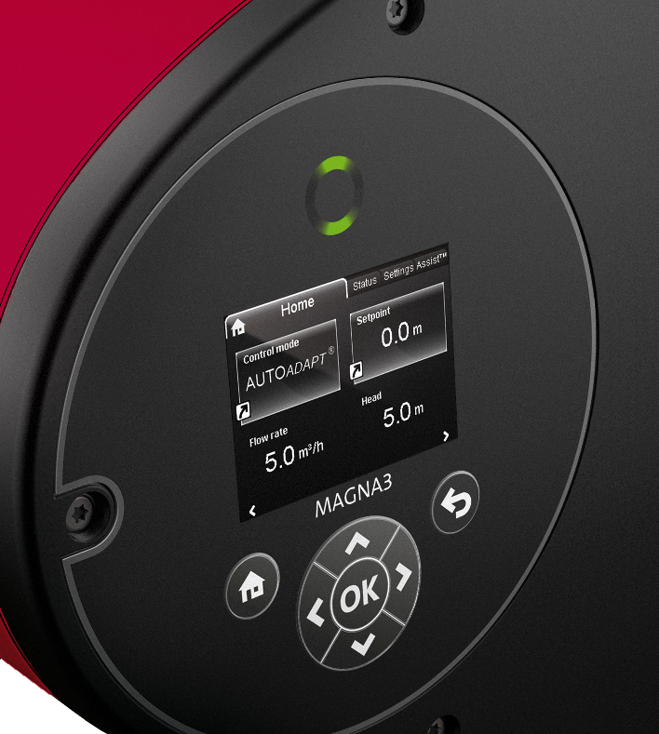
MAGNA3 saves time with simple Intelligent Interface

Slide 21
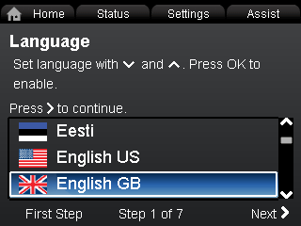
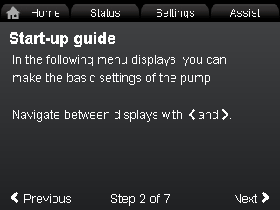
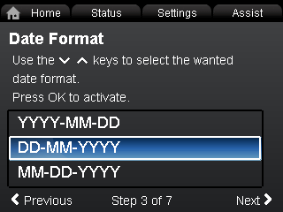
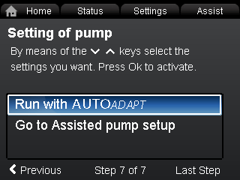
Simple from the start – MAGNA3 will guide the user through startup

Slide 22
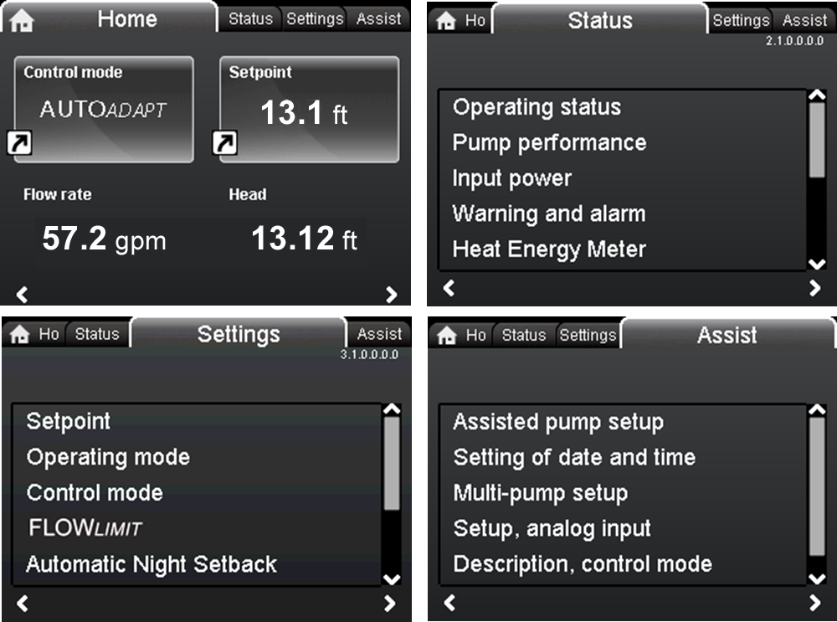
Simple to navigate menu provides quick access to status or settings

Slide 23
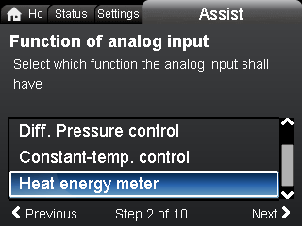
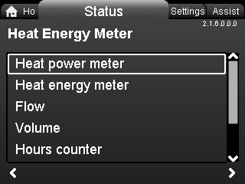
Intelligent monitoring provides the most information ever seen
MAGNA3 comes with a monitoring function, which makes it possible to keep track of the heat energy distribution and consumption within a system. This avoids excessive energy bills caused by system imbalances.
The heat energy meter makes installing a separate energy metering device within your system superfluous.

Slide 24
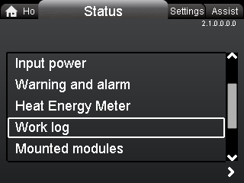
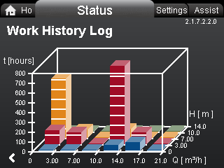
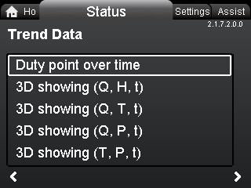
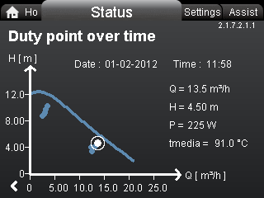
Historic log enables future system optimization
Every duty point and the operational conditions are tracked and stored in the pump.
The 3D work log and duty over time curve, provide instant overviews of historical pump performance and operational conditions.
The perfect tools for pump optimization, replacement and troubleshooting.

Slide 25
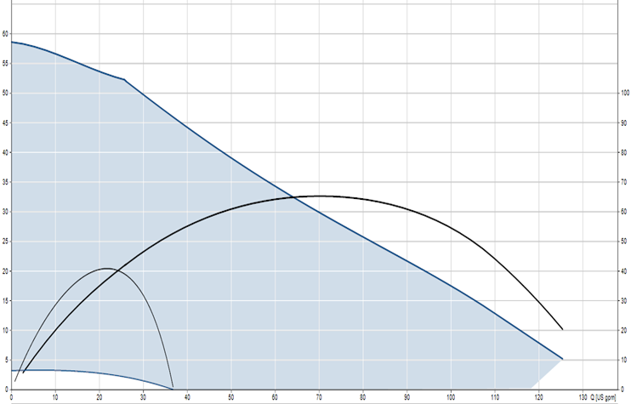
Wire to Water is what’s important
EXAMPLE: B&G Stocking Model 623 (1.5x1.5x7) vs MAGNA3 40-180
MAGNA3 40-180
TOTAL Efficiency
623
Hydraulic Efficiency
70%
60%
50%
40%
30%
20%
10%

Slide 26
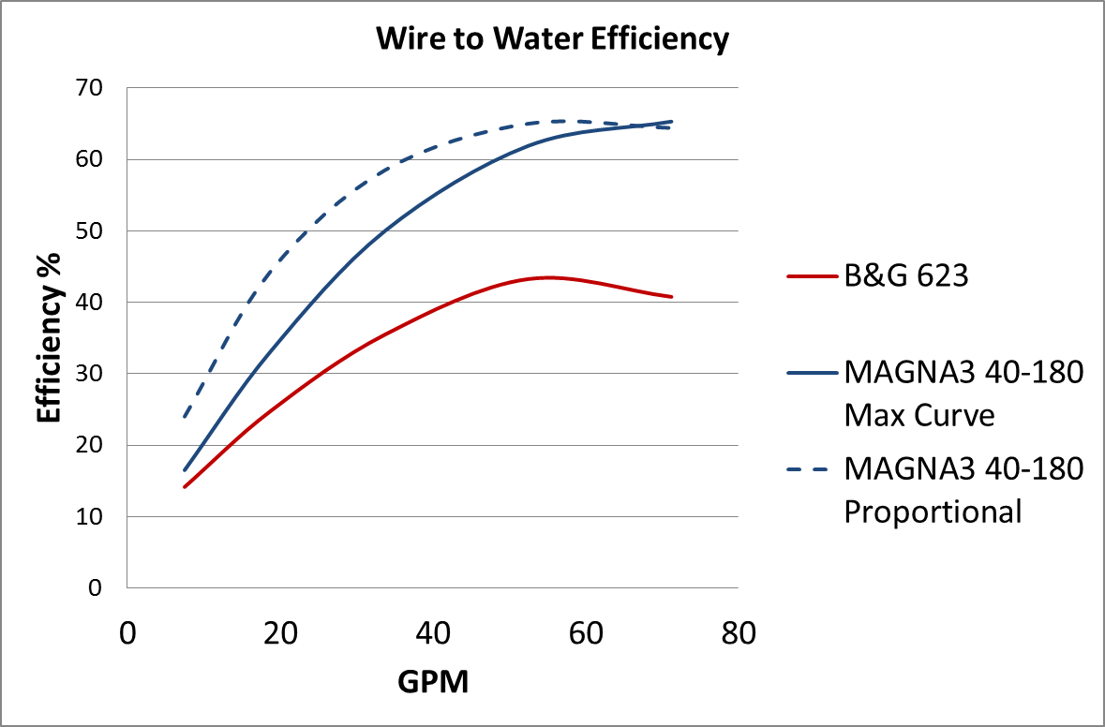
MAGNA3 is optimized for variable speed efficiency
EXAMPLE: B&G Stocking Model 623 (1.5x1.5x7) vs MAGNA3 40-180

Slide 27
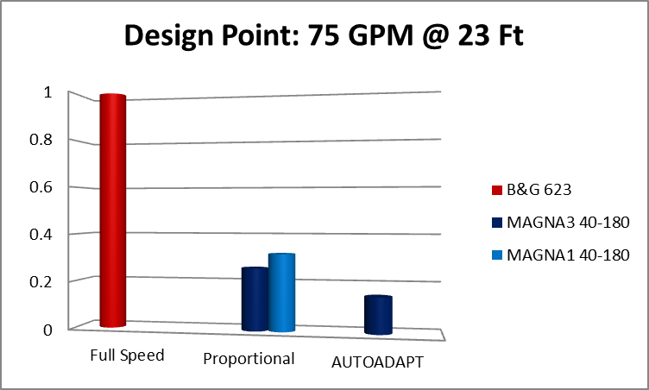
EXAMPLE: B&G Stocking Model 623 (1.5x1.5x7) vs MAGNA3 40-180

Slide 28
“Wire to Water” and EEI ( Energy Efficiency Index) will be how the game is played.
75% Energy Reduction
before AUTOADAPT
EEI 0.27
EEI 0.23
EEI 0.20
EEI 0.17
MAGNA3
65-120
Notes:
Typcial Installed Circulator – Reference of power consumption of a traditional circulator
EEI 0.27 – Requires PM Motor, Proportional Control (Wilo Stratos, Current Magna)
EEI 0.23 – Nobody else today (Wilo by 2015)
EEI 0.20 – Benchmark Best in Class Level used for EEI calulations, “We required MAGNA3 to be this or Better”
EEI 0.17 – Example of MAGNA3 65-120 far exceeds anything out there.

Slide 29
Everyone benefits from MAGNA3
Engineers
Contractors
Maintenance Managers
Owners
You too
Notes:
Engineers – growing demands on efficient designs
Contractors – Simple Installation, Fewer devices, less time on the job
Maintenance Managers – maintenance free, no oil puddles, no bearing assemblies, no shaft seals
Owners – less equipment to buy, no maintenance, lower energy bills
You – because not only did we add new features an increase the energy savings, but we did it with ZERO cost to you!

Slide 30
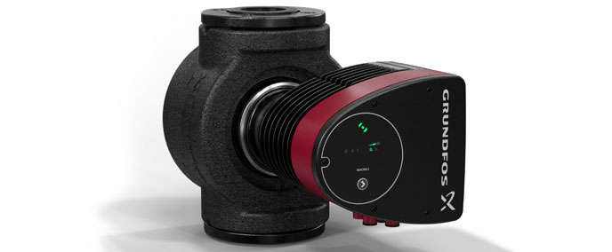
MAGNA1 is “Lean and Mean”
Control Settings
3 Constant Curve
3 Constant Pressure
3 Proportional Pressure
Interface
Grundfos Eye
LED Field
Single Button
Communication
None

Slide 31
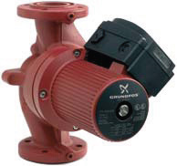
A Solution for Every Job
MAGNA3
Whisper Quiet
Maintenance Free
Highest Efficiency
AUTOADAPT
FLOWADAPT
Monitoring
Communication
and more…
MAGNA1
Whisper Quiet
Maintenance Free
High Efficiency
3-Speed
3-Constant Pressure
3-Proportional Pressure
UPS
Whisper Quiet
Maintenance Free
3-Speed

