Slide 1



GRUNDFOS COMMERCIAL BUILDING SERVICES

Slide 2
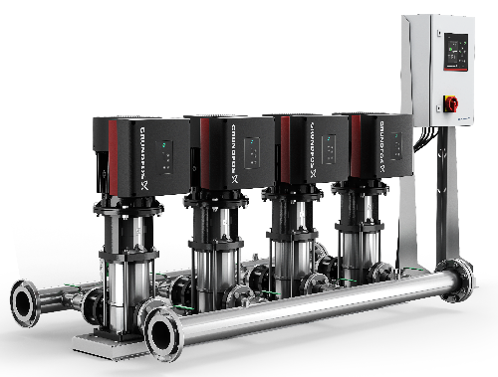
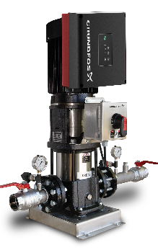
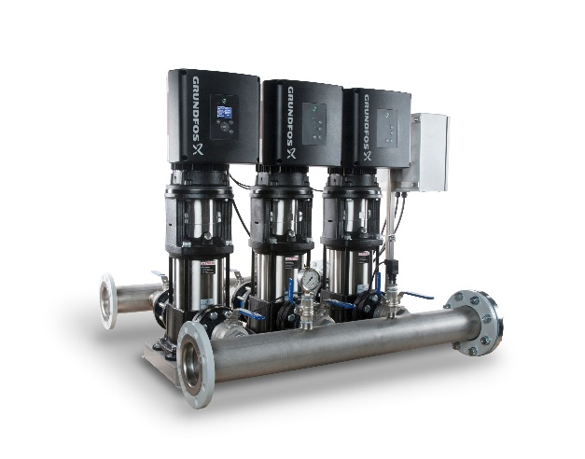
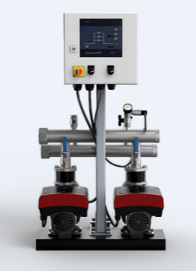
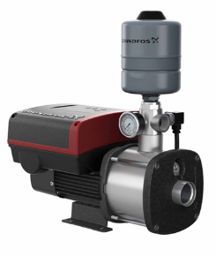
Hydro Booster Portfolio – Buildings
Hydro MPC BoosterpaQ
CRE Plus
Plug-n-Pump Complete single pump system with CRE Pumps
Hydro Multi-E
Hydro Multi B
Advanced control 2-6 pump systems. Control Variants: (-E,-F,-S)
CMBE
2-3 pump systems utilizing all CRE pumps.
Simple control All VFD 2-3 pump systems
CME 3 - 25 (A-version CI/304SS

Slide 3

NEW Hydro Multi-E – Sales Release November 2017

Slide 4

Hydro Multi-E Booster Systems
Product Range
Pump Types: CRE3 thru CRE20
2 and 3 pump systems
Same plumbing as BoosterpaQ
UL Listed Packaged Pumping System
NSF61/372 System Approval
Advanced Control Interface – System Controller installed in one pump on system

Slide 5
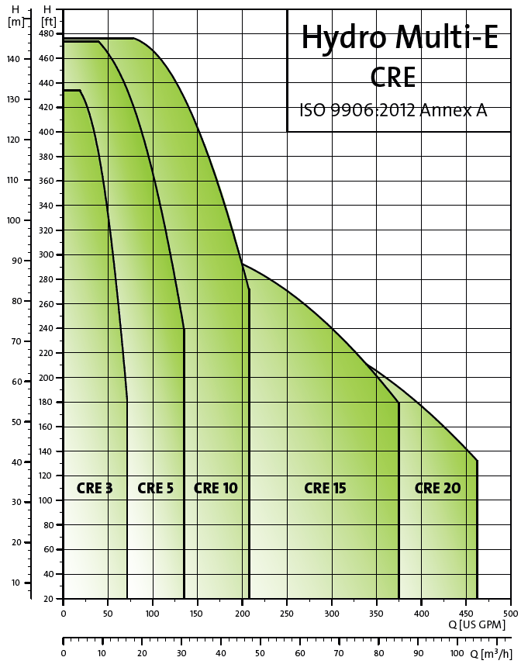
NEW Multi-E
2&3 pump systems with CRE3 – CRE20 pumps
Performance range: max gpm 420 max pressure 232 psi
All motors capable of master motor control
Two sensors standard – 100% redundancy
Advanced control interface installed in one pump – System Controller
New Functionality:
  Control from discharge-suction sensor (DP across pumps)
  Limit Exceed 1&2
  Setpoint Influence
  Soft pressure build-up
  SCADA via CIM expansion card
Release 11/6/17

I&O & DB
Specs
Flyer
Sales presentation




Slide 6
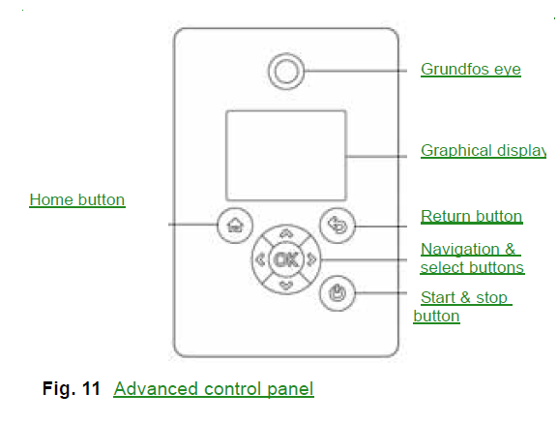
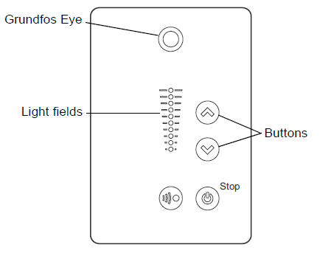
Hydro Multi-E Control Interface
Advanced Control Interface - HMI300 installed in one pump on system
System Control Interface “Controller” with access to all pumps on system
HMI200 installed in other pumps on system

Slide 7
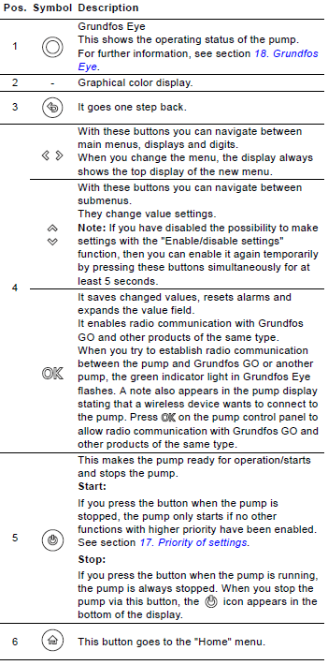
Hydro Multi-E Control Interface
Advanced Control Interface - HMI300 installed in one pump on system
System Control Interface “Controller” with access to all pumps on system

Slide 8
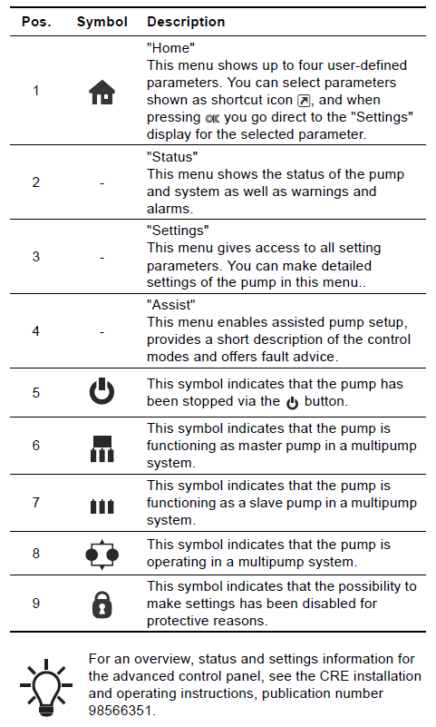
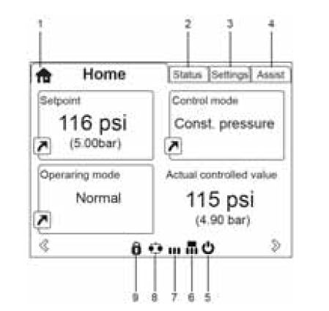
Hydro Multi-E Control Interface
Example of “Home” display

Slide 9
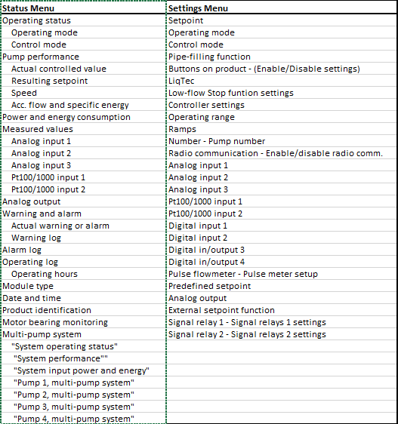
Overview of available menus via HMI300

Slide 10
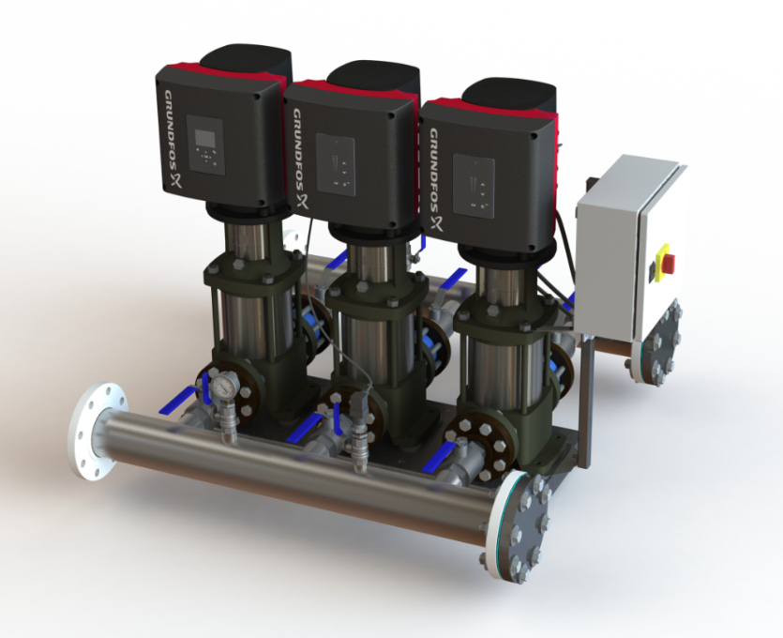
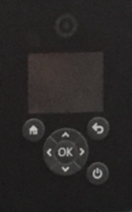
Hydro Multi-E Function Overview
Multimaster function (System Control)
Automatic cascade control
Dry-running protection
Pump alternation
Limit exceeded 1 and 2
Number of starts per hour
Low Flow Stop function
Pipe-filling function
External setpoint influence
Predefined setpoint
Two digital inputs
Two digital outputs
Two analog inputs
Control from subtraction of discharge – suction sensors -> DP across the pumps

Slide 11
Hydro Multi-E Function Overview
Multi-master function
Constant pressure
Redundant sensor
Stop at low flow
Cascade control of pumps
Automatic alternation
Pipe filling
Limit-exceeded function
Two digital inputs
Two digital outputs
Two analog inputs
SCADA via Grundfos CIM modules

Slide 12
Electric Motor Efficiency Standards
NEMA Motor Efficiency
Standard Efficient
Energy Efficient
NEMA Premium
“Super” Premium (not officially defined)
“Extreme-Premium” (not officially defined)
Similar IEC Designation
IE1
IE2
IE3
IE4
IE5
  The highest defined MEPS for motor efficiency level today is NEMA Premium in the USA and IE3 for much of ROW.

Slide 13
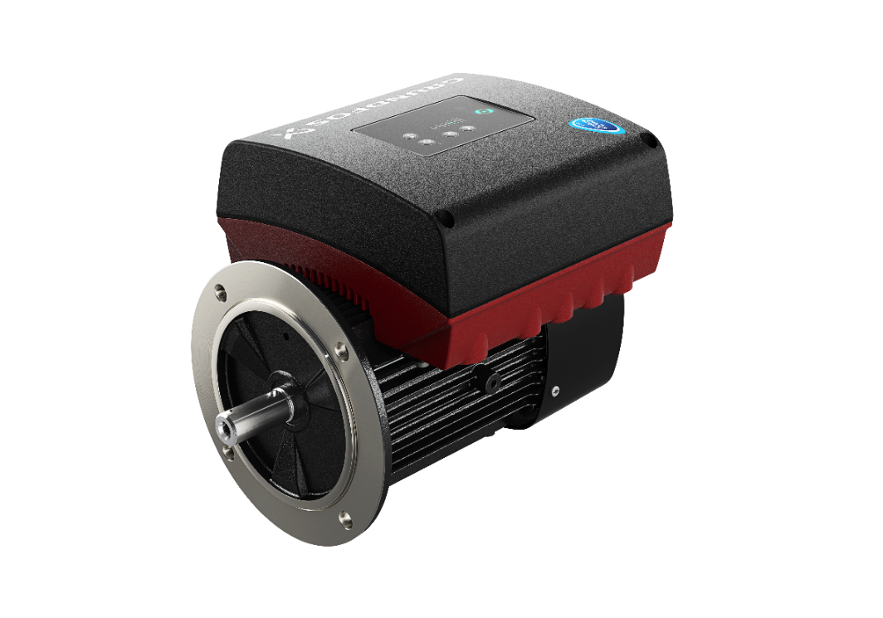
Introducing Grundfos MLE Motor - Integrated VFD/Permanent Magnet (ECM) Motor
New MLE motor up to 15HP
IE5 – the highest energy efficiency class worldwide for electrical motors
Grundfos MLE motors are among the first approved IE5 motors on the market

Slide 14
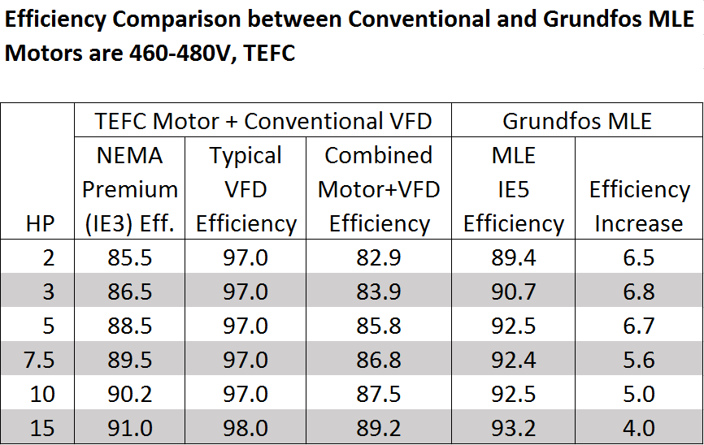
Grundfos MLE Motor – Integrated VFD/ECM Motor
Overall electrical efficiency increase of 4 - 6.8%
Directly impacts (reduces) operational costs –KW/h

Slide 15
Efficient Pump System Energy Savings
Examples

Slide 16
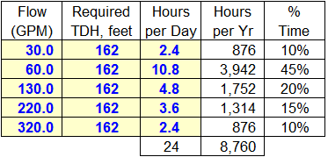
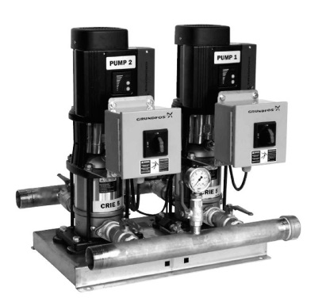
ECM MLE Impact - Energy savings example
Example: Domestic Water Pressure Boosting
Design Condition: 400 gpm @ 70 psi (162 ft.) TDH; (3) - 33% pumps
Pump to Pump “Apple to Apple” Comparison:
Hydro Multi-E 3CRE20-4 10HP 3x460V
  Asynchronous MLE motors – Comparable to NEMA Premium Eff. Motors & Conventional VFD’s
Hydro Multi-E 3CRE20-4 10HP 3x460V
  ECM MLE Motor – IE5 Efficiency Level

Slide 17
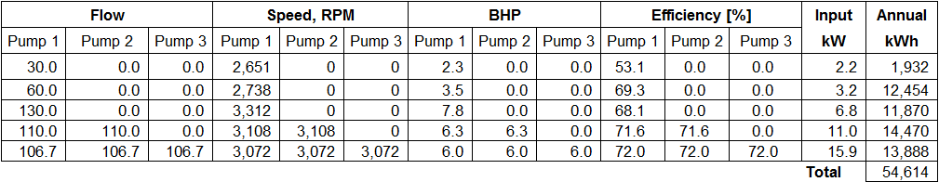

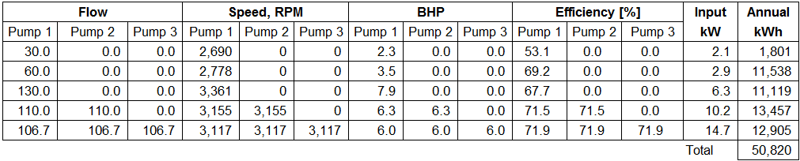
Energy saving example summary
3CRE20-4 10HP 3x460V =============➔ Annual Operating Cost: $5,461
  Asynchronous MLE Motors – Comparable to NEMA Premium motor & VFD
3CRE20-4 10HP 3x460V =============➔ Annual Operating Cost: $5,082
  MLE ECM Motors IE5 Efficiency
Conclusions:
ECM MLE IE5 efficiency motors reduces energy costs by 7.5%
ECM MLE motors result in $379 annual savings over NEMA Premium Eff. Motor & Conventional VFD

Slide 18
MLE Electrical Efficiency Gain vs. Conventional VFD/Motor
H
(FT)
Hydraulic Efficiency - 72%
Wire to water efficiency ECM MLE – 66%
Wire to water efficiency Asynch. MLE – 62%
300
250
EFF
[%]
200
72 %
80
Shaded are represents energy savings due to increased wire to water efficiency ECM MLE over Asynch. MLE/NEMA Premium & VFD
66 %
62 %
150
60
100
40
50
20
0
50
100
150
200
250
300
350
400

Slide 19
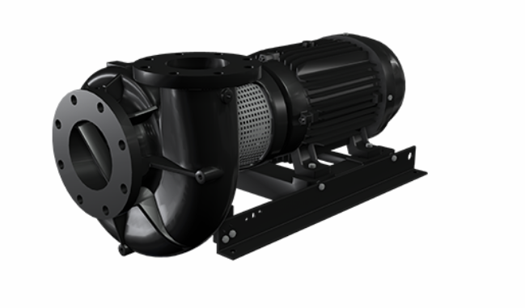
Single Pump vs. 3-Pump System- Energy savings example
Example: Pressure boosting / Hydronic water circulation
Design Condition: 400 gpm @ 70 psi (162 ft.) TDH
Energy Analysis Comparison:
PACO LCS 2507 25HP – (1) 100% VFD controlled pump
  NEMA Premium motor and conventional VFD
Hydro Multi-E 3CRE20-4 10HP 3x460V – (3) 33% parallel connected VFD controlled pumps
  ECM MLE motors - IE5 Efficiency Level

Slide 20
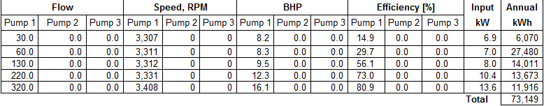
Energy saving example summary
(1) PACO LCS 2507 25HP 3x460V ======➔ Annual Operating Cost: $7,315
  NEMA Premium Efficiency motor and conventional VFD
(3) CRE20-4 10HP 3x460V =============➔ Annual Operating Cost: $5,082
  ECM MLE Motors IE5 Efficiency
Conclusions:
The 3-pump system utilizing ECM MLE IE5 efficiency motors reduces energy costs by 44%
The parallel connected pump system utilizing (3) 33% pumps with ECM MLE motors result in $2,233 annual savings over the 100% pump utilizing NEMA Premium Eff. Motor & Conventional VFD

Slide 21
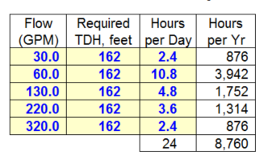
3 x CRE20-4 10 HP vs. 1 x LCS25707 25 HP
H
[FT]
3-Pump Max. Wire to Water efficiency – 66%
1-Pump Max. Wire to Water efficiency – 69%
300
250
EFF
[%]
200
78 %
80
72 %
75% of the time the flow is less than 200 gpm.
150
60
100
40
At 60 gpm the difference in Hydraulic efficiency is 35%, 69% vs. 34%
50
20
50
100
150
200
250
300
350
400
Q [U.S. GPM

Slide 22
3 x CRE20-4 10 HP vs. 1 x LCS25707 25 HP
H
[FT]
3-Pump Wire to Water efficiency – 66%
1-Pump Wire to Water efficiency – 69%
300
250
EFF
[%]
200
80
66 %
69 %
150
60
Wire to Water Efficiency: Pump _{Efficiency} x Motor _{Efficiency} x VFD _{Efficiency}
At 60 gpm the difference in wire to water efficiency is 32% => 62% vs. 30%
100
40
50
20
50
100
150
200
250
300
350
400
Q [U.S. GPM]

Slide 23
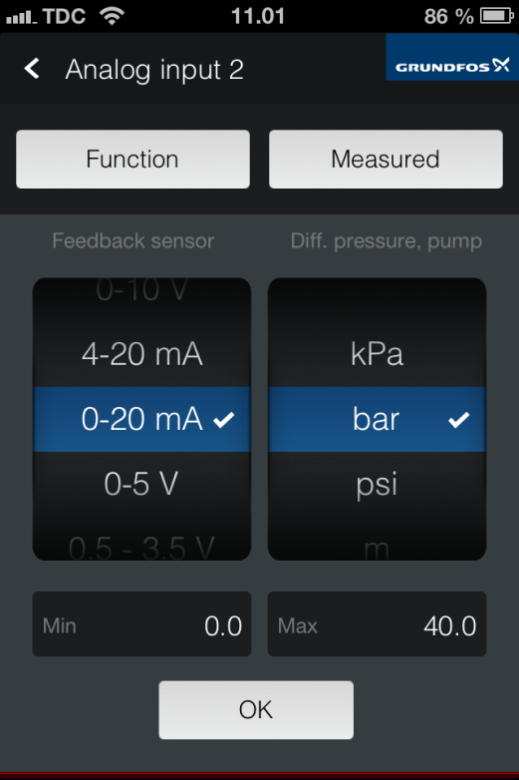
Settings – Analog input
Analog inputs can be configured to different functions.
Setting with Grundfos GO or HMI300 advanced control interface
Measured parameter
Pump inlet pressure
Pump inlet differential pressure
Pump outlet pressure
Pump outlet differential pressure
Pump differential pressure
Remote pressure 1
Remote pressure 2
Remote differential pressure
Feed tank level
Storage tank level
Pump flow
Remote flow
Pumped medium temperature
Temperature 1
Temperature 2
Remote diff. temperature
Ambient temperature
Other parameter
Function
Not active
Feedback sensor
External setpoint influence
Other function
Electrical signal
0-10 V
4-20 mA
0-20 mA
0-5 V
0.5-3.5V
Unit
kPa, bar, psi
m, ft, in
m³/h, l/s, gpm, yd³/h
°C, °F
%
Range
Min - Max

Slide 24
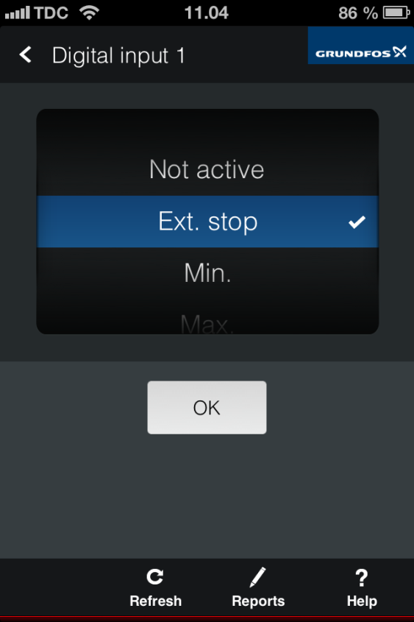
Settings – Digital input 1 and 2 (up to 4)
Digital input 1 and 2 can be configured to different
user selected functions
Function Dig input 1
Not active
Ext. Stop
Min.
Max.
Ext. fault
Flow switch
Alarm reset
Dry running
Accumulated flow
Function Dig input 2
Not active
Ext. Stop
Min.
Max.
Ext. fault
Flow switch
Alarm reset
Dry running
Accumulated flow
Predefined setpoint digit 1

Slide 25
Hydro Multi-E Operation – Cascade Control
Hydro Multi-E Cascade Control
Only the required number of pumps are running at any given time to maintain the Constant Pressure.
Pump operation is automatic and alters among the pumps in the system.
Pump alternation is based on First-On, First-Off. This insures equal wear on all pumps, i.e.: Pump #1 is not necessarily the Lead Pump.
  When a pump needs to be staged ON, the pump that has been OFF the longest time will be staged ON.
  When a pump needs to be staged OFF, the pump that has been ON the longest time will be staged OFF.
  When one pump has been running continuously for 24 hours, the pumping duty is automatically taken over by the pump which has been OFF for the longest time, i.e. if there are any free pumps.

Slide 27
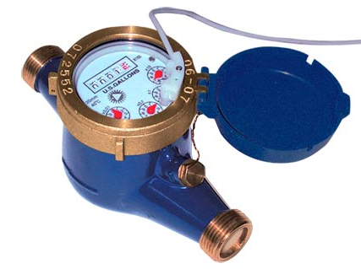
Pulse flowmeter input
Pulse flowmeter
Can connect an external pulse flowmeter to available digital input and use to register the actual and accumulated flows
Accumulated flow and specific energy calculation

Slide 28
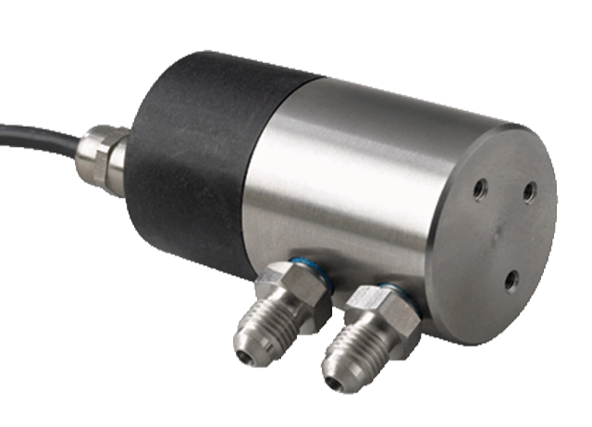
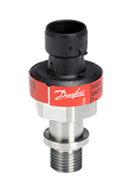
Calculate Diff. pressure / temp. based on single sensor inputs
Control from discharge-suction sensor (DP across pumps)
Replaces need for a differential pressure sensor installed across pumps

Slide 29
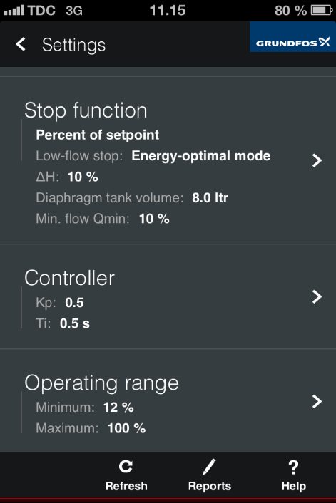
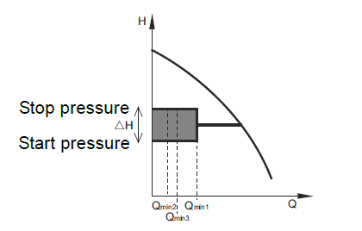
Low Flow Stop Function
Choices to determine activation:
  Energy optimal – Qmin 20%
  High comfort – Qmin 5%
  Custom – Qmin 10% (Adjustable)
Diaphragm tank volume has to be entered for all operation modes
Custom mode the function will use user set values of Delta H, Qmin and diaphragm tank volume.
In a low flow condition (Q<Qmin) operation is changed to on/off operation
Notes:
Thank you for your attention
29

Slide 30

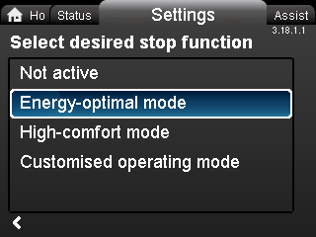
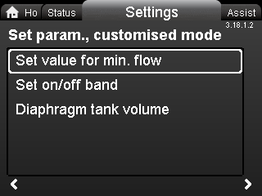
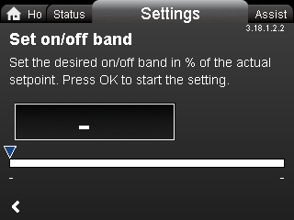
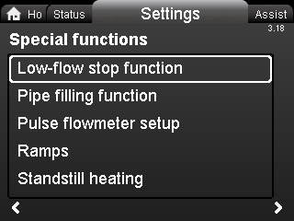
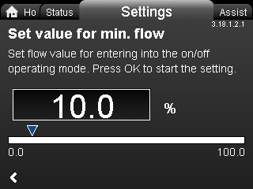
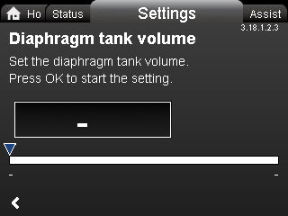
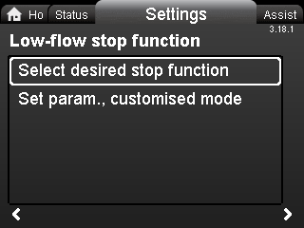
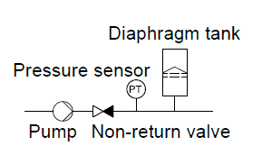
Stop Function
Stop Function “Trap”
  Diaphragm tank precharge = 70% setpoint pressure

Slide 31
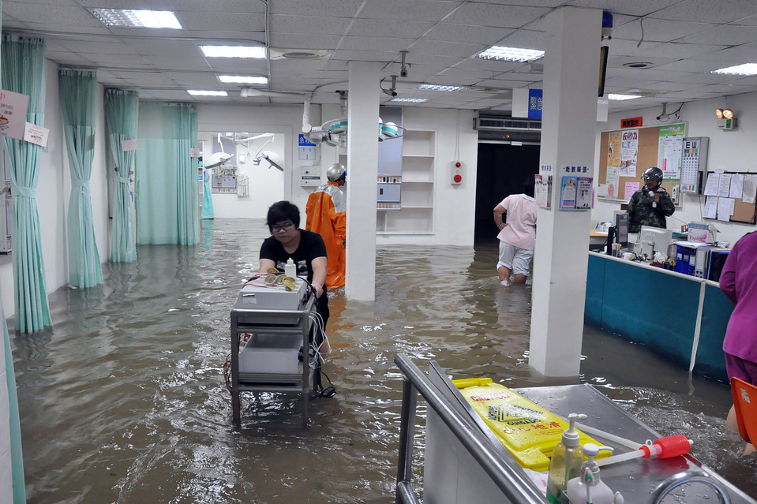
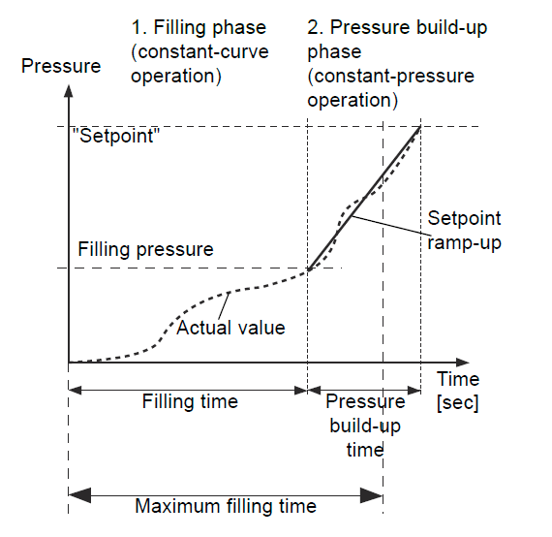
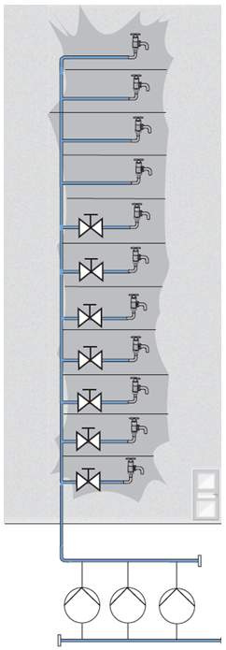
Pipework protection
Application challenge
Water hammer can happen when filling empty pipes during commissioning or after a power interruption. The result can be pipe burst and flooding.
Normal solution
Slowly fill the pipe system manually during commissioning
Ideal solution
Pipe Fill
How?
Slowly fill pipe in two phases
  Filling phase
  Pressure build up phase

Slide 32
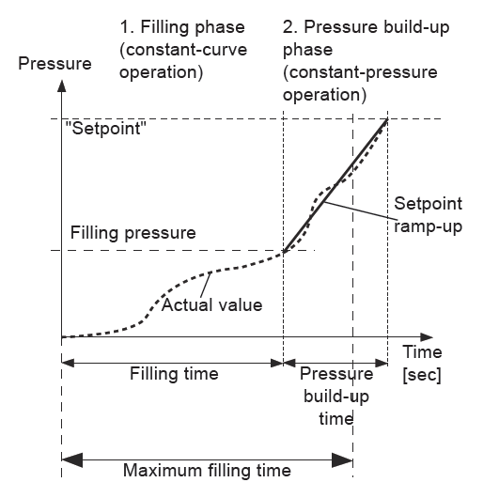
Pipe Fill
Pipe Fill takes place in two phases
Filling phase – pipework is slowly filled with water. When pressure sensor of system detects pipework has been filled, phase two begins.
Pressure build-up phase – system pressure is increased until setpoint is reached. Pressure build-up takes place over a given time.
  Note: If setpoint is not reached within given time, a warning or alarm can be given, and pumps can be stopped at same time.

Slide 33
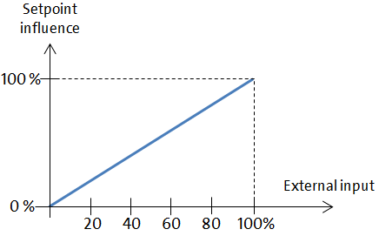
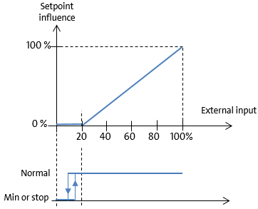
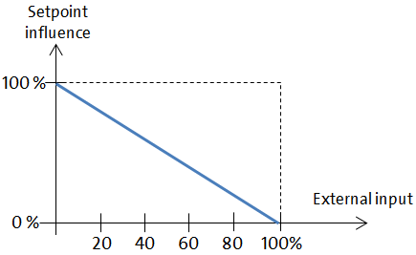
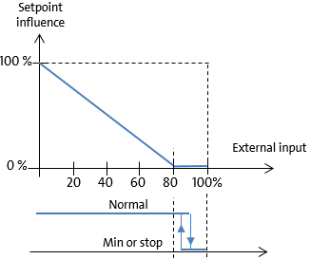
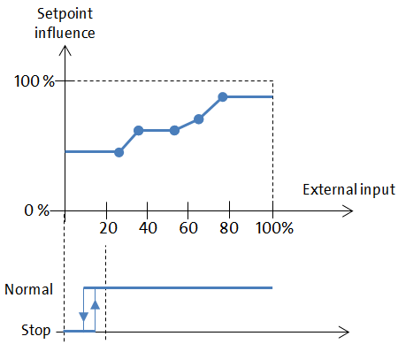
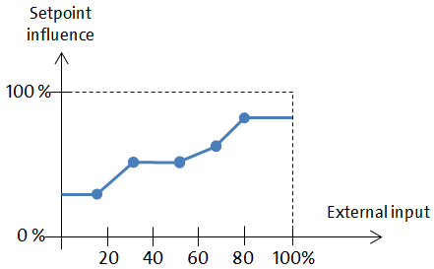
External Setpoint influence
Nine different influence functions are available.
Linear function
Linear with MIN/STOP
Inverse function
Inverse with MIN/STOP
Influence table
Influence table with STOP at MIN/MAX

Slide 34
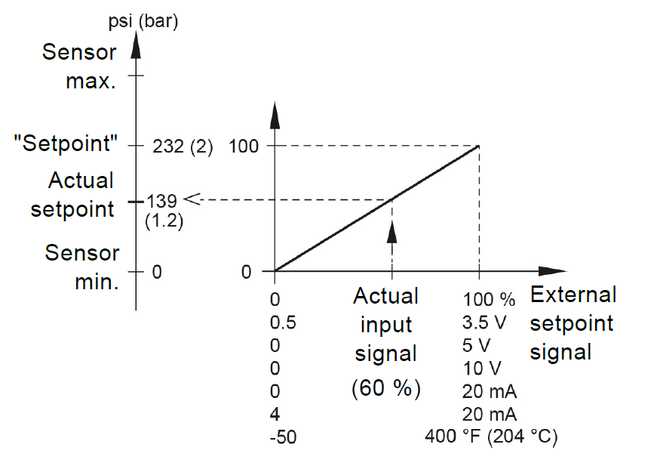
External Setpoint influence
H
Setpoint
139
(60%)
6V
0 10V
Actual Setpoint = Sensor min + (setpoint – sensor min) x Input signal/Input signal range
Example: Input signal type 0-10V. Vin = 6.0V
Actual Setpoint = 0 + (232 – 0) 6/(10-0) = 232 x 6/10 = 232 x 0.6 = 139 psi

Slide 35
Documentation & Submittal Information
Documentation & Submittal information available on the BoosterpaQ website: www.BoosterpaQ.com
AutoCAD drawings and pdf drawings – available on:
Plumbing component submittal information
CSI Specifications
Grundfos Product Center update 12/14/17
Hydro Multi-E Installation and Operation Instructions 98419766
Hydro Multi-E Data Booklet 98607787
Hydro Multi-E Flyer L-HME-SL-01
Hydro Multi-E Brochure L-HME-SL-02

Slide 36
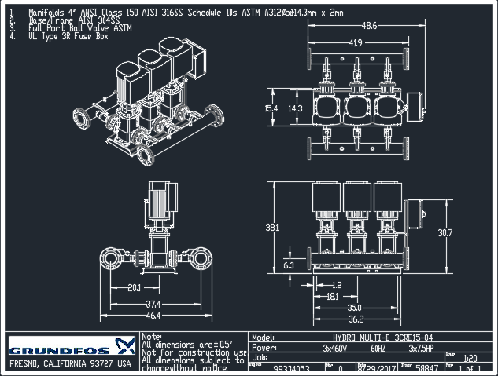
Example Multi-E Drawing:

Slide 37
Hydro Multi-E - Summary
Performance range: max gpm 420 max pressure 232 psi
2 & 3 VFD/ECM CRE 3-20 pump systems
  3x460V up to 10HP
  3x208-230V up to 7.5 (Available Q218)
  1x230V up to 2HP
All VFD/ECM MLE motors are capable of system control
  Two motors on system have discharge sensors
  100% system control redundancy
VFD/PM MLE combined efficiency are more efficient than NEMA Premium motor only efficiency!
Features and benefits
Control panel HMI for communication
Single Point Power Connection
IE5 Efficient MLE Motors
System NSF61/372 certified
UL Listed Packaged Pumping System
Small footprint
Notes:
Main characteristics
Booster set with 2 or 3 CRE pumps
One master pump (pump no. 1) the rest of the pumps are slaves.
The master pump has an add-on card inserted in its terminal box. The master pump dictates the performance of the slave pumps.
Note: The master pump is not necessary the first pump to start in all situations. Hydro Multi-E is designed to align the number of operating hours of all pumps in the system meaning that pump no. 2 or 3 can be cut-in while pump no. 1 is cut-out
Applications
Specially designed for building services applications such as water supply in high rise buildings, hotels, hopitals, office buildings, etc.
Features
Advanced pump control with constant pressure
The use of Grundfos CRE pumps (with integrated frequency converter enables
100% adaptation to the need (constant pressure)
High comfort level (a minimum of pressure pulsation due to speed control
Reduced noise
Reduced water hammering effect
Use of a small diaphragm tank compared to fixed speed pumps, etc.
Basic user interface
Hydro Multi-E incorporates
a control cabinet with a basic user interface with one mains switch and relays. Easy to use and operate
easy communication on master pump by means of arrow buttons (setpoint setting) or R100 for more readings
Data communication interface
Data communication by means of
a building management system (for example: CRE pump -> internal GENIbus -> Gateway (CIU 100) -> LON fieldbus communication with remote PC
a R100 remote control
the control panel on master pump (slave pumps feature blinded control panels)
Reliable solution
Hydro Multi-E booster sets are build on the famous and reliable CRE pump (developed by Grundfos)
The motor is developed by Grundfos
Designed, assembled and tested by Grundfos
Many years of experience (first booster to be produced by Grundfos was in 1945)
Build according to Grundfos quality standards
All functionality has been thoroughly tested before sales release
Hydro MPC booster sets are tested before shipment
Hydraulically optimised manifold
Hydro Multi-E is designed with a hydraulically optimised manifold with rounded pipe edges (on the inner side). This ensures
No gaps or cracks where corrosion can grow
Reduced dead water zones as there is no pipe neck (compared with manifolds with pipe necks inside the pipe)
Reduced vortex generation
Reduced pressure losses
Reduced noise, etc

Slide 38
Questions?

Slide 39

SCADA Communication - CIM
Communication Interface Module (CIM)
CIM 270 GRM CIM 500 GRM IP
CIM 250 GSM / GPRS / SMS
CIM 200 Modbus RTU
CIM 500 Modbus TCP
CIM 050 GENIbus
CIM 200 COMLI
CIM 150 PROFIBUS DP
CIM 500 PROFINET
CIM 300 BACnet MS/TP
CIM 500 BACnet IP
CIM 100 LON CIM 110 LON MPC

Slide 40


