Slide 1


2021
Grundfos NBS Product Launch
WWW.HURLEYENGINEERING.COM 1-800-861-7122

Slide 2


Slide 3
Simplified installation, industry leading efficiencies and reliability for a lifetime
Grundfos NBS End-suction Pumps
Notes:
Or use: …designed to last - for end of headline

Slide 4
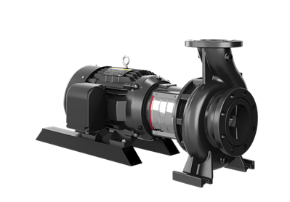
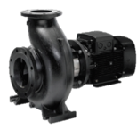
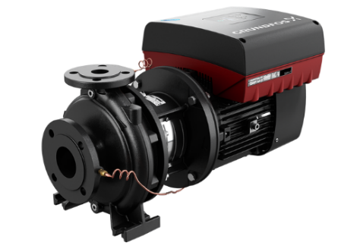
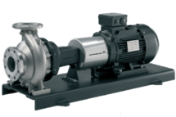
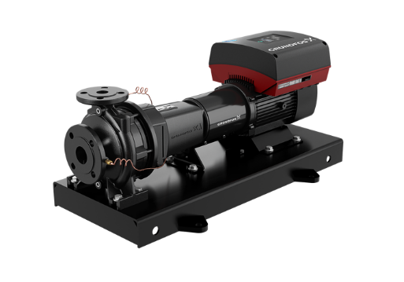
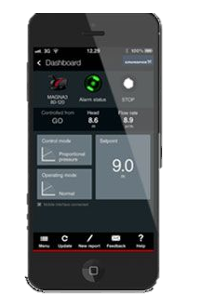
Grundfos N-Series: End-suction pump range – NBS/NBSE, NK/NKE, NB/NBE
  Product range:
    NBS/NBSE Split-coupled
    NB/NBE Close-coupled
    NK/NKE Long-coupled
  Performance range:
    NBS: 5800 gpm, 450 ft
    NBSE: 1250 gpm, 250 ft
    NB: tbd gpm, tbd ft
    NBE: tbd gpm, tbd ft
    NK: tbd gpm, tbd ft
    NKE: tbd gpm, tbd ft
  Pressure range:
    Class 125: 175 psi
    Class 300: 363 psi
  Liquid temperature:
    Standard: -13 to 248 °F
    Optional: Up to 284 °F
NBE Series 2000
NK
NKE Series 2000
Notes:
High level overview of N-SERIES; but let’s talk about a few things to consider before choosing and end-suction pump

Slide 5



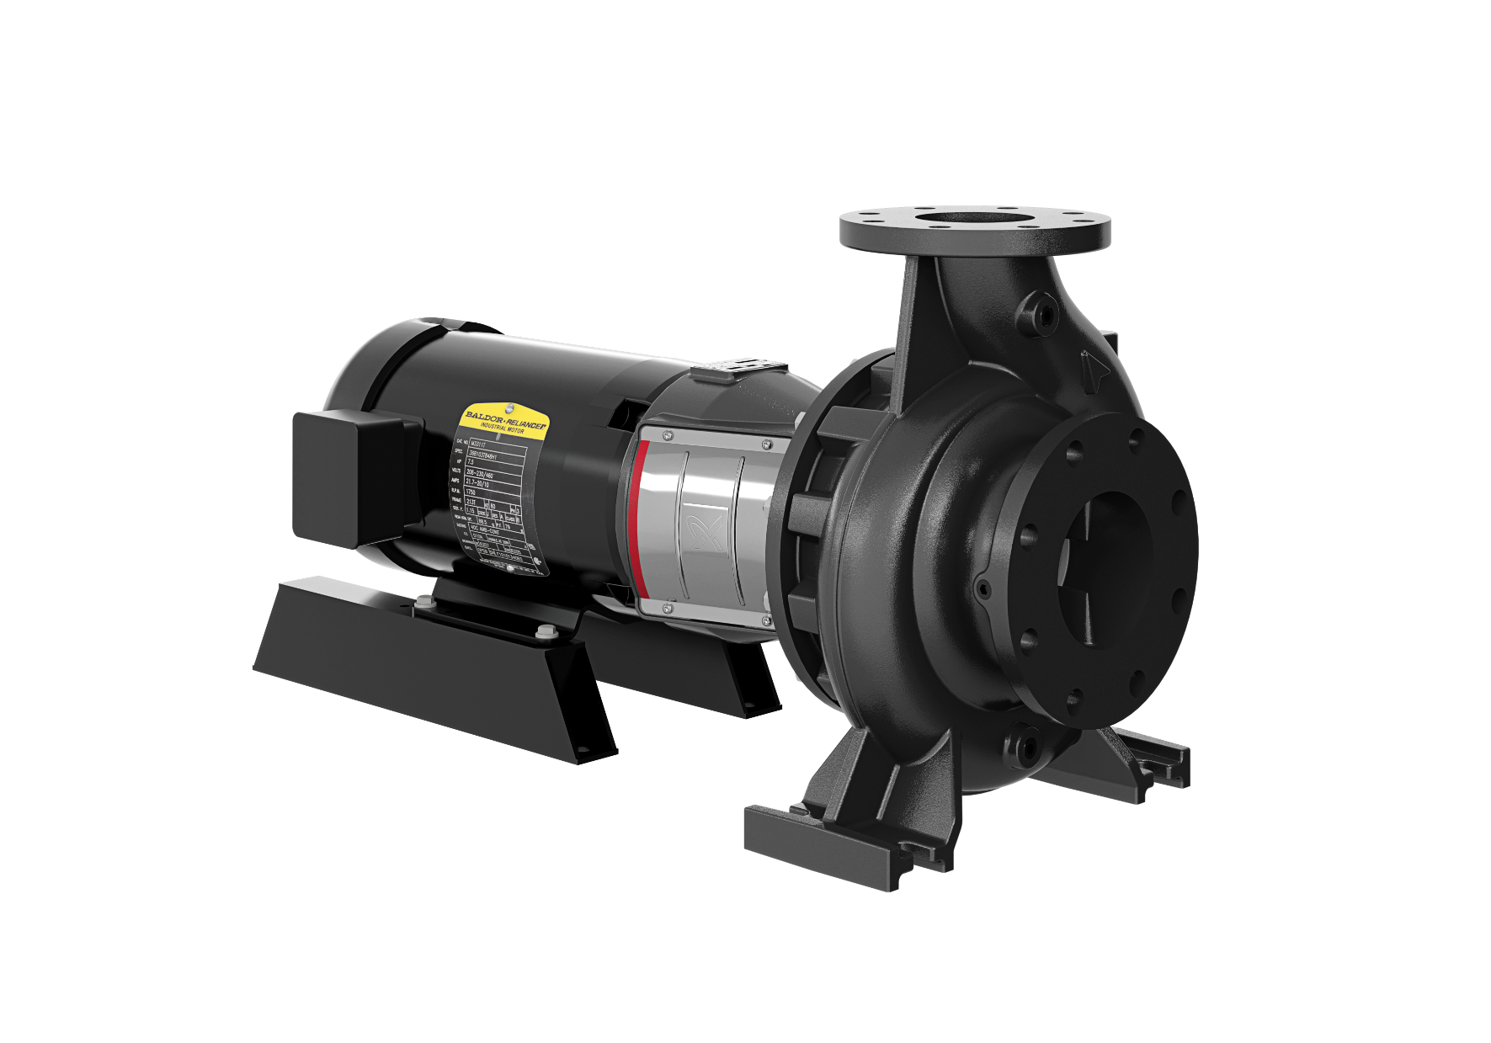
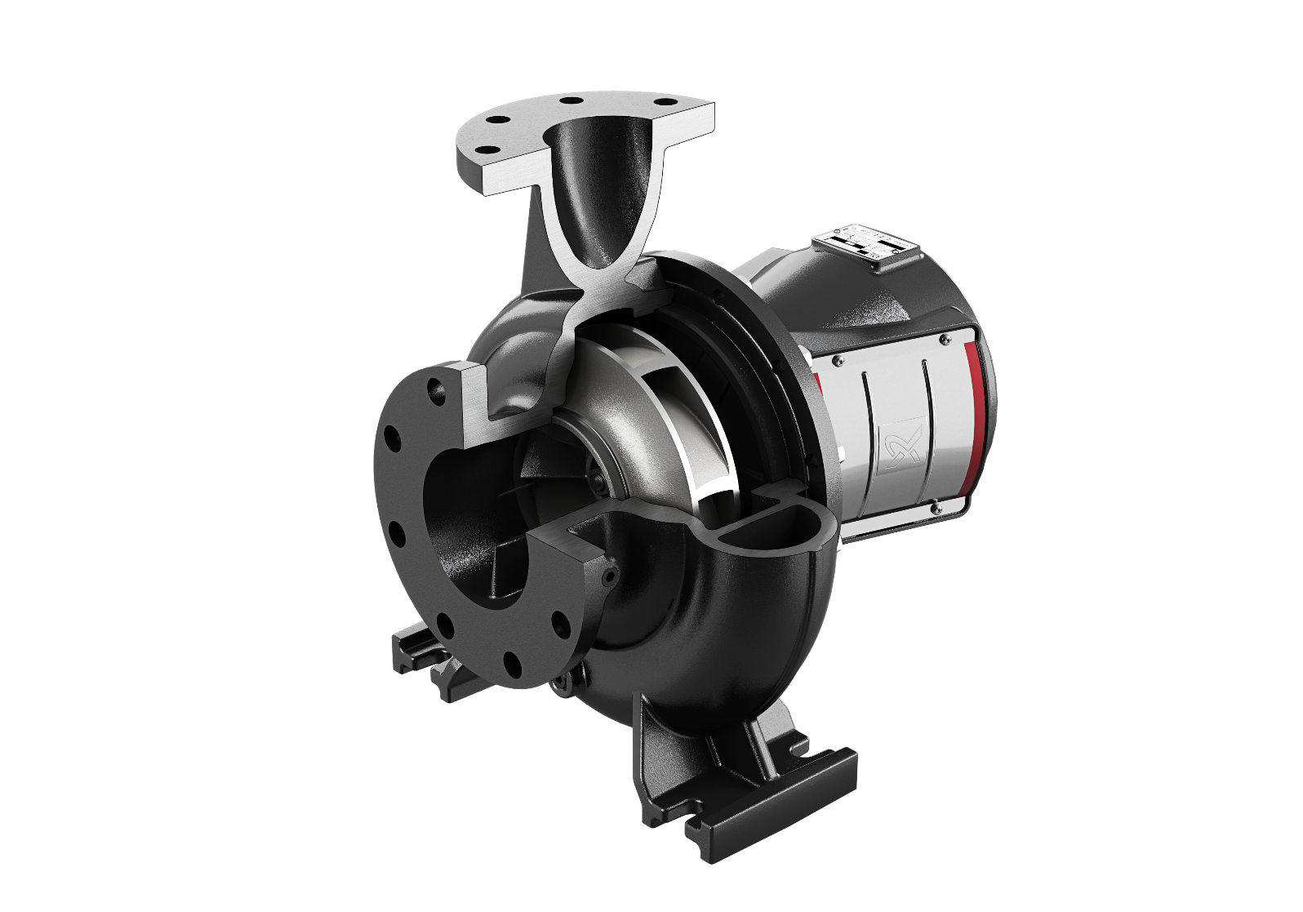
Grundfos N-Series: NBS Split-coupled pumps
SIMPLICITY
EFFICIENCY
RELIABILITY
Complete range of pumps with Industry leading efficiencies from advanced Computational Fluid Dynamics/3D hydraulic modeling
BENEFITS
The industries smallest footprint
Simplest installation No base, grout required for install
Lifetime alignment guarantee
Silicon Carbide / Silicon Carbide hard faced seals STANDARD
Easy serviceability
5
5

Slide 6
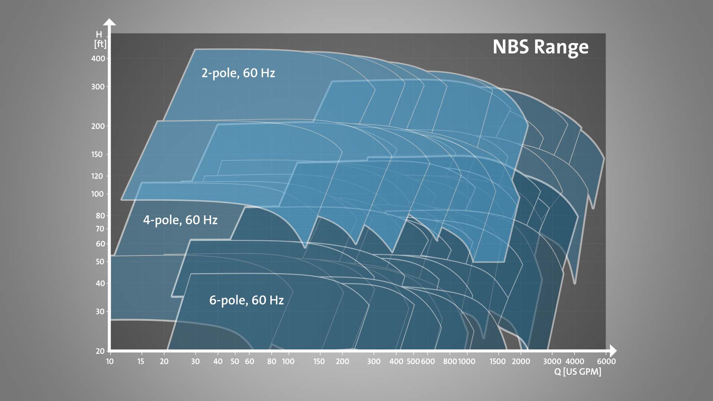
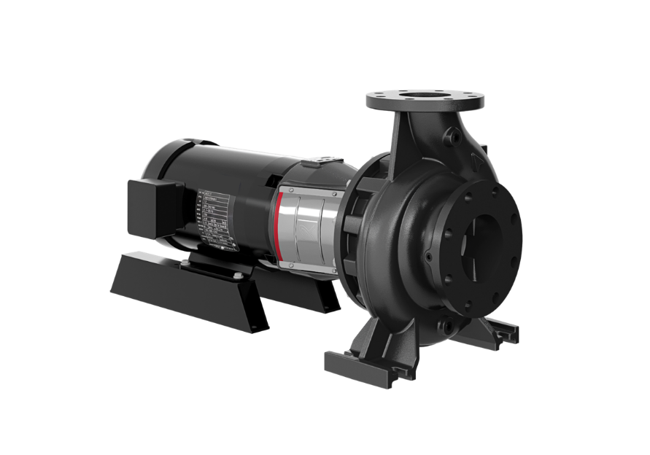

Slide 7
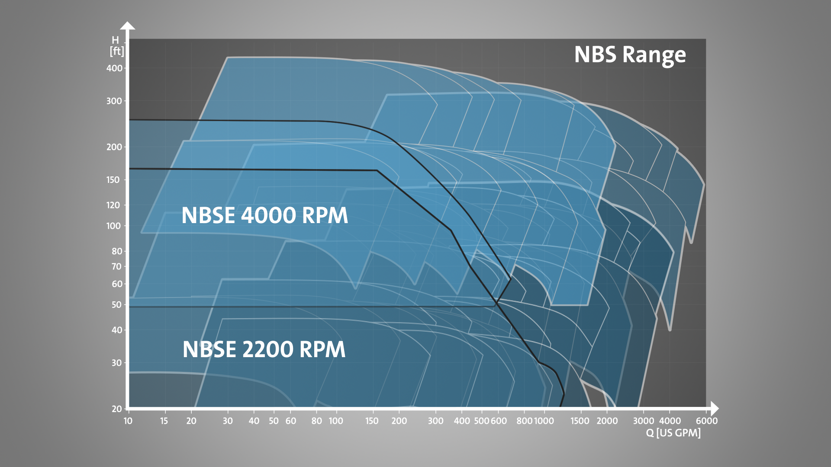
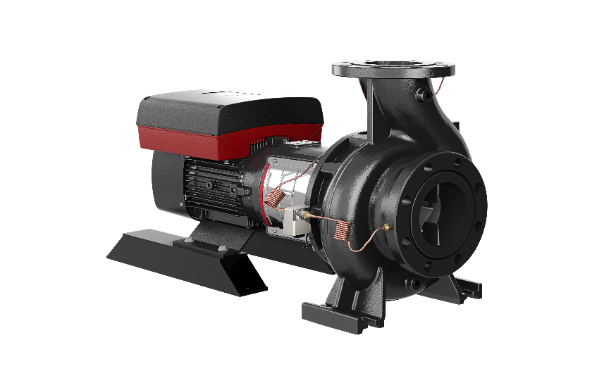

Slide 8
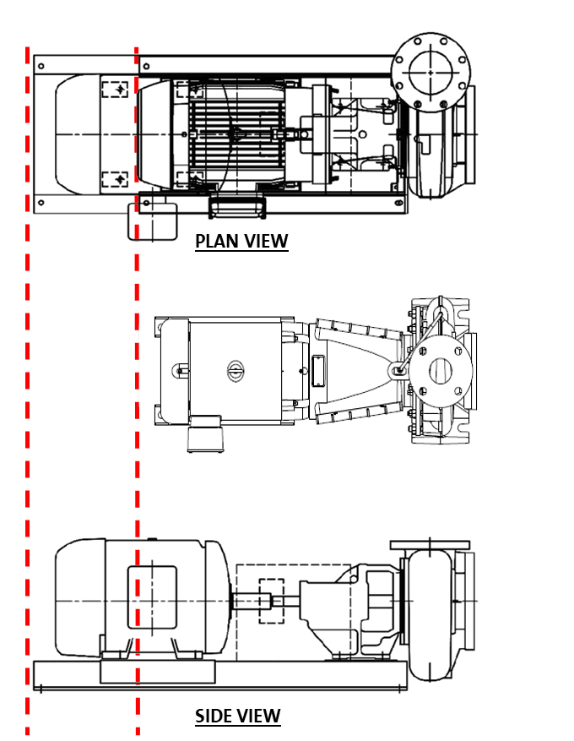
The industry's smallest footprint
SIMPLICITY
EFFICIENCY
RELIABILITY
Optimized, space-saving design has 35% smaller footprint than frame mount designs, without sacrificing serviceability or performance
Notes:
NBS as compared to Paco LF

Slide 9
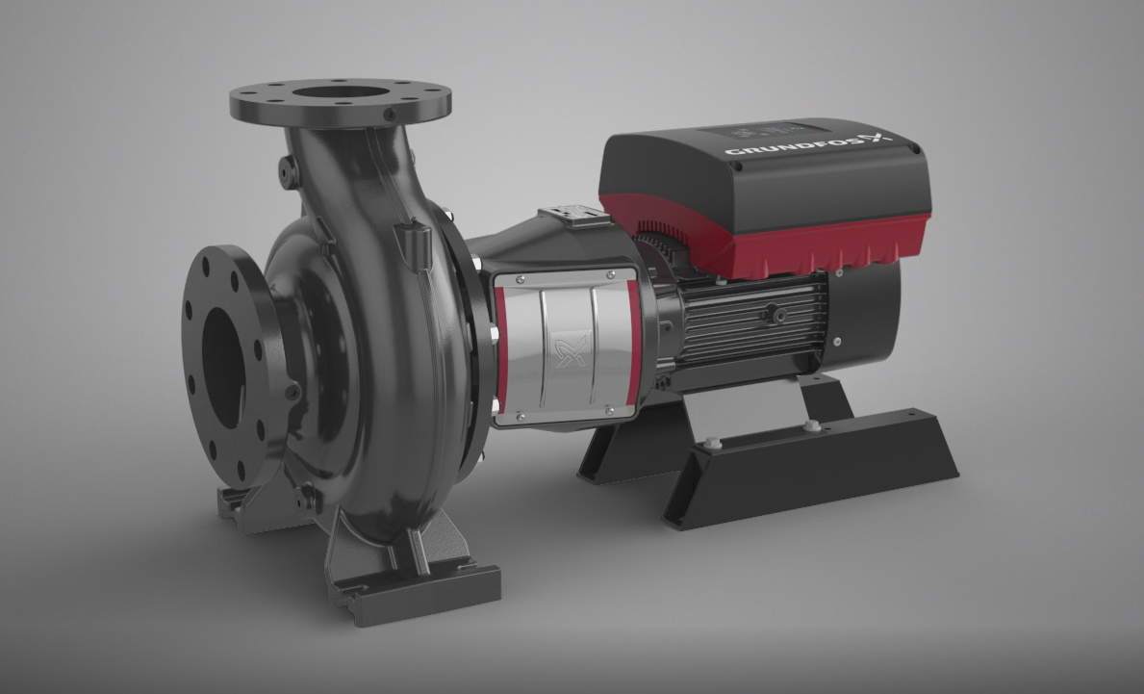

Slide 10
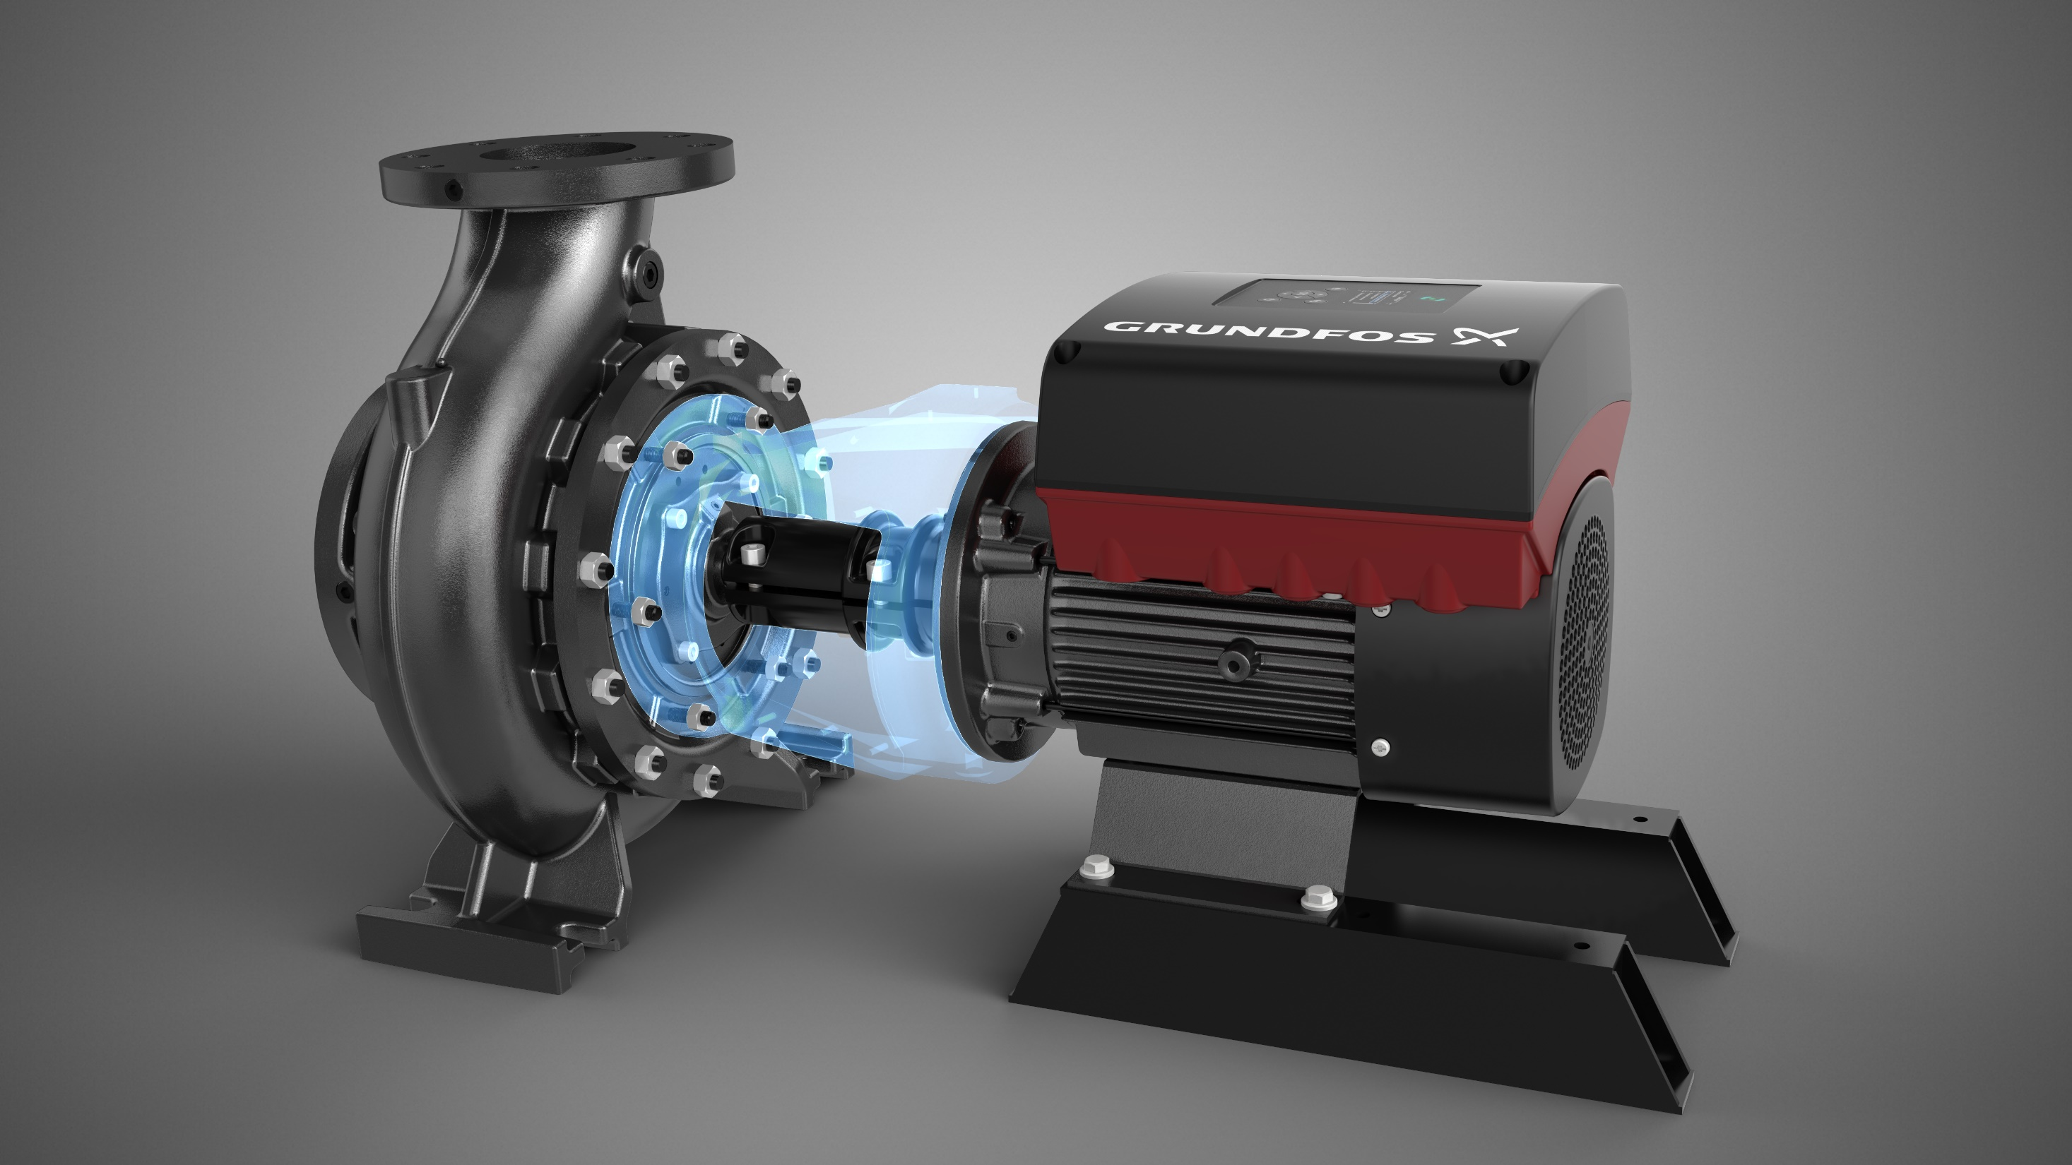

Slide 11
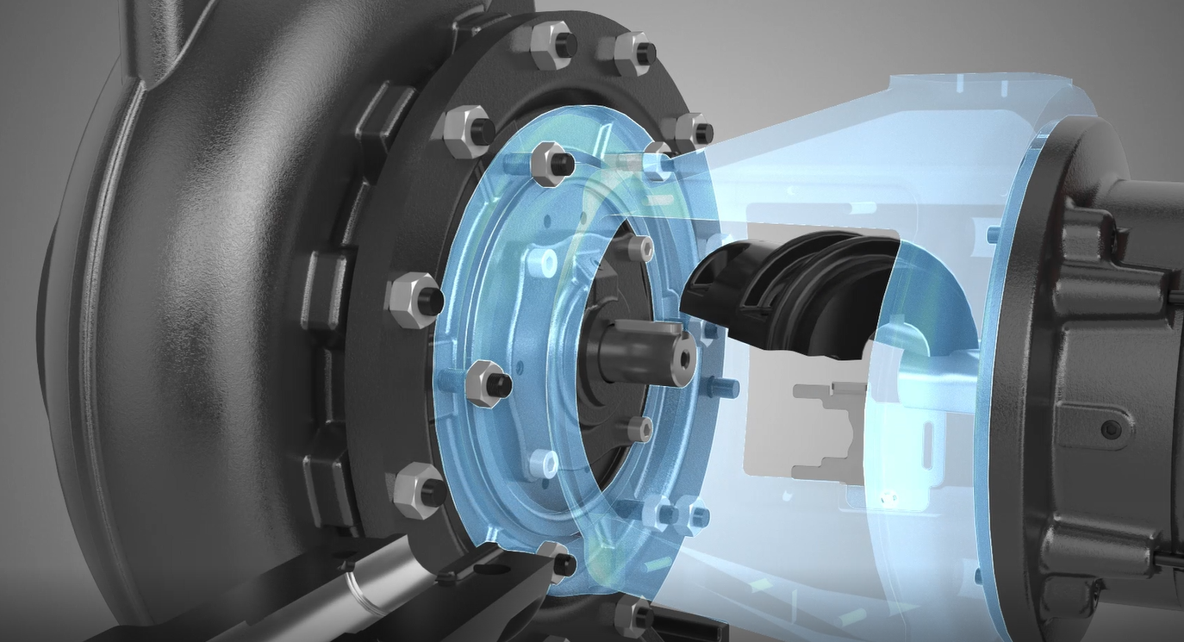

Slide 12
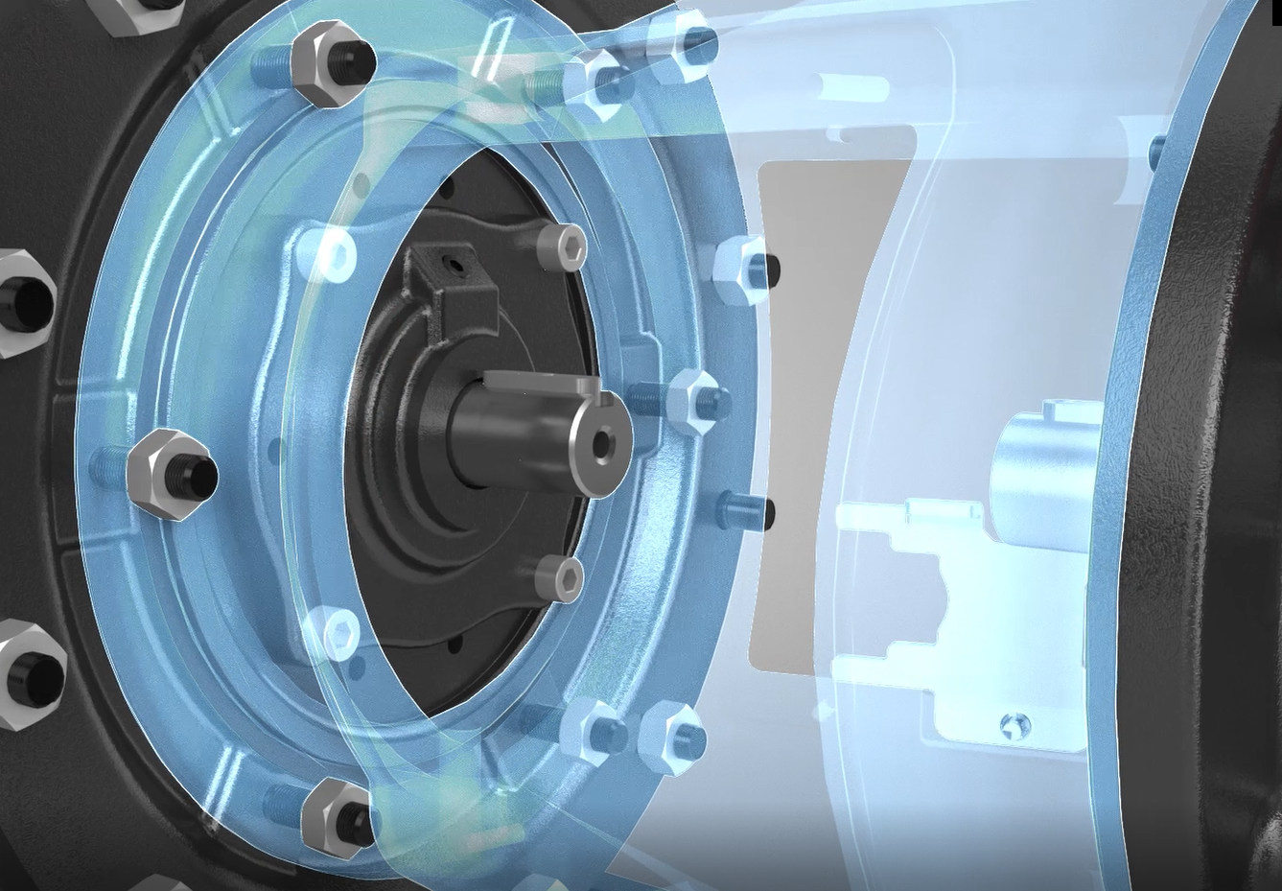

Slide 13
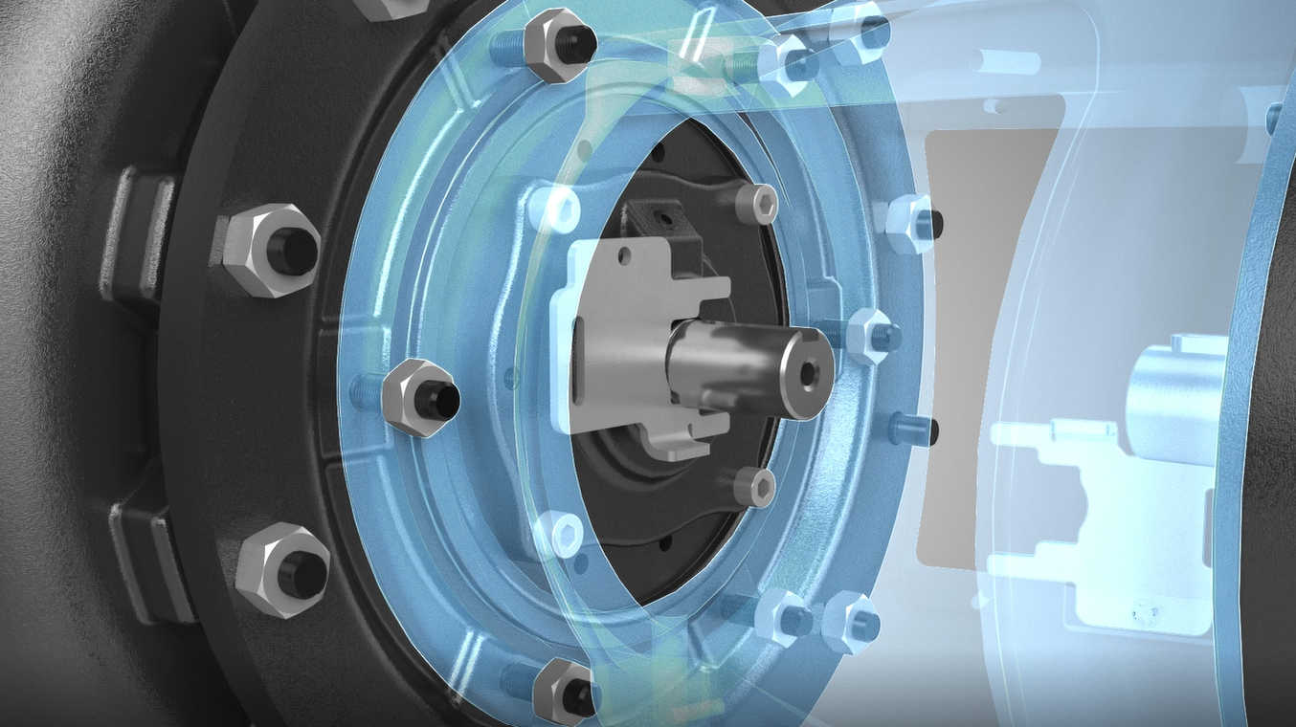

Slide 14
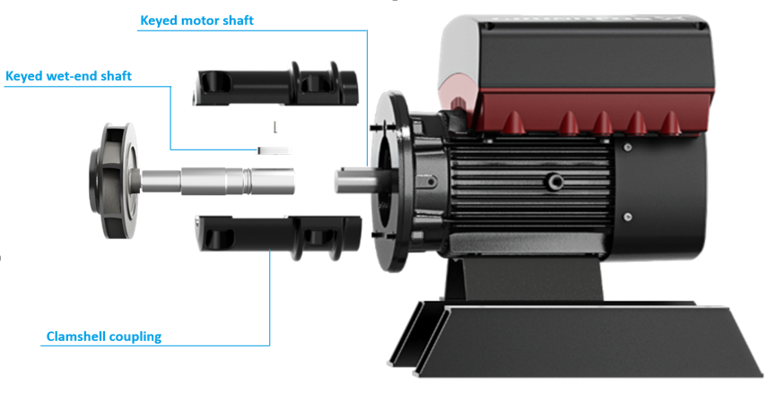

NBS Lifetime Alignment
SIMPLICITY
EFFICIENCY
RELIABILITY
Keyed shafts along with clamshell coupler automatically align pump and motor shafts
Eliminates laser alignment costs and reduces installation time

Slide 15
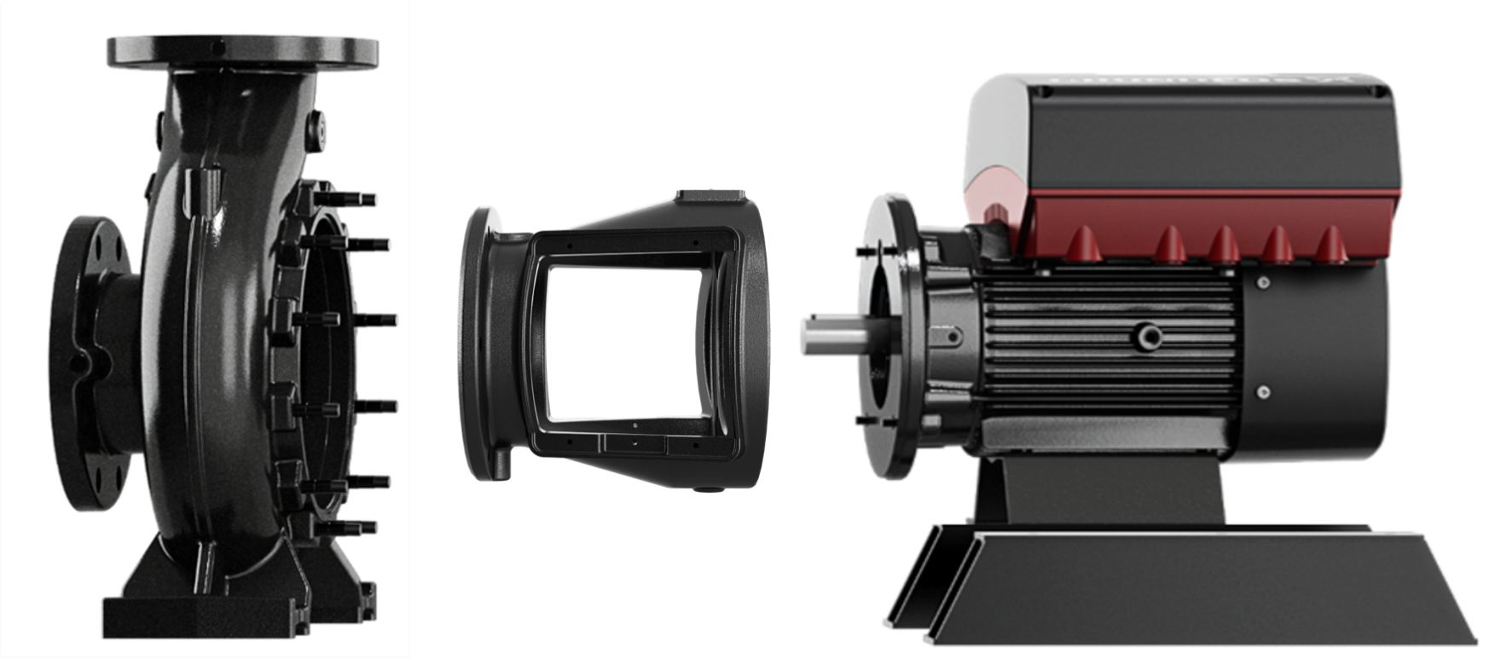
NBS – NO ALIGNMENT NEEDED
SIMPLICITY
EFFICIENCY
RELIABILITY
Rigid motor adapter
Registered fit of motor adapter eliminates the need for alignment
Foot mounted volute
Motor feet

Slide 16
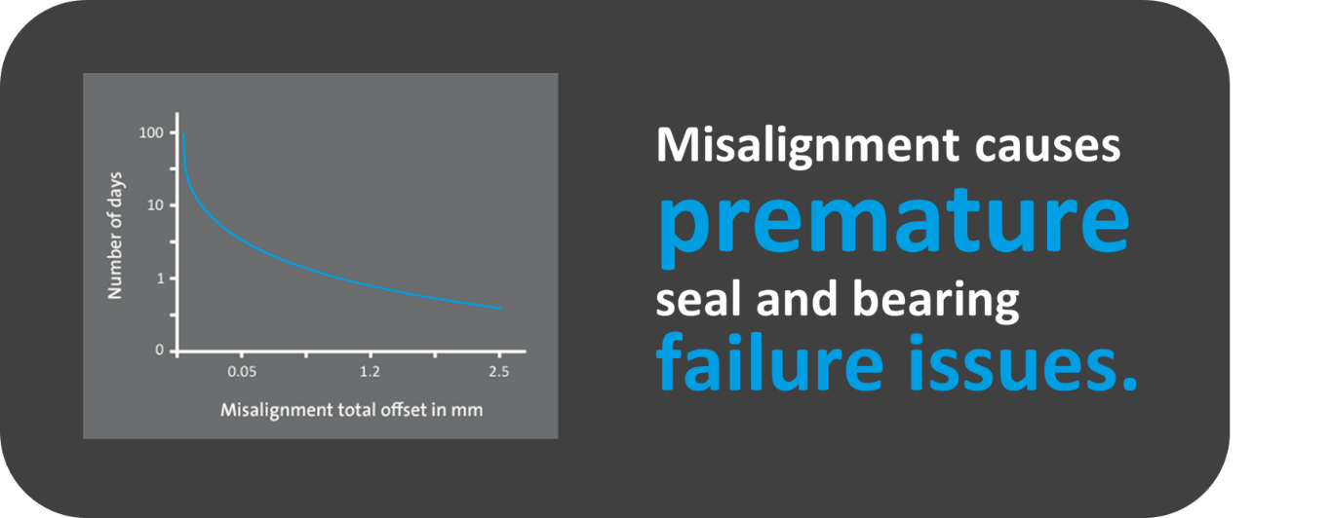
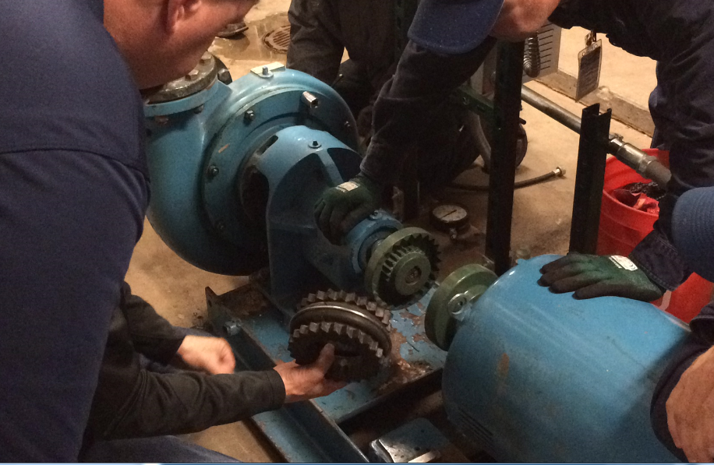
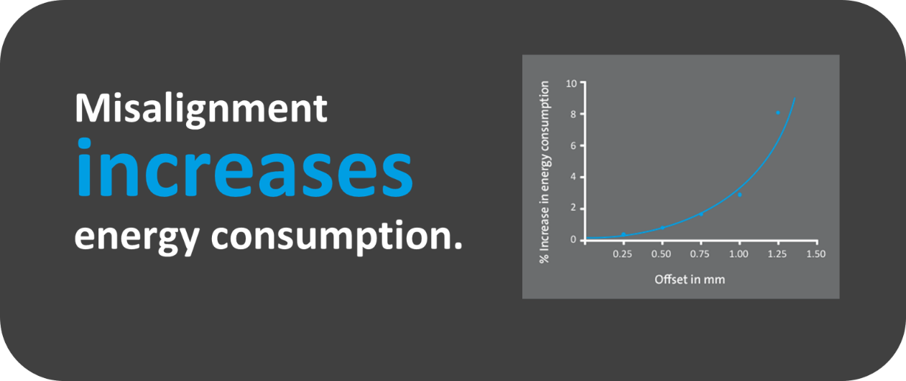
Did you know that only 7% of measured machines fall withing acceptable alignment tolerances?
SIMPLICITY
EFFICIENCY
RELIABILITY

Slide 17
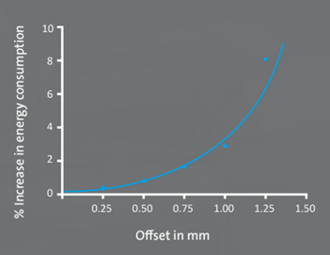
Efficiency: Did you know that…
Misalignment
increases
energy consumption.
*Source: Grundfos
Notes:
Source: Grundfos, Commercial Buildings – Chilled Water System Efficiency. Jens Nørgaard, Grundfos Senior Application Manager, 2019.
https://www.grundfos.com/content/dam/Global%20Site/campaigns/iSolutions%202018/GiS%20CBS/CBS%20HVAC/CBS-HVAC-WP-Chilled-Water-2019.pdf

Slide 18
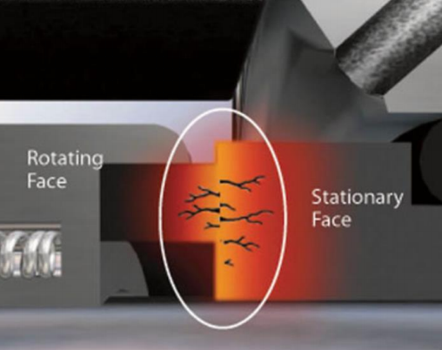
Reliability: Did you know that…
Stat around how many seals in CBS market fail in the first year? How many seal kits does our service team send out as good will and then extrapolate?
Mechanical seals are the most common cause of pump failure and system downtime.
Shaft misalignment
Axially moving shaft
Friction
Dry run
Changing load conditions
Abrasive fluids
Inconsistent chemical additive concentrations
Dirt on seal face
Fractures
Pressure changes
Notes:
SOURCE AND IMAGE: Silicon Carbide Materials Properties Selection for Mechanical Seal Faces William Charles Hoskins University of Tennessee, Knoxville, zyn245@vols.utk.edu
SOURCE: https://modernpumpingtoday.com/why-do-mechanical-seals-fail/

Slide 19
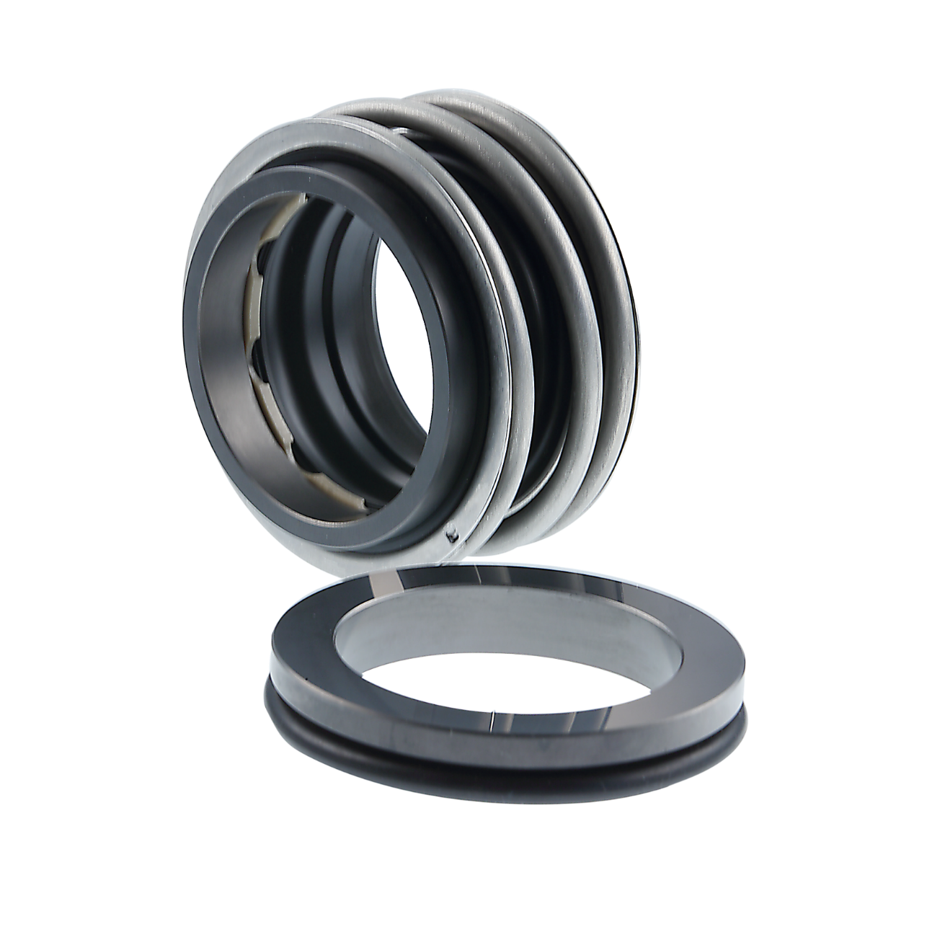
Silicon Carbide (SiC) seal STANDARD
SIMPLICITY
EFFICIENCY
RELIABILITY
Grundfos NBS utilizes an innovative SiC/SiC hard face mechanical seal as standard
Best in class seal design uses the latest materials and advanced features to improve performance
The eSiC-07 material provides longer life due to: broad chemical resistance, improved abrasives handling and excellent emergency running characteristics
EPDM elastomers allow for a wide temperature range
PEEK-PTFE disk has excellent wear characteristics, improved sliding behavior and a self-cleaning surface which allows for better adjustment under variable load conditions
PEEK-PTFE disk
eSiC-07
Is this page correct? Particularly the range for shaft seal. Implies that the seals have very limited temp range. Also which seal is standard Q5 or Q6? If Q5 then 194 deg F is not high enough!
The Q6 Celsius temp 120 needs to be updated to 248. If that is the standard that is great then we meet (not exceed) competition.
Notes:
Mechanical seals are the most common cause of pump failure and system downtime.

Slide 20

Simplicity: Did you know that…
Poor maintenance practices can increase energy consumption by
30-60%*
*Source: Institute for Building Efficiency
Notes:
Source: Institute for Building Efficiency, Energy Savings From Maintenance. Johnson Controls, 2012
https://buildingefficiencyinitiative.org/resources/fact-sheet-ibe-energy-savings-maintenance
Note to commercial insight:
The same study from 2012 showed that best practices in building maintenance and operations reduce energy use by 10-20% across all climate zones in the US.

Slide 21
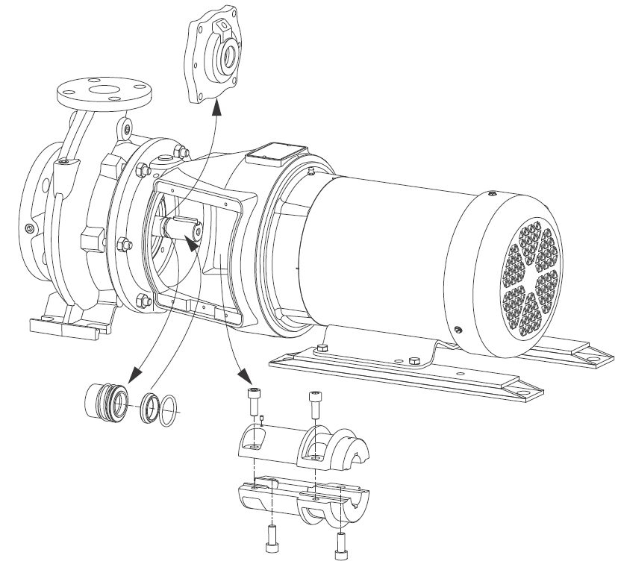
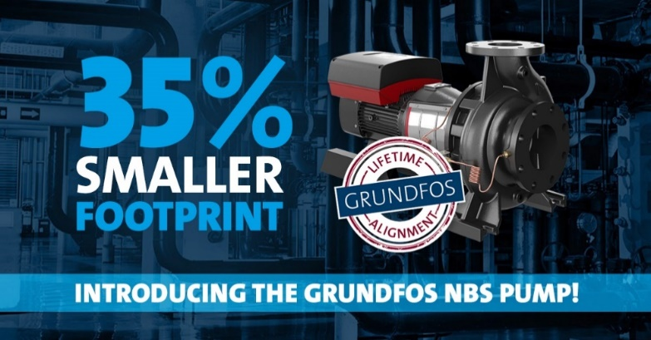
Easy serviceability
SIMPLICITY
EFFICIENCY
RELIABILITY
Pump design optimized for easy installation, easy service and low maintenance costs
Axially split, rigid coupling enhances ease of service with reduced maintenance costs
Back pull-out design
Spacer coupling allows for rapid mechanical seal access without removing the motor
Notes:
Add video segment showing back pull out and seal serviceability?

Slide 22
The industry’s least expensive installation
SIMPLICITY
EFFICIENCY
RELIABILITY
No baseplate or grouting
No alignment
Save $550-$750 on inertia bases and grouting
Save $300-$400 in labor costs per pump
Total Savings / Pump Initial Installation: $850-$1,150
*Source: Institute for Building Efficiency
Notes:
Source: Institute for Building Efficiency, Energy Savings From Maintenance. Johnson Controls, 2012
https://buildingefficiencyinitiative.org/resources/fact-sheet-ibe-energy-savings-maintenance
Note to commercial insight:
The same study from 2012 showed that best practices in building maintenance and operations reduce energy use by 10-20% across all climate zones in the US.

Slide 23
NBS installation
SIMPLICITY
EFFICIENCY
RELIABILITY
Rigid motor adapter
No pump baseplate or grouting required
Rigid motor adapter allows for simplified installation
Registered fit of motor adapter eliminates the need for alignment
Foot mounted volute
Motor feet

Slide 24
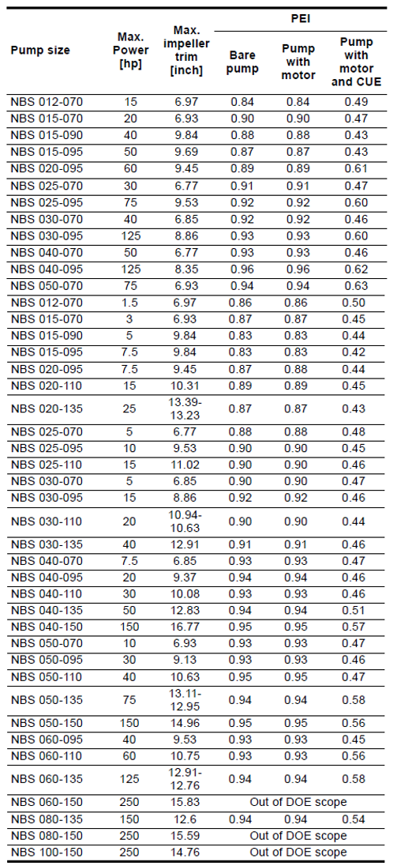
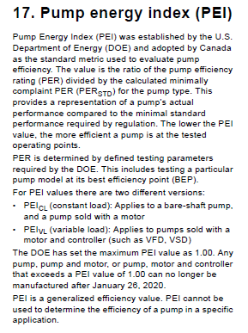
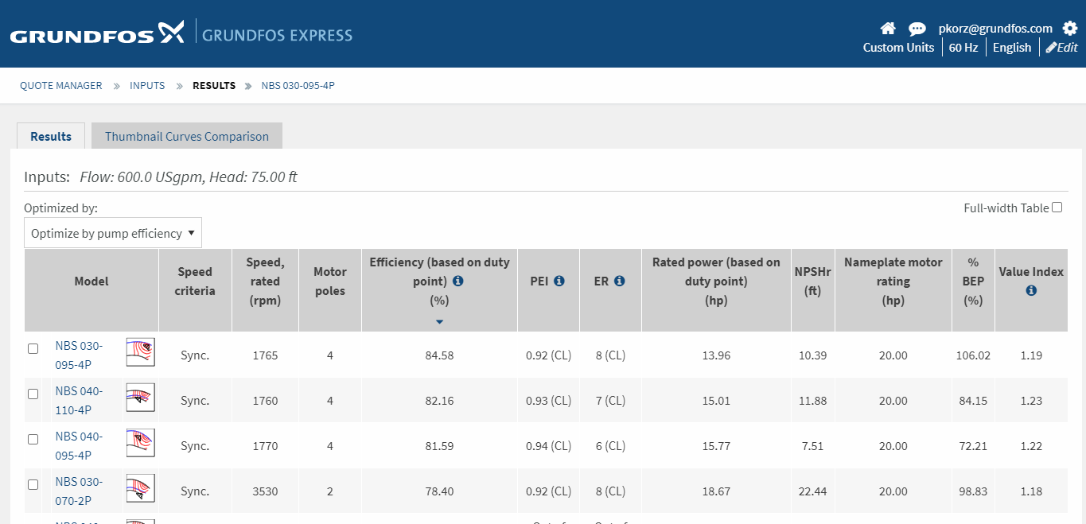
Industry leading efficiencies
SIMPLICITY
EFFICIENCY
RELIABILITY
Industry leading PEI values
Support information in the NBS Databook and on GXS

Slide 25
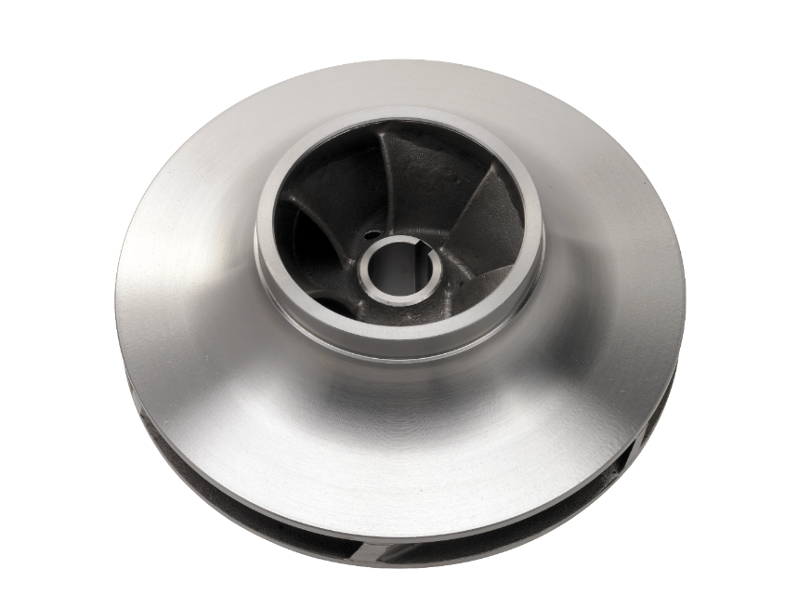
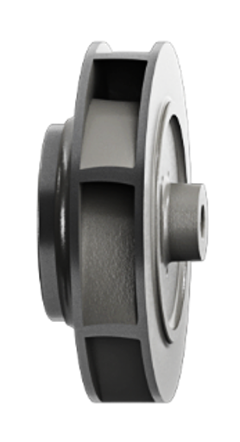
Industry leading efficiencies
SIMPLICITY
EFFICIENCY
RELIABILITY
State of the art CFD or Computational Fluid Design analysis and design
304SS investment cast impellers
Balanced impellers reduce noise and vibration providing quieter operation better efficiency and prolonged seal and bearing life
Lower net positive suction head required (NPSHr)
Notes:
- CFD is a computer based design analysis technique that utilizes a computational model that is built to represent a theoretical pump design. General fluid flow equations are applied to the model to study and develop the most efficient pump design possible.
- Investment castings are created using a lost-wax process that results in a significantly improved surface and part quality than the more common die-cast process or the sand-cast process historically used on bronze castings. The end results of this process are greater efficiency, better product consistency and better hydraulic performance. Sand cast impellers typically require grinding to address surface imperfections. Investment cast impellers have cleaner edges and a more consistent surface.

Slide 26
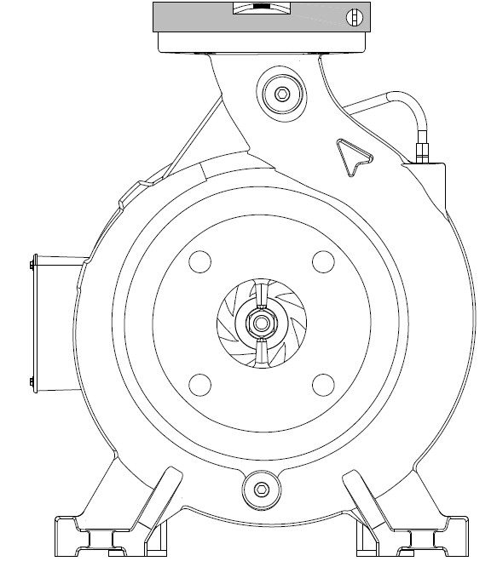
Industry leading efficiencies & reliability
SIMPLICITY
EFFICIENCY
RELIABILITY
Integrally cast diffuser vane provides balanced flow to the eye of the impeller, reducing axial forces and improving efficiency
Integrally cast foot mounted volute provides a solid foundation that helps eliminate distortions and deflections which can shorten the life of the pump’s rotating assembly
Top centerline discharge allows for self-venting and more compact piping layouts

Slide 27
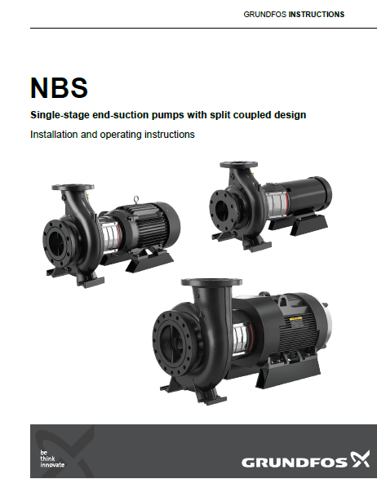
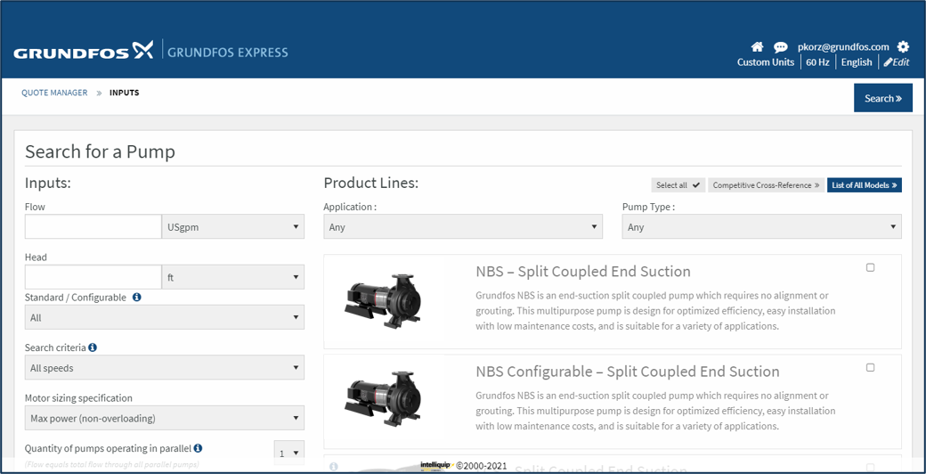
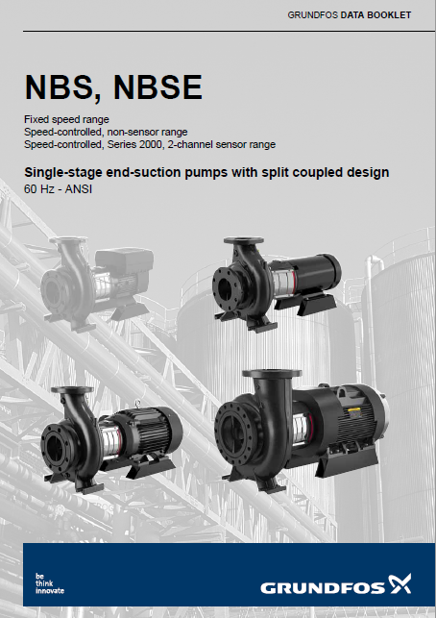
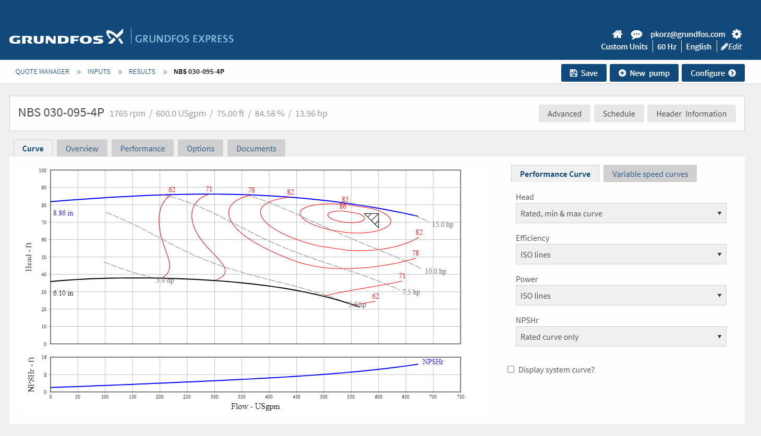
Grundfos NBS Support
SIMPLICITY
EFFICIENCY
RELIABILITY
Notes:
Add curves, submittal docs, sample dwg from GXS?

Slide 28
Grundfos NBS GXS
SIMPLICITY
EFFICIENCY
RELIABILITY
Notes:
Add curves, submittal docs, sample dwg from GXS?

Slide 29

2021
WWW.HURLEYENGINEERING.COM 1-800-861-7122

Slide 30

2021
Module 1 – Pump basics
Module 2 – Commercial Building Pumping Systems
Module 3 – System Components
Module 4 – Standards, Guidebooks & Codes
Module 5 – Methods of Controlling Pumps
Module 6 – Steps to Manage Existing System Efficiency Improvements
Module 7 – Economics of Pumps Selection
COMING IN OCTOBER
WWW.HURLEYENGINEERING.COM 1-800-861-7122

Slide 31
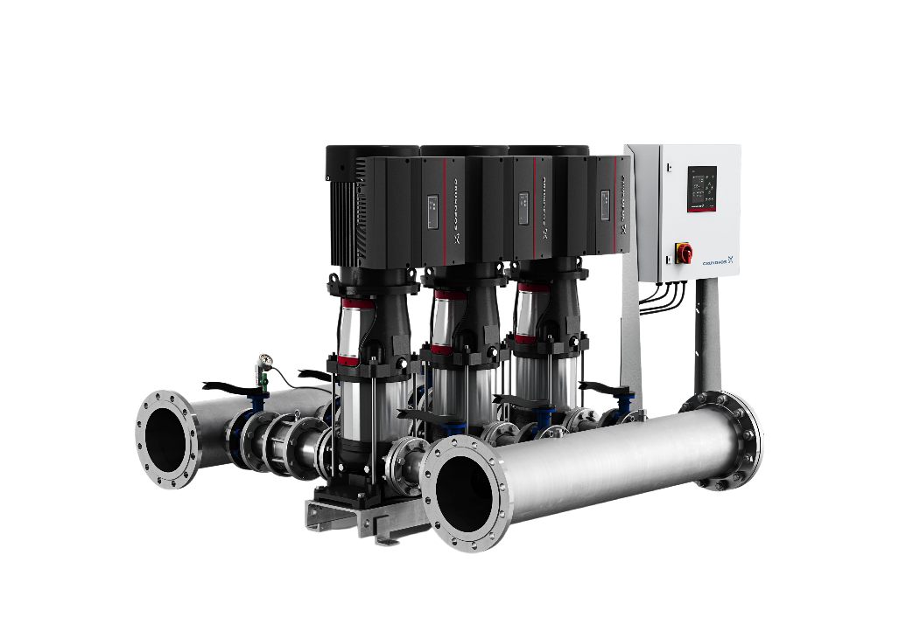
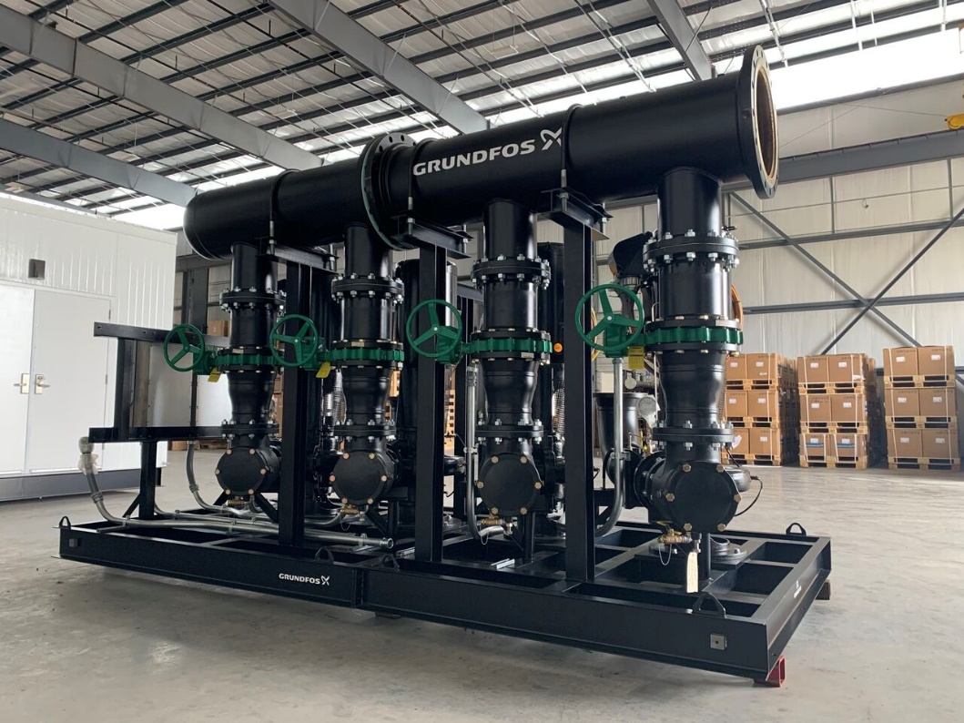

2021
WWW.HURLEYENGINEERING.COM 1-800-861-7122

Slide 32
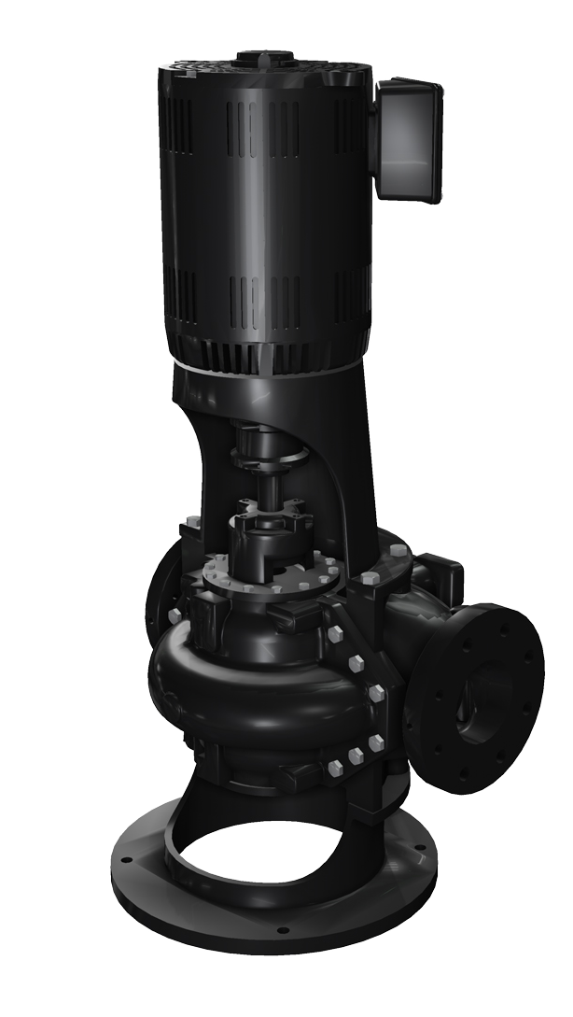


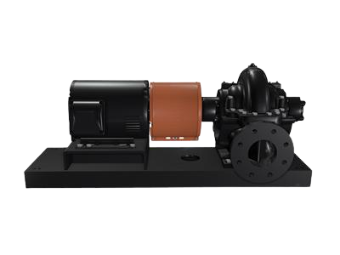
2021
WWW.HURLEYENGINEERING.COM 1-800-861-7122

Slide 33
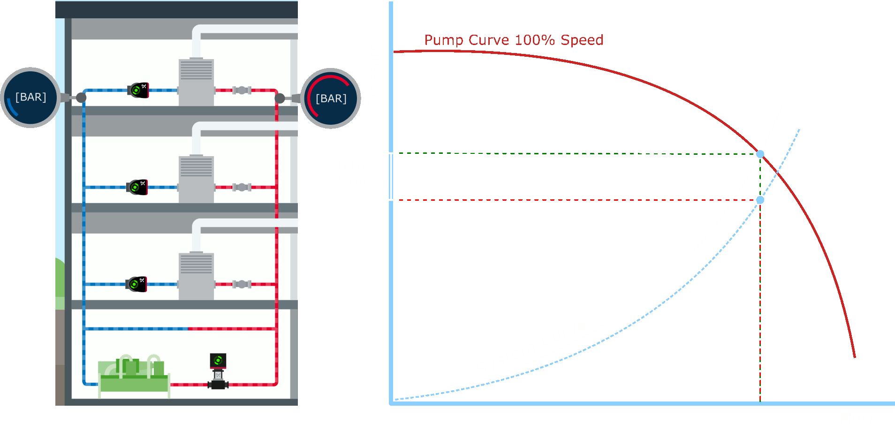
Grundfos iSOLUTIONS offer a new pumping principle for chilled water systems with distributed pumping systems
Distributed pumping:
Traditional control valves as well as system balancing valves are made redundant and replaced by intelligent and connected pumps that generate flow and pressure - only when and where it is needed.
This results in an automated and more efficient pumping systems.
The benefits include:
Energy savings
Reduced commissioning time and system complexity
Automated balancing of system
Increased indoor climate quality

Slide 34
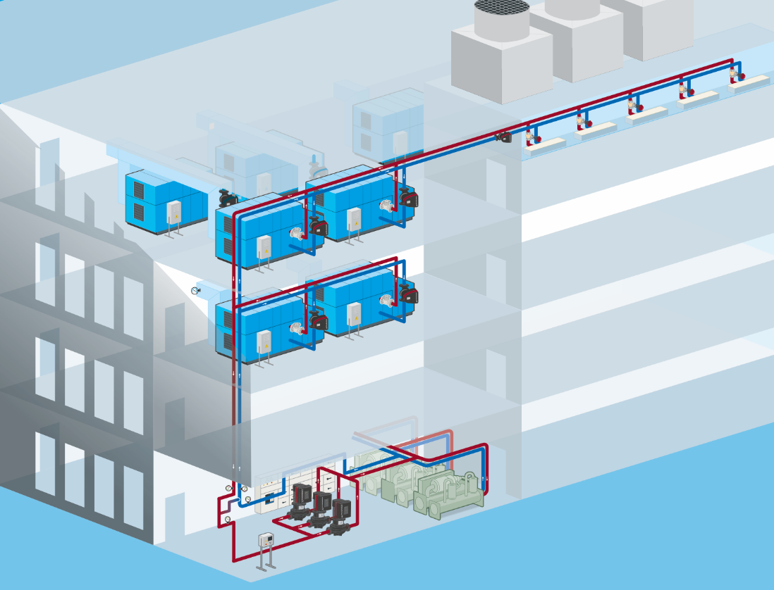

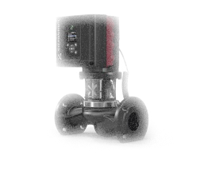


Distributed Pumping | The concept
DIPU
The intelligent MAGNA3 assures optimum flow and pressure for each terminal unit while continuously keeping the system in balance, based on input from the sensors (3b).
1
3b
2
The non return valves assure that there is no backflow in the loops where the terminal units are off.
1
A variety of sensing elements (a) can be used for operation of the controller. Air temperature (b) measurement are ensuring that the MAGNA3 adjust in the variable load demand.
3
2
4
The primary pumps provide the supply pressure for only the primary side.
6
The controller minimizes the flow in the bypass line, prevents the primary pumps from over pumping and ensure that the chillers’ flow is always above their minimum constraint. The controller is connected to the sensors (3a).
5
3a
6
The complete solution ensures a superior comfort level in the whole building.
4
5

Slide 35
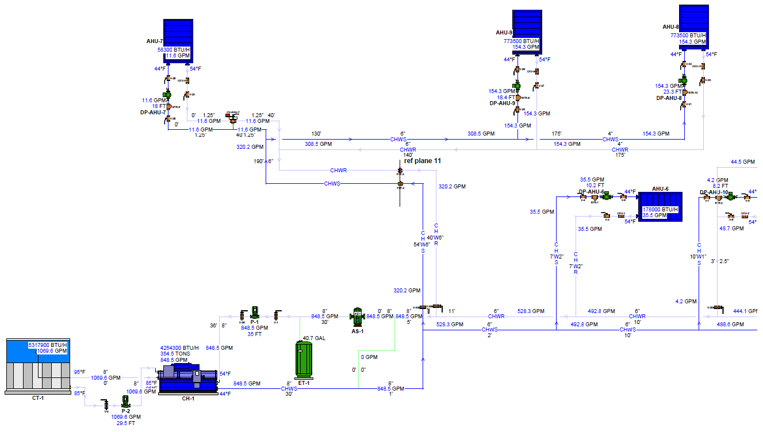

Slide 36
2021
WWW.HURLEYENGINEERING.COM 1-800-861-7122

Slide 37
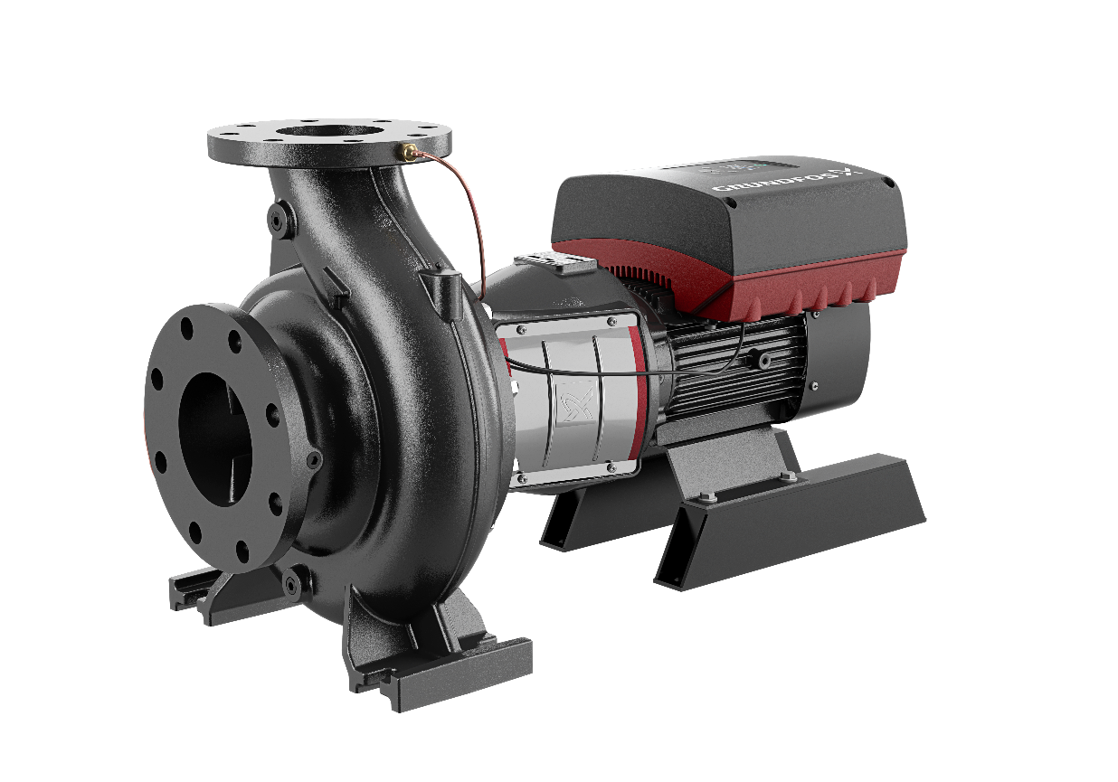
Thank You

Slide 38
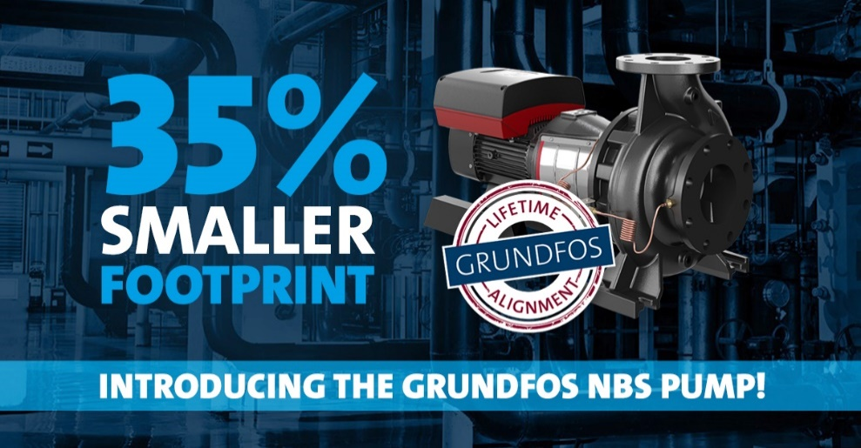


Social Image Sample

