Slide 1
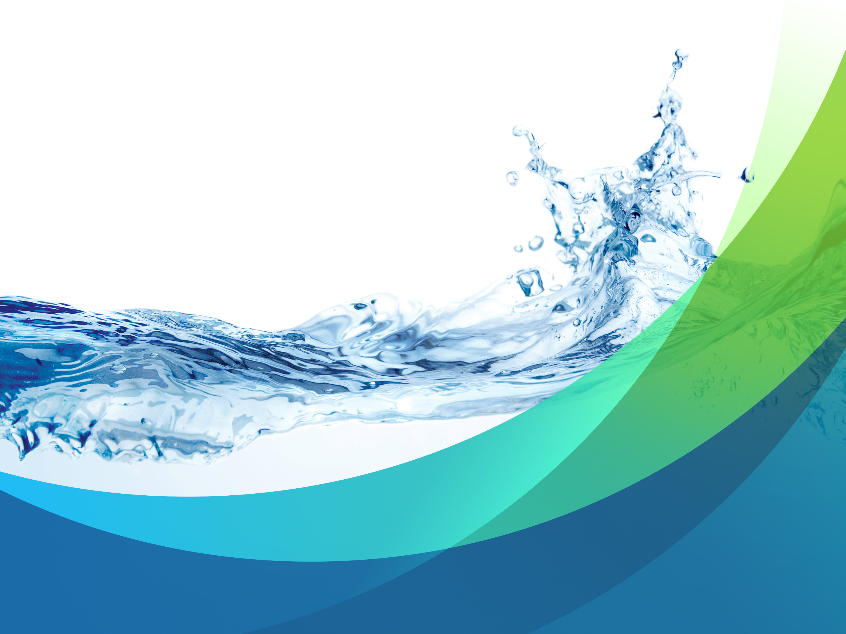

FORCE FIELDTM
FILTER TECHNOLOGY
2020

Slide 2
Introduction:
Triple Clear Water Solutions is a premier provider of innovative water technologies
TCWS Force Field™ Technology is unique in its ability to:
  Achieve:
    4 & 6 log reduction of Virus, Bacteria, Parasite
    Excellent reduction of heavy metals, trace pharmaceuticals, and cellular debris
  Unlike the competition we offer:
    Minimal Pressure drop
    High flow
    No chemicals
    No electricity
    No wasted water
Perfect for potable water systems and HVAC systems
Available in pre-packaged and custom solutions

Slide 3
Company Overview
2014 Founded by Andrew Borden and Eric Levin
  Experienced Entrepreneurs Acquire Rights to Force Field Technology
  R&D, Testing and Product Roadmap
2015 Secured Anchor Client, Starwood Capital & Representation
  Q1, Delivered to 1st Hotel - Miami
  Added GA Fleet Associates in NY as first distribution partner
2016 Began Worldwide Rollout
  Represented in Washington DC, Chicago, Southern California, Boston, Northern California, South Florida
  Middle East & Mexico
  TCWS Acquires Seromix™ Heavy Metals Removal Technology and renames as Kinomix™
2017 Key Partners begin jumping on board
  Continued success with huge customers like GE Headquarters, Boston Garden, U-Penn Medical Center, Tishman Speyer, Marriott, and many more…
2018 The Road Continues...
  Focusing on everyday solutions in Hospitality, Medical, Education, and Food Production

Slide 4
Established Partners

Slide 5
Water Quality Concerns
Public Health
Operator Safety
Reduce Waste
Energy Efficient

Slide 6
Breadth of Offering
HEALTH &
WELFARE
Water
Filtration
Water
Disinfection
Water Polishing
Advanced Metals
Removal

Slide 7
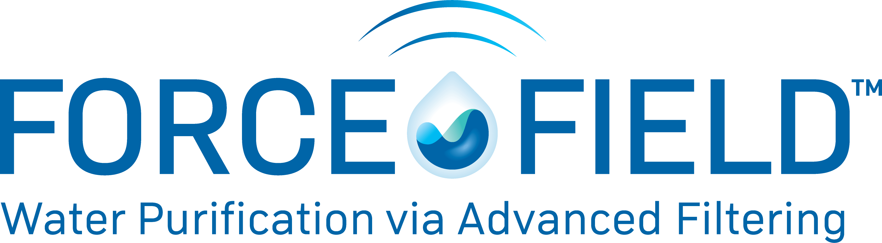

Slide 8
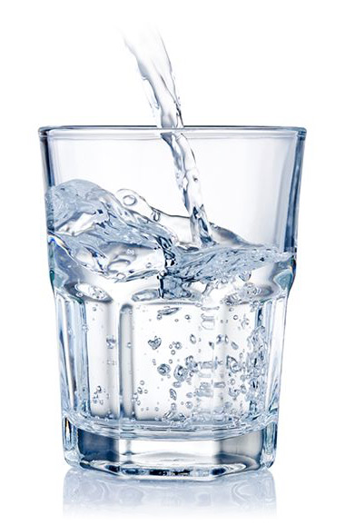
Triple Clear’s Force Field™ – a New Filtration Technology!
The development of this electro-adsorptive technology started over 10 years ago with fundamental research partially funded by an SBIR grant from NASA for the development of water filters to be used on space exploration vehicles. As work progressed, many intriguing aspects of the media were identified.
This technology is changing the world of filtration because it is not just a mechanical filter media. More importantly, it removes submicron contaminants through electro-adhesion and ion exchange.
This powerful combination of mechanical filtration and electro-adsorbtion all in one filter creates a new category of filtration that has countless powerful applications.

Slide 9
Game Changing Shift in Water Technology
Submicron Filtration Efficiency
Flow
Rate
Pressure
Drop

Slide 10
Comparative Technologies
Water Remediation Technologies - Residential, Commercial, Industrial, Municipal, Desal
Contaminants | Force FieldTM Pac Technology | RO | NF | UF | MF | Particulates Cartridges | Carbon Block | Ultra Violet
Dissolved Salts |  | ■
Endotoxin | ■ | ■ | ■ | ■ | ■ | ■
Virus | ■ | ■ | ■ |  |  |  |  | ■
Bacteria | ■ | ■ | ■ | ■ | ■ | ■ | ■ | ■
Cysts | ■ | ■ | ■ | ■ | ■ | ■ | ■ | ■
Polysaccharides (TEP) | ■ | ■ | ■ | ■ | ■
Colloids | ■ | ■ | ■ | ■ | ■
Particulates | ■ | ■ | ■ | ■ | ■ | ■ | ■
Chemical Reduction | ■ | ■ |  |  |  |  | ■ | ■
Trace Pharmaceuticals | ■ | ■ |  |  |  |  | ■ | ■
Water Remediation Technologies - Residential, Commercial, Industrial, Municipal, Desal

Slide 11
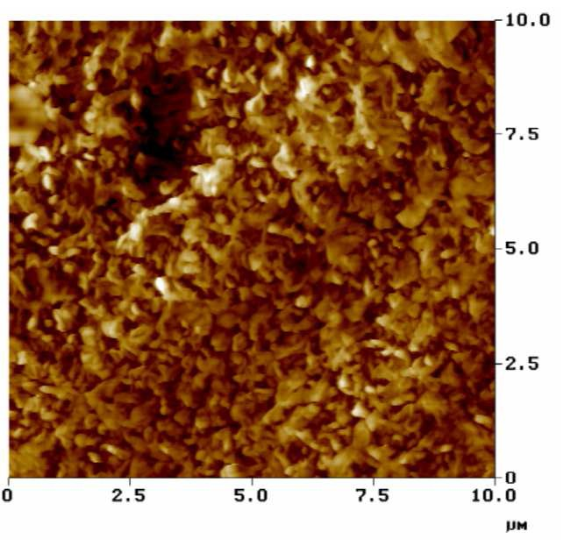
Force Field™ Pore vs. RO Membrane
Force Field pore size on same scale!
RO membranes work on the basis of mechanical filtration and contain very small pores to remove submicron particles.
The extremely tight pores of a membrane cause
low flow rates and high pressure drop.
Force Field media has a much larger physical pore size which allows for higher flow rates and lower pressure drop, and can still remove submicron particles due to the inherent charge field extending across the void volume of the pores.
RO Membrane surface

Slide 12
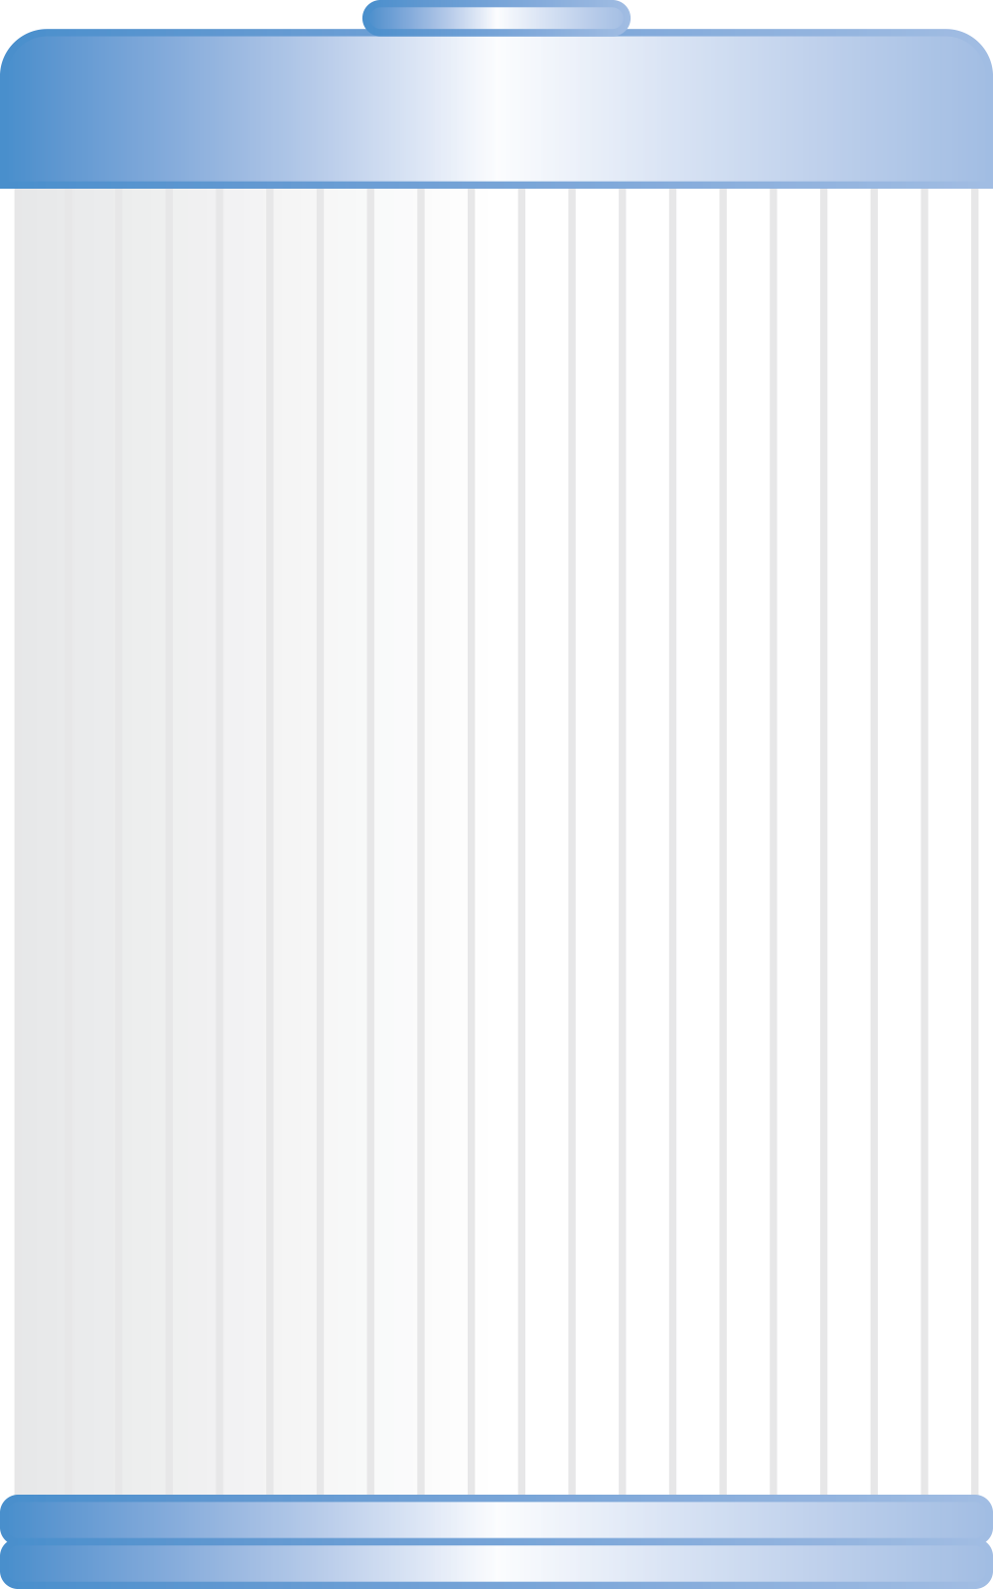
Summary of Force Field’s Removal Capabilities
Virus
(Polio, Norovirus, Rotavirus, etc.)
Bacteria
(E. coli, Legionella, Pseudomonas, etc.)
DNA, RNA
Polysaccharides
Cyst*
Humic Acid
Bromine (carbon)
Chlorine* (carbon)
Iodine (carbon)
Lead 6.5 and 8.5 pH*
Ortho-phospate
PCBs
PBA
Penicillin G
Flumenquine
Arsenic III 6.5 pH*
Arsenic III 8.5 pH*
Arsenic V 6.5 pH*
Bromine (white)
Ferrous Iron*
Soluble Silica
Trihalomethanes (THM)
Chloramine*
VOC*
Decreasing negative charge
Significant removal
Some removal

Slide 13
Triple Clear’s Force Field™ Filters
Unique Competitive Advantages:
4 & 6 log contaminant removal of virus, bacteria, cyst:
Testing by BCS Labs (1/2/14), #1401002
Challenge Species: Triple Clear 2.5” Force Field™ Gravity Camp Filters | Filter Influent Average Concentration | Percent removal of the challenge species by the filter initially and following the passage of the indicated volume (liters) of laboratory grade reagent water
 |  | 1.0 liter | 10.0 liter | 25.0 liter | 50.0 liter
Bacteria: Raoultella terrgena | 3.45 x 10⁵ cfu/ml | >99.9999%* | >99.9999%* | >99.9999%* | >99.9999%*
Virus: MS-2 Bacteriophage | 3.45 x 10⁵ pfu/ml | >99.9999%* | >99.9999%* | >99.9999%* | >99.9999%*
e: 3.0 micron microspheres | 1.8 x 10⁴ spheres/ml | >99.998%* | >99.998%* | >99.998%* | >99.998%*
* No species were detected in the filter effluent for the duplicate samples analyzed. Filter effluent samples were analyzed in duplicates at the minimum following collection.
  Achieved Using:
  No Chemicals
  No Wasted Water
  Minimal Pressure Drop
  No Electricity
  Low Maintenance
  Cost Effective Pricing

Slide 14
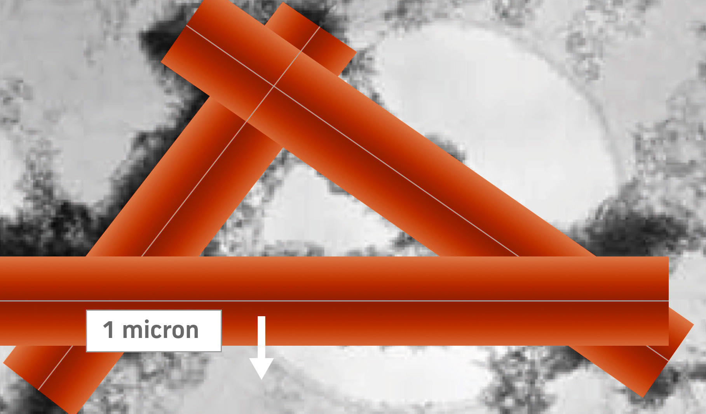
Mechanical and Adsorptive Filter Media
The pore size of the media is engineered such that the charge field covers the entire void volume of every pore
There are approximate 400 layers of these pores in the thickness of the media that contamination pass through during filtration, creating a tortuous path
The charge field removes the negatively charged, submicron particles while larger particles are captured within the fiber structure of the media
The Result is a “Force Field” of
protection over each pore!

Slide 15
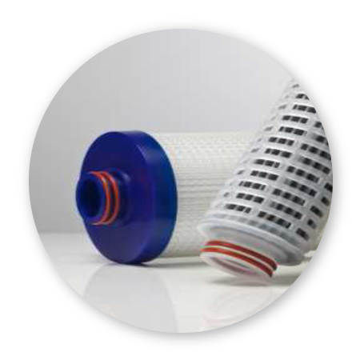
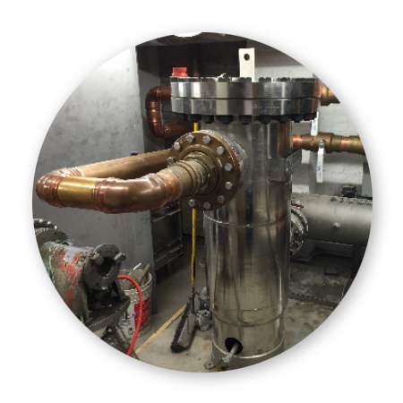
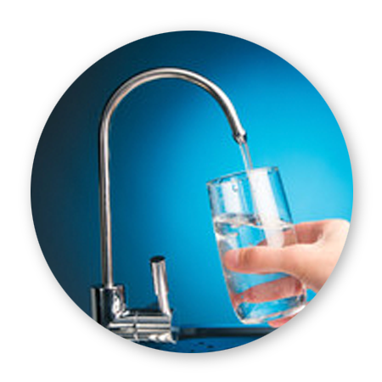
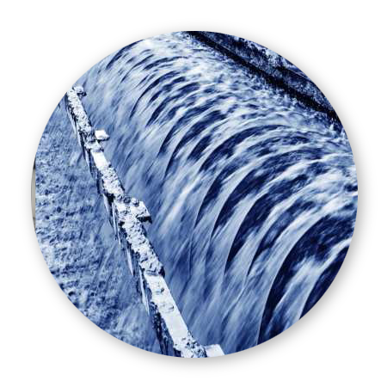
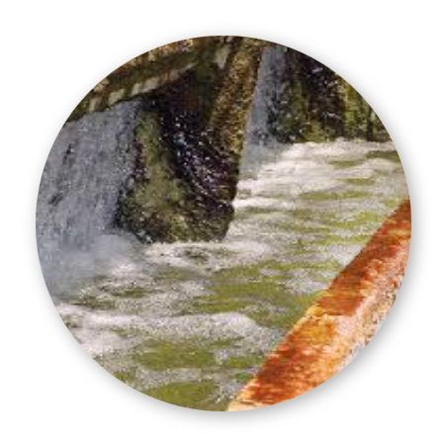
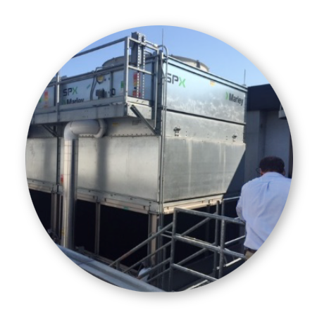
Applications for Force Field™ Technology
Post stagnation of water
  Any time water is stored in a tank
Cooling Towers
Rain Water Harvesting
Potable water disaster protection
Potable water polishing
Legionella prevention
When Biofouling is an issue
  RO pre-filtering
  Cooling towers
  Storage tanks
Maintenance reduction for mechanical systems
  Reducing metals,
  particulates, chemicals
Brown water
And more…

Slide 16
The Primary Force Field Product Offerings
Potable Water
Point of Entry
Point of Use
Cooling Tower Solutions
Side-stream Purification
Water Storage (Hot Water Heaters)
Energy Saving Anti-Legionella barriers
Water Reuse
Rainwater Collection Filtration
Chemical Free Greywater Treatment

Slide 17
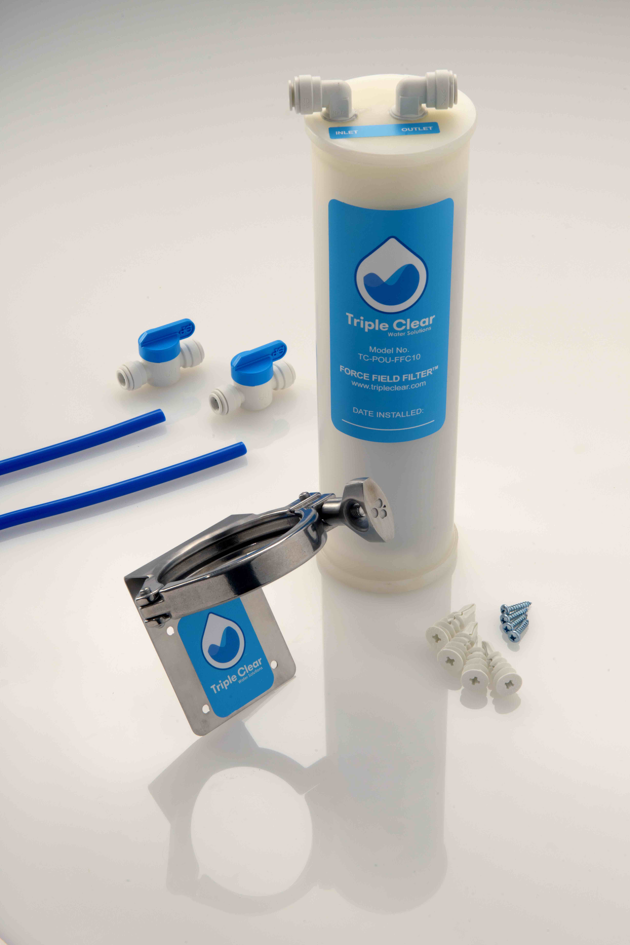
POU Water Purification System
Features:
Quick change cartridges at 1.5gpm to 15gpm.
Remove particulate matter down to 0.001um equivalent.
Remove > 99.99% of viruses, bacteria, and cyst.
Remove > 98% of lead.
Remove > 99.99% of cellular debris that causes biofilms.
Bottled-water-quality taste, odor, and levels from every tap.
Requires no chemicals.
Uses almost no electricity.
Low maintenance
Pressure drop as low as 2psid (12psid max recommended)
2.5gpm, POU System
Quick Change Kits
Protect Your Building.
Protect Your Tenants.
Installs quickly and includes all the needed hardware.
Change disposable cartridges in under a minute!
Protect Your Profits.

Slide 18
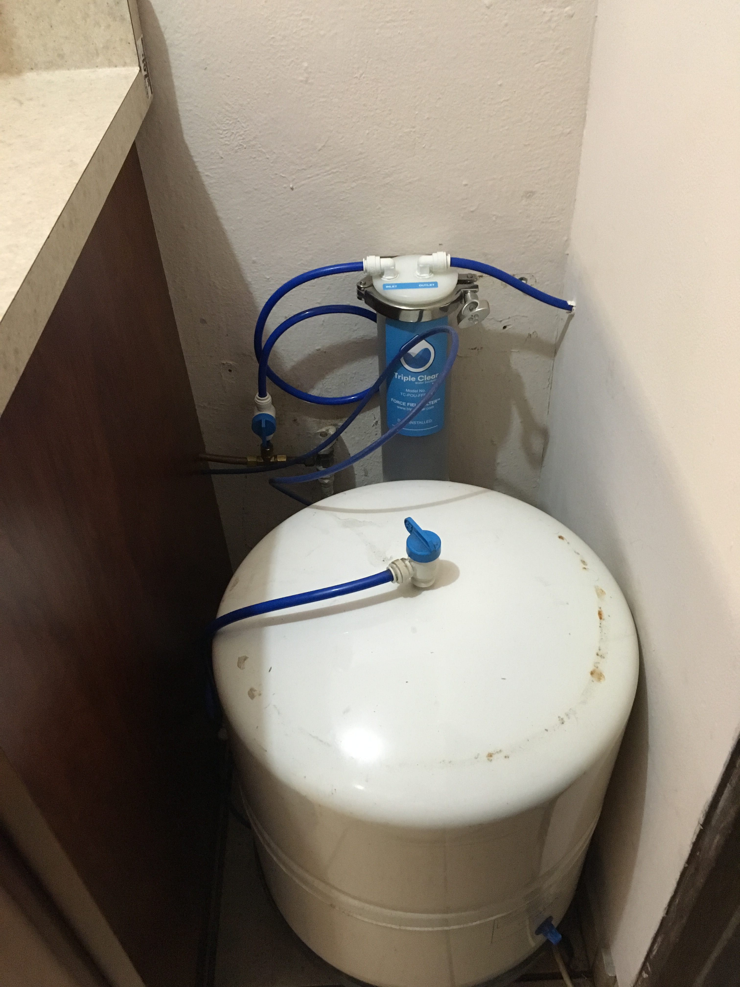
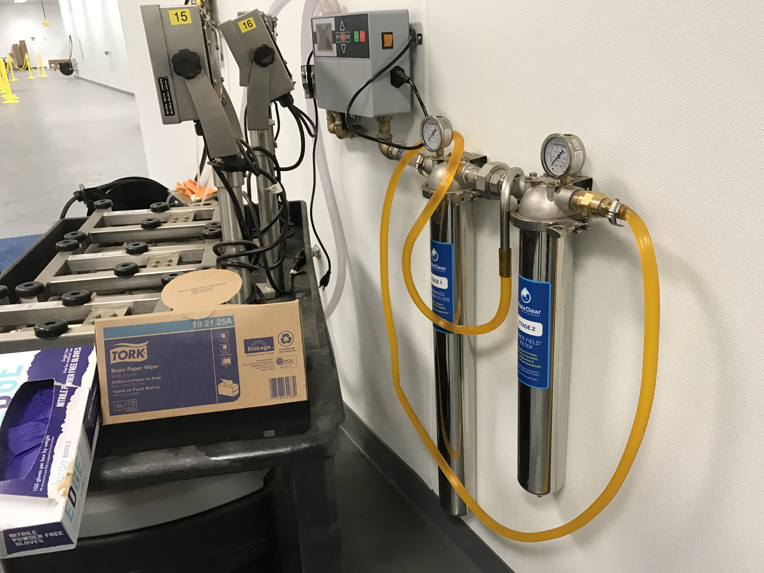
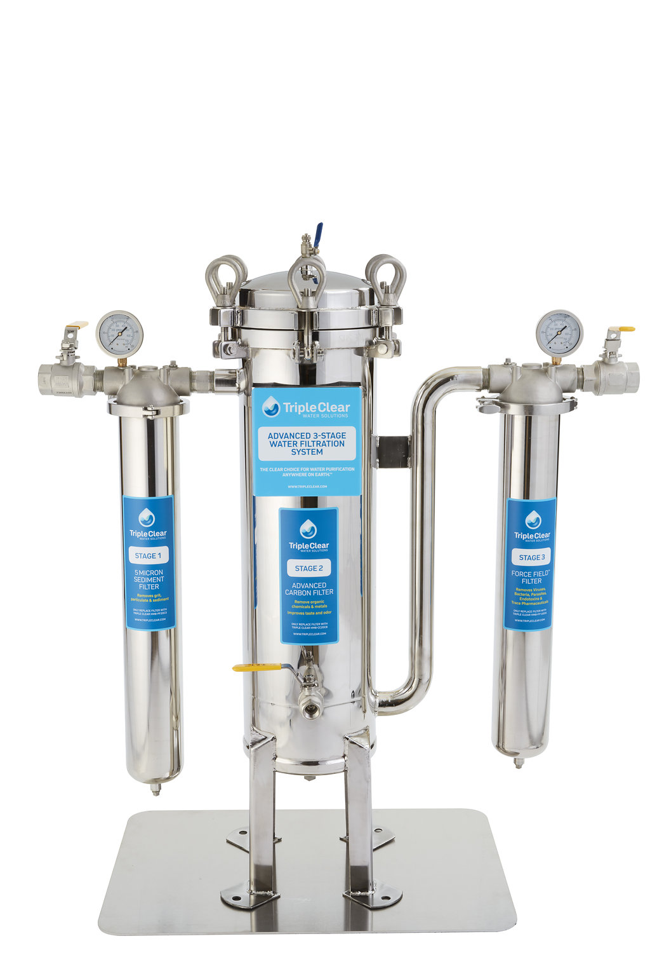
POU Water Purification System
Why do buildings need POU protection? The distribution systems are less than clean…

Slide 19
Point of Use and Bottle Fillers – Northwestern University
The Triple Clear® Force Field filtering technology was employed to reduce bacterial loading in a drinking water fountain at XXXXXX University. A study done in the summer of 2018 showed that > 37.5 % of drinking fountains had detectable levels of Legionella bacteria. 67.5 % of these fountains had bottle fillers with filtration. The filtration within the units was NSF 42 and 53 certified for lead, particulate class 1, chlorine, taste and odor reduction. The study showed that legionella was present both before and after the filter indicating that the filter system did not prevent bacteria from amplifying and/or from entering the storage section of the drinking fountain. In some instances, the Legionella bacteria were much higher after the carbon filter.
Results from the study shows that the while the levels of Legionella bacteria stay relatively constant before the filter they drop after the filter to non-detectable after several weeks.

Slide 20
Point of Use and Bottle Fillers – Northwestern University
Alternative Solutions:
When a drinking fountain system is found to be contaminated it must be remediated. This typically entails a process whereby:
The carbon filter is removed from the system,
A “blank” filter is placed into the system
The fountain is flushed with chlorinated potable water for a minimum of 4 hours
The system is put back into service
The system is tested to insure that the bacteria levels are below standards.
This was done on multiple systems, however, we quickly discovered that the systems were recolonized due to a variety of factors including:
Low usage to unit (low water turnover)
Higher levels of incoming bacteria

Slide 21
Point of Use and Bottle Fillers – Elkay Replacement Filters

Slide 22
Point of Use and Bottle Fillers – Murdock Bottle Fillers
NSF 53
NSF 42
NSF 61
ADA Compliant

Slide 23
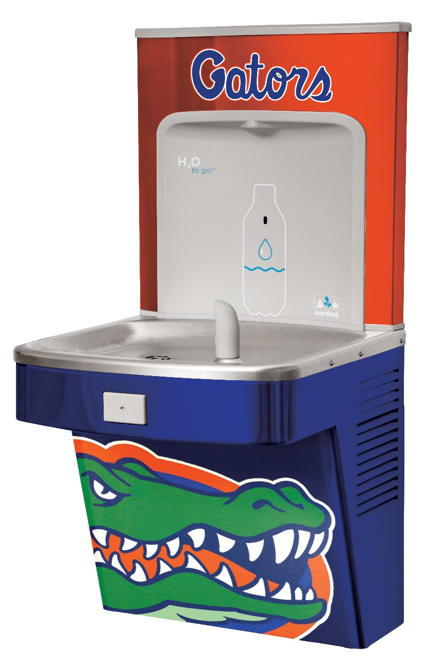
AND... Fully Customizable

Slide 24
AND... Fully Customizable

Slide 25
Marriott Global - Point of Use

Slide 26
Children’s Hospital Of Philadelphia – Point of Use
POU Solution -
Bottle Fillers & Ice Machines

Slide 27
Recap:
Triple Clear Water Solutions is a premier provider of innovative water technologies
TCWS Force Field™ Technology is unique in its ability to:
  Achieve:
    4 & 6 log reduction of Virus, Bacteria, Parasite
    Excellent reduction of heavy metals, trace pharmaceuticals, and cellular debris
  Unlike the competition we offer:
    Minimal Pressure drop
    High flow
    No chemicals
    No electricity
    No wasted water
Perfect for potable water systems and HVAC systems
Available in pre-packaged and custom solutions

Slide 28
Thank you
Questions and for more information –
Please contact:
Mr. Patrick Verwys
Triple Clear Water Solutions, Inc.
1 Little West 12th Street, 5th floor
New York, NY 10015
484-888-9218
patrick@tripleclear.com

Slide 29
AND... Fully Customizable

Slide 30
AND... Fully Customizable

Slide 31
AND... Fully Customizable

Slide 32
AND... Fully Customizable

