Slide 1
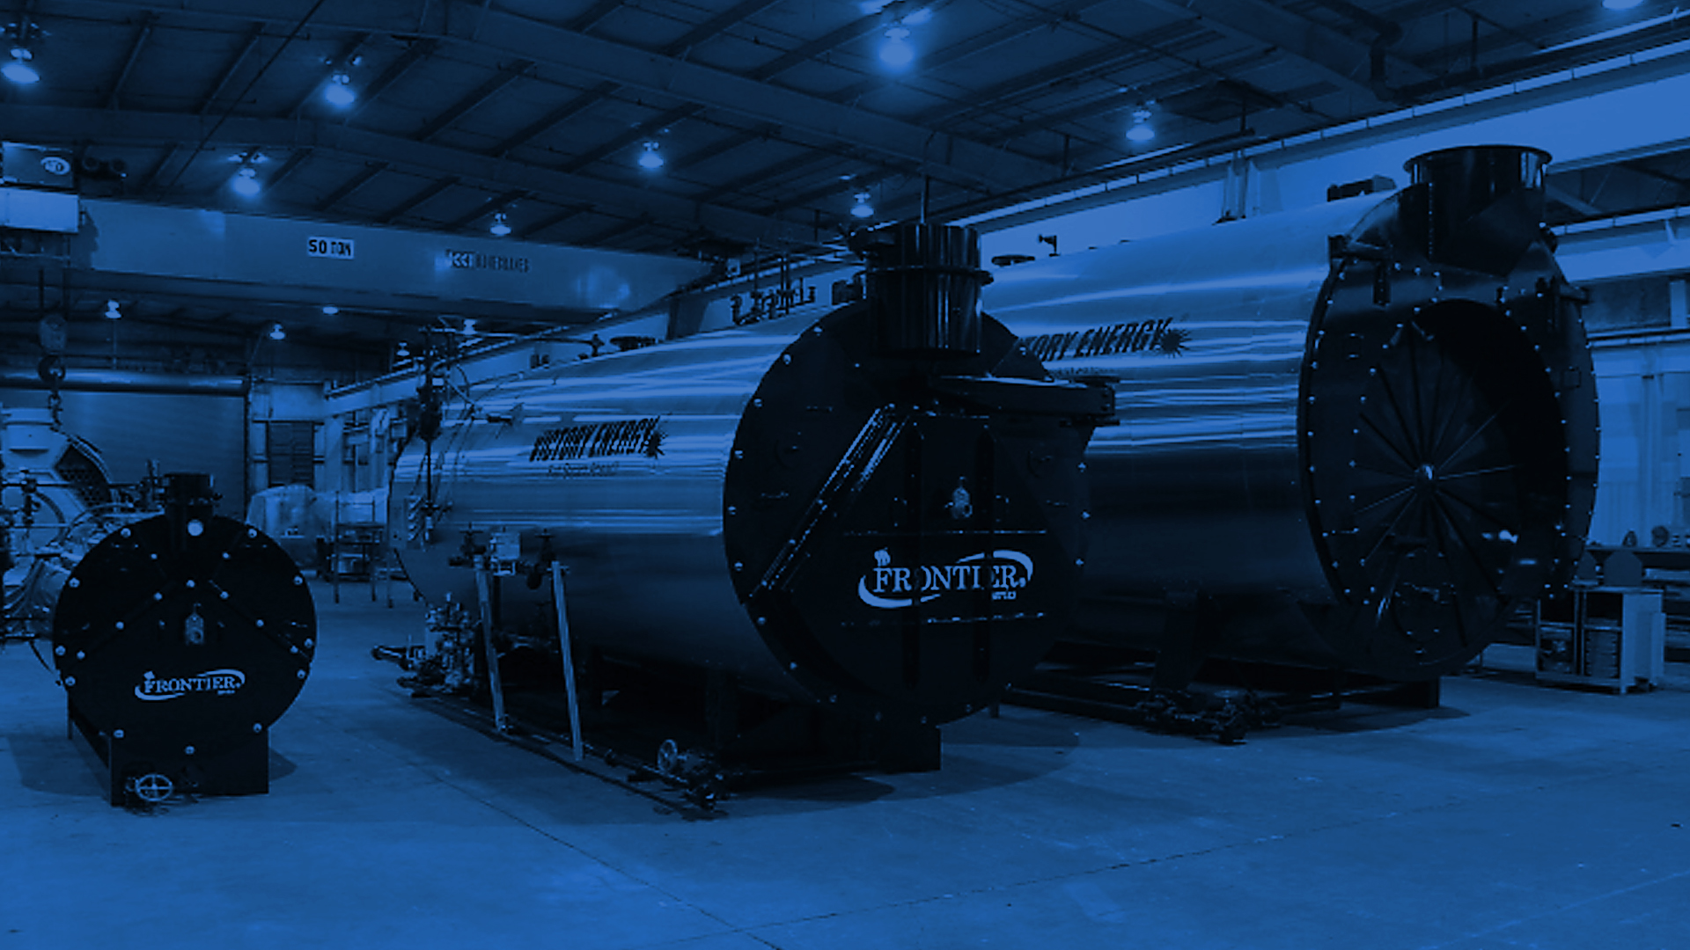
REPRESENTATIVE TRAINING
FIRETUBE “BASICS”

Slide 2
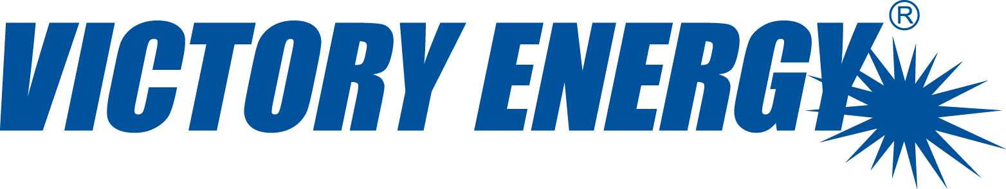
INTRODUCTION

Slide 3
VICTORY ENERGY OPERATIONS, LLC
We take pride in the fact that we are not considered ‘a cookie cutter’ provider. Nor are we strangers to custom engineering or demanding applications. Our leadership is a team of dedicated professionals, each with over 30 / 40 years of experience in the industrial boiler industry. Located in Collinsville, Oklahoma, just 20 minutes north of Tulsa, Victory Energy is able to tap into a highly skilled talent pool.
1999 VEO founded by John Viskup and Jim Sponder
2003 Acquires a license to manufacture watertube boilers
2005 Hires 100th employee
2008 VEO is ranked #1 fastest growing manufacturer in the nation by Entrepreneur Magazine
2009 FRONTIER Firetube wetback production commences
2014 Industrial “VISION” burner product line is introduced
2016 FRONTIER Firetube center furnace three pass dryback product line is introduced
2017 Boiler Steam Test Facility is completed with capability to fully test boilers of capacities up to 100,000 pph.
2018 FRONTIER Firetube two pass dryback product line is introduced
2019 FRONTIER Firetube four pass dryback product line is introduced

Slide 4
KEY CONTACTS – FRONTIER FIRETUBE TEAM
Al Wasinger
VP of Operations
Oversees all design, purchasing, production and shipping (Collinsville and Cushing plants).
Manages firetube team including sales, Rep development,
project management and engineering.
Oren Hardesty
National Sales Manager
Quotations, handles all firetube waste heat boiler (HRSG) RFQ’s.
Jim Atkinson
Regional Sales Manager - Central and Eastern Region
Quotations, Rep recruitment, Rep training and presentations.
Carson Lushin
Regional Sales Manager- Western Region
Quotations, Rep recruitment, Rep training and presentations.
Clay Viskup
Sales Engineer
Quotations, Rep configurator / pricing tool development.
Sara Rawn
Project Manager
Handles after-sale functions including transition of projects from
order, to submittal, to production.
Charles Swallow
Marketing Manager
Website, social media, literature, trade shows, promotional items, etc.

Slide 5
PRODUCTS MANUFACTURED BY VICTORY ENERGY
Firetube Boilers
Industrial Watertube Steam Boilers (O, D and A Style)
Heat Recovery Steam
Generators (HRSG)
High Temperature Hot Water Generators (HTHW)
Waste Heat Boilers (WHB)
Economizers
Industrial Burners / Controls
Auxiliary Equipment
Water Level Equipment

Slide 6





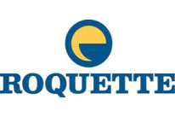

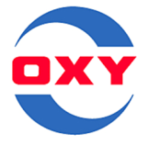






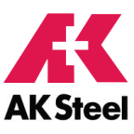





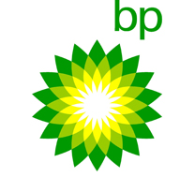

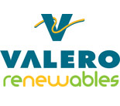
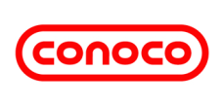
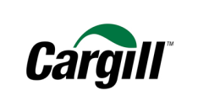
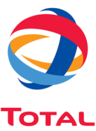
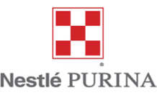
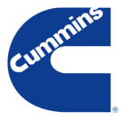

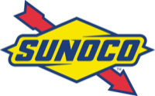



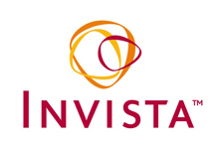
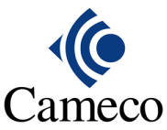

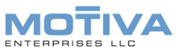

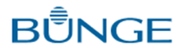





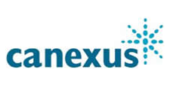
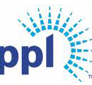

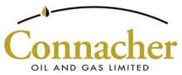

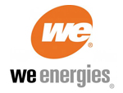
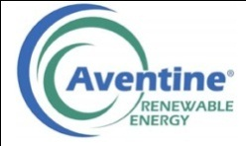


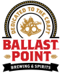




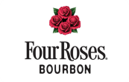
THE COMPANY WE KEEP
University of Colorado

Slide 7
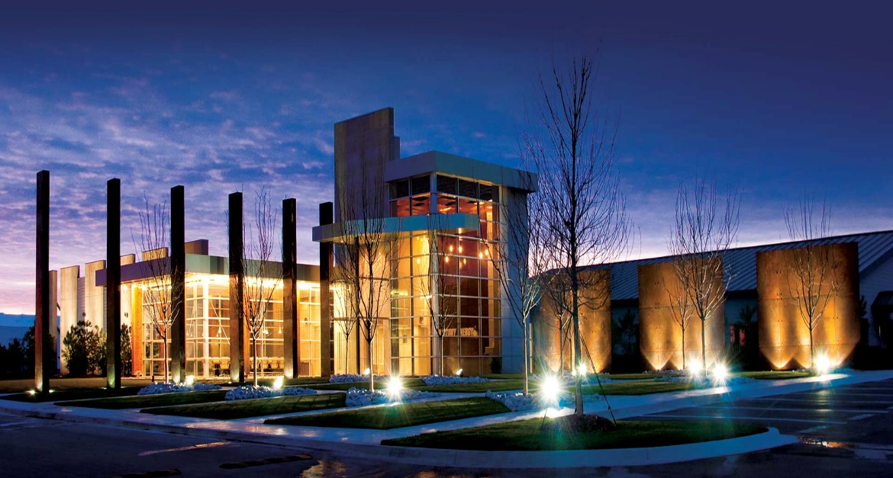
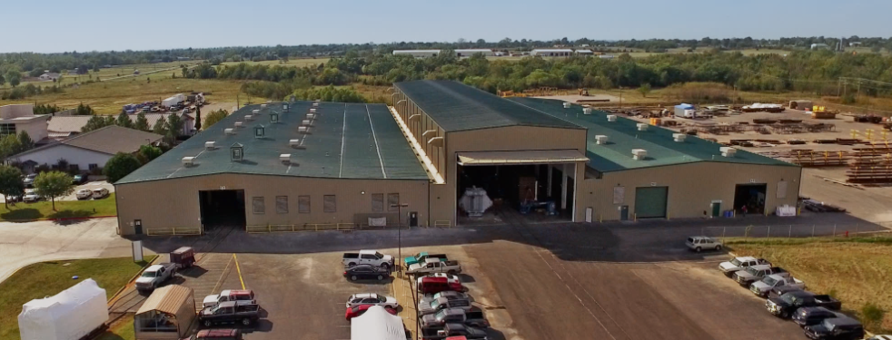
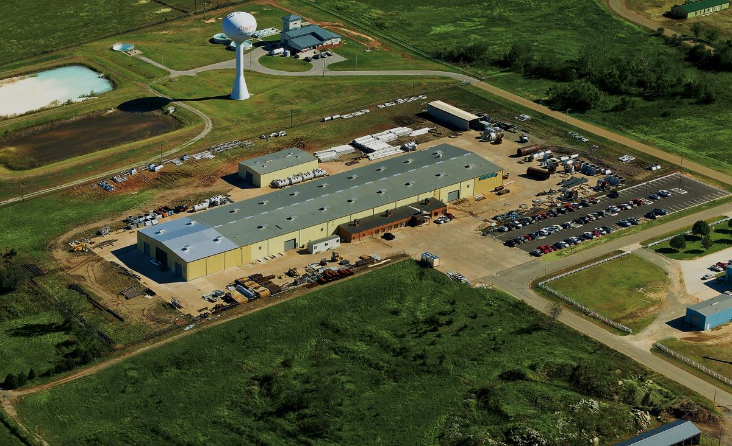
MANUFACTURING FACILITIES EQUIPPED TO MEET DEMANDS

Slide 8
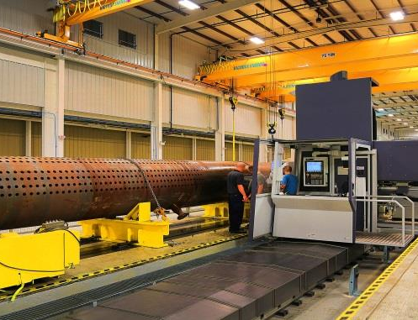
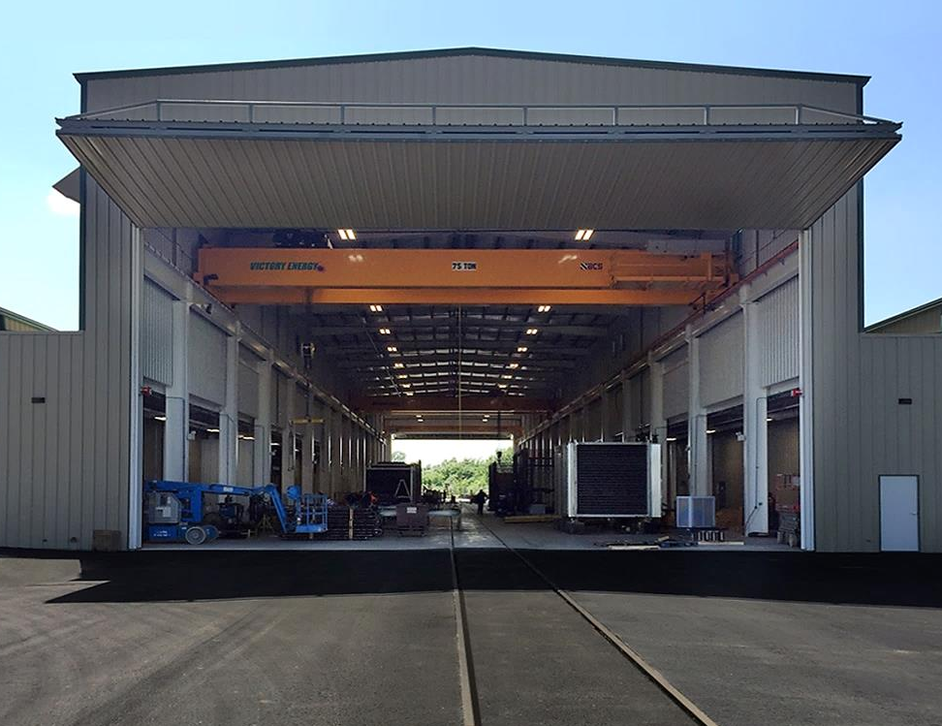
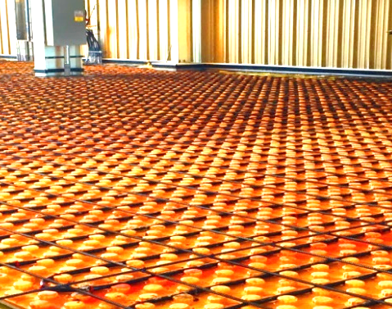
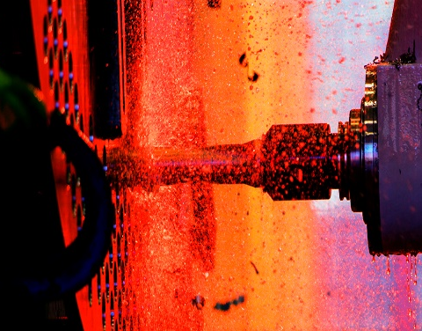
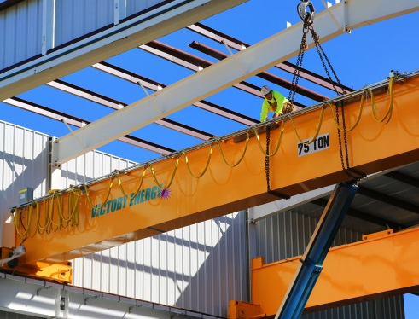
INVESTED IN MANUFACTURING EFFICIENCY

Slide 9
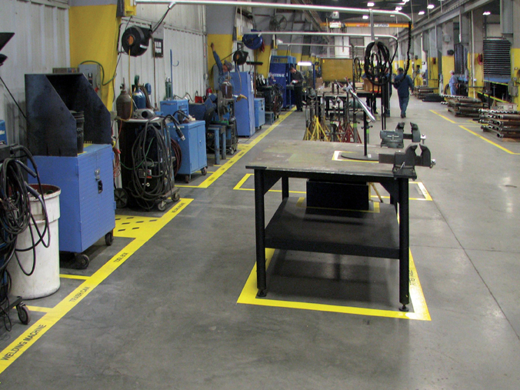
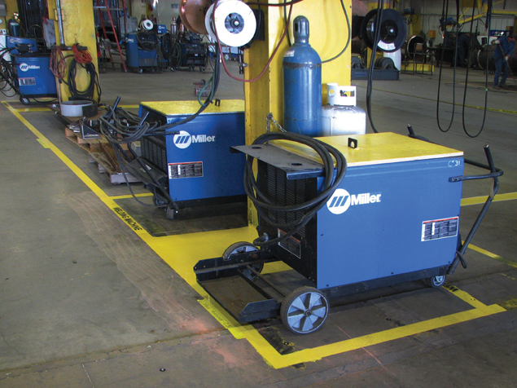
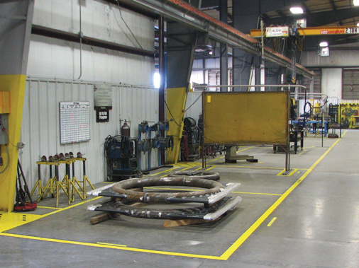
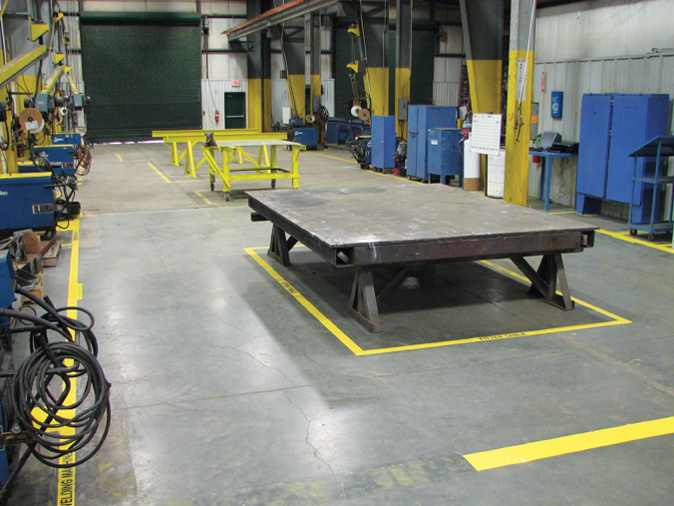
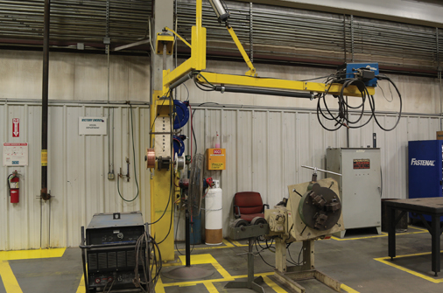
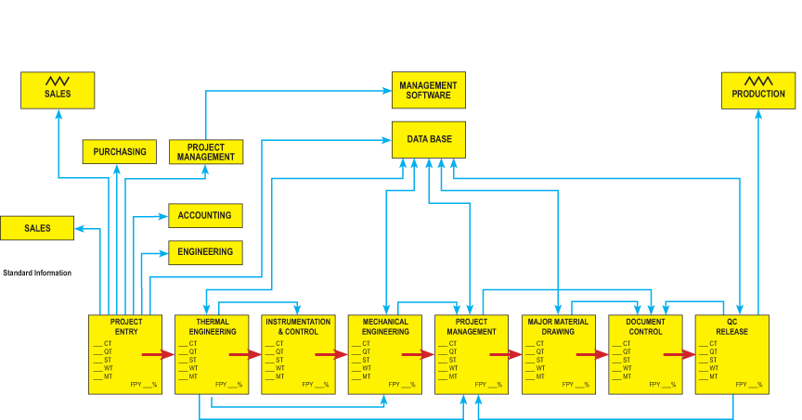
5S LEAN & CLEAN – MORE THAN A BUZZ WORD TO US
1 - SORT
2 - STRAIGHTEN
3 - SHINE
4 - STANDARDIZE
5 - SUSTAIN

Slide 10
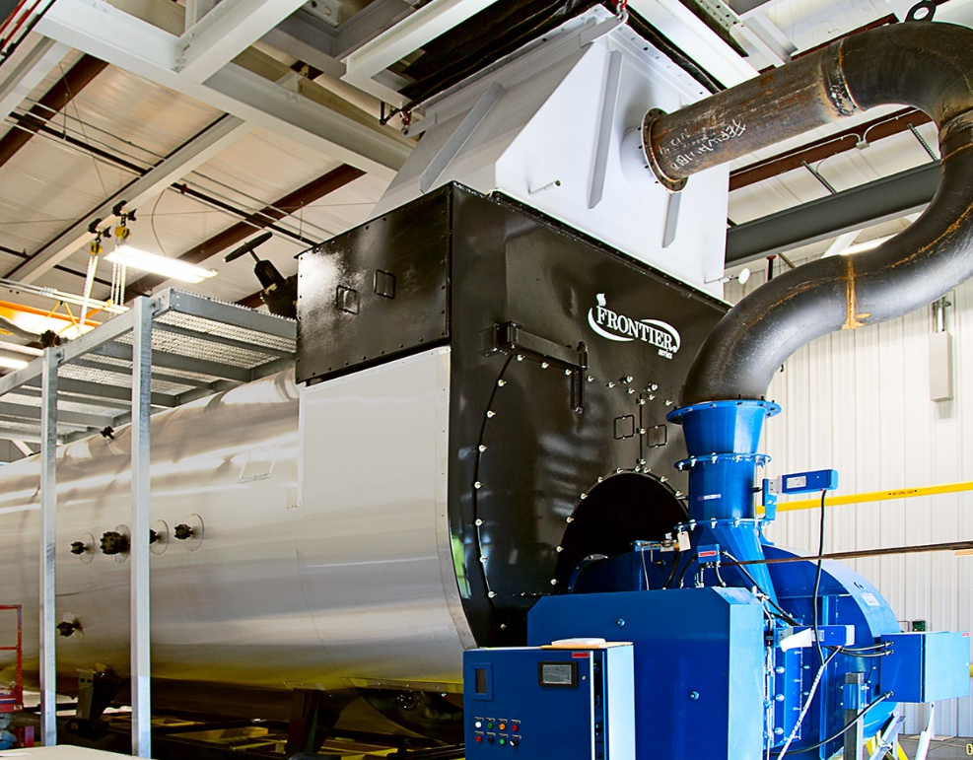
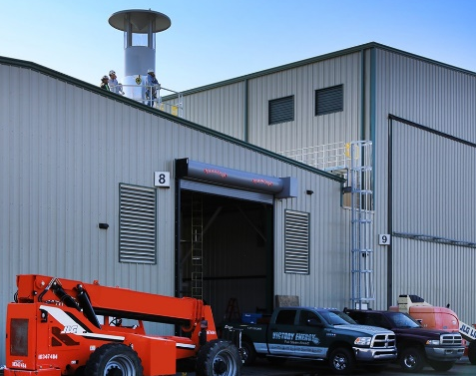
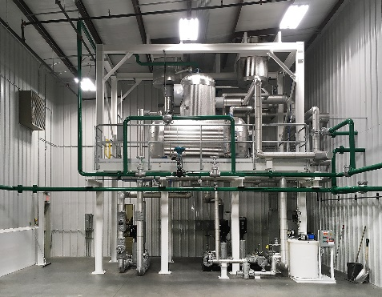
STEAM TEST FACILITY – TEST UP TO 2,500 HP / 86,250 PPH
The Victory Energy Steam Test Facility is a true boiler industry first - a fully functional steam test facility that simulates a boiler plant. If required, complete boiler / burner operational testing can be done prior to shipping.
6,500 Square Feet
Water Purification System
Control Room
Boil-out, Waterside Prep
Fuel Curve Programming
Emissions Testing

Slide 11

FIRETUBE BOILER BASICS
(TYPES & CONFIGURATIONS)

Slide 12
WHAT IS A FIRETUBE BOILER?
In a watertube boiler, the water is contained inside the tubes. A firetube boiler has fire or products of combustion in the tubes. It is commonly built in two, three, and four pass configurations. Firetube boilers are also offered as single pass designs for specialty applications such as waste heat boilers (WHB) or heat recovery steam generators (HRSG).
On applications fired by gaseous fuels such as natural gas and LP gas or oil (#2, #4, #6), heat transfer from the products of combustion to the water surrounding the tubes begins in the first pass with a large tube also known as the furnace or “morrison tube.” The furnace contains the flame from the burner and needs to be large enough so that the flame doesn’t touch or impinge on the furnace walls or rear of the boiler. Impingement causes numerous problems which can include carbon monoxide (CO) production in addition to damage to components which are inadequately cooled by water.

Slide 13
WHAT IS A FIRETUBE BOILER?
From the furnace a.k.a. first pass, flue gases which are the products of combustion in the furnace then travel through 2nd, 3rd or even 4th passes of much smaller tubes- typically in diameters ranging from 1.5” to 3.0” – to extract the maximum heat possible without condensing inside the boiler.
Victory’s firetube product line is called the FRONTIER Series.

Slide 14
FIRETUBE BOILER APPLICATIONS
Hot Water Space Heating
Low Pressure Steam Heating
Low Pressure Steam Process
High Pressure Steam Process
Notes:
Examples:
HOT WATER- hydronic heating. Much of this market has been taken over by condensing boilers.
LOW PRESSURE STEAM (less than 15 psi operating pressure, max 12 psi)- heating, typically associated with older cities and larger commercial buildings
LOW PRESSURE STEAM PROCESS (less than 15 psi, max 12 psi)- processes not requiring high temperatures that would necessitate high pressure steam or humidification
HIGH PRESSURE STEAM PROCESS- process requiring approx. 13 psi or higher boiler operating pressure up to approx. 300 mpsi operating pressure.

Slide 15
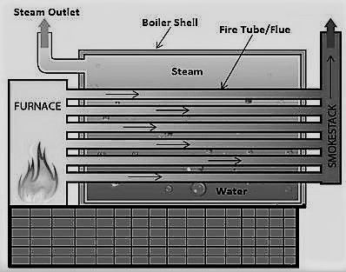
FIRETUBE BOILER TYPES
HRT (horizontal return tubular)
The HRT is a very basic, single pass design that has been in use for a long time. It is a single pass design where the boiler vessel sits on top of a rectangular furnace constructed of steel, refractory brick, or a combination of the two.
The products of combustion flow up from the furnace to one end of the boiler, down the tubes horizontally and out the stack at the opposite end. The HRT design is commonly used for solid fuel applications. It can be constructed to higher design pressures than a traditional “scotch” firetube design.

Slide 16
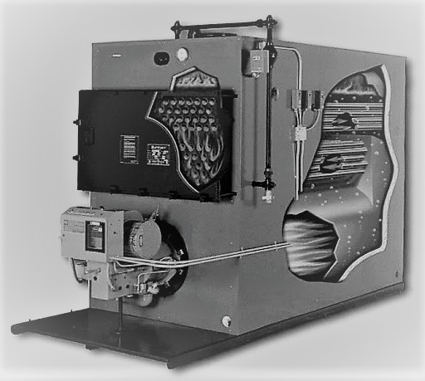
FIRETUBE BOILER TYPES
Firebox
Similar to the HRT, this is an older design that in the past was designed with a refractory chamber at the bottom. More recent designs have incorporated at least a partially water-cooled furnace and are built in two and three pass configurations.
Generally, this product is used for hot water and low pressure steam heating applications due to design pressure limitations (typically limited to 15 psi steam). It is also used for solid fuel applications.

Slide 17
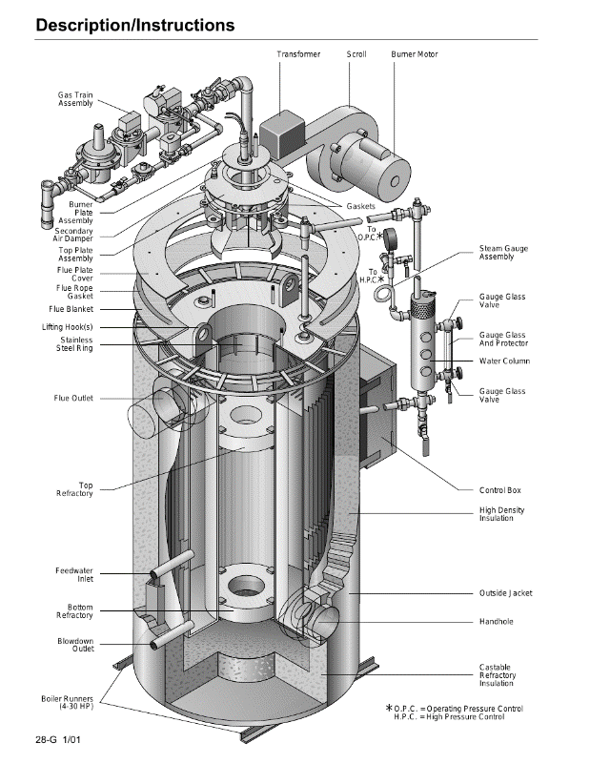
FIRETUBE BOILER TYPES
Vertical tube or tube-less
Vertical boilers are built in both tubed and tubeless designs, this design has been popular in the laundry business for a long time and more recently micro-brewery applications. In some designs, the burner fires horizontally or through the side of the boiler while others utilize a burner down-firing from the top of the boiler (shown here).

Slide 18
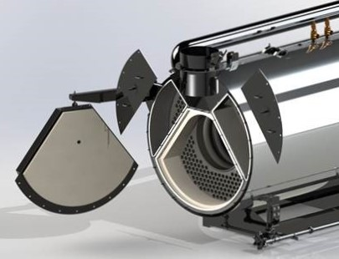
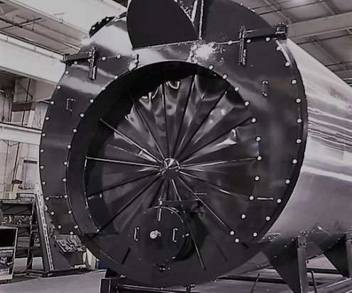
FIRETUBE BOILER TYPES
Scotch Marine
Characterized by a large tube which is the furnace (1st pass), this design utilizes smaller tubes in the 2nd pass in two pass designs, more tubes in the 3rd pass of a three pass design, and yet more in a four pass design. The majority of heat transfer occurs in the furnace and the 2nd pass. Consequently, the 2nd pass is where rifled tubing (vs. plain tubing) is most effective in terms of improving boiler efficiency.
DRYBACK – 3-PASS
WETBACK – 3-PASS

Slide 19
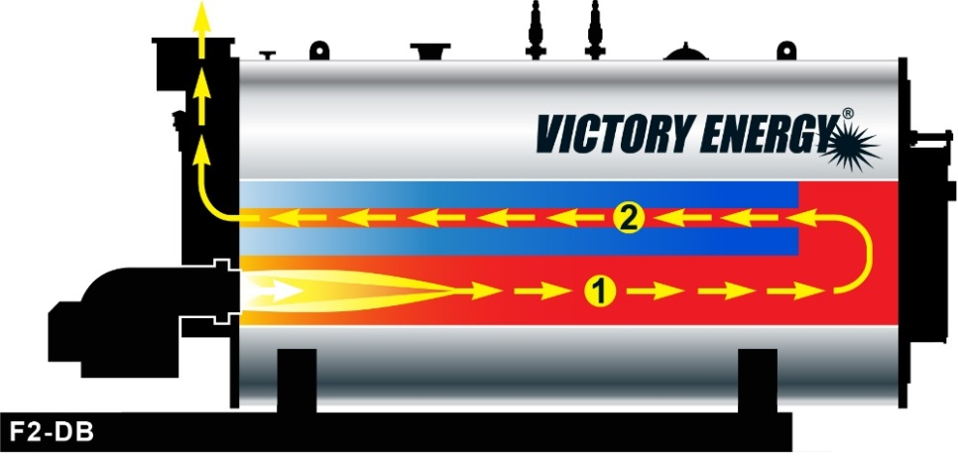
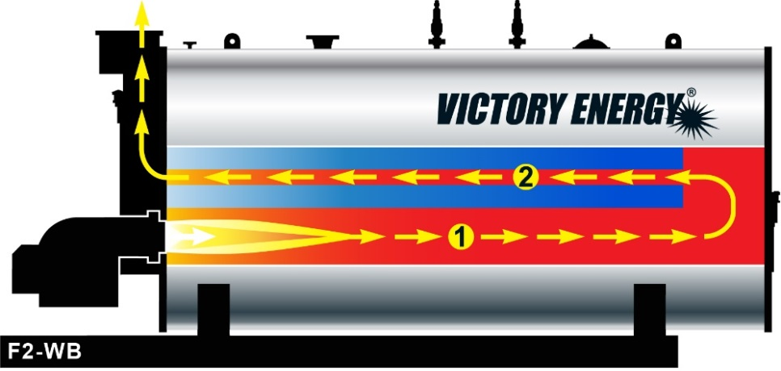
FIRETUBE BOILER – SCOTCH MARINE, 2-PASS
DRYBACK
WETBACK

Slide 20
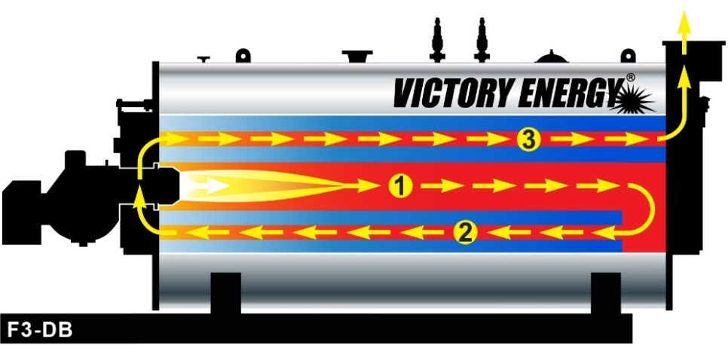
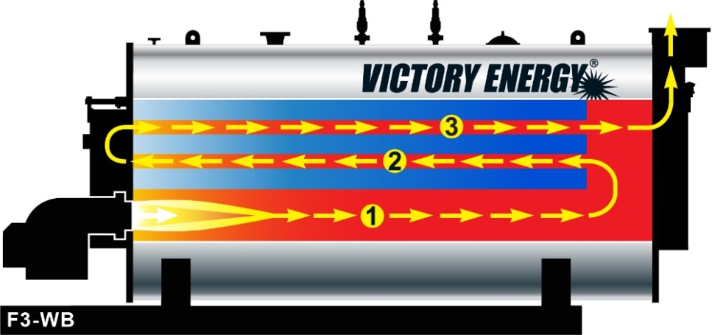
FIRETUBE BOILER – SCOTCH MARINE, 3-PASS
DRYBACK
WETBACK

Slide 21


FIRETUBE BOILER – SCOTCH MARINE, 4-PASS
DRYBACK
WETBACK

Slide 22
STANDARD FRONTIER FIRETUBE PRODUCT OFFERINGS
2-Pass Wetback* with Integral Economizer, 200-2500 HP**
2-Pass Dryback* (Integral Economizer option available), 200-2500 HP**
3-Pass Wetback* (Integral Economizer option available), 200-2500 HP**
3-Pass Dryback With Center Furnace (Integral Economizer option available), 50-1500 HP**
4-Pass Wetback* 200-1500 HP**
4-Pass Dryback With Center Furnace, 200-1500 HP
*Wetback designs are typically not offered below 200 HP
**2-pass and 3-pass designs utilize Extended Surface “Rifled” Tubes in the 2nd pass

Slide 23

FOLLOW A LEADER!

