Slide 1
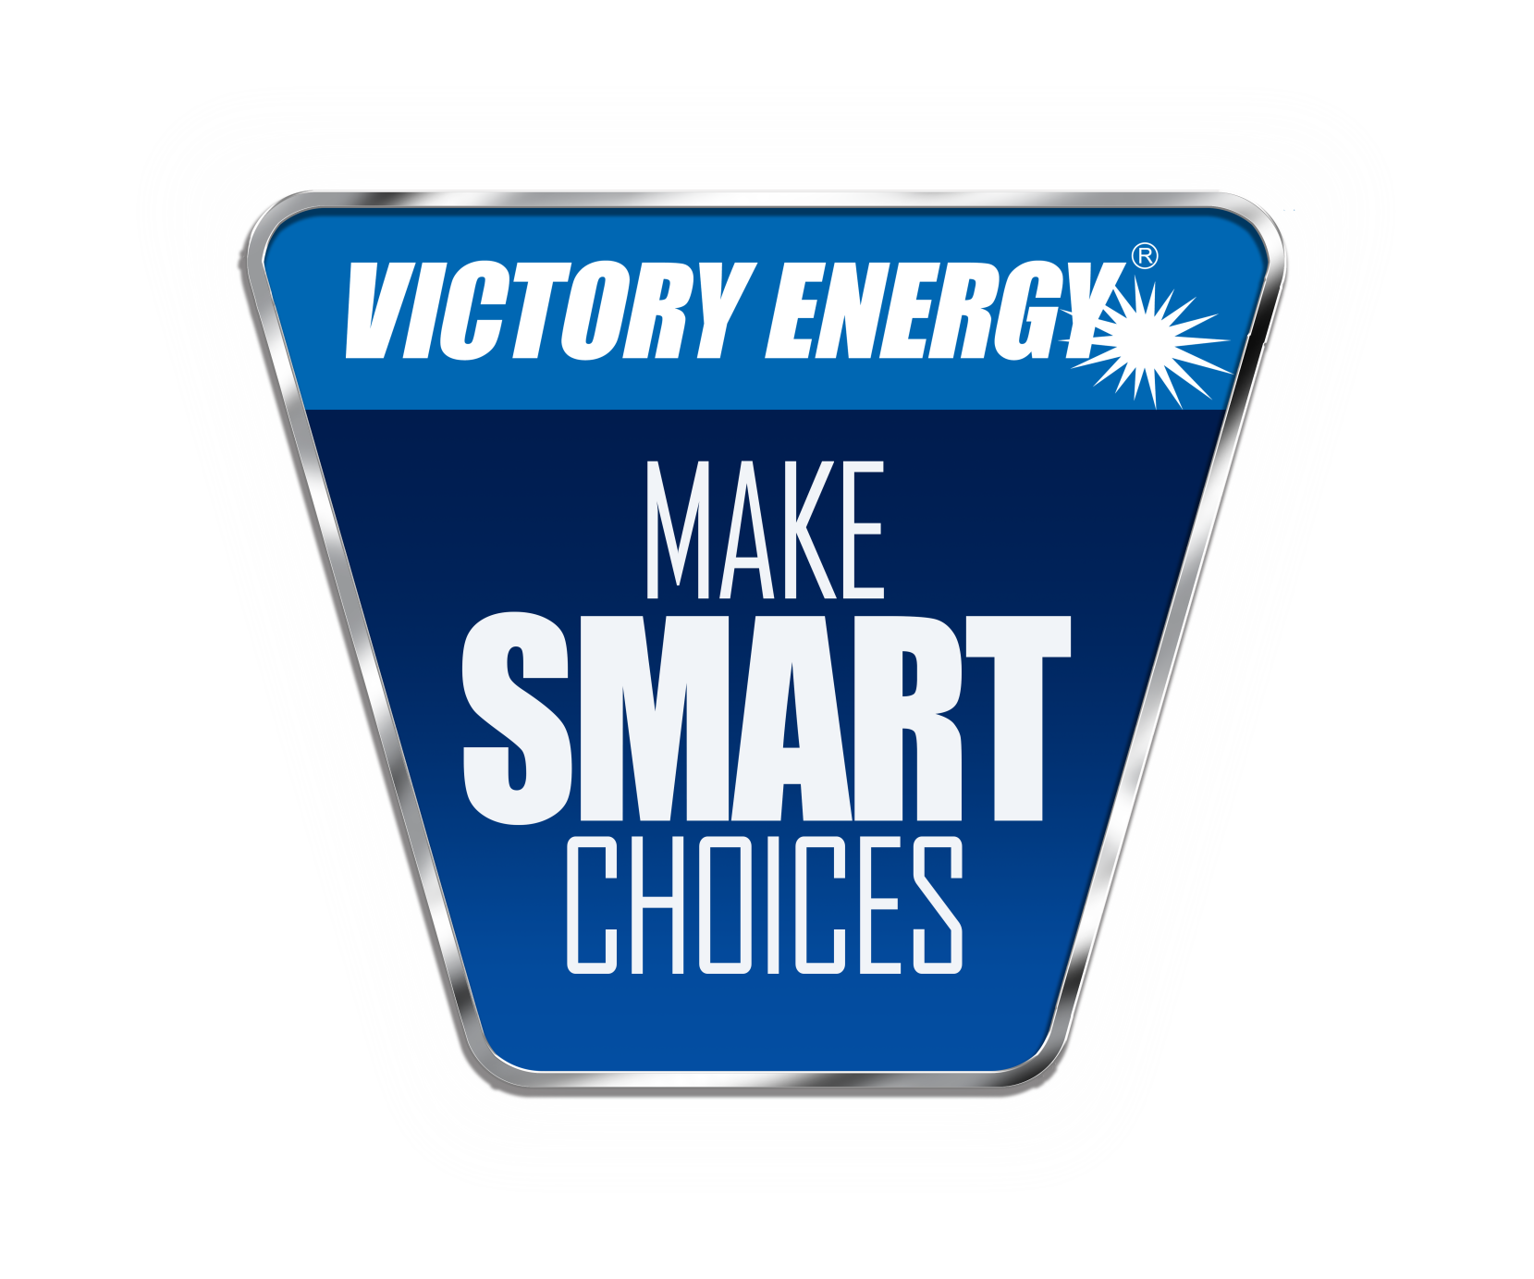

Slide 2
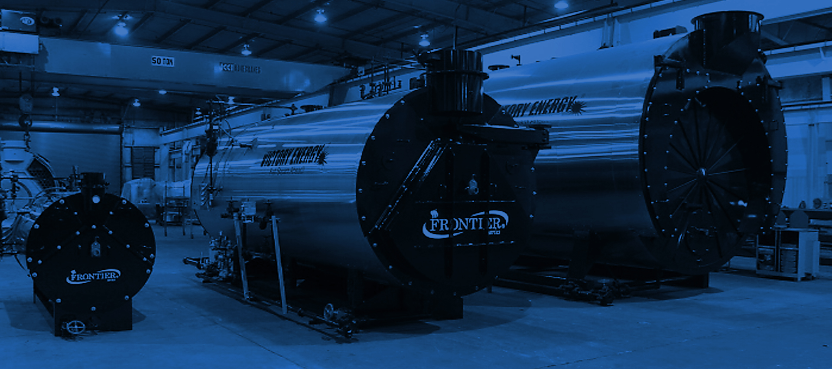
What Drives Us!
Our mission:
… to provide our customers
the best Boilers, Burners, HRSG’s,
Heat Transfer Solutions and Services.

Slide 3


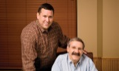
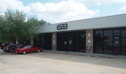
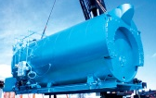
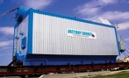
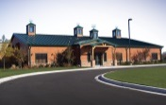

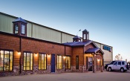
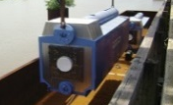



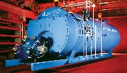
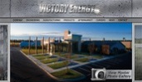
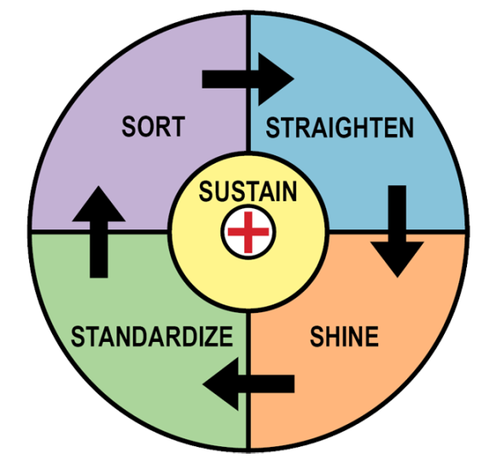
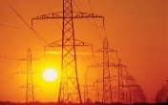
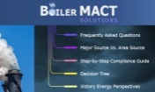
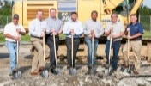
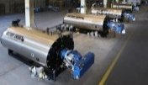
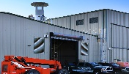
A Company Built to Last
1 9 9 9
2 0 0 0
2 0 0 1
2 0 0 3
2 0 0 4
2 0 0 5
2 0 0 6
2 0 0 7
2 0 0 8
Victory Energy Founded by
John Viskup and Jim Sponder.
First Boiler Sold.
Victory Energy Relocates
to its
2nd Location.
3rd VEO Location.
VEO = Firetube Wetback Boiler Rep
VEO Acquires License to Manufacture Watertube
Boilers
Corporate Headquarters Completed
in Collinsville, OK
Victory Energy Hires its
100th
Employee
2nd Manufacturing Facility – dedicated to Firetube
boiler Production
VEO Ranked #1 Fastest Growing Manufacturer
in the Nation
BY Entrepreneur Magazine
1st Barge Shipment
2 0 0 9
2 0 1 0
2 0 1 2
2 0 1 3
2 0 14
2 0 1 5
2 0 1 6
2 0 1 7
New CNC tube sheet drilling machine.
Firetube Pulse Line
New Headquarters
Firetube Wetback production
VEO Launches Global Marketing Initiatives with
New Website
and Social Media Campaign.
Victory Energy Launches
Major GT-HRSG
Initiative
Intro Combustion Solutions
VEO Launches BoilerMACT.org Website
Manufacturing Expansion
Begins
New Boiler
Steam Test Facility Complete
New VEO Website launched
5S Lean Practices and Value Stream Mapping

Slide 4





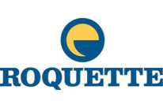








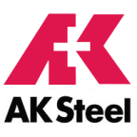







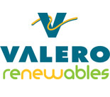
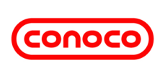
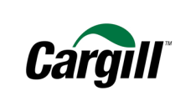
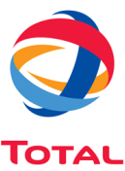

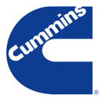

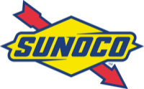






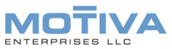

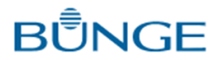

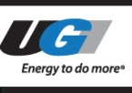




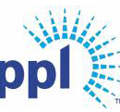
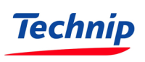


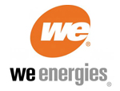
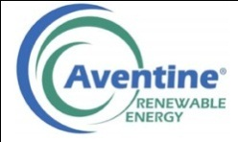








The Company We Keep
University of Colorado

Slide 5
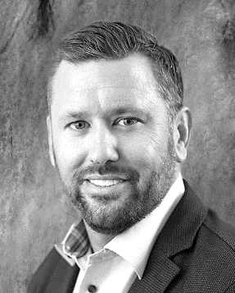
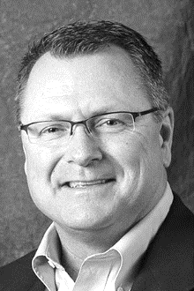
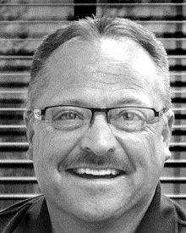

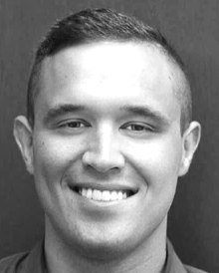


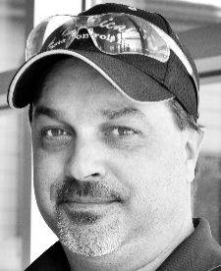

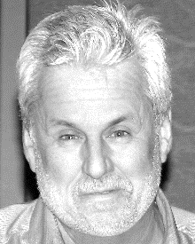
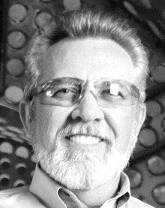

The Firetube Steam Team!
JOHN VISKUP
CEO / PRESIDENT
AL WASINGER
VP / OPERATIONS
OREN HARDESTY
NATIONAL SALES MGR – PACKAGE BOILERS
JIM ATKINSON
REGIONAL SALES MGR – FIRETUBE DIVISION
CLAY VISKUP
SALES APPLICATION ENGINEER
ALAN RIDGWAY
DESIGN ENGINEER
SARAH RAWN
PROJECT MANAGEMENT
TONY BASORE
PLANT SUPERINTENDENT
MORGAN MARKEY
DESIGN ENGINEER
BILL FIELD
MARKETING AND COMMINICATIONS
CHARLES SWALLOW
MARKETING MANAGER
ERIK RICHISON
MARKETING COMMUNICATION SPECIALIST

Slide 6
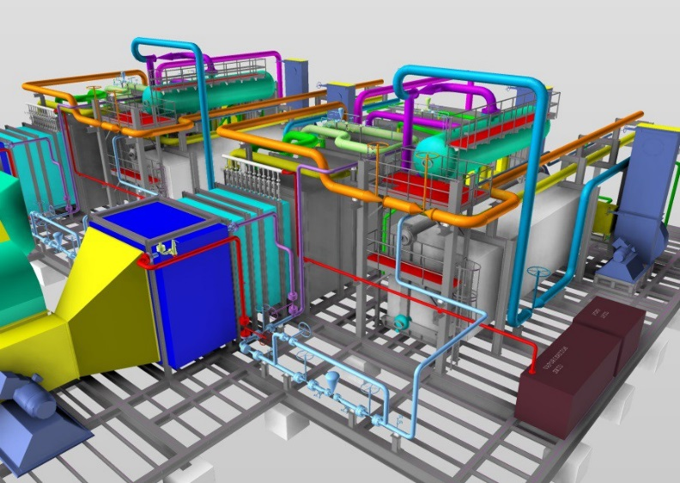
Victory Energy - Engineering
3 Ph.D.’s on staff and 12+ professional engineers who specialize in boilers and all types of heat transfer solutions.
Victory is devoted to innovation with continued investment in R&D.
Detailed engineered product models created by Victory engineers and designers provide for standard product designs.
Engineers work closely with client to customize and develop the most optimized solution from standard designs

Slide 7
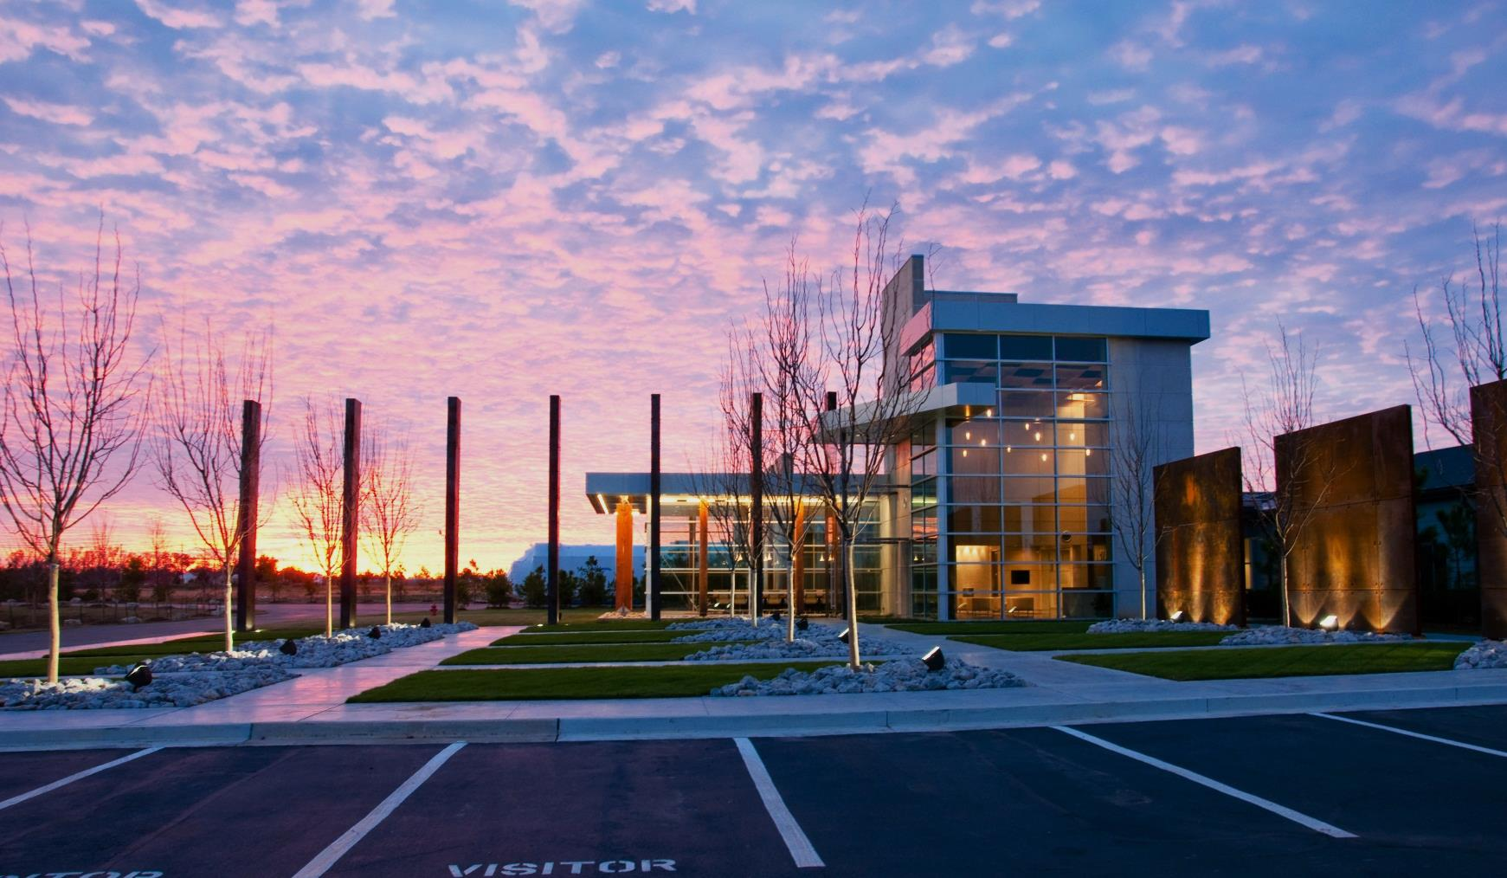
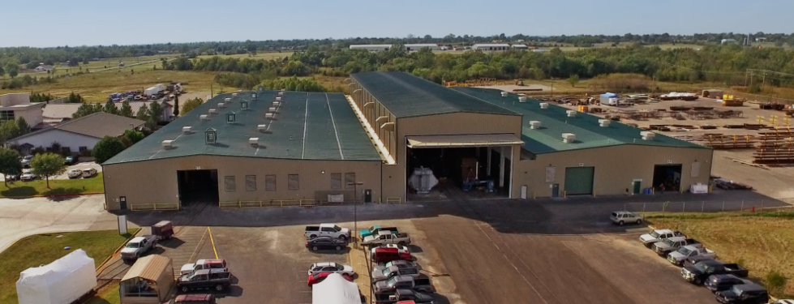
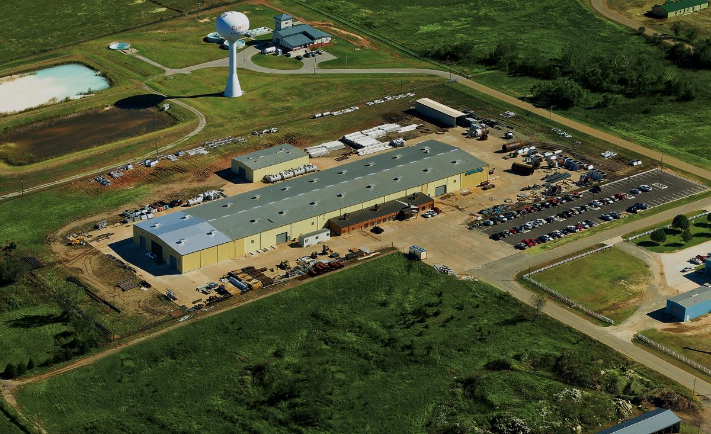
Manufacturing Facilities Equipped to Meet Market Demand

Slide 8
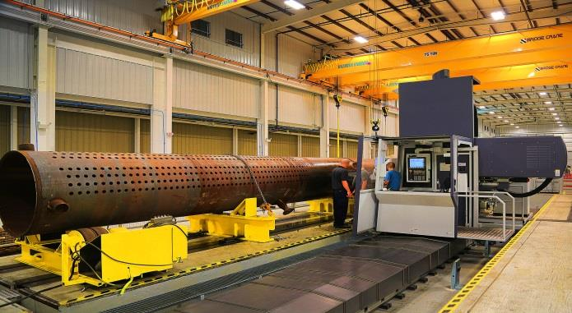
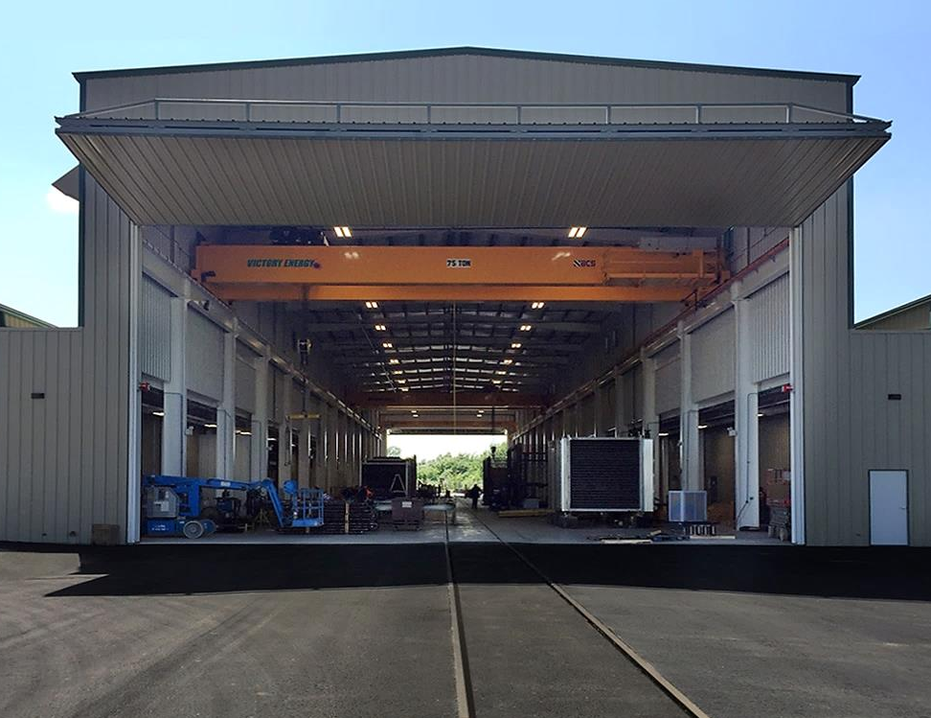
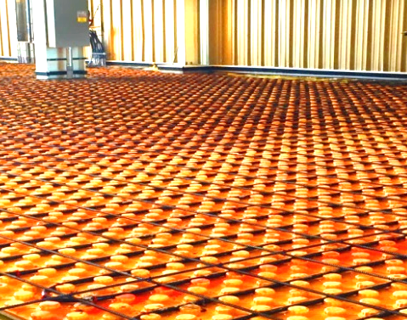
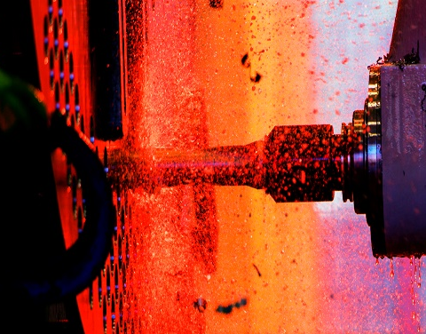
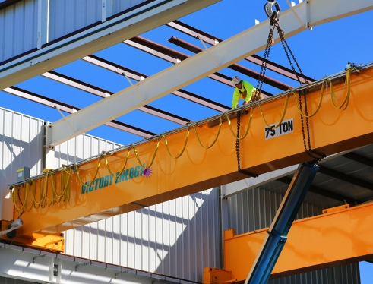
Invested in Manufacturing Efficiency

Slide 9
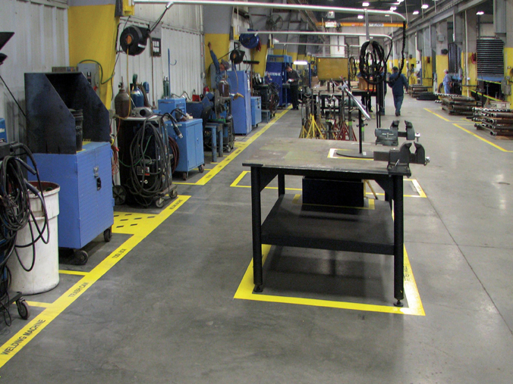
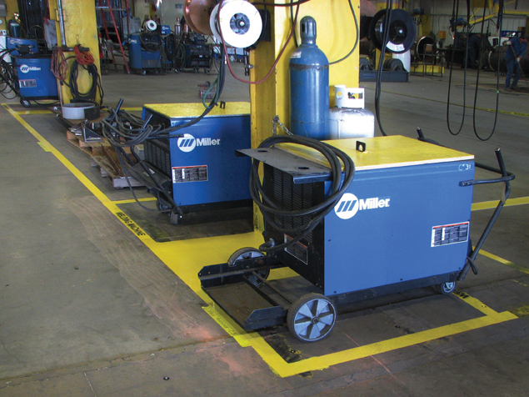




Extra Lean, Extra Clean – (5S) Lean, Not Just a Buzz Word to Us
1 - SORT
2 - STRAIGHTEN
3 - SHINE
4 - STANDARDIZE
5 - SUSTAIN

Slide 10



Steam Test Facility - Able to Test Up to 2,500 HP / 86,250 lbs./hr.
6,500 Square Feet
Water Purification System
Control Room
Emissions and Performance Testing
Boil-Out

Slide 11








A Full Firetube Line - Fired and Heat Recovery boilers

Slide 12



Market-Driven Product Development

Slide 13




The Power of Vertical Integration – Combustion & Controls Solutions

Slide 14

VEO Pulse Line Extends Lean Manufacturing to Firetube Production.
Waste is minimized.
Emphasis on consistency and repeatability in the manufacturing processes and quality in every boiler produced.
A logical progression from order entry and engineering to final assembly where trim, burner, fuel train(s), and controls are installed and wired.
Production bottlenecks are avoided.
The result?
INDUSTRY BEST quality and lead time!

Slide 15


In-House Logistics – A Game Changer!
Boiler loadout
Shrink wrapped and ready for delivery

Slide 16
Standard Frontier Firetube Product Offerings
2-Pass Wetback with Integral Economizer, 100-2500 HP*
2-Pass Dryback (Integral Economizer option available), 200-2500 HP*
3-Pass Wetback (Integral Economizer option available), 200-2500 HP*
3-Pass Dryback With Center Furnace (Integral Economizer option available), 50-1500 HP*
4-Pass Wetback 200-1500 HP*
4-Pass Dryback With Center Furnace, 200-1500 HP
*Two pass and 3 pass designs utilize Extended Surface “Rifled” Tubes in the 2nd pass

Slide 17

STANDARD
QUALITY FEATURES

Slide 18



Stainless Steel Jacket
Optional painted jacket available upon request

Slide 19



Enhanced Heat Recovery System
All 2-pass boilers include a shop-assembled enhanced heat recovery system which is also available for 3-pass boilers.
Low fire side pressure drop for better performance and minimal blower HP requirement.
Retains boiler footprint with minimal increase to height
Efficiency comparable or superior to 4-pass boilers without high back pressure and minimal difference
in tubesheet temperatures.
Feedwater is preheated 50-70° above deaerator temperature, accelerating steam production and minimizing stress on components
Notes:
Fuel to steam efficiency of 2-pass exceeds any 3 & 4 pass regardless of heating surface area. Feedwater at 5psi can pickup 25psi+ on average. Significant drop in flue gas temp to 260F, but well above the dew point.

Slide 20

Extended Surface Rifled Tubes
Extended Surface Rifled tubes used in 2nd pass only.
Increase heating surface 23% over standard tubes.
Increase efficiency 1 - 2% over standard tubes.
Heavy wall 12 gauge tubes
(.105" wall thickness + rib height = .150")
12 gauge tubes

Slide 21

Thicker Tubesheets
NEVER built to ASME minimum standards
3/4" to 1.0" minimum thickness on tubesheets.
Thicker tubesheets promote more contact area between the tubes and tubesheets. This significantly reduces tube leaks, upon start up and over the service life of the boiler.
3/4" to 1.0" thickness

Slide 22

“Ring Groove” in Tubesheets- robust tube-to-tubesheet connection
Victory Energy incorporates a practice more commonly utilized in the industrial watertube manufacturing process.
During pre-assembly and after the tubesheet is drilled on our CNC 5-axis mill (shown during finishing of a watertube boiler drum), we add a 1/16” serration or “ring groove” on the inside of the tube hole as a final step.
When the tubes are installed, the tube ends expand into the ring groove.
RESULT is a better seated tube end and a stronger joint at the tube connection to the tubesheet with a reduced likelihood that the tubes can be loosened at this vital connection due to thermal stress or other factors.
GOAL is to eliminate the need for re-rolling, re-beading, or re-flaring of tube ends.

Slide 23

Wall-to-Wall Super Structure
The VE tubesheet design utilizes a tube ligament design (shortest distance between tube hold edges) which is often greater than the competition - never less than ¾”.
Thicker tubesheets and ligaments eliminate costly repairs - re-rolling, re-beading or re-flaring tube ends.
The benefit is better tube sealing and longer tubesheet life.
More space between tubes reduces temperature stratification in the boiler and promotes better internal circulation reducing the possibility of “hot spots”.

Slide 24

Socket Welded Fittings
Frontier boilers do not use couplings
in water or blowdown piping.
All joints are slip-on flanges.
Elbows and T's are socket -welded for the
Wetback series.
Crosses have nipples and caps for cleaning access.
Notes:
100 hp & below use threaded fittings.

Slide 25

Steel covering over door insulation
Most manufacturers spray a hardener on top of the ceramic fiber which insulates the split
davited fireside access doors. The hardener and insulation can degrade over time or be easily damaged during routine annual service.
Victory Energy includes a rugged steel covering.

Slide 26


“Customer-friendly” from the get-go.
Project #
Customer
Part #

Slide 27

Advanced Combustion Technology – All Burner Manufacturers
Low Excess Air to Maximize Combustion Efficiency
Low NOx, Ultra Low NOx
Linkage-less Control
- ”set it and forget it”
Maximum Efficiency and Minimum Maintenance
Heavy-duty
boxed tube skid

Slide 28



Multiple Pass Designs
2-Pass
3-Pass
4-Pass

Slide 29

Wetback Design - Highlights
The wetback design is the original VEO firetube product offering.
First 3 pass unit manufactured in 2009- focus on demanding industrial users.
2 pass with integral economizer (shown here) introduced in 2012
Stainless steel jacket is standard.

Slide 30

3 Pass Wetback Design
Three different tubesheets at the rear of the boiler for furnace and tubes attachment.
Reversal chamber from furnace to tubes is water backed eliminates expensive maintenance and repair.
No refractory issues.
2
3
1

Slide 31

24-inch Rear Fireside Access
A true, full-sized fireside “manway”
Industrial quality sight glass assembly
Hinge and davit allows fast opening and closing, minimizing down time.
Manway design + split front and rear davited door minimizes manpower and equipment requirements when periodic maintenance is required.

Slide 32

2 Pass Dryback-rear door access
Robust Davit door assembly
Safety cable Assy
Solid, poured refractory, not bricked
No jack required for closure or alignment

Slide 33

3-Pass Dryback Firetube Series

Slide 34


3-Pass Dryback Firetube Series
Engineered for long-term performance
Centerline furnace optimizes water circulation
Same heavy vessel construction as wetback series- minimum ¾” thick tubesheets and ¾” ligament between tubes promotes longevity with minimal need for major repairs during the life of the unit
Centerline furnace design incorporates two tube sheets and a centrally located furnace achieving uniform stress with minimal difference in tube sheet temperatures
Centerline furnace design also allows for smaller back door - easier to open and close for maintenance, eliminates refractory bridge which is costly to maintain.
Rear tube-to-tubesheet connections are seal welded to provide extra strength where heat radiates from the refractory door

Slide 35

3-Pass Dryback Firetube Series
Victory designed hinge and davit assembly
Includes needle bearings for years of reliable and safe operation when opening for cleaning, maintenance, and inspection
Designed so that only minimal manpower and no additional equipment is needed
Rear door assembly includes superior quality refractory material
Heavy duty 3000°F rated refractory provides thermal protection and extremely robust target wall-turnaround from furnace to second pass.
Virtually impervious to expansion-related stress cracking
Design does not include a bridge or arch which is a common failure point on competitors’ dryback designs

Slide 36


Waste Heat Recovery (HRSG)
Generate steam from waste gas streams - engine exhaust, industrial processes

Slide 37

Why you should consider Victory Energy
We are a forward-thinking, innovative company that is not shackled to the old ways of doing things. You won’t hear “…because that’s the way we’ve always done it” from us!
We bring the engineering expertise and “can do” spirit that is vital to conducting business
in the industrial market to the firetube boiler business
We challenge anyone to compare our facilities and craftsmen with others.
Visitors are welcome anytime! We guarantee that you will leave impressed.
is not just a catchy phrase. We take it very seriously.
How important is the longevity of your purchase?
How important is less costly maintenance and minimal downtime to your facility?

Slide 38

Follow A Leader

