Slide 1
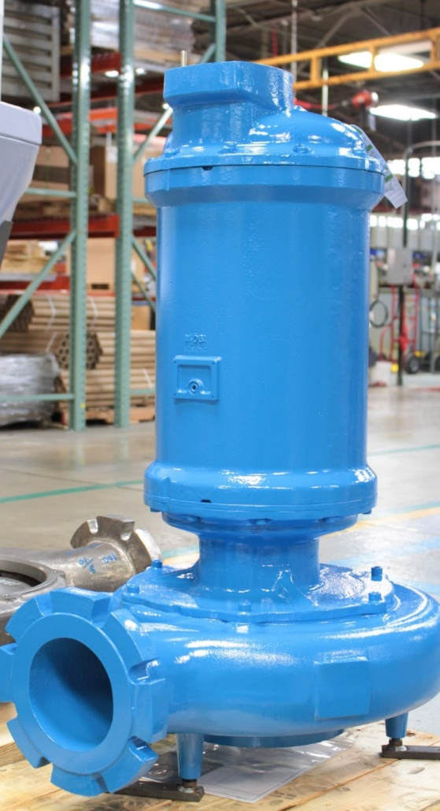
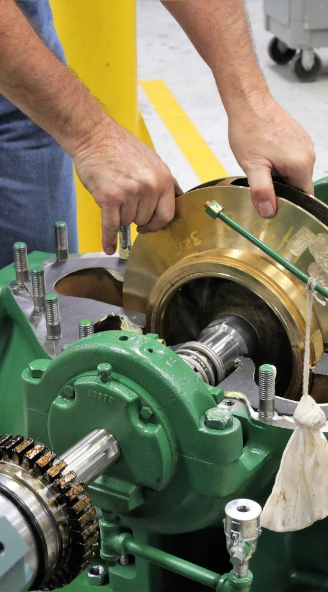
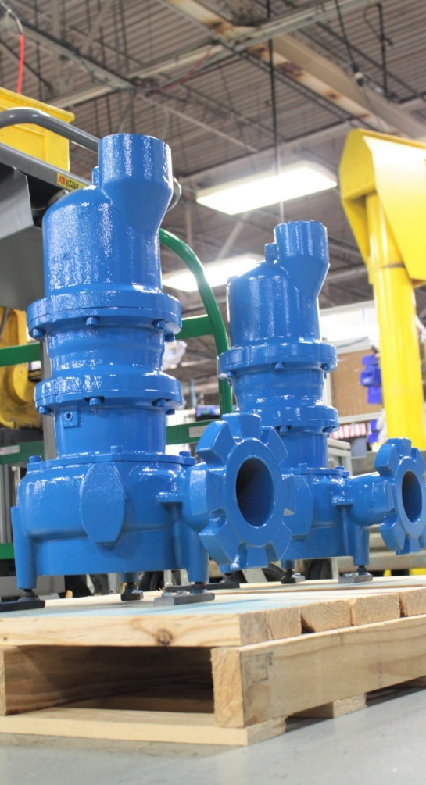
CRANE PUMPS & SYSTEMS
A business of Crane Co.
FLUID HANDLING
Deming Demersible Chopper Pumps

Slide 2
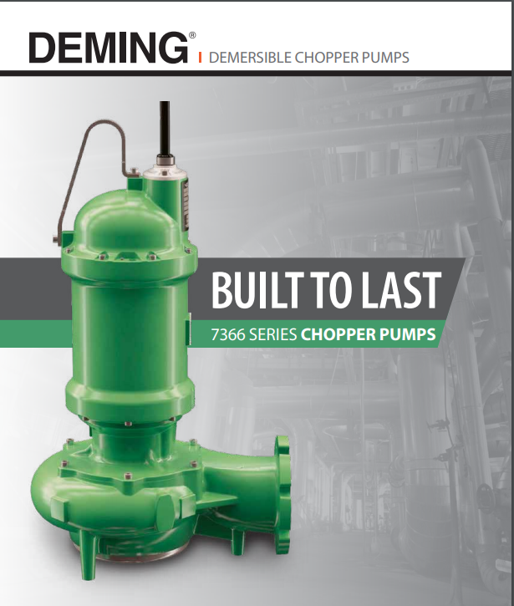

Slide 3
Chopper Pumps & Non-Clog Platform
Evolution of Deming 7365 Platform
Chopper
2005
Beginning of 7365 Development
2010
Phase 1: 4” ; 3&4 Frames; 7.5 ~ 60HP; 2&4 Poles
2011
Phase 2: 6” & 8”; 7.5 ~ 40HP; 6 poles
2012
Phase 3: 3” & 4”; 2 Frame; 2 ~ 10HP; 2&4 Poles
2015
Phase 4: 3” to 10”; 2, 3, 4 & 5 Frames; 10 ~ 150HP; 2,4&6 Poles
2017/18
Chopper Phase 1: 4” & 6”; 3&4 Frames; 7.5 ~ 60HP; 2&4 Poles
<2010
2010
2011
2012
2013
2014
2015
2016
2017
2018
>2018
Deming Chopper pumps utilize Deming non clog platform. Hence, they offer all the advantages of the non clog platform including rugged & reliable design, proven Deming hydraulics and ease of servicing.
Notes:
In last slide, I mentioned that the idea of developing a chopper pump originated in 2016. However, the secret sauce that makes SITHE such a great product actually began before this decade…. Way back in 2005 !!
You see Sithe chopper pumps have the same platform as the Barnes SH non clog platform…. The platform that Crane started investing in 2005, a platform that Crane has been consistently investing ever since…. We launched 4” SH products in 2010, 6” and 8” products in 2011, the smaller 18 frames in 2012 and the larger 32 frames in 2015…. In 2016, we were brainstorming what else we can do to develop even more superior products…. What else Crane can do to help our channel partners, you all, to win your competition…. And that how we decided that we will invest further in the Barnes SH non clog platform and develop the Sithe chopper pumps under the Barnes brand…. And thus began the Sithe journey at WEFTEC 2017…..
Read the slide takeway….

Slide 4


The Chopper Story
Crane Pumps & Systems began the initial development effort of Chopper Pump with a Voice of Customer (VOC) event.
During this event, multiple 3-person teams traveled throughout the US conducting interviews with a list of questions.
Interviewees included industrial customers, commercial contractors, municipalities, engineering consultant firms, service providers, and channel partners.

Slide 5
The Chopper Story
The VOC results?
We learned a great deal about customer needs and issues.
The biggest customer issue?

Slide 6
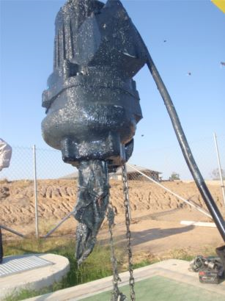
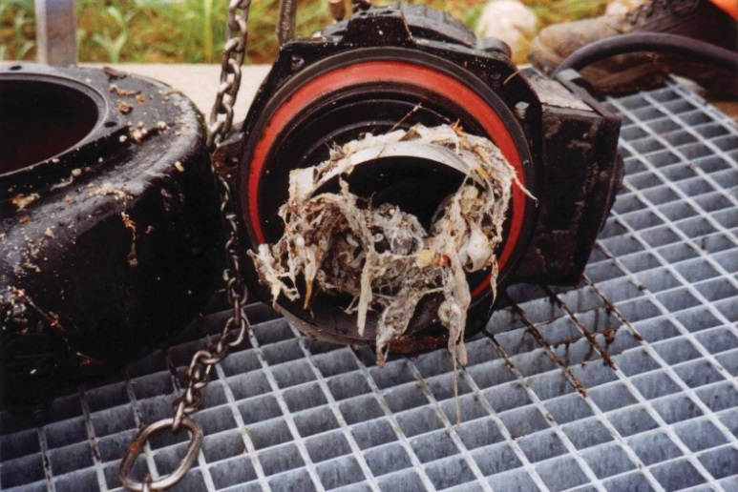
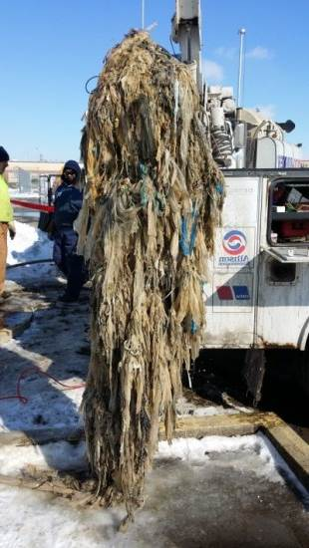
The Chopper Story
Non-Clog pumps clog!
2013 & 2016 VOC - Clogging in Pump Stations worse now than ever!

Slide 7
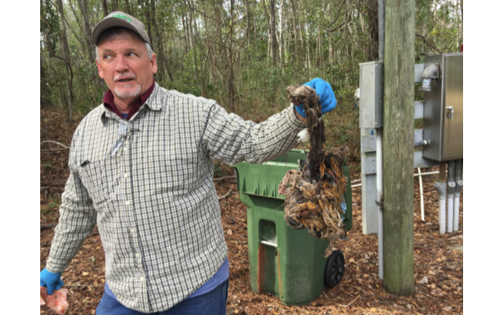
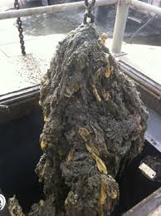
Clogging Issues
Clogging was caused by:
  Concrete
  McDonalds Toys
  Chipmunks
  Feminine hygiene products
  Sanitary wipes
  Swiffer's
  Disposable cleaning brushes
  Mop heads
  Mardi Gras beads
  Hair Weaves
  Underwear
  Possums
  Bed sheets
  Diapers
  Plastic
  Copper pipe
  Gowns
  2 x 4’s
  Cats
  Pulp
  Jail contraband
  Rubber gloves
  Construction debris
  Duffle Bags of Money
Notes:
7
This slide always produces a few chuckles when audience members see dead animals and Mardi Gras beads on the same list.
Point out that the survey revealed that lift stations just downstream from prisons are considered the worst as prisoners flush everything when the guards do a sweep. The second worst service is downstream of senior care facilities where all kinds of material gets flushed.
The photo shows a Flygt N pump totally clogged, taken at a site in Florida. Interestingly, the N on the pump looks like a stylistic η, the Greek letter nu, which in the Engineering world stands for efficiency. Their strategy, recently emulated by ABS, is to design for maximum efficiency and thereby sacrifice clogging resistance. The 4 “ discharge Flygt N pumps DO NOT meet the 10 States Standard requiring the ability to pass up to 3 inch spherical solids.

Slide 8

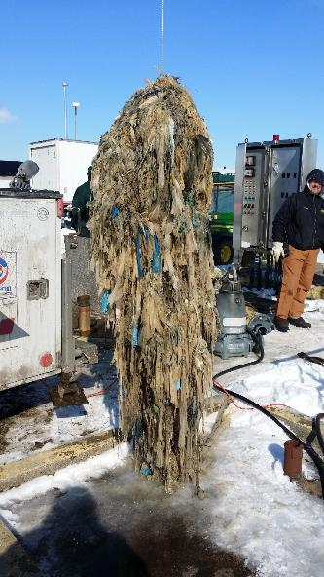
Conquer the Clog
Notes:
Magazine published this year discusses our water ‘crisis’ An article in it talks about new designs for shower heads that use only 3.5 lPM but with same shower feel. Water usage will continue to decline. Our older conveyance system was not designed for this small amount of water. Scarier is the fact that we are still using same guidelines for collection systems going in the ground today.
Make joke about no water crisis. We are all drinking dinosaur pee. Water is just packaged differently today.
200 years ago did we have:
Gas stations every mile that have a wall of beverages including 10 types of water
At least one water tower in every town
80 billion 150 lb bags of water walking around (people)
100’s of millions of cows, chickens, pigs to feed those 80 million people
No
Water conservation is not going away. It will continue to affect our collection systems and clogged pumps will continue to be a time consumer.

Slide 9
Top Pain Point - Clogging
Every 5 years, the USGS issues a report on water withdrawal
For the period 1980-2010, per capita public water use is down 25%
Evidence of the impact of low water washing machines, toilets and just plain water consumption!
The percentage of solids is increasing!
Notes:
9
Reduced flow shower heads, low flush toilets, low water consumption washing machines and just plain conservation explains, we believe, flat water consumption. And population continues to grow at just over 1% per year.
Add increased solids load in general to the new “flushable” items being marketed and we now see an ever-increasing issue with non-clog pumps clogging.

Slide 10
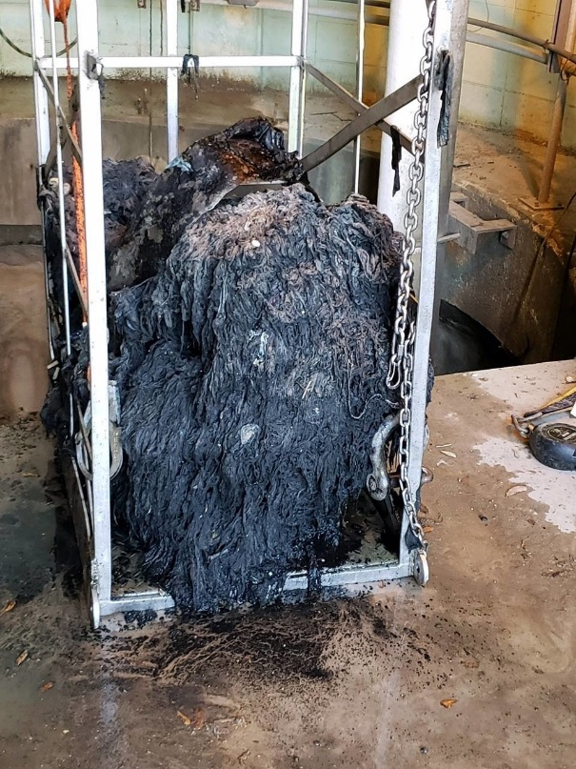
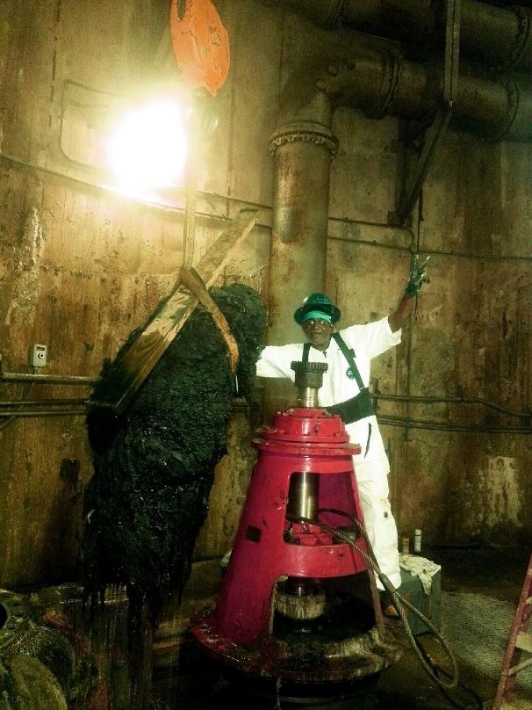
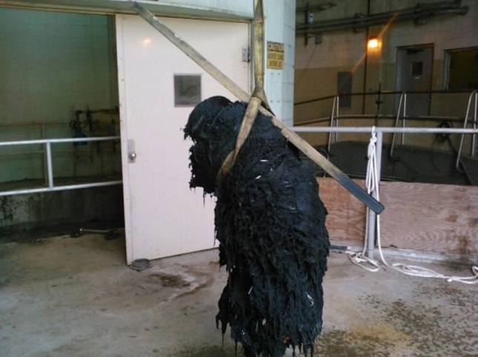
FATBERGS
Massive glob made of "flushable wipes" combined with Fats, Oils, and Grease which are clogging sewer pipes.
City of Charleston, South Carolina. Divers plunged 28 meters at the Plum Island Wastewater Treatment Center. Pumps were clogged with thousands of baby wipes, a baseball and a large piece of metal!!

Slide 11
Pump Clogging Resistance vs Pump Efficiencies
  “What really makes a pump efficient is that it doesn’t clog. The average pump only runs two hours per day anyway.”
  “No one has ever called and said, ‘Your pump is an energy hog.’ My calls are always ‘Here are how many service calls your pumps have tallied.’”
  “I need the pump to work dependably. I don’t care about efficiency; I get in trouble when it doesn’t work.”
Notes:
11
KISS was an often repeated comment as most users equate simplicity with reliability.
Steep curves were identified as needed to provide more positive flow control in conjunction with VFDs.
When we asked, “How important was efficiency?” The answers were surprising.

Slide 12
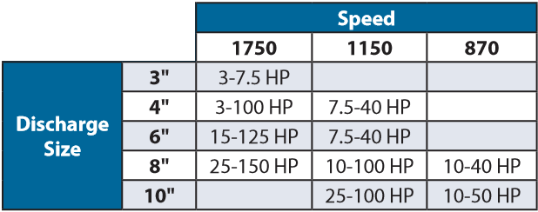
Chopper Pumps
Deming Submersible Chopper pumps (7366 Series) are Deming’s solution to non clogging in highly demanding waste water applications for industrial and commercial markets.
Deming Chopper pumps are available in 3”-10” discharge sizes, with mono vane and dual vane impellers.
All Deming Chopper pumps have inverter ready motors - 3 phase, 60Hz, 3HP to 150HP, 208-230V, 230/460V and 575V voltages**, 1750RPM, 1150RPM and 870RPM
Deming Submersible Chopper pumps are available in standard and explosion proof models.
** Refer to catalog for more information on HP voltage combinations
Notes:
Crane launched Sithe at Weftec last year. I know many of you came to our booth and supported us during the launch. We had a very successful launch, and we couldn’t have done it without you.
Read first point.
The idea of developing a chopper pump originated in 2016. When we were trying to scope the product, we went and interviewed our customers and collected their thoughts or voices… in total, we interviewed 56 people and collected about 1400 voices… And that’s how we zeroed in on the scope of Sithe chopper pumps… Today, our Sithe chopper pumps are available in 4” and 6” discharge sizes and in mono and dual vane impellers. Sithe is available from 7.5HP to 60HP in 1150 and 1750 RPMs, and in 3 phase. Another great feature about Sithe is that Sithe is also available in explosion proof design, as an option…. A feature that one of the competing solutions does not have.

Slide 13



Chopper Applications
Deming Chopper pumps solve clogging in numerous applications like:
Trailer parks,
Correctional Facilities,
Retirement Communities,
Truck Stops,
Zoos,
Agriculture.
Notes:
To summarize the applications of SITHE chopper pumps in one sentence, Sithe can be used in any sewage application that involve extreme conditions of clogging. In fact, when we tested our SITHE choppers, we tested with solids like plastic bottles, ropes, glass, wood, and literally all solids that are typically found in the waste stream. We even tested our chopper pumps in lifts stations involving rags, wipes, grease in services like truck stops, trailer parks, commercial and residential lift stations. Our Sithe chopper pumps will solve clogging even in the most toughest of applications…

Slide 14
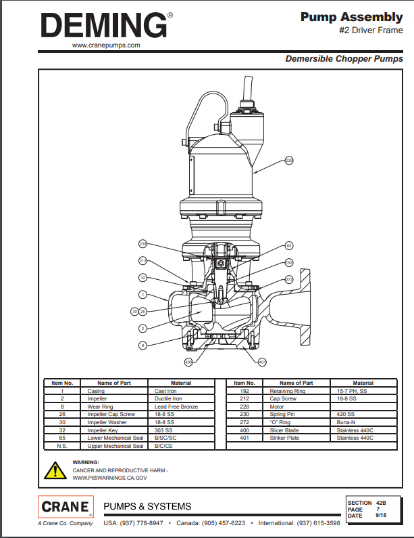
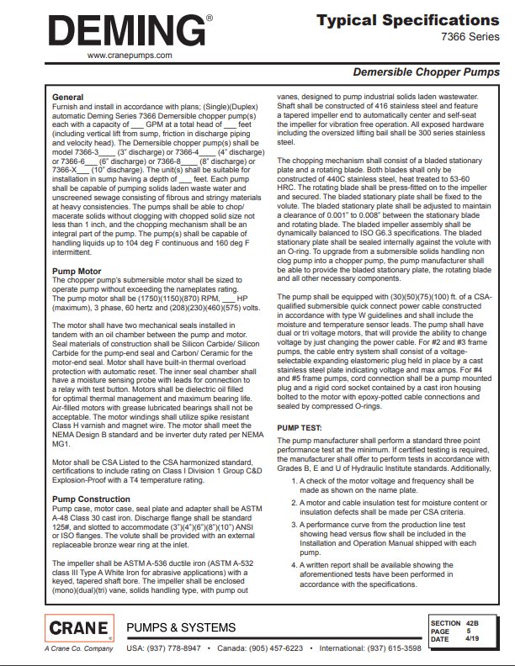
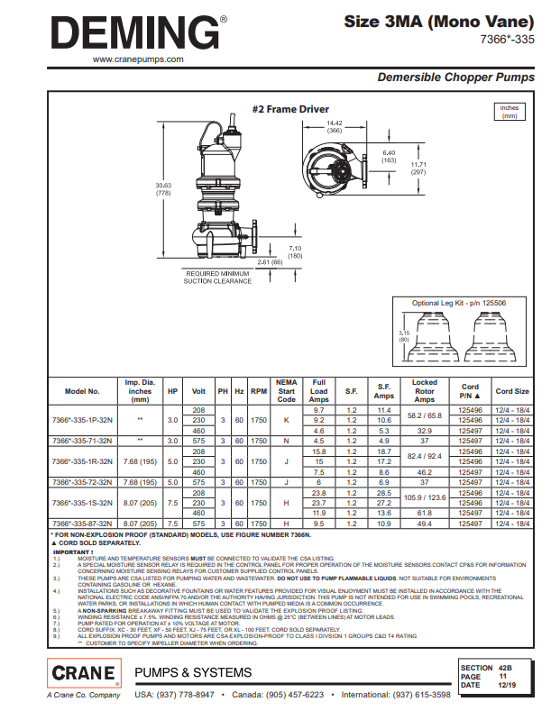
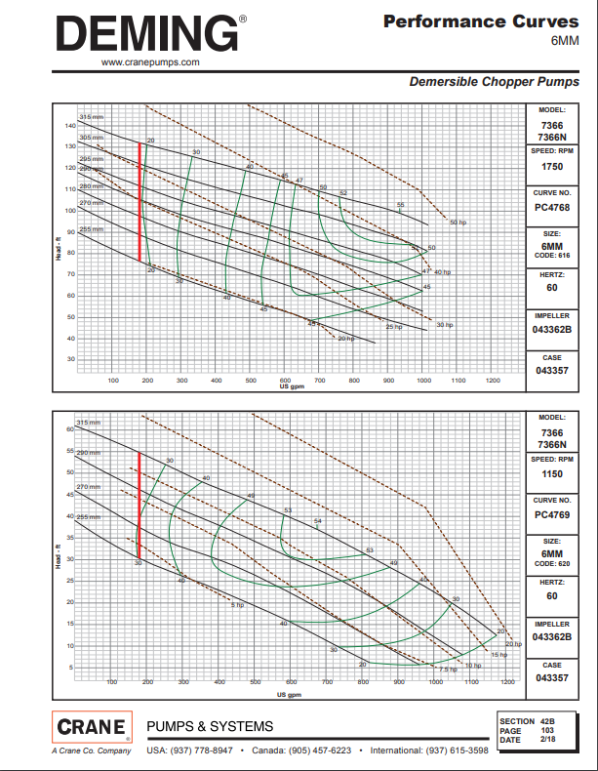
Chopper Technical Information
Notes:
Jumping into SITHE’s technical details, as I mentioned earlier, Sithe uses the same non clog platform as our SH pumps. The additions in Sithe are the striker plate and the slicing blade. The striker plate is the stationery blade attached to the volute, and the slicing blade is the rotating blade attached to the rotating impeller. Both blades are made of heat treated stainless steel with hardness of upto 60HRC. Other components that you see here are same as the SH, like the 416 impeller, bronze wear ring, plug—play cord, etc…..

Slide 15
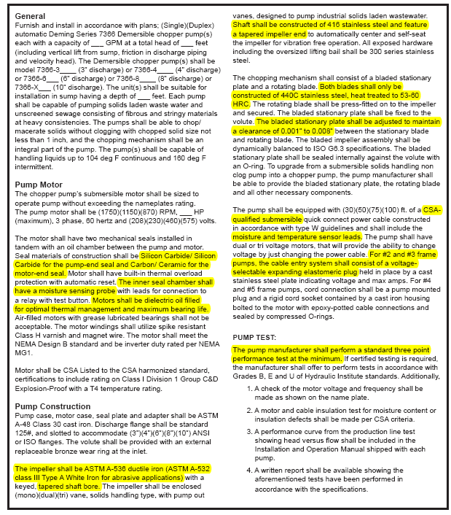
Chopper Technical Information
Deming’s specable features
Deming’s specable features
Optional White Iron Impeller
HI Performance Testing
Commercially available Silicon Carbide/ Silicon Carbide seals
Moisture sensor in seal oil chamber
416SS shaft with tapered impeller fit
Oil filled motor for maximum bearing life & optimal thermal management
440C SS heat treated chopping blades, 53-60 HRC
CSA Certification
0.001” to 0.008” clearance between blades
Plug-n-Play quick connect power cable
Pump out vanes at back of impeller
Moisture & Temperature sensors integral with cord
Notes:
This slide lists out some of the market distinguishing features of the Sithe that make this product a truly unique product…. A product that you will feel very proud to sell…. A product that will help you win over your competition and grow… Sithe’s specable features include the heat treated stainless steel blades, the clearance between the blades which is one of the smallest in the chopper industry, commercially available mechanical seals, plug-n-play quick connect cord, 50000 hour bearing life, tapered stainless steel shaft, epoxy coating and oil cooled motors…. We feel that these specable features are unique after studying other competing solutions in the market…. We literally spent hundreds and hundreds of hours researching competing solutions in the market… we wanted to develop a product that solves your problems and delivers value…. At the beginning of the training, I shared with you how we interviewed people to identify their pumping and clogging problems…. We took all that intel, and defined what true value means to Crane’s channel partners… We defined value as “Non clogging & solid size reduction capability”, “high reliability”, “ease of maintenance”, and “ability to upgrade/convert a SH non clog pump into a chopper”. This definition of a chopper value became Crane’s guiding mantra when we developed our Sithe chopper pumps. In the next few slides, we will see how Sithe delivers this value to you…..

Slide 16
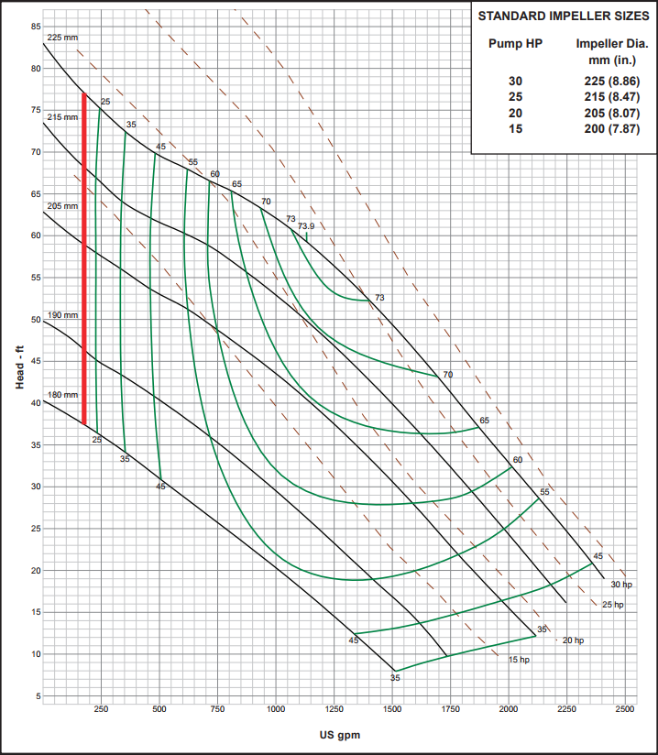
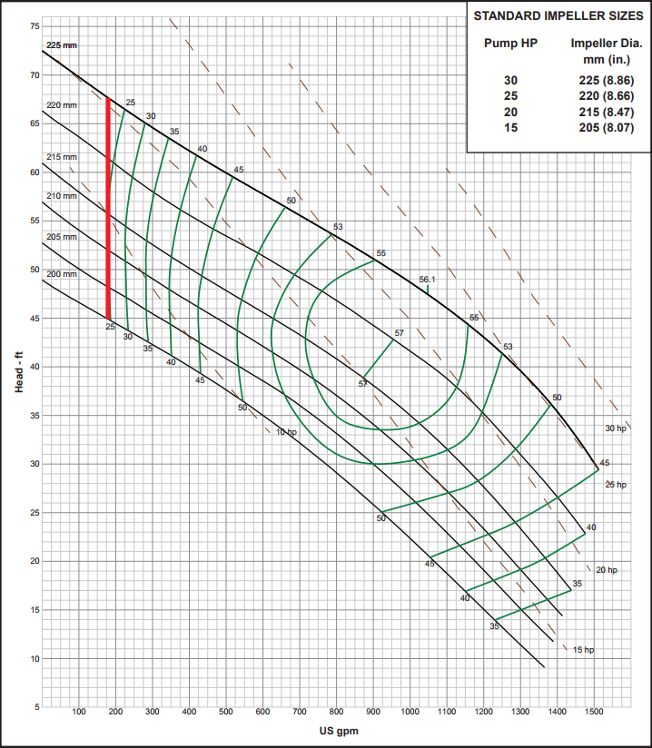
Chopper Technical Information
7365 6D (Non-clog)
7366 6D (Chopper)

Slide 17
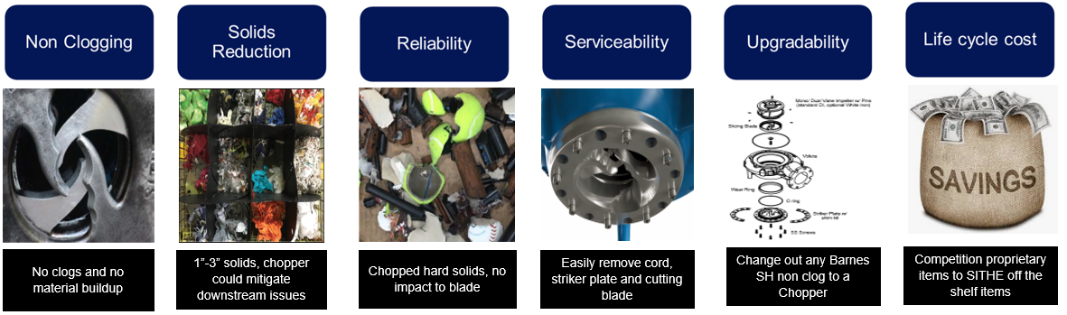
Value Props
Deming chopper pumps will solve THE most challenging problems faced by customers

Slide 18
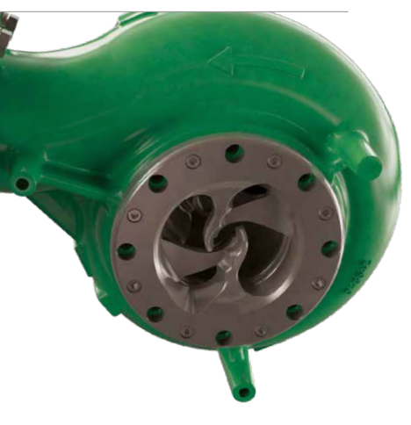
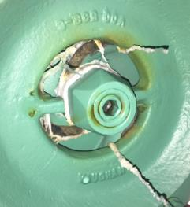
Chopper’s Superior Non Clogging & Solid Size
Reduction Capabilities
Deming’s superior non clogging and solid size reduction capabilities are due to its unique chopping mechanism.
Deming’s chopping mechanism has a first-of-its-kind open center cutter design… directs solids to the cutting edges instead of pushing the solids out… prevents solids building up outside pump and ensures cleaner wet well.
Deming’s open center cutter design
Competitor’s design with a constricted inlet

Slide 19
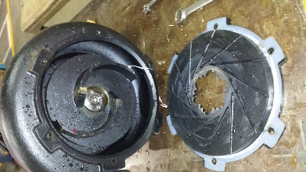
Chopper’s Superior Non Clogging & Solid Size
Reduction Capabilities
Deming’s superior non clogging and solid size reduction capabilities are due to its unique chopping mechanism.
Deming’s chopping mechanism has an open center design with large cutting edges… allows solids to enter and get chopped… solids do not pass without getting chopped.
Deming’s open center & large cutting edges
Competitor’s enlarged open center & minimal cutting edges… allows large solids to pass without chopping

Slide 20
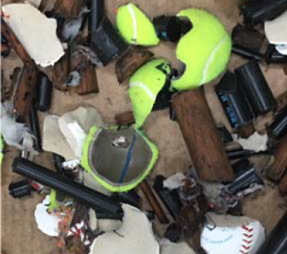
Chopper’s Superior Non Clogging & Solid Size
Reduction Capabilities
The chopping blades are made of heat treated 440C stainless steel with 53-60HRC… can easily chop any solid like wood dowels, baseball, nylon rods, plastic bottles, mop heads, metal cans, stuffed toys, rags, hairballs, wipes..., blade sharpness easily lasts for 7 to 8 years…
The clearance between rotating blade (slicing blade) & stationery blade (striker plate) is 0.001” to 0.008”… ensures solids don’t get stuck between the blades unlike competing solutions (0.013” and 0.01”). Competing solution’s material is also tool steel… may wear quickly & result in increased clearance after few months in service.
Solid size reduction
Deming’s blades after 6 months in service –
No clogging and in pristine condition

Slide 21
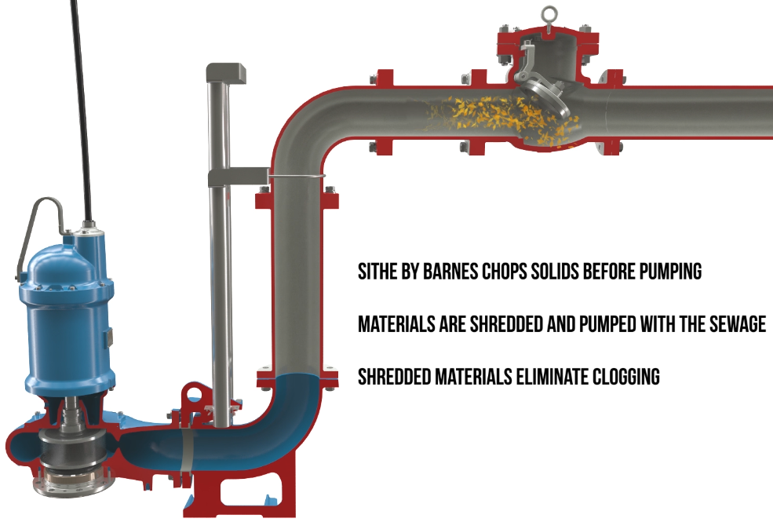
Chopper’s Superior Non Clogging & Solid Size
Reduction Capabilities
Deming Chopper reduces solid size to 1” to 3”… the “right” size… this prevents downstream clogging issues in check valve & head works.
Deming choppers have a slicing action compared to a chopping action… this reduces stress on shaft, seals and bearings… increasing their service life.
Deming chopper pumps have tested and proven Deming 7365 hydraulics… pumps can pass chopped solids of 3” diameter with ease.
No downstream clogging
Solid size reduction
Notes:
Talk about Vaughan and how it chops to less than 1”…. Tsurumi doesn’t chop at all…

Slide 22
Chopper’s High Reliability
All Deming Chopper pumps are CSA certified.
Explosion Proof, available as an option, is also CSA certified for Class I, Division 1, Groups C & D, T4 rating.
All Deming chopper pump motors are VFD ready with 1.2 service factor and class H varnish & magnet wire.
Deming’s motors are oil cooled… enhances motor cooling & increases bearing life.
Deming choppers are equipped with high capacity bearings… provides 50,000 hour bearing life at 2ft/s flow.
All Deming hardware are of stainless steel… have increased corrosion resistance. All bolts on the pump are the same size, which contributes to the easy maintenance.

Slide 23
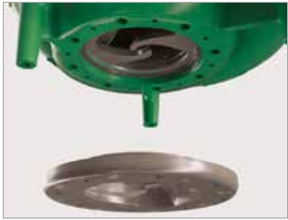
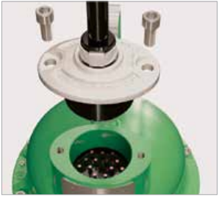
Chopper’s Ease of Maintenance
Deming chopper pumps have field replaceable blades… time & cost to replace blades is less.
Deming choppers have dual voltage motors. Voltage can be changed by just changing cords. Deming Choppers also have Plug-n-Play Quick Connect cords… saves time during maintenance.

Slide 24
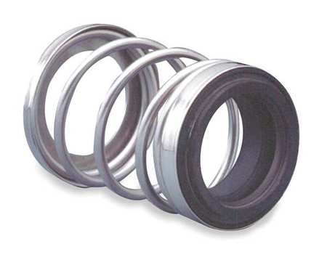
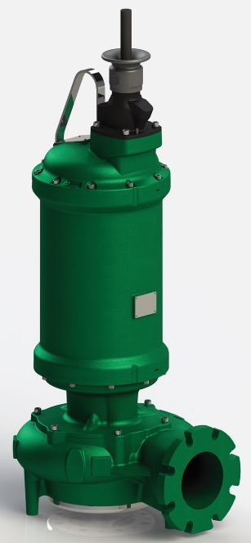
Chopper’s Ease of Maintenance
Deming choppers have easily available commercial mechanical seals… reduces maintenance and inventory costs.
Deming chopper pumps have large lifting bails that facilitate easy hooking and lifting.

Slide 25
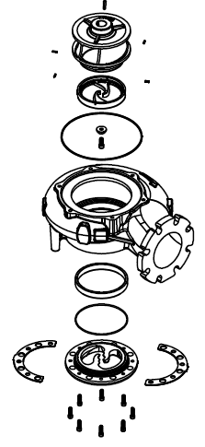
Chopper’s Ability to Upgrade Non Clog Pumps
Upgrade Kits* are available to convert an existing Deming 7365 non clog pump to a Deming 7366 chopper.
Mono/ Dual Vane Impeller w/ Pins
Slicing Blade
Volute
Wear Ring
O ring
Striker Plate w/ shim kit
SS Screws
* In addition to components in picture above. SH upgrade kits include safety gloves, manual and packaging. Other kits like volute kit, slicing blade kit and striker plate kit are also available

Slide 26
Deming Non Clog Additions
White Iron / 25% Chrome Impellers
Hardened material is ASTM A-532 Class III Type A and have a hardness of 55 HRC.
Deming White Iron (or 25% Chrome) impellers are available for both Non-Clog and Chopper.
All impellers (mono vane, dual vane, tri vane and vortex) have White Iron Impellers as an option.
All existing trims are available with White Iron impellers.
Impellers can be purchased along with the pump, and as replacement parts.
In Deming, replacement white iron impellers are available as kits that include balanced white iron impeller – SS rotating blade, pins, safety gloves and packaging.

Slide 27
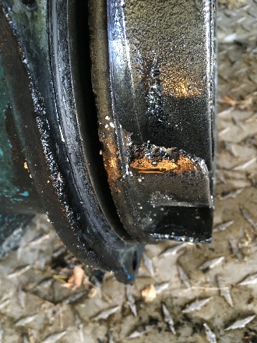
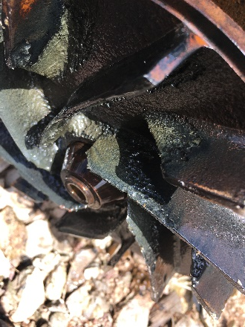
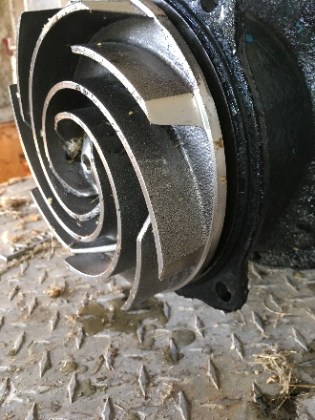
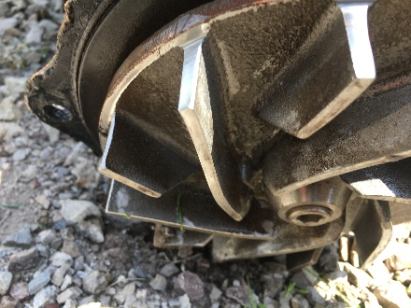
Deming Non Clog Additions
White Iron / 25% Chrome Impellers
Worn out Impeller edges of a Cast Iron impeller in just three months of service
Worn out Impeller edges of a Cast Iron impeller
Deming White Iron impellers in excellent condition after months in service
Deming White Iron impellers in excellent condition after 8 months in service

Slide 28
Chopper’s Success Stories
Installation Location | Application/ Service | Problems solved by Chopper
Upper Bern, PA | Truck Stop | rags, wipes, and other trash from the truck stop
Waterford, MI | Senior Housing Center | wet wipes, elastic material
Hebron, OH | Trailer Park & Residential | rags, underwear; required de-ragged every 2-3 months prior to installing Sithe
Hamilton, AL | Housing Development | rags, debris, plastics
Whitinsville, MA | Residential & Light Commercial | wipes, grease
Lincoln Parish, LA | Residential | rags, debris, grease
Cedar Hill, TX | Senior Housing Center | rags, mop heads, wipes
St. Mary’s, GA | Residential & Commercial | rags, mop heads, wipes
Sarasota, FL | Residential & Light Commercial | rags, wiped
Deming is receiving highly positive feedback from customers… Many customers didn’t have to derag since they installed a chopper.

Slide 29
Some Frequently Asked Questions
Will the Deming Chopper pumps’ performance curves be same as Demersible non clog pumps?
Deming chopper pumps’ curves are not be the same as Deming Demersible non clogs. Please refer to performance curves prior to ordering a chopper pump.
Will upgrading an existing non clog pump to a Deming Chopper pump require upgrading the panel?
Upgrading an existing non clog pump to a Deming Chopper pump may/may not require upgrading the panel. Please refer to the performance curves and check if motor HP changes.
What options and accessories will be available with Deming Chopper pumps?
50’, 75’ and 100’ cord length options (cord ordered separately)
Break Away fitting (similar to non clog)
Intermediate Break Away Fitting (similar to non clog)
Silicon Carbide and Tungsten Carbide seal options
Moisture/ Temp Relay (aka Pump Monitor Relay)
Where can we find the cord gauge information for Deming Choppers?
Cord gauge information is available in O&M Manual.

Slide 30
Some Frequently Asked Questions
What components are included in the Upgrade kit?
Upgrade kits include machined volute, wear ring, factory balanced impeller-slicing blade assembly, striker plate, screws, O-ring, shim kit, safety gloves, manual and packaging.
Will installing the Upgrade kit alter the performance of the previously installed non clog pump?
Installing the Upgrade kit does alter the performance of the pump. Please compare both Deming Chopper’s and the non clog’s performance curves and determine suitability prior to purchasing the upgrade kits.
Are the Deming station drawings available?
Lift station drawings will be available in the catalog.
What is the warranty?
Deming chopper pumps have a limited warranty of 2 years.
What is the standard lead time for Deming pumps and kits?
Standard lead time for chopper pumps and kits is 3-4 weeks (60HP & Below), 6-8 Weeks (60HP & Above). For expedited delivery, please follow standard expediting process.

