Slide 1

Notes:
Be it for WSHPs, FCUs, VAVs, Unit Heaters, Blower Coils, Chilled Beams, Radiant Heat Systems, AHUs, or even Chillers – this presentation is designed to give a basic overview of balancing methods (Manual v Automatic), the differences between the Hays Mesurflo and spring type automatic designs, and the general list of items Hays can provide our customers.

Slide 2
Balancing Methods
Balancing Methods
Notes:
Let’s review the main balancing methods seen.

Slide 3
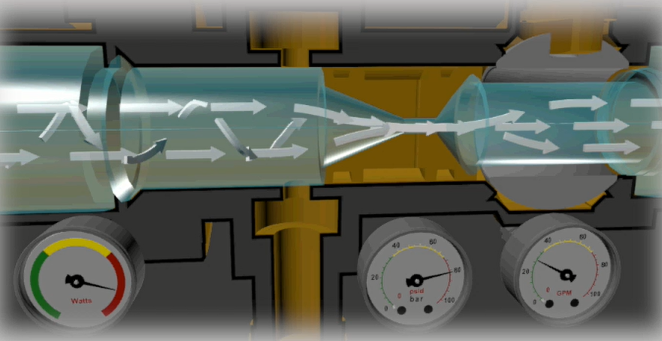
Manual Balancing Valves
Notes:
Manual Balancing Valves: What’s shown is a Venturi Style manual balancing valve. The insert is used to create resistance for the flow, which in turn creates a smaller window for the ball valve to range between while balancing. Manual valves are STATIC, PRESSURE DEPENDENT, and basically a GLORIFIED BALL VALVE. That means that it is unable to react to system pressure fluctuations. As units close off elsewhere in the system, the ones that remain open will have to contend with excess pressure/flow. If the pressure differential increases across a manual balancing valve – so does the flow (likewise with decreases in differential). In short, manual balancing valves allow overflow conditions to occur, which effects energy usage at the pump.

Slide 4
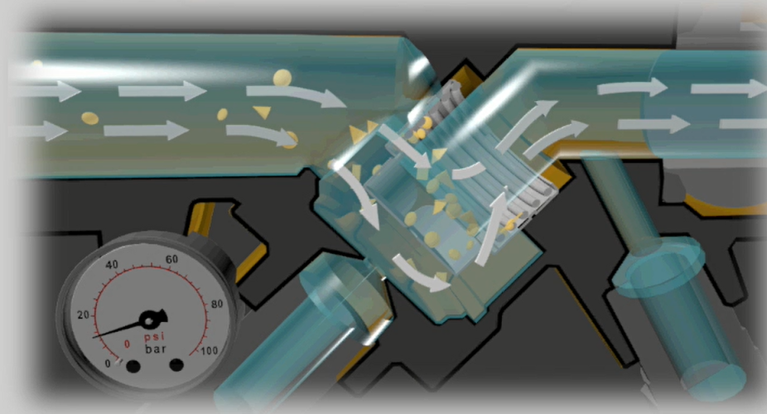
Spring Type Automatic Flow Control Valves
Notes:
Spring Type Automatic balancing valves: These valves use a spring and piston cartridge, that involves orifice openings calibrated to the designed maximum flow for the unit it’s installed on. The piston will DYNAMICALLY compress and decompress in reaction to pressure changes within the system. These valves have an OPERATING RANGE, which translates to the amount of motion allowed to limit flow to the designed maximum.

Slide 5
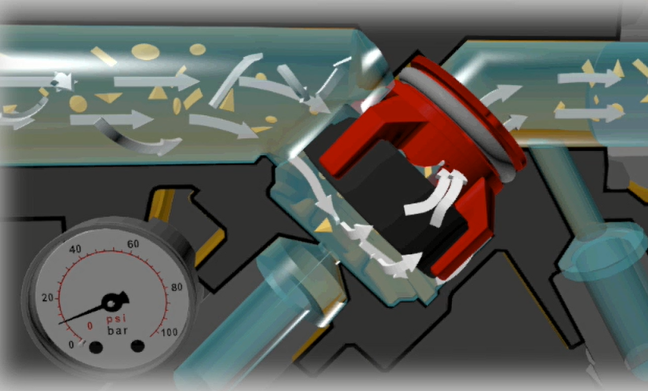
Diaphragm Orifice Automatic Flow Control Valves
Notes:
Hays Mesurflo Automatic Balancing Valves: Similar to the Spring type design, Hays is a DYNAMICALLY RESPONSIVE VALVE, and is PRESSURE INDEPENDENT within our Operating Range of 2-80 PSID. The unit only sees what is needed and excess flow is distributed to the rest of the system. The obvious difference is that we do not use a spring-based design but rather a Diaphragm and Orifice Plate construction (which will be discussed further later). Using the diaphragm’s flexibility to compress and decompress against the orifice plate, the flow is LIMITED to the designed maximum flow rate regardless of system pressure fluctuations. This motion is the reason these valves are called AUTOMATIC balancing valves (since Manual Valves are stuck in place and manually need adjustment).

Slide 6
Balancing Methods
Test & Balance (TAB) Process
Notes:
Let’s look at the process of how these valves are balanced.

Slide 7
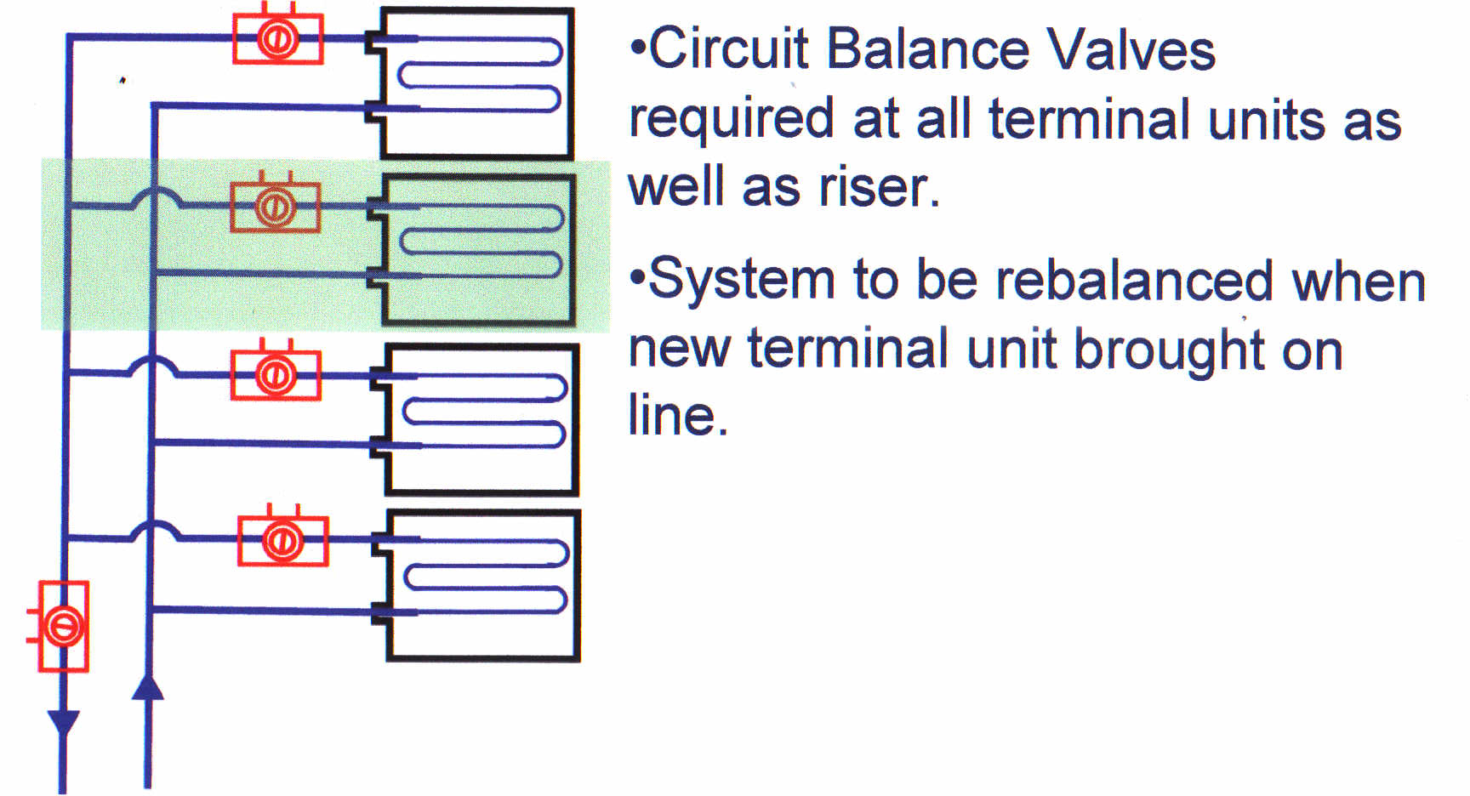
Manual Balance Valve System
Manual Balance = No Balancing
  Balanced at 100% Design Flow
  Unbalanced at ALL Other Flows
Notes:
Generally, manual balancing valves are known as being “cheaper”, which valve for valve they often are due to a lack of technology (again, they are glorified ball valves). Even if each valve (placed at each terminal unit) is 10-15% cheaper than automatic balancing valves, at times there is a specified requirement for yet another manual valve on the branch/riser piping as well. This acts like the Venturi insert in each individual valve and serves the purpose to get numerous units into an easier balancing “window”. However, that means any savings that might have come from the unit valves, is being spent on a large valve for that entire branch (meaning the cost savings is now gone).
The balancing process is also very lengthy, and that cost needs to be added to that of the individual balancing valves (or else the total cost isn’t complete). The process to balance these is to take a differential across each balancing valve, check the Cv rate of your valve and desired maximum flow rate for the unit, and adjust the differential accordingly until the correct amount is found per the balancing chart. Once Unit 1 is done, and we’ve moved on to Unit 2 to balance that valve – the pressure across Unit 1 changed which means the flow is off. TAB contractors charge to balance the system THREE times all the way through, because that’s how many times it will take to whittle away all the pressure changes as each valve is adjusted. This could take a very long time and is costly.
Also, after the balancing is completed, if units are added, or perhaps flow rates need to be changed, or maybe the project is retrofit where whole floors are remodeled at different times – the entire system will need to be rebalanced. It’s a false sense of authority to think you can walk up to a valve and adjust the flow on only that ONE – because with manual valves being pressure DEPEDENT, every valve around it has been impacted!

Slide 8
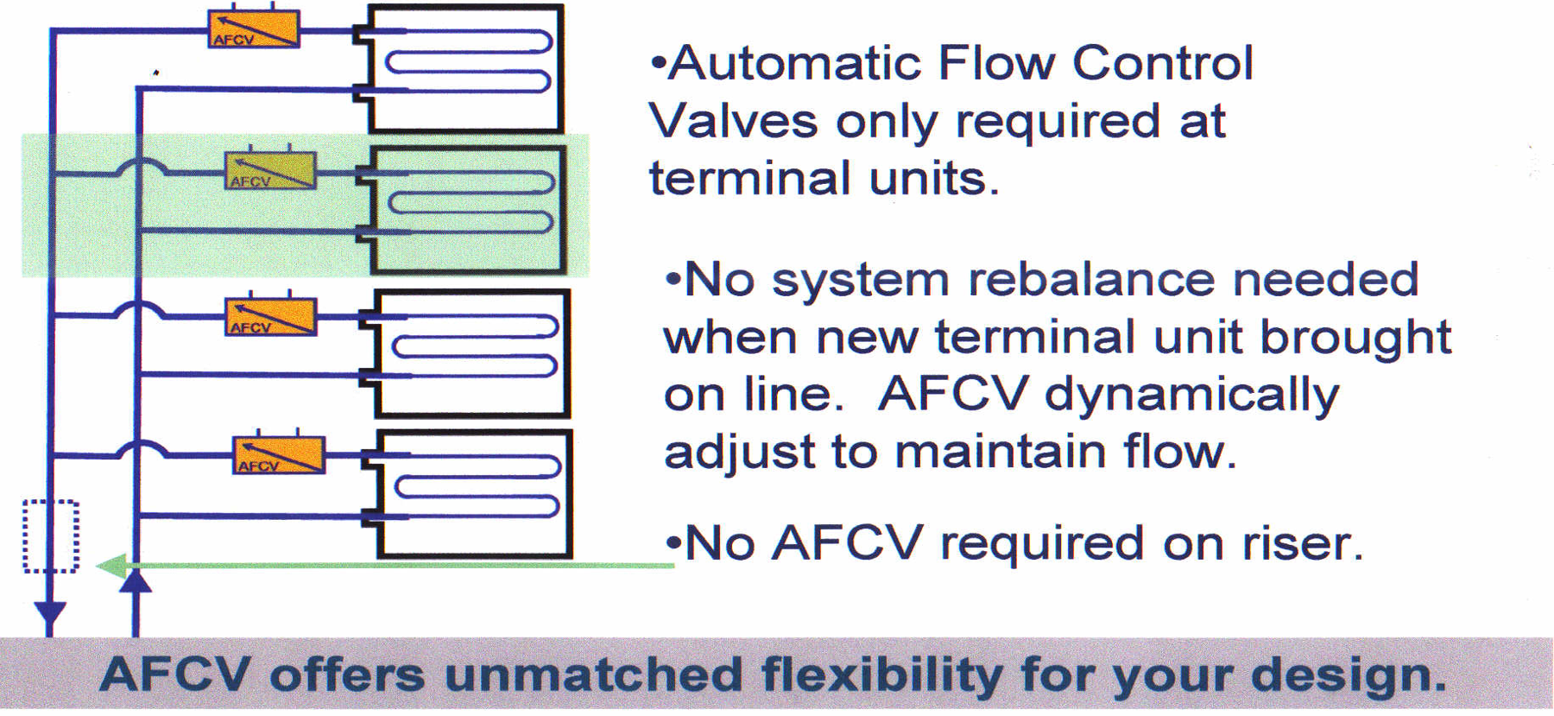
Automatic Flow Control Valve System
Notes:
With automatic balancing valves, we still have one valve per unit. However, the branch/riser valve is no longer needed due to the OPERATING RANGE of the automatic valve. That also means that since these were factory set, all that is required of the TAB contractor is to simply VERIFY that the valve differential is within the operating range, meaning the flow is being balanced/LIMITED to the design maximum flow rate. This reduction in labor will amount to 66% savings for the TAB time and cost because each valve only needs to be checked ONCE (as opposed to THREE times for manual valves).
Also, if any units are added, adjusted, or retrofitted well afterwards, each individual automatic balancing valve continues to limit flow to the designed amount because they are PRESSURE INDEPENDENT.

Slide 9
Balancing Methods
Building Efficiency
Notes:
That was the installation/balancing process, but let’s look at what happens after the system is up and running.

Slide 10
Annual System Load Profile
Normal Operating Conditions: 30- 70% of system design load
Notes:
This is an average operating chart from ASHRAE, and a generalization of total system load for 1 year for most applications. It shows that the system operates most commonly between 30-60% design condition. [Advance to show the circle around 100] Yet, manual balancing valves are set to 100% design condition only…which happens roughly 1% of the year. That means someone spent all that time and money to balance the system with valves that only work under one circumstance.

Slide 11
Energy Calculations
% System Load | % of Operating hours | Operation Cost ($ per % of operating hours)
 |  | Fully Open No balancing | Manual Balancing |  | Automatic Balancing
 |  |  | Fixed Speed Pumping | Variable Speed Pumping | Fixed Speed Pumping | Variable Speed Pumping
30 | 15.25 | 2026 | 1961 | 2031 | 1088 | 1084
40 | 19.75 | 2834 | 2744 | 2828 | 1961 | 1810
50 | 21.5 | 3251 | 3169 | 3275 | 2618 | 2186
60 | 14.25 | 2228 | 2185 | 2238 | 1841 | 1777
70 | 9.50 | 1521 | 1497 | 1545 | 1307 | 997
80 | 4.00 | 652 | 644 | 672 | 586 | 459
90 | 2.25 | 372 | 368 | 370 | 350 | 289
100 | 0.50 | 83 | 83 | 82 | 82 | 82
Approx. Annual Pump Running Cost ($/year) |  | $12,967 | $12,650 | $13,041 | $9836 | $8686
Notes:
The way this looks in dollars and cents is the graph shown, taken from a case study at a dorm building in LSU. We see that the percentage of operating hours is more common in the 30-60% system load. Again, the manual valves would only truly be balanced at 100% (which amount to .50% of the year).
If the system had not been balanced at all, it would amount to roughly $13k a year to operate.
With manual balancing, and a fixed speed pump – they would only save $300 annually. That’s far less than the balancing process would have cost, so the ROI on that method would take years. With manual balancing and a VFD pump system, they are actually hurting the energy savings. That’s because manual balancing valves allow for overflow conditions, which mean the VFD sensor doesn’t recognize excess flow to then do its job to ramp the pump down. That pump type is more complex from the start, and the manual valves won’t help it operate any better than a fixed speed.
AUTOMATIC BALANCING VALVES however, take only what is needed for each unit when others are turning off. This means constant speed pumps don’t work as hard, and we see our pump curve move to the left). That also means they help OPTIMIZE the VFD system type by sending excess flow downstream faster to the censor, which then allows for the signal to be sent to the pump and ramp down, thus saving energy. In those cases we provide roughly 30% energy savings EACH YEAR, which will make that ROI much faster to achieve the true benefit of energy savings.

Slide 12
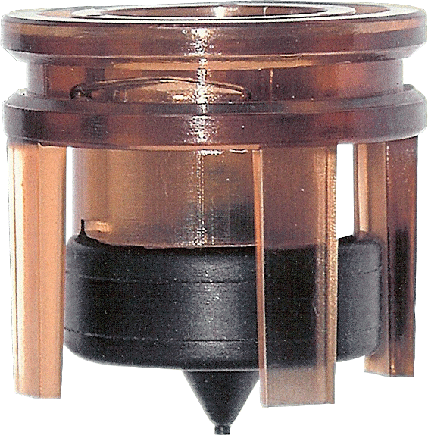
Mesurflo®
Design

Slide 13
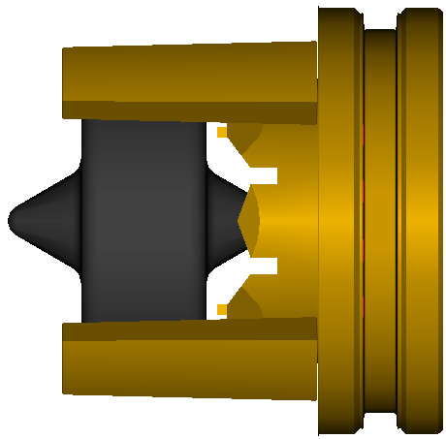
Mesurflo® Cartridge
Polyphenylsulfone Orifice Plate
Elastomeric Polymer Diaphragm
Large Openings
Notes:
As reviewed earlier, we have a different design than spring-based companies. We use a simple two-piece construction; an elastomeric diaphragm that comes in 3 densities (or durometers), and an orifice plate that has a variety of cuts based on size and flow. These two work in conjunction to dynamically limit the flow to the designed amount.

Slide 14
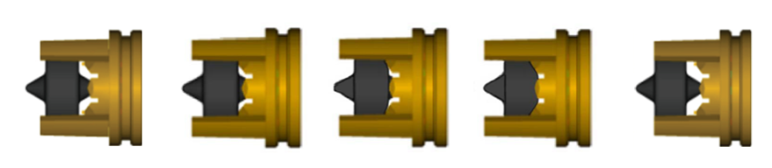
How Mesurflo® Works
As differential pressure increases, the diaphragm presses against the orifice plate to regulate flow. As ΔP decreases, the diaphragm backs away from the orifice plate maintaining accurate flow.
0 PSID
2 To 80 PSID
Reverse Flow
Notes:
As we work from our left to right, the Mesurflo design starts to limit flow at 2 psid.
Anything under that amount would be considered underflow. This would likely be the result of a modulating control valve taking authority over the flow to achieve a less than maximum flow rate per the request of the unit's internal sensors (typically on VAV boxes or AHUs).
As the differential increases across our internals, the diaphragm compresses further into the orifice plate, making the orifice opening smaller. With higher pressure, and a smaller orifice opening, the flow rate is still limited to the maximum design. This dynamic response is the key to automatic balancing.
You’re also able to reverse the direction of flow to perhaps back flush the system to remove debris upon start up. This process does not effect our design nor our warranty.

Slide 15
Other AFCV
Stainless Steel Spring Designs
Notes:
Every other automatic balancing type out there…

Slide 16
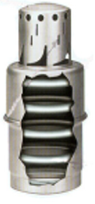
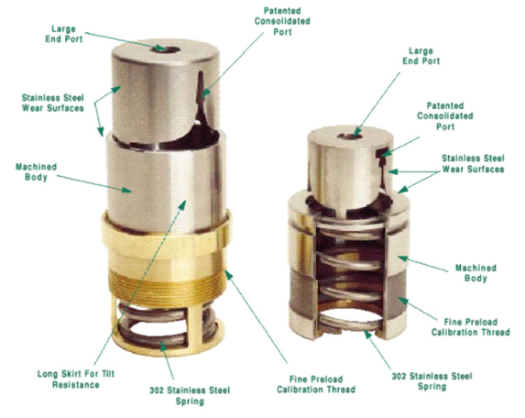
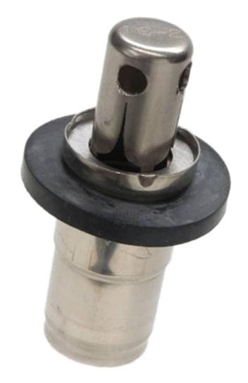
Common Spring-style AFCV Design
Notes:
…is a spring-based design. The orifice opening may change, but the dynamic response still comes from a spring-based cartridge.

Slide 17
Design Comparison
Spring Based Design
Fatigues Over Time
5 Year Warranty
Diaphragm and Orifice Plate Based Design
Rugged and Resilient Components
Lifetime Warranty
Smaller Operating Ranges
Multiple Spring Ranges
2-32 PSID Most Common
Large Operating Range
2-80psid
Noisy
Metal on Metal design
Chatters
Quiet
Self Dampening Components
Virtually silent
Clog Prone
Tight Sliding Components Seize on small debris
Cannot Back Flush
Clog Resistant
2 piece construction
No tight fitting or sliding components
Back Flush Allowed
Notes:
There are 4 key issues that spring type valves present, and that our Mesurflo design improves.
[Advance]
The simple fact they use a spring. Springs fatigue over time, regardless of application. That’s why they only have a 5 year warranty. Within roughly 7-10 years, these springs will go outside their spec range and as a result, the flow will be impacted. Spring pistons will eventually get to total compression, which means a fixed orifice like a manual valve, which means overflow conditions and poor flow distribution throughout the system. [Advance]
HAYS valves however come with a lifetime warranty due to not using a spring at all. We have valves decades old that are still running to spec.
[Advance]
Spring designs have smaller operating ranges (2-32, 2-45 are very common). The issue here is that if placed in close proximity to the pump of a large system, the pressure these valves are having to deflect may be so great that the piston is completely compressed, again allowing overflow. That would then steal flow from units further downstream, causing the pump to have to ramp UP to meet the demand, and waste energy/money doing so. [Advance]
With HAYS valves, we have a constant 80 psid high side to our operating range. We can even handle short burst of pressure differential up to 150 PSID! That means we’re always able to take only what the unit needs, redirect excess flow down stream, and properly distribute flow throughout the system.
[Advance]
If we REVERSE our proximity from the pump and look at the units at the end of the system, spring type valves that are made of metal start to chatter and create noise. In those last units, the differential only needs to be between 2-6 psid (no need to push 40 psid across the last unit and waste energy). That means as the valve is just starting to limit flow, the metal piston is chattering against the metal cartridge. In high hotels and condos, or in schools and hospitals, this noise can be a major issue. [Advance]
That’s why with the HAYS MESURFLO design, our inherently quiet components are virtual silent. That’s the main reason for our material selection to begin with and why folks like the US Navy and Marriott have relied on Hays for decades.
[Advance]
Lastly, spring type valves are prone to clogging due to tight space constraints. It’s not necessarily the orifice openings, but rather the space the piston sinks into the housing. If/when debris gets stuck in that crevice, the piston will seize up in place, and effectively become a fixed orifice/manual balancing valve – again, allowing overflow and poor system balancing. [Advance]
With HAYS however, our simple two-piece construction doesn’t have tight sliding components to seize up in the first place. We’re able to operate even without the use of a strainer, and even be used in geothermal pump and dump applications without our design clogging.

Slide 18
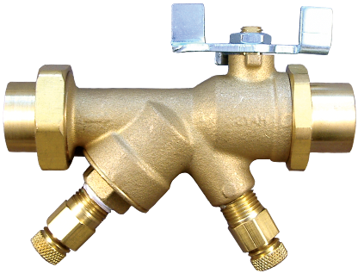
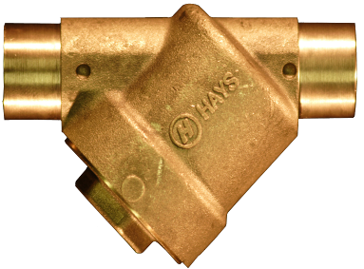
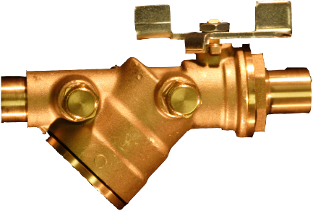
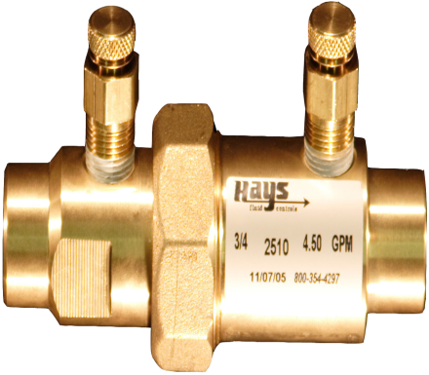
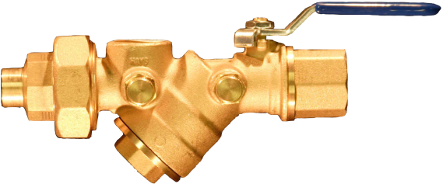
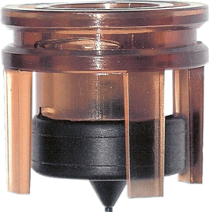
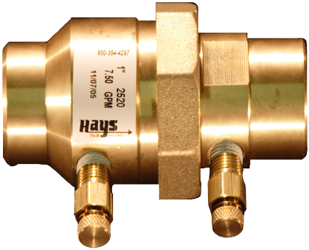
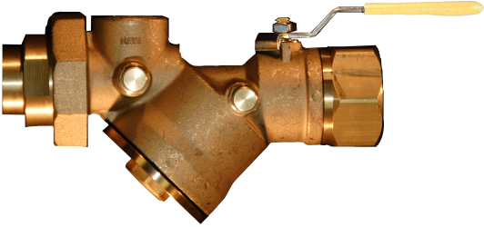
2517
2519
2516
2514
2510
2524
2520
Notes:
Here are some of the smaller valve models we put our Mesurflo design within.

Slide 19
Hays HVAC Product Line
Mesurflo® Automatic Balancing Valves
  Inline Valves
  (Threaded, Sweat, or Flanged – ½” to 36”)
  Y-Ball Valves
  (Multiple Connection Types – ½” to 1½”)
  Lead Free Valves
  (Sweat connections – ½” to ¾”)
Notes:
We make valves ranging in size from ½” all the way up to 36” in size. The most ordered sizes however are between ½” and 2”. Inline valves are just the balancing portion, whereas Yball valves have integral ball valves as well (see previous slide).

Slide 20
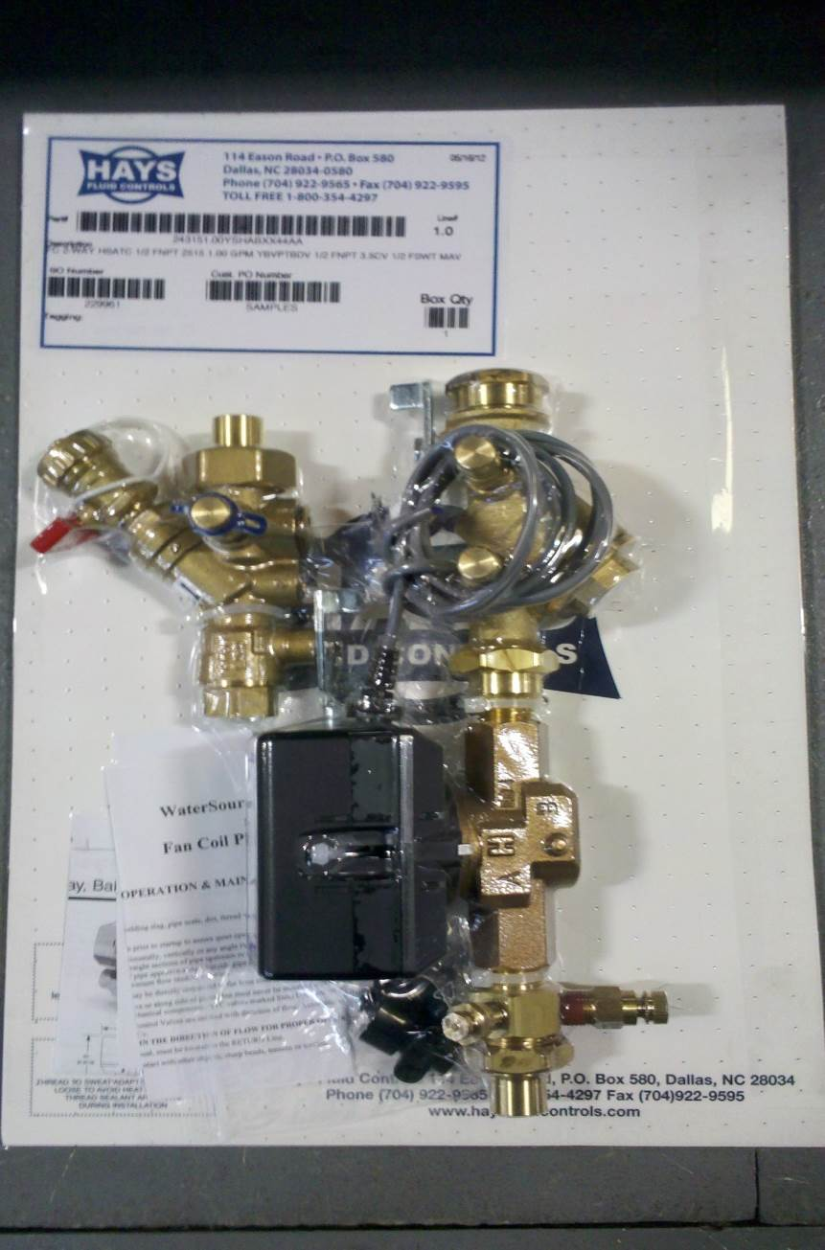
Piping Packages and Hose Kits
Fully Assembled
Pressure and Leak Tested
  Every Piping Package, Hose Kit, Balancing Valve, and Individual Hose
PPs Shrink Wrapped to Cardboard
Tagged per unit schedule/flow rate
HKs Zip Tied
Custom Solutions Available
  Components
  Inventor Designs
  Submittals
Notes:
All of Hays piping packages (for FCUs, VAVs, Blow Coils, etc) are fully assembled, pressure/leak tested, and tagged per the provided schedule. We can even package/box like floors/tags together to provide an even more organized process for the installing contractor. Hard pipe and flexible packages, plus customized options are available. Control valves can either be provided by Hays, provided by a controls contractor and installed in the field, OR provided by a controls contractor and SENT TO HAYS for our assembly. That way the package arrives ready to be fully installed.

Slide 21
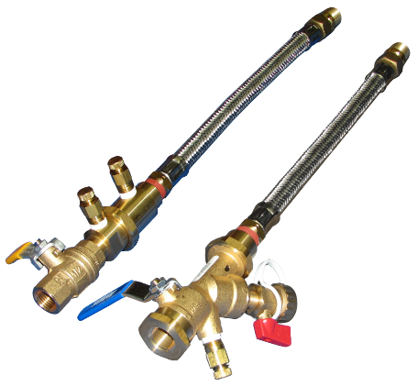
Hose Kits
Chilled Beams, WSHP, Watersource VRF
Mesurflo Automatic Flow Control Valve
Stainless Steel Hoses, 400 psi rated
Custom hose lengths and connection types available
Notes:
Hays hose kits (for heat pumps, chilled beams, or water cooled VRF units) are also fully assembled, pressure/leak tested, and tagged per the schedule. Our hoses are rated for 400 psi working pressure/1,600psi burst pressure. We can customize hose lengths as well, but our standard lengths are 12”, 18”, 24”, 36”, and 48”.

Slide 22
Hays Fluid Controls
Pre/Post Sale Support
  Regional Technical Manager
  Application Engineering
  Customer Service
  Engineering Team
  Quality Team
99.7% on time delivery rate
Expedited Manufacturing – 5 Day Typical Lead Time
  24 and 48 Hour Quick Ship Program
Notes:
With the full support of outside and inside resources, Hays will be able to assist our customers as quick as possible. Our lead times are 5 business days for a very wide range of products, and expedite options are available as well.

Slide 23
Save Time, Less Work
Hays Fluid Controls Applications Engineers can do the work
  Schedules
  Piping Details
  Specifications
Or you can use the Online Price Guide (OPG)
Notes:
The Hays team can either put quotes together for the customer, or we also have our Online Price Guide as a tool to utilize.

