Slide 1

Please Read. Legal Disclaimer.
We promise this is the only legal slide!
NO WARRANTY WEBINAR CONTENT IS INTENDED FOR GENERAL PURPOSES ONLY
This Patterson-Kelley, LLC (“P-K”) webinar and the information contained within it are not directed to or intended for use by any person. The information presented in this webinar is collected, maintained and provided purely for the convenience of each P-K supporting business (eg. Manufacturer Representatives). We have made every attempt to ensure that the information contained in this site has been obtained from reliable sources and P-K is not responsible for any errors, decisions or omissions of the information. The information in this webinar is not universal in its application, has been incorporated in good faith, and it is for general purposes only. It should not be relied upon for any specific purpose and no representation or warranty is given for its accuracy or completeness.
RECORDING AND/OR REDISTRIBUTION IS STRICTLY PROHIBITED
By participating or viewing this webinar, you agree that P-K will not be liable for any loss incurred due to the use of the information and the material contained in this webinar and that you will not record or redistribute this information. The copyright in the material contained in the webinar solely belongs to P-K and any access to it by P-K supporting businesses or the general public does not imply free license to use it, unless otherwise expressly permitted by law.

Slide 2
P-K Water Heaters
Compact Training

Slide 3
Features of the Compact Water Heaters
Over 60 years of design and development – thousands in service
Steam to DHW design
Water to DHW design
Dedicated water heater recirculation line for anticipated temperature control
Venturi options to recirculate building domestic water direct to unit (NY Trim)
10 year warranty on original bundle
20 year warranty on the shell
Cupro-Nickel 90/10 shell and bundle standard
Custom designs for your application

Slide 4
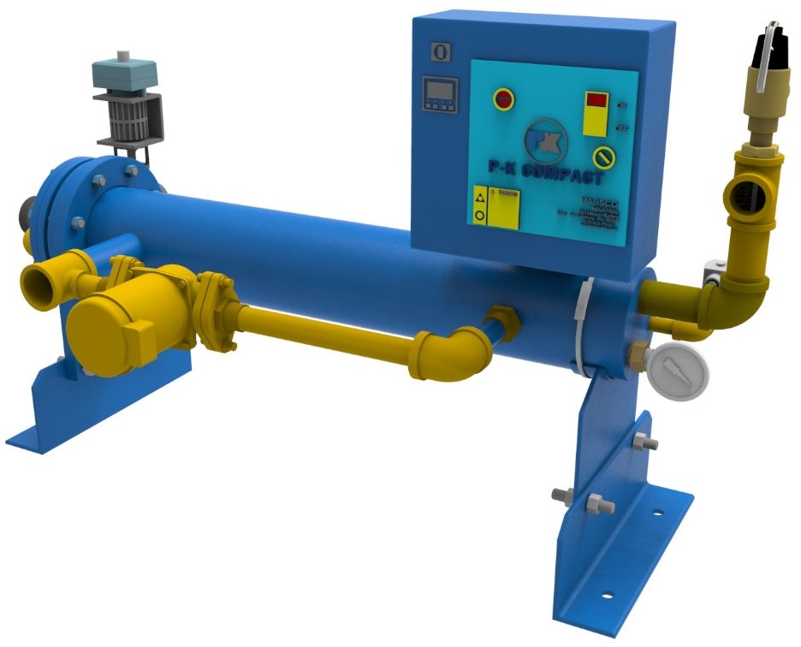
Indirect Water Heating
(COMPACT)
*GPM from 40°F to 140°F @ 100 PSIG Steam
1 GPM
100 GPM
400 GPM
25 GPM
50 GPM
75 GPM
200 GPM
300 GPM
500 GPM
COMPACT Double Wall (Vertical) | COMPACT Double Wall (Horizontal) | COMPACT Single Wall (Vertical) | COMPACT Single Wall (Horizontal)
PK06D | PK06DH | PK06S | PK06SH
PK08D | PK08DH | PK08S | PK08SH
PK10D | PK10DH | PK10S | PK10SH
PK12D | PK12DH | PK12S | PK12SH

Slide 5
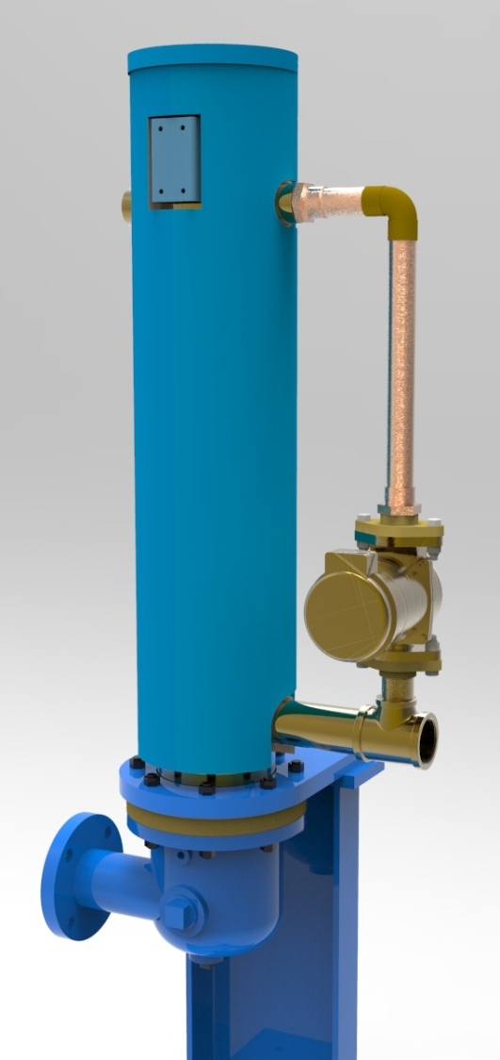
P-K COMPACT
Two Energy Source Options
  Steam-to-Water
    Bonnet
  Water-to-Water
    Billet
    2, 4, 6, or 8 Pass Configurations

Slide 6
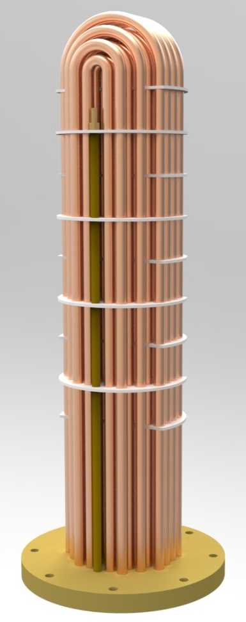
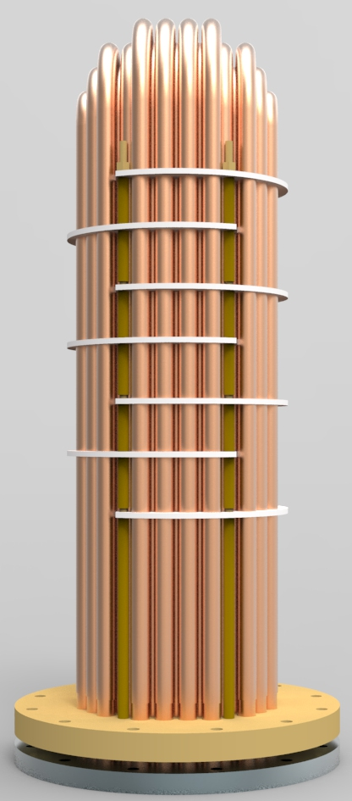
Tube Bundle Configurations
Materials
  Copper
    Maximum heat transfer
    Lower Steam Pressure units
  Copper Nickel
    Better corrosion resistance
    Steam pressure greater than 50 PSIG
    Outlet Temperature greater than 150ºF
  Stainless Steel
    Corrosion Resistance
    Single Wall Only
Single Wall
  Maximum heat transfer
Double Wall
  Extra protection against cross contamination
  Required in most medical applications

Slide 7
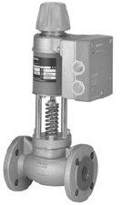
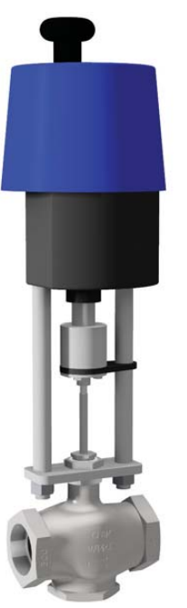
Electronic Control Valves
Valve Options
Siemens MVF and Watson McDaniel HB/CV
  Siemens sizes range from 1” to 2”
  WMD sizes range from 2 ½” to 4”
  Electronically Controlled
    LOVE Controller
Pros
  Dial in response time with controller
  Building Automation
    MODBUS (Native)
    BACnet (Protonode)
    LONWORKS (Protonode)
Cons
  Failure at power outage
  Tuning relationship more labor intensive

Slide 8
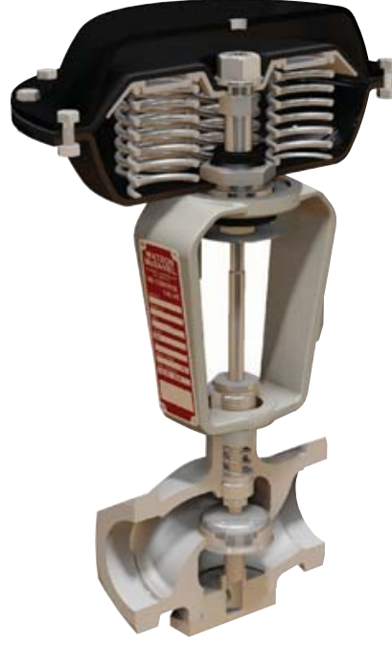
Pneumatic Control Valves
Valve Options
Watson McDaniel Control Valves
  Sizes Range from 1” to 4”
  Accritem Pneumatic Pilot
Pros
  Fastest reacting valve
Cons
  Requires a compressor
  No BMS integration

Slide 9
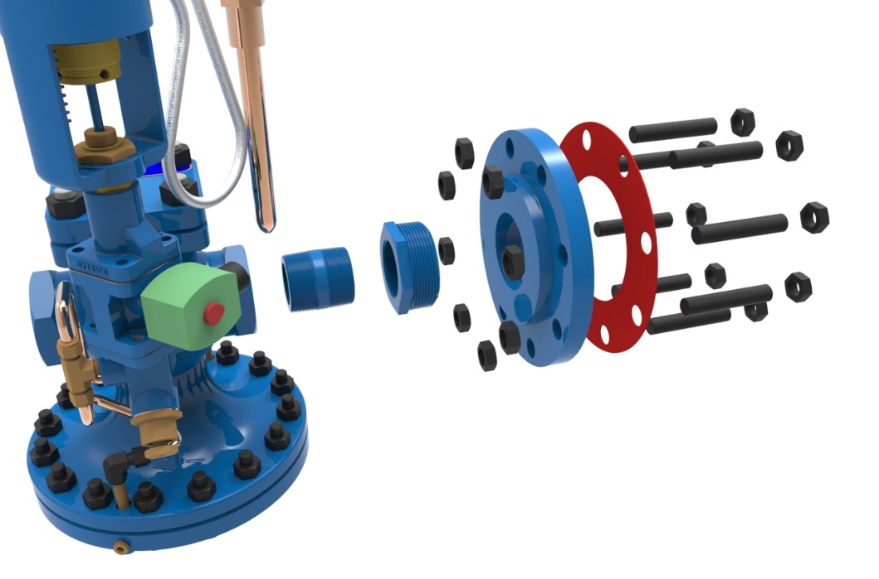
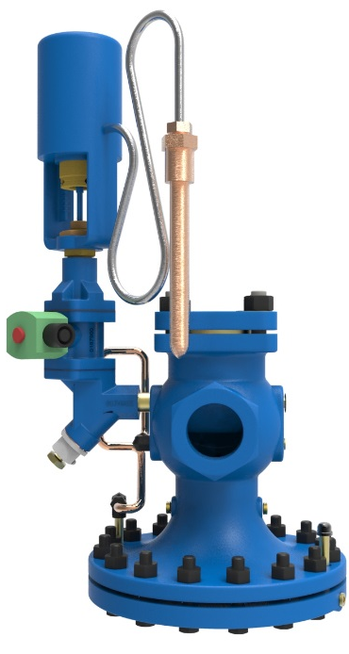
Self Contained Control Valves
Valve Options
Watson McDaniel HD Control Valves
  Sizes range from 1” to 4”
  Main valves for 15-150PSI Operating Pressure
  LP Valves for 0-15 PSI Operating
  Pressure
  PTRP Temperature Pilot
Pros
  No Compressor or Electronic Controller needed
  No maintenance on air compressors
Cons
  No BMS integration

Slide 10
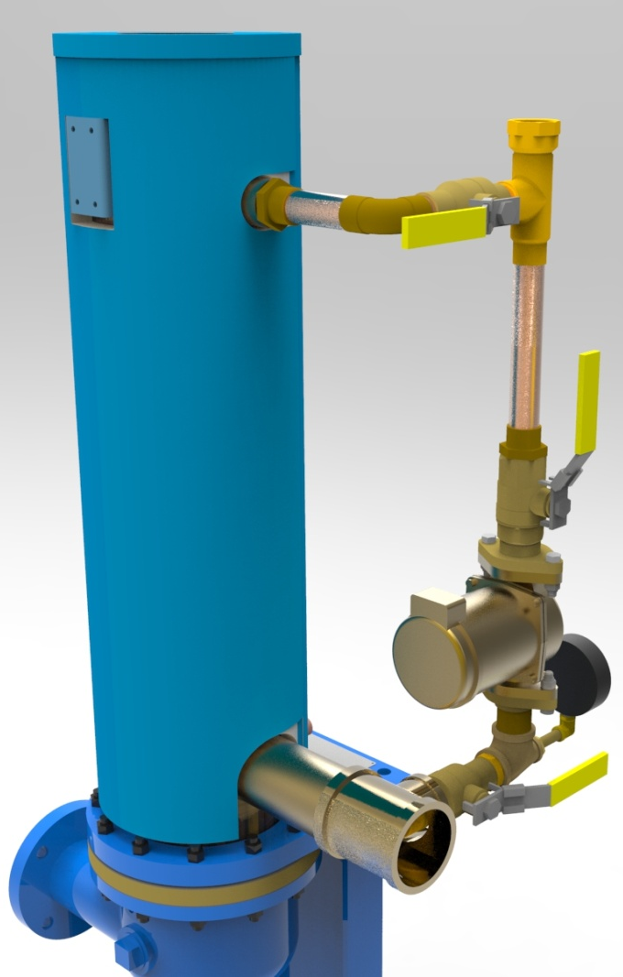
Pump Configurations
Standard
  Includes a B&G PL30B all bronze pump
  WITH ISOLATION FLANGES
NY-Trim
  Three different pump choices
    B&G PL30B – 1/12HP
    B&G PL36B – 1/6 HP
    B&G PL50B – 1/4 HP

Slide 11
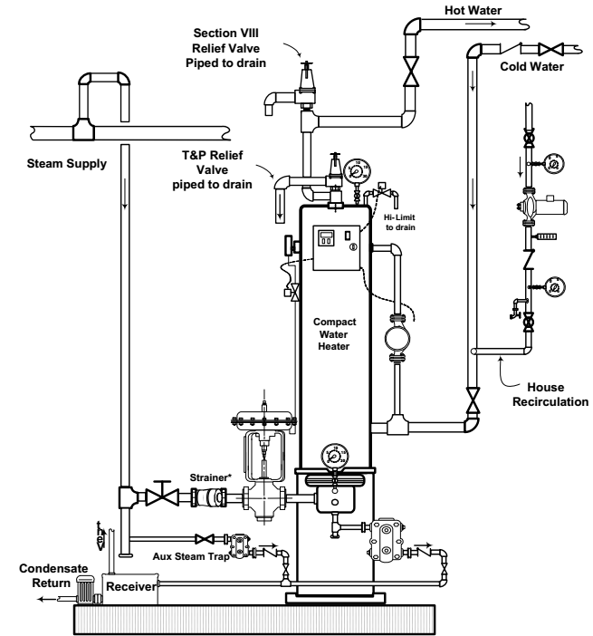
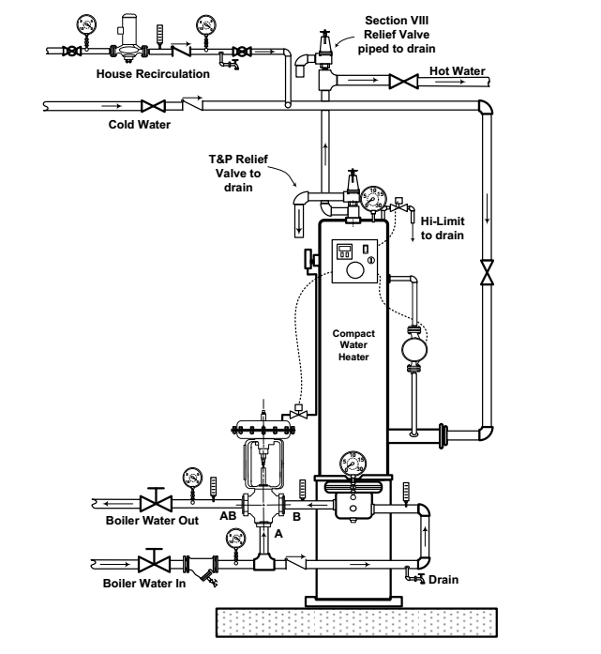
Compact Piping Diagram

Slide 12
Compact Piping Diagram

Slide 13
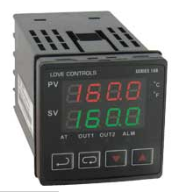
LOVE Controller
Supply
Return

Slide 14
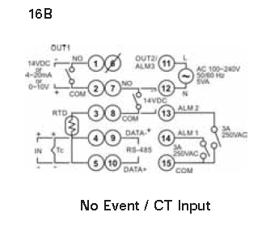
LOVE Controller: 16B – 5.3 Overview
Compact Water Heater Controller & Duration III
Configurable Single Loop Temperature PID Controller
  J-type Thermocouple or RTD
  Steam Valve Control
  Water Valve Control
Modbus communication available
  Direct Modbus Protocol
  Connection to BMS through Protonode
    BACnet
    MetaSys/N2
    LonWorks
1 Current Output and 1 Relay Output
  Current Output is for Valve
Power Requirement
  120 VAC

Slide 15
LOVE Controller: Wiring
Terminal Description | Terminal Number
Power Feed to the LOVE Controller | 11: Line 12: Neutral
J Thermocouple or RTD | 4: T/C + 3:RTD 5:RTD 5: T/C - 4:RTD
Valve Reference Signal (4-20ma) | 1: 4-20ma (-) 2: 4-20ma (+)
Relay Output | 7: Norm Open 8: Common
Modbus Connectivity | 9: Data (+) 10: Data (-)

Slide 16


LOVE Controller: Overview
3 User-Friendly Menus to Configure System
To go through the different parameters use the INDEX key
. To change a value use the UP and DOWN arrow
keys and then press the ENTER key.
  Operation Menu
    Press the INDEX key ( ) to cycle through the parameters
  Regulation Menu
    Press the ENTER key ( ) to cycle through the parameters
  Initial Settings
    Press the ENTER key ( ) for 3 seconds to cycle through the parameters

Slide 17
LOVE Controller: Overview
  Operation Menu
    Press the INDEX key ( ) to cycle through the parameters
  Features
    Temperature Set Point [140F from factory]
    Alarm High Setpoint (AL1H) [20 from factory]
    Signal Output (out1) [varies depending on system requirement]

Slide 18
LOVE Controller: Overview
  Initial Settings
    Press the ENTER key ( ) for 3 seconds to cycle through the parameters
  Features
    Thermocouple Input Type (inPt) [Type J from factory]
    Alarm Setting (ALA1)
      Sets Limits and Output functions [2 from factory]

Slide 19
QUESTIONS?

