Slide 1
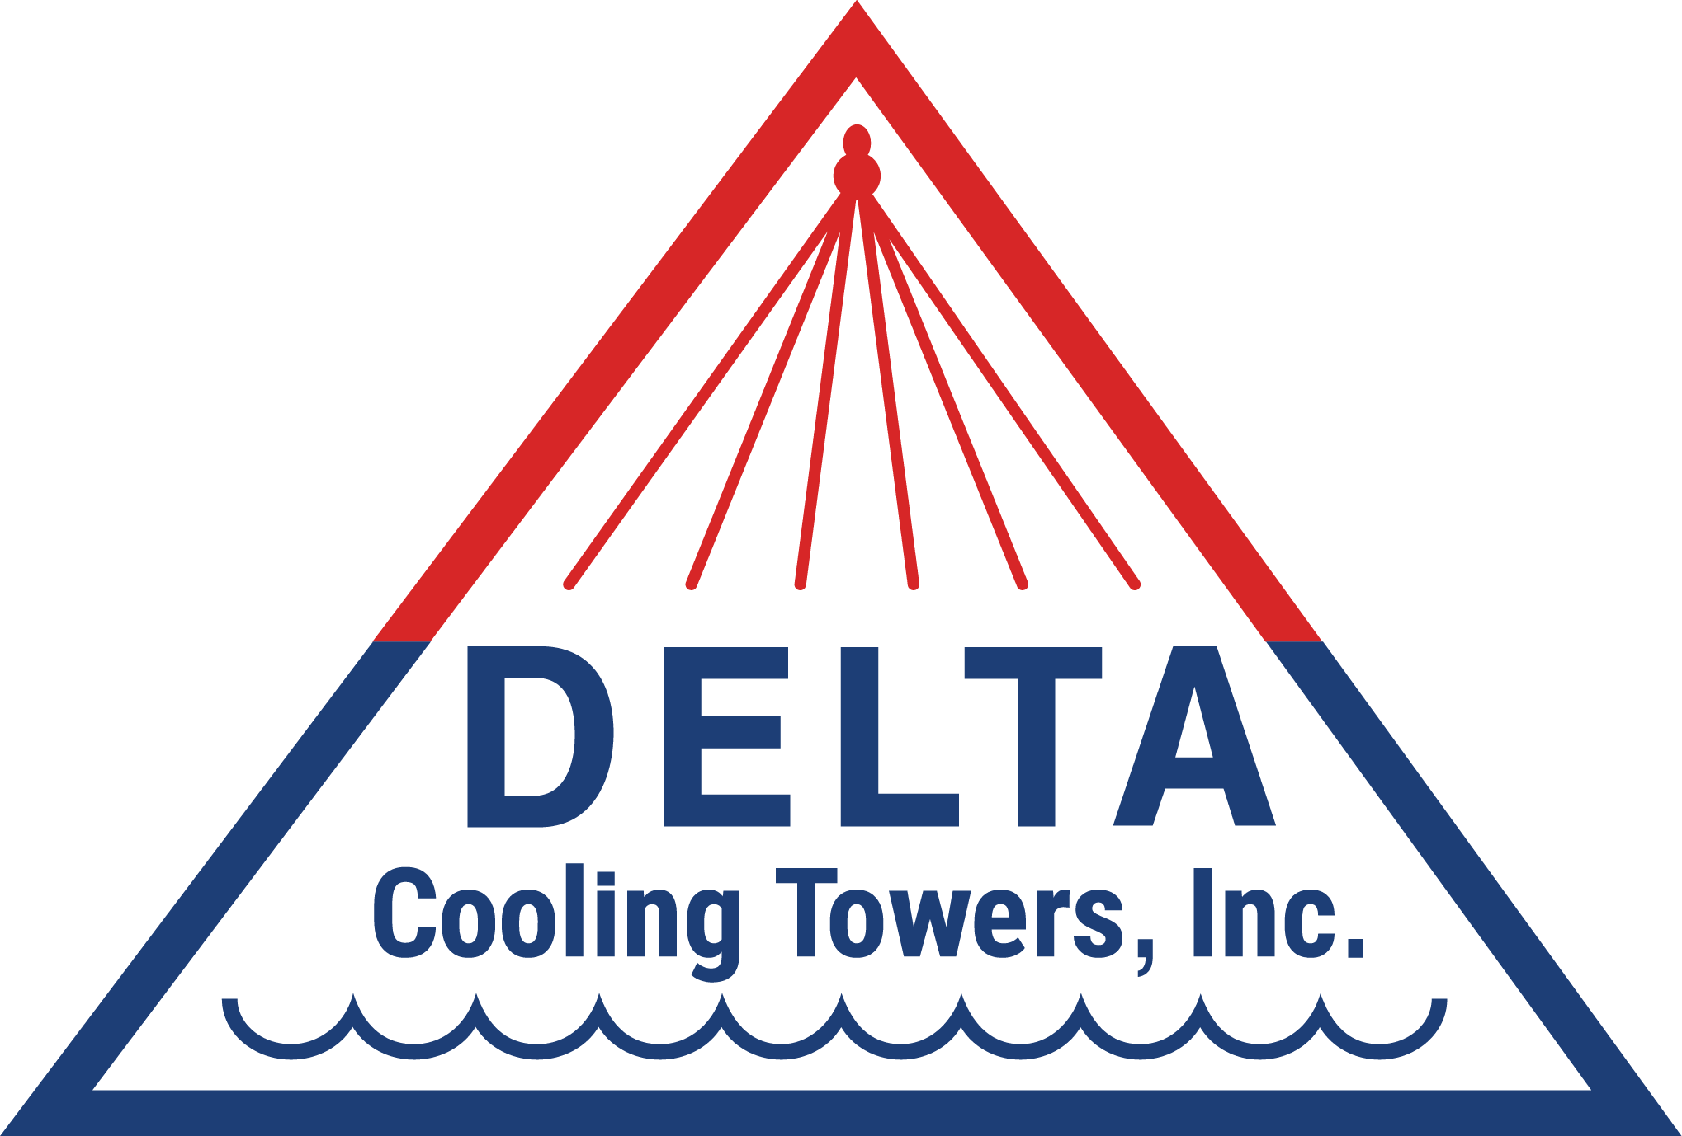
Delta Cooling Towers, Inc
Engineered HDPE Cooling Towers

Slide 2
Introduction

Slide 3
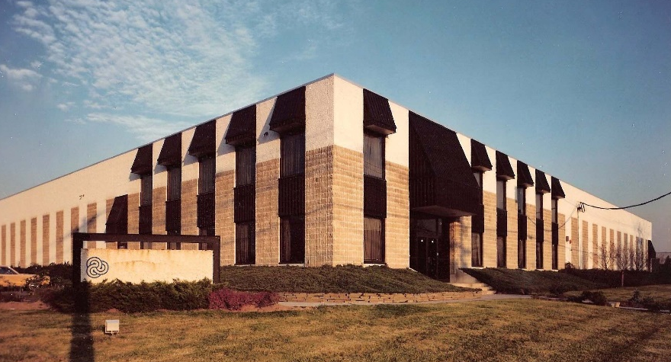
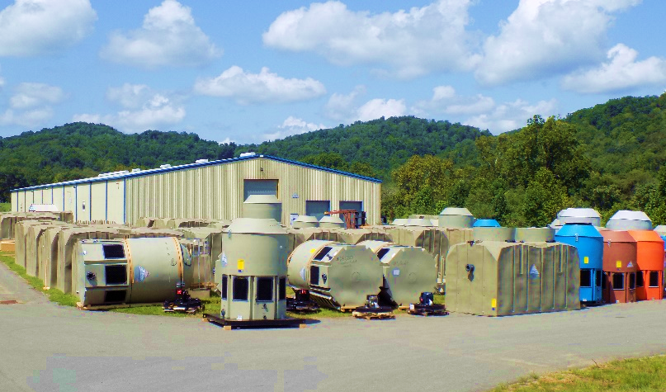
Why Delta Cooling Towers
Over 50 years of tower manufacturing experience
20-year warranty
Strong outside sales operation
World Class Service team
Made in the U.S.A. supporting global industry
Continuous innovative improvement

Slide 4
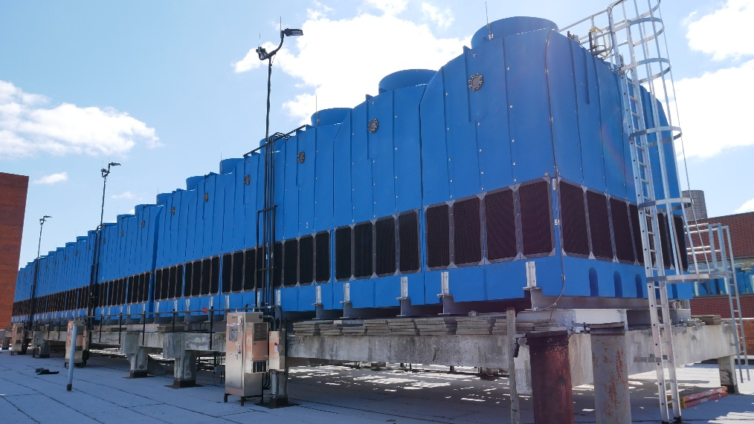
Why We Are Different
Our customers are concerned about cooling tower longevity, 100% uptime, and lower installation and operating costs. Delta Cooling Towers is the only cooling tower manufacturer with a 20-year warranty, a HDPE seamless non-corroding shell, and compounded ANTI-MICROBIAL resin, which helps minimize Legionella risk.
We are NOT the square metal solution

Slide 5
Delta Benefits
Totally seamless cooling tower shell - rotationally molded of HDPE
NO panels NO rivets NO fasteners
Corrosion proof and chemical resistance
u Will not rust, flake, chip, peel, or ever need painting or protective coatings
u Complete UV protection (UV inhibitors added to the resin prior to molding)
u Unaffected by water treatment chemicals, salt, sunlight or air pollution
Can withstand harsh temperature environments
u Inlet temps to 180°F and shell temps to -94°F
Lighter in weight by 30% to 50% compared to steel towers of the same capacity
u IBC Compliant – wind loads to 205 MPH/Seismic Zone 4
Lighter in weight by 30% to 50% compared to steel towers of the same capacity
u IBC Compliant – wind loads to 205 MPH/Seismic Zone 4
Notes:
Seismic calcs process and costs

Slide 6
Why Polyethylene?
All towers are “rationally molded” of high-density polyethylene (HDPE) plastic
Excellent chemical resistance – unaffected by chemicals typically used for cooling water treatment
Not affected by acids or saltwater
Does not support growth of algae, bacteria, or fungi
Resin contains UV inhibitors to prevent degradation
Recyclable and a green solution that outlasts fiberglass and galvanized and stainless steel

Slide 7



Industry Leading Warranty
1 Year
5 Years
20 Years

Slide 8
Product Overview

Slide 9
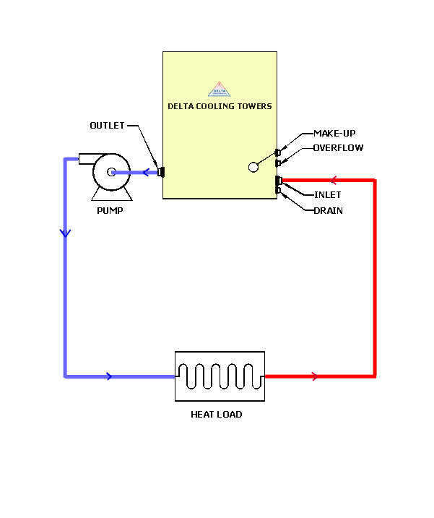
Cooling Tower Basics
A cooling tower is a device that transfers quantities of heat from one mass (water) to another (air)
Allows you to re-circulate process water instead of wasting it.
Warm Water
`
Cold Water

Slide 10
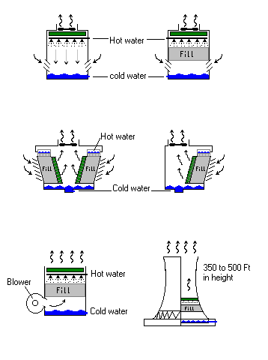
Various Types of Cooling Towers
Induced draft, counter flow
Induced draft, Cross flow
Forced draft
Counter flow
Hyperbolic
Natural draft

Slide 11
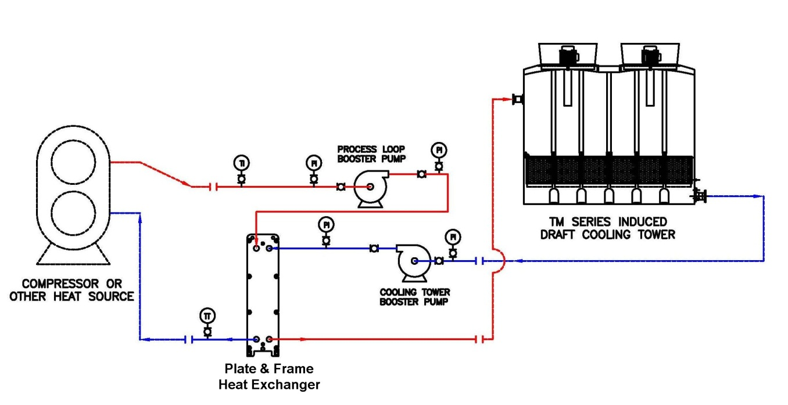
Closed-Circuit Cooling Systems
For closed-circuit cooling Delta recommends a cooling tower plus a plate heat exchanger system. The skid-mounted plate heat exchanger provides a closed-circuit on the hot side of the heat exchanger. The non-corroding Delta cooling tower feeds the cold side of the plate heat exchanger.

Slide 12
Sizing and Selection
Flow rate in GPM
Range of cooling in °F (inlet – outlet temperature
Area wet bulb temperature in °F
Important Formulas
Heat Load (Btu/hr) = GPM x 500 x ° Range of cooling
GPM = Heat Load (Btu/Hr)
500 x ° Range of Cooling
Nominal Load = GPM x ˚ Range of Cooling
30

Slide 13
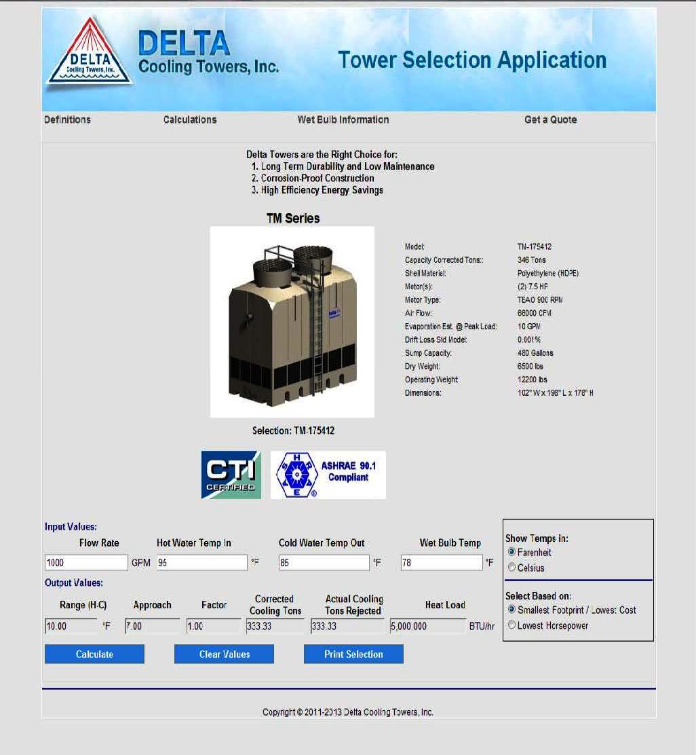
Sizing and Selection
Theoretical Design
Website Sizing Program
1 Chiller Ton = 12,000 Btu/Hr
1 Cooling Tower Ton = 15,000 Btu/Hr*
*Cooling Towers need to make up not only for the Nominal. Heat Load but also Approximately 25% Due to the Heat of Compression Imposed by the Chillers Compressor.
Based on Design Conditions
95°F Hot water Range = 10°
85°F Cold water Approach = 7°
78°F Wet bulb
Computer program that calculates Delta Cooling tower model required for given design conditions
Computer program that calculates Delta Cooling tower model required for given design conditions. Allows viewing of Brochures, Specifications, Engineered Drawings and Quote Forms.

Slide 14
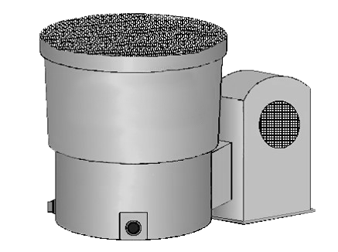
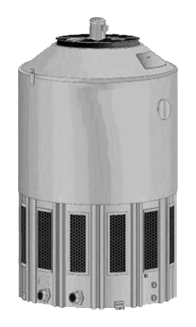
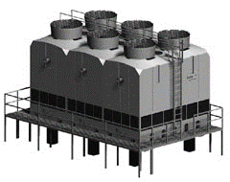
Delta Tower Models
Pioneer® Force Draft Towers
10 Tons - 100 Tons
Paragon® Induced Draft Towers
55 Tons - 250 Tons
TM Series® Induced Draft Towers
265 Tons – 2,074 Tons

Slide 15
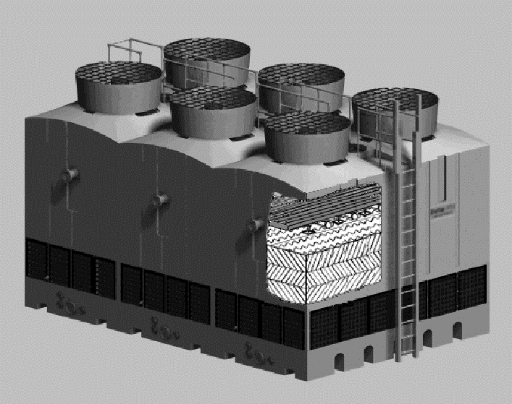
8
1
7
6
2
5
3
4
1 Double Wall Corrosion Proof Shell – HDPE double wall plastic construction can not corrode and is backed by 20-year warranty.
5 Fill Material – High efficiency PVC cellular design for maximum cooling.
2 Multi Cell with Independent Cell Capacity – Independent cells allow isolation of cells for operational flexibility.
6 Nozzle Water Distribution System – Non-Clog large orifice removable spray nozzles evenly distribute the water.
3 Leak-Proof Sloped Sump – Molded as Unitary (One-Piece) structure that has no joints to leak or require re-caulking and sealing.
7 Drift Eliminator – Three pass PVC drift eliminator prevents water droplets from leaving the tower.
4 Self Supporting Plastic Base – Tower can be set on flat surface or on I-Beams in integrally molded I-Beam pockets.
8 Direct Drive Air Moving System – Totally enclosed cooling tower motor powers fiber-reinforced polypropylene axial propeller fan.

Slide 16
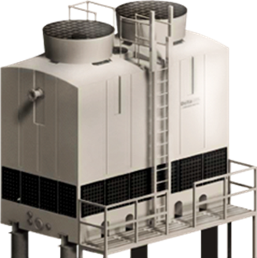
Up to Six (6) Multi Cells with Independent Cell Capacity.
The Independent cells allow isolation of cells for operational flexibility.

Slide 17
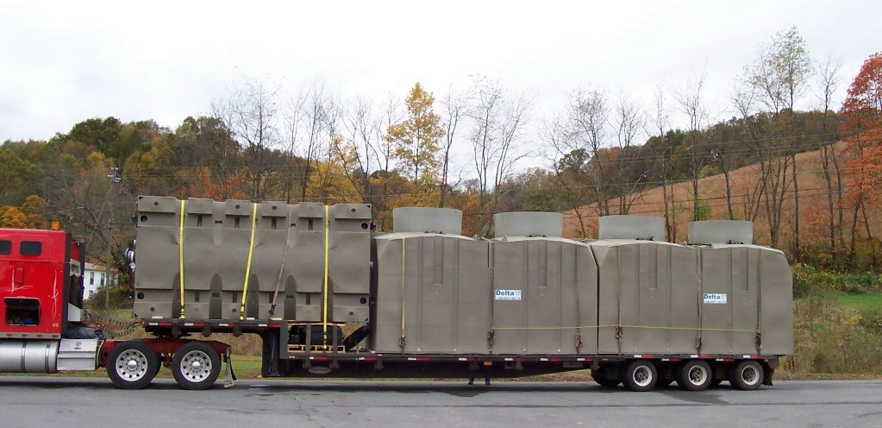
Shipping
Figure 1 Delta TM Series 2 Cells

Slide 18
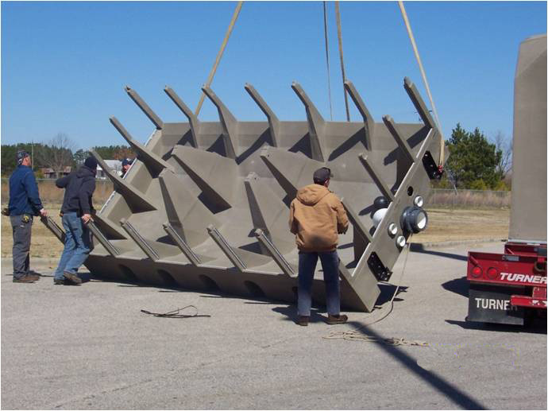
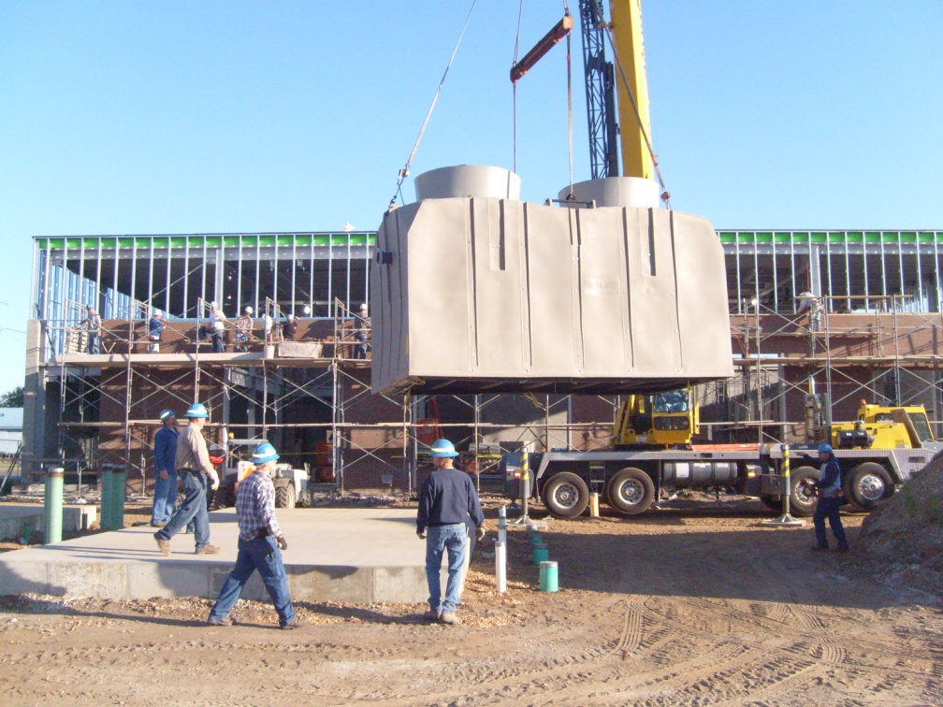
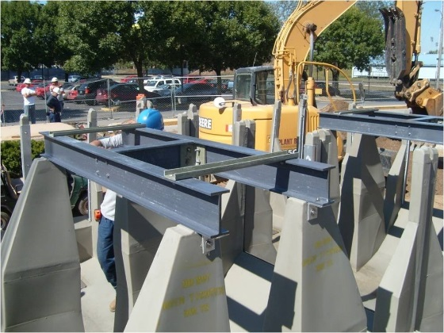
TM Installation
  Each cell ships in two pieces, the sump section & the upper body section

Slide 19

Low Sound Fan Assemblies
Low sound option utilizes a wide chord blade fan prop to achieve large reductions in sound noise.
Depending on model tower and site dynamics, at ground levels sound pressure levels are reduced 4-8 dB(A); overhead sound pressure levels are reduced 10-17 dB(A)
Designed to have very high efficiency as standard designs, utilizing premium efficient motors, resulting in the no derate cooling tower capacity.

Slide 20
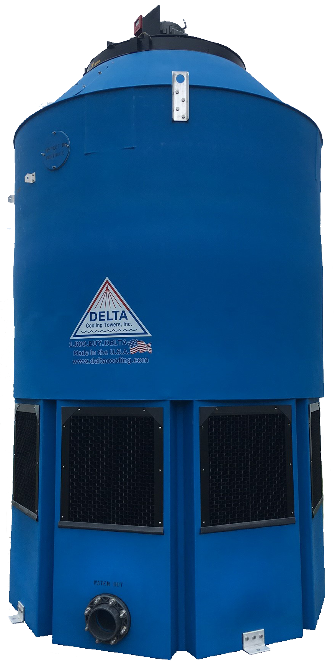
Anti-Microbial Cooling Tower
Tested Independently by Special Pathogens Laboratory®, The Legionella Experts®
Delta AM tower displays the only Anti-Microbial efficiency against Legionella bacteria out of all the common cooling tower materials.
Legionnaires’ Disease
Legionnaires’ disease is a severe form of pneumonia
Caused by inhalation of aerosols containing Legionella bacteria
84% of US cooling towers contain Legionella bacteria (source)
The potential for Legionnaires' disease outbreaks exists wherever a colonized cooling towers and a susceptible population coincide

Slide 21
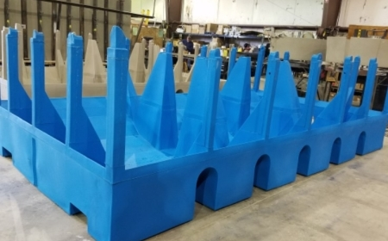
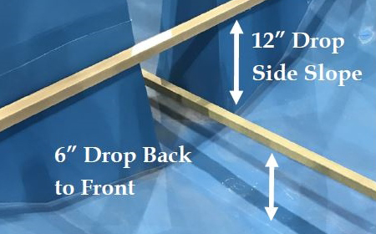
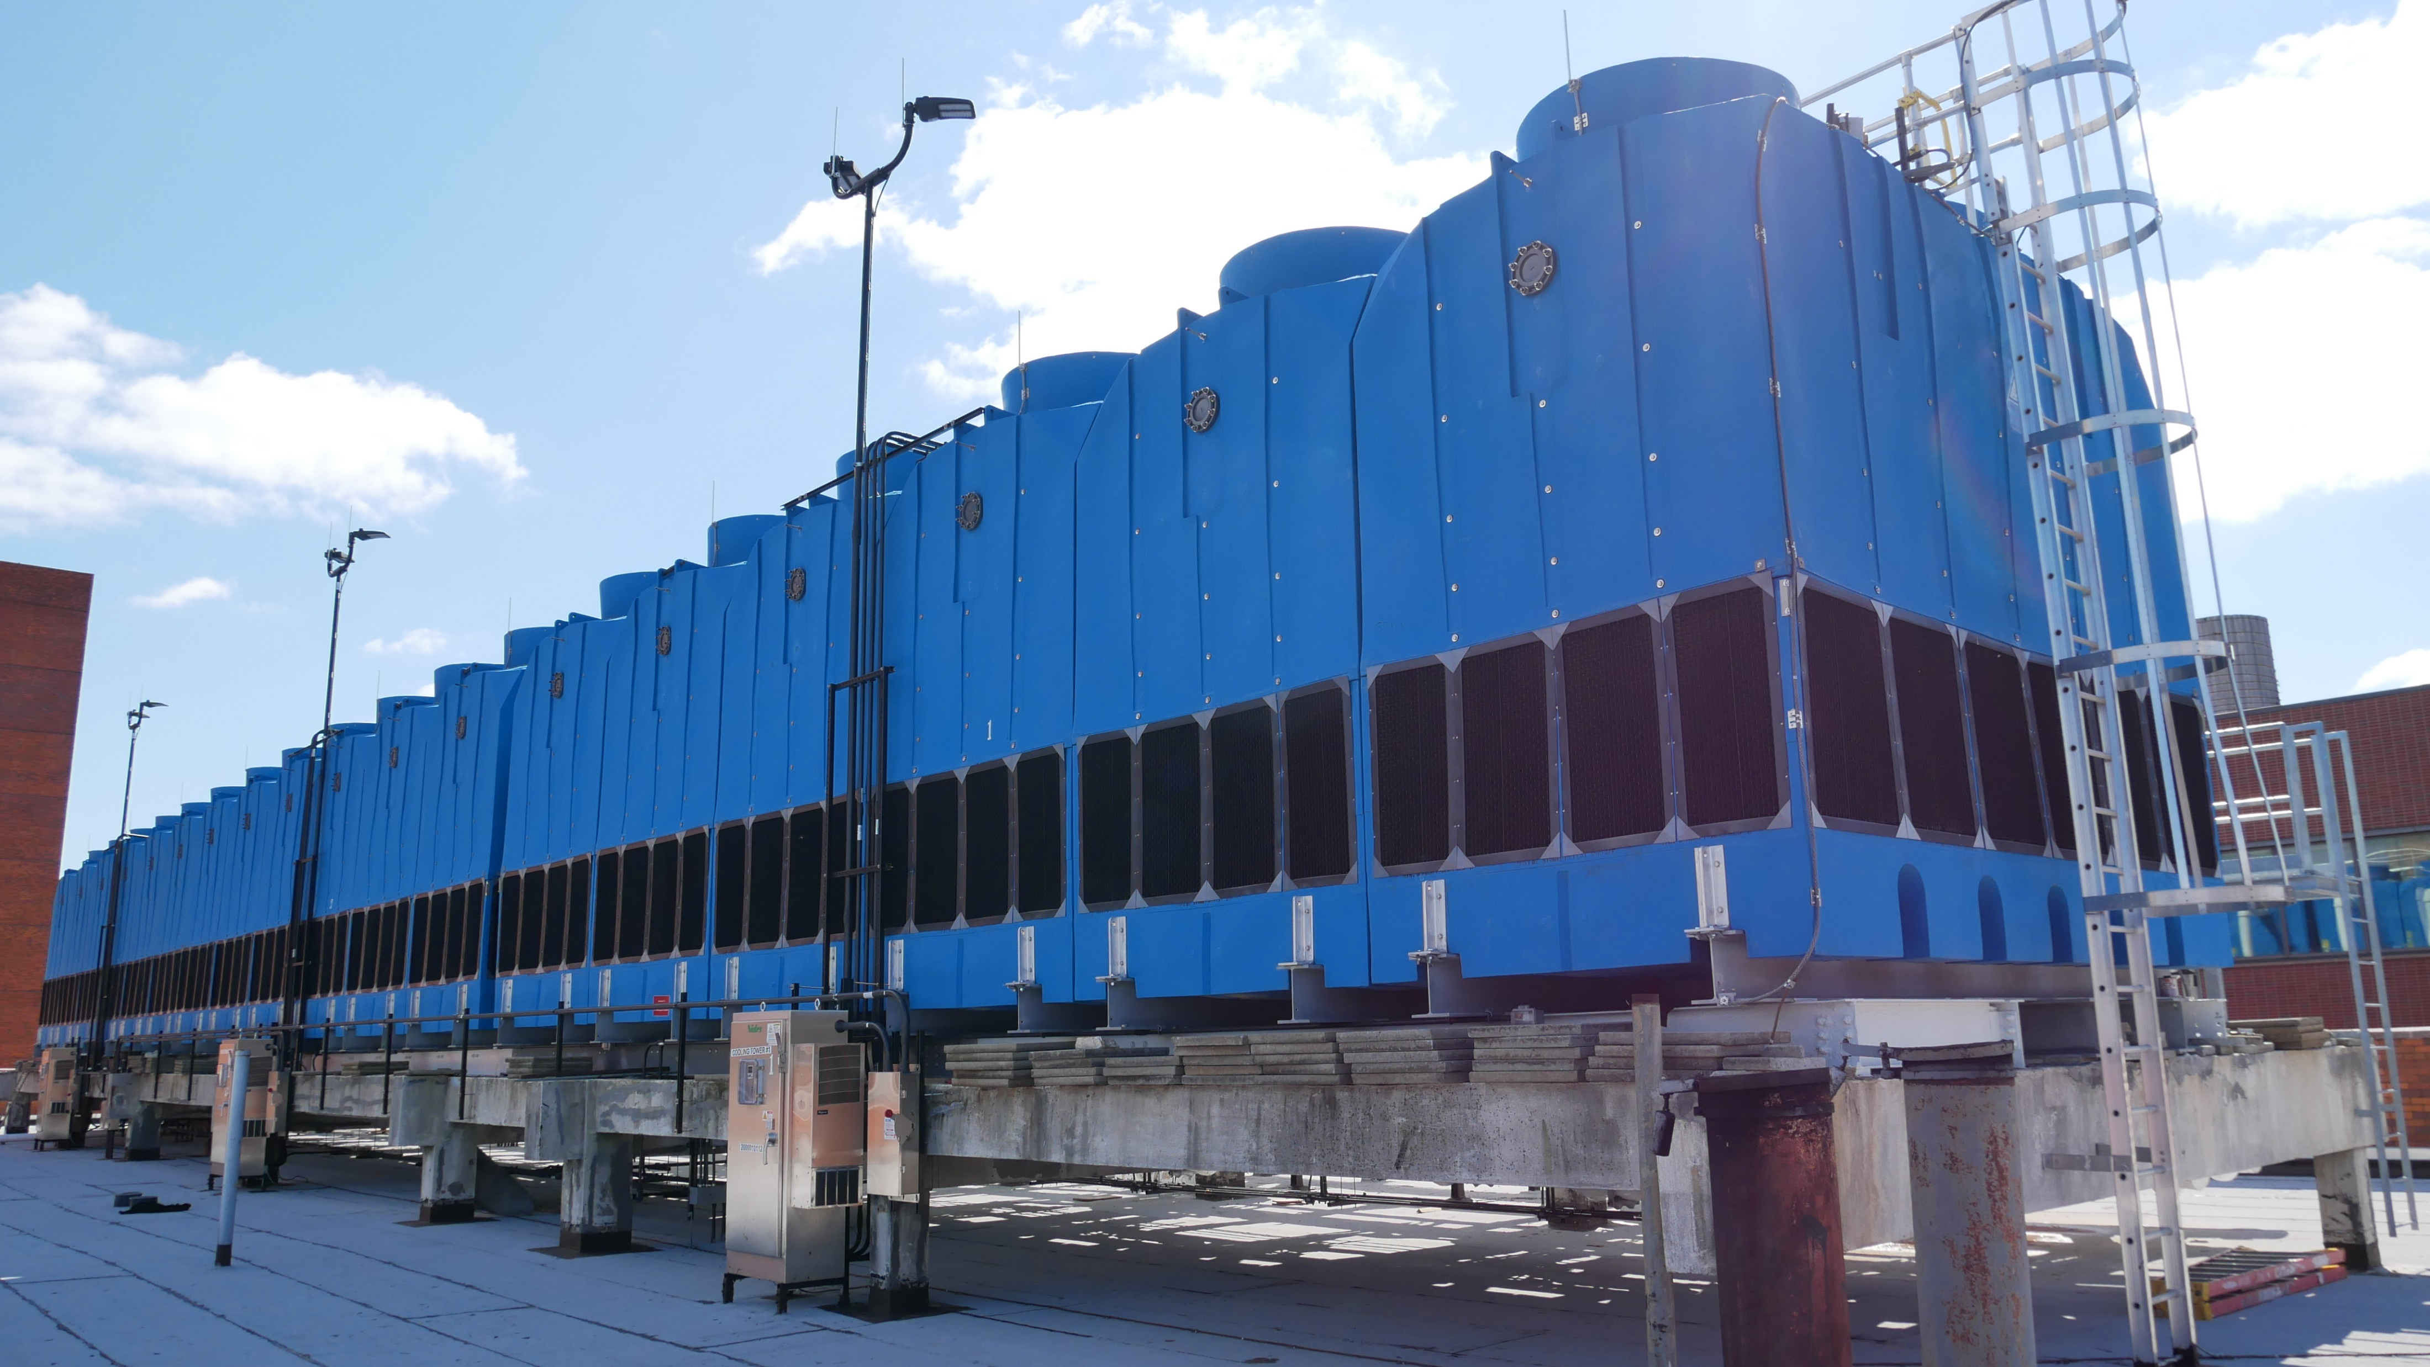
Anti-Microbial
Shell and Fill
Anti-Microbial
Basin
Anti-Microbial HDPE Resin Shell
Anti-Microbial Compounded PVC or PP
Fully Compounded Throughout Resin
Resists Biofilm Growth
Withstands Aggressive Chemical Treatments
Stagnant Water is a breeding ground for microorganisms which reproduces Legionella. Our design prevents stagnant water
Aggressive slope side-to-side
3% slope front to back
Basin Sweeper Available

Slide 22
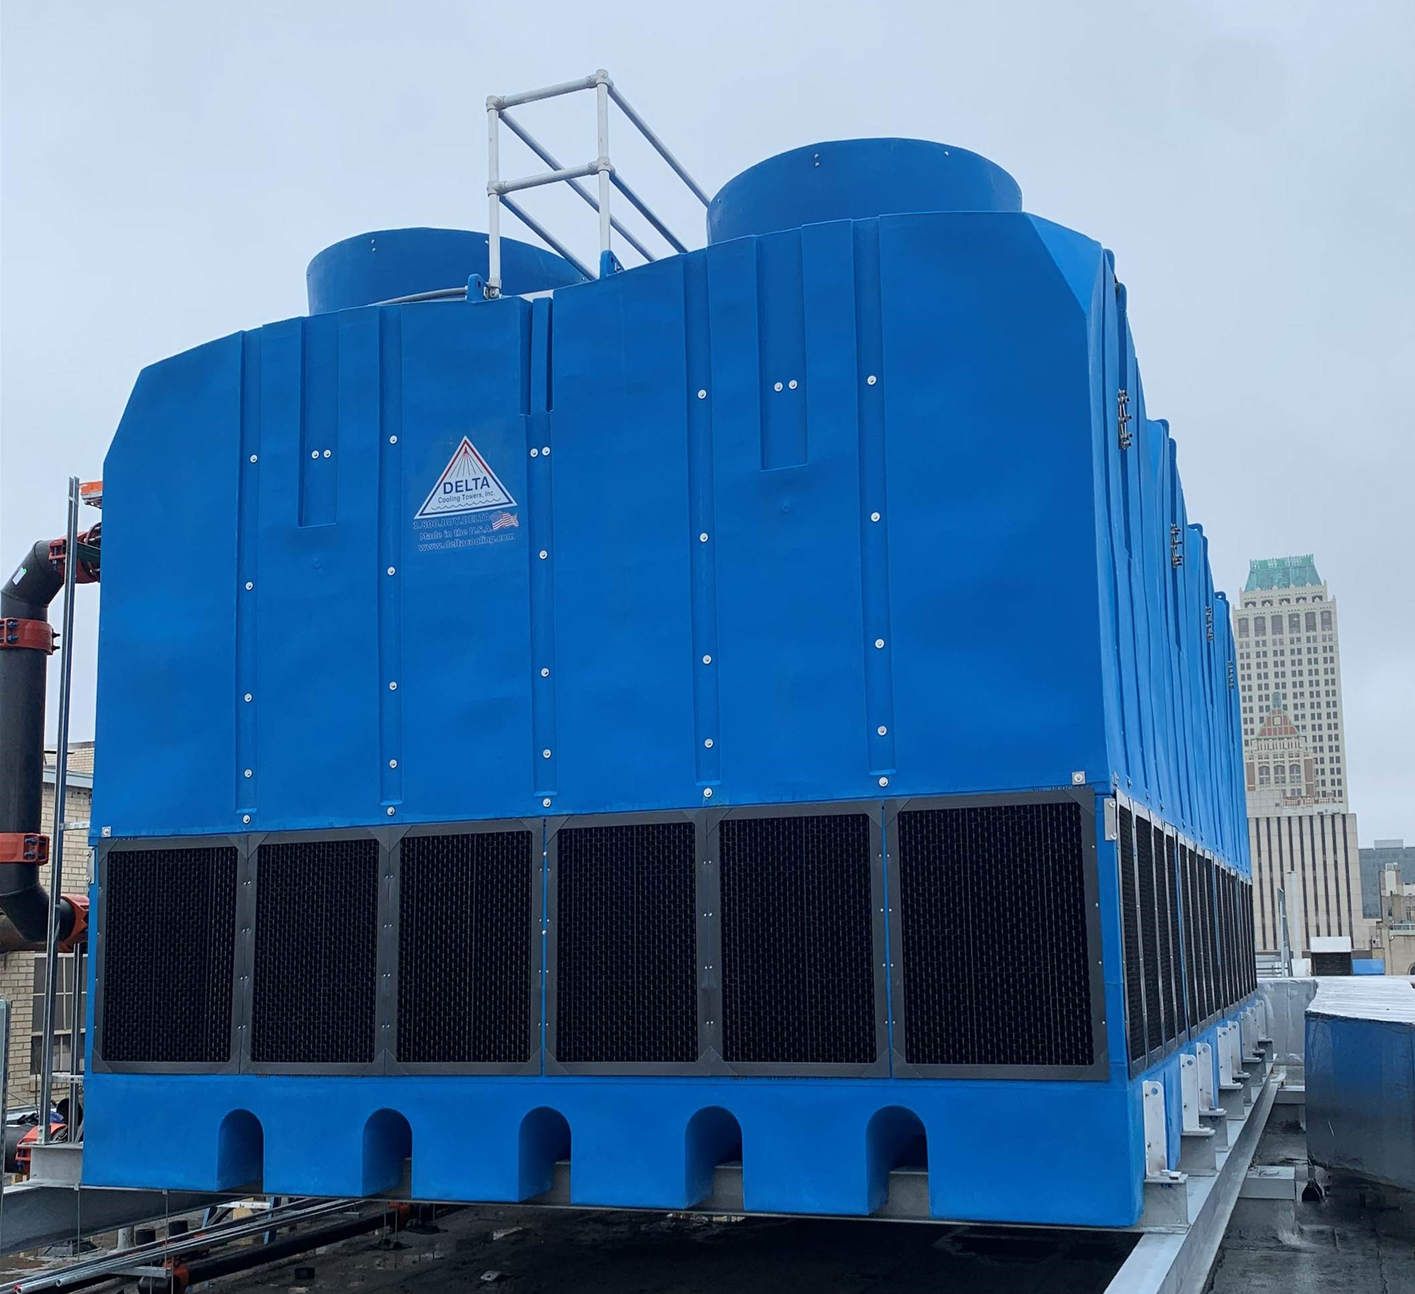
Anti-Microbial Water Treatment
Delta AM minimizes risk at the tower- does not protect upstream/downstream therefor Chemical Treatment is recommended
Treating with harsh chemicals WILL NOT have an adverse effect on tower life or Anti-Microbial properties of tower
Water treatment chemicals don’t provide continuous control of microorganisms.
Hospital-approved biocides quickly reduce bacteria counts, but within 120 minutes of drying, bacteria will rebound, and disinfection must reoccur in order to keep the bacterial count down.

Slide 23
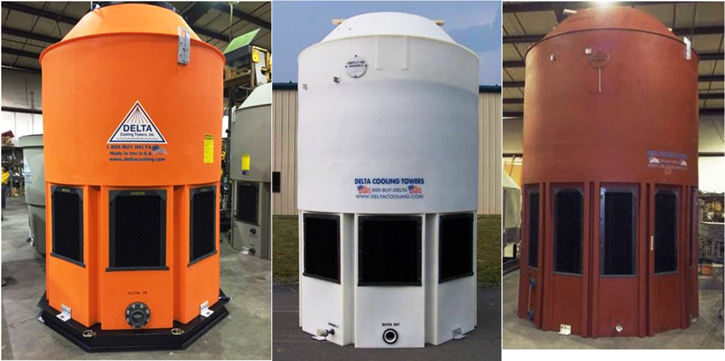
Resin Color Match Available

Slide 24
Case Studies

Slide 25
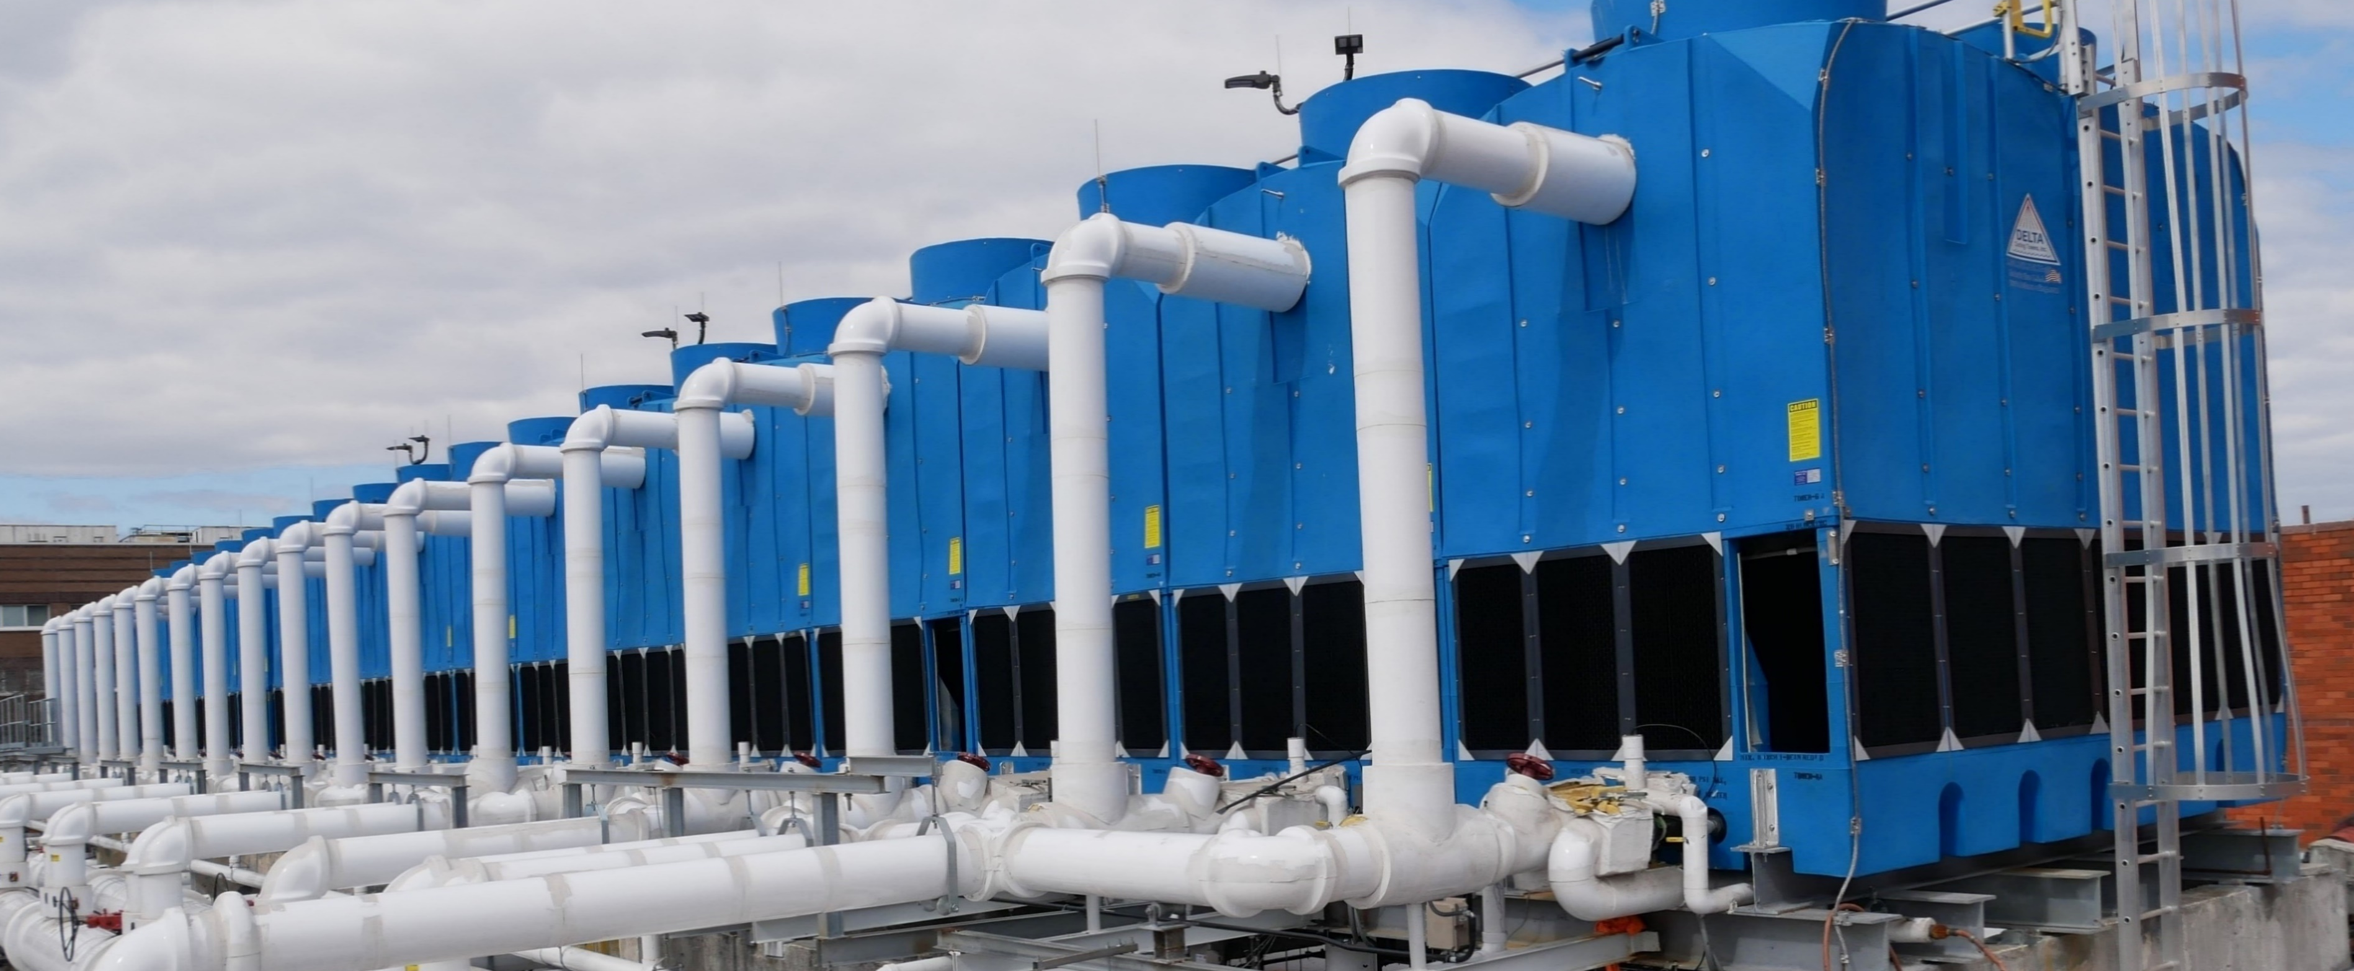
Lincoln Hospital
Neighboring communities had experienced outbreaks of Legionnaires’ Disease
Associate Executive Director wanted to think outside the box and was concerned about the dangers of microbial growth
Selected our TM Anti-Microbial series with 18 modular cooling towers with a combined total of 6,000 cooling tons because of the rounded design, HDPE durability and protective features of anti-microbial material

Slide 26
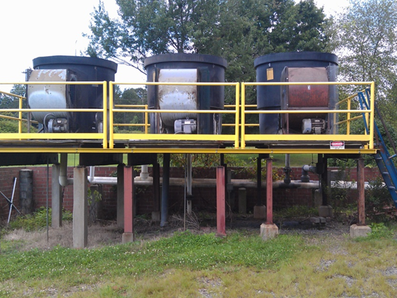
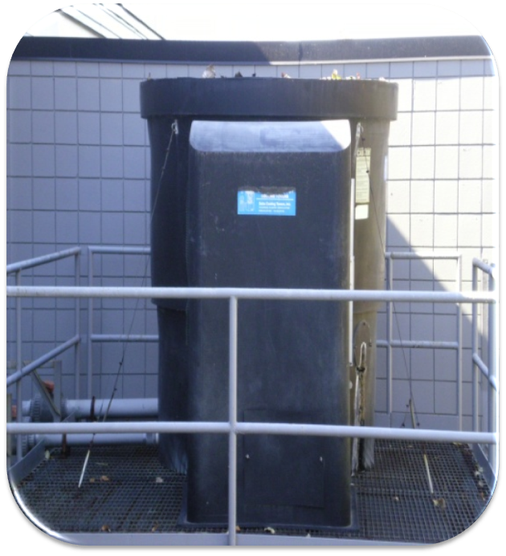
Oldest towers
1971- 49 years in Service

Slide 27
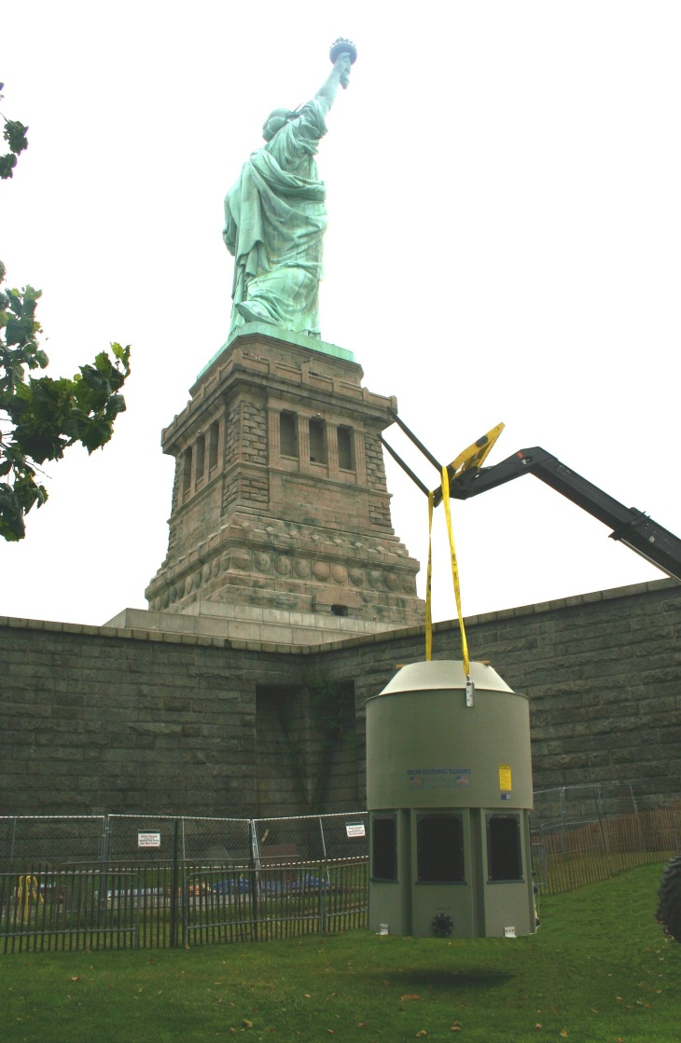
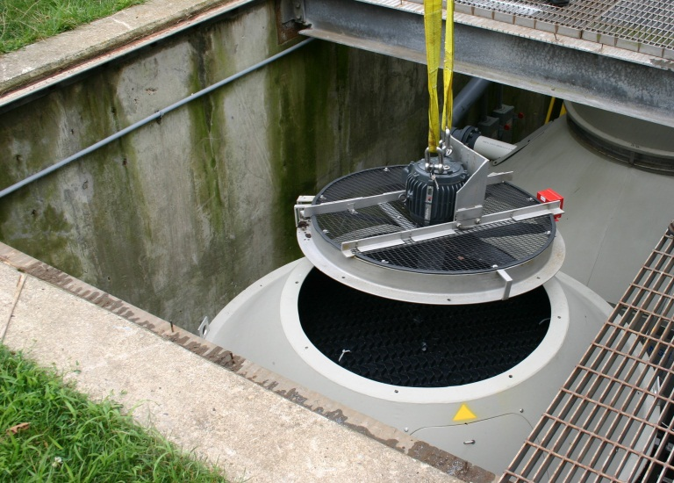
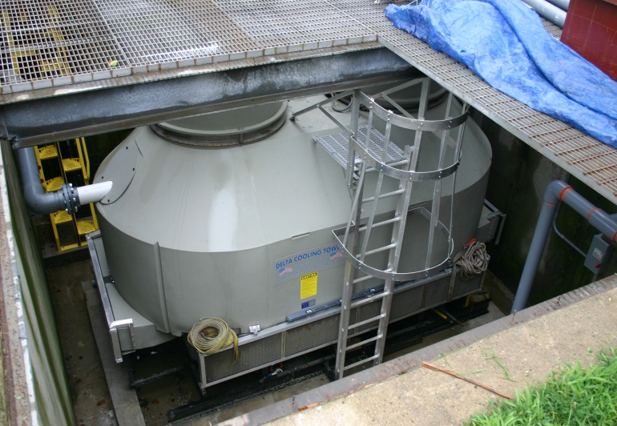
Statue of Liberty
Due to the salty, wet, corrosive environment of Liberty Island, all the galvanized metal equipment needed to be removed
They needed a corrosion proof cooling tower that could survive the elements since their old towers had rotted out
In such a harsh, damp environment, the seamless 250-ton Premier tower and 70-ton Paragon will keep moisture and water away from vital parts of the tower

Slide 28
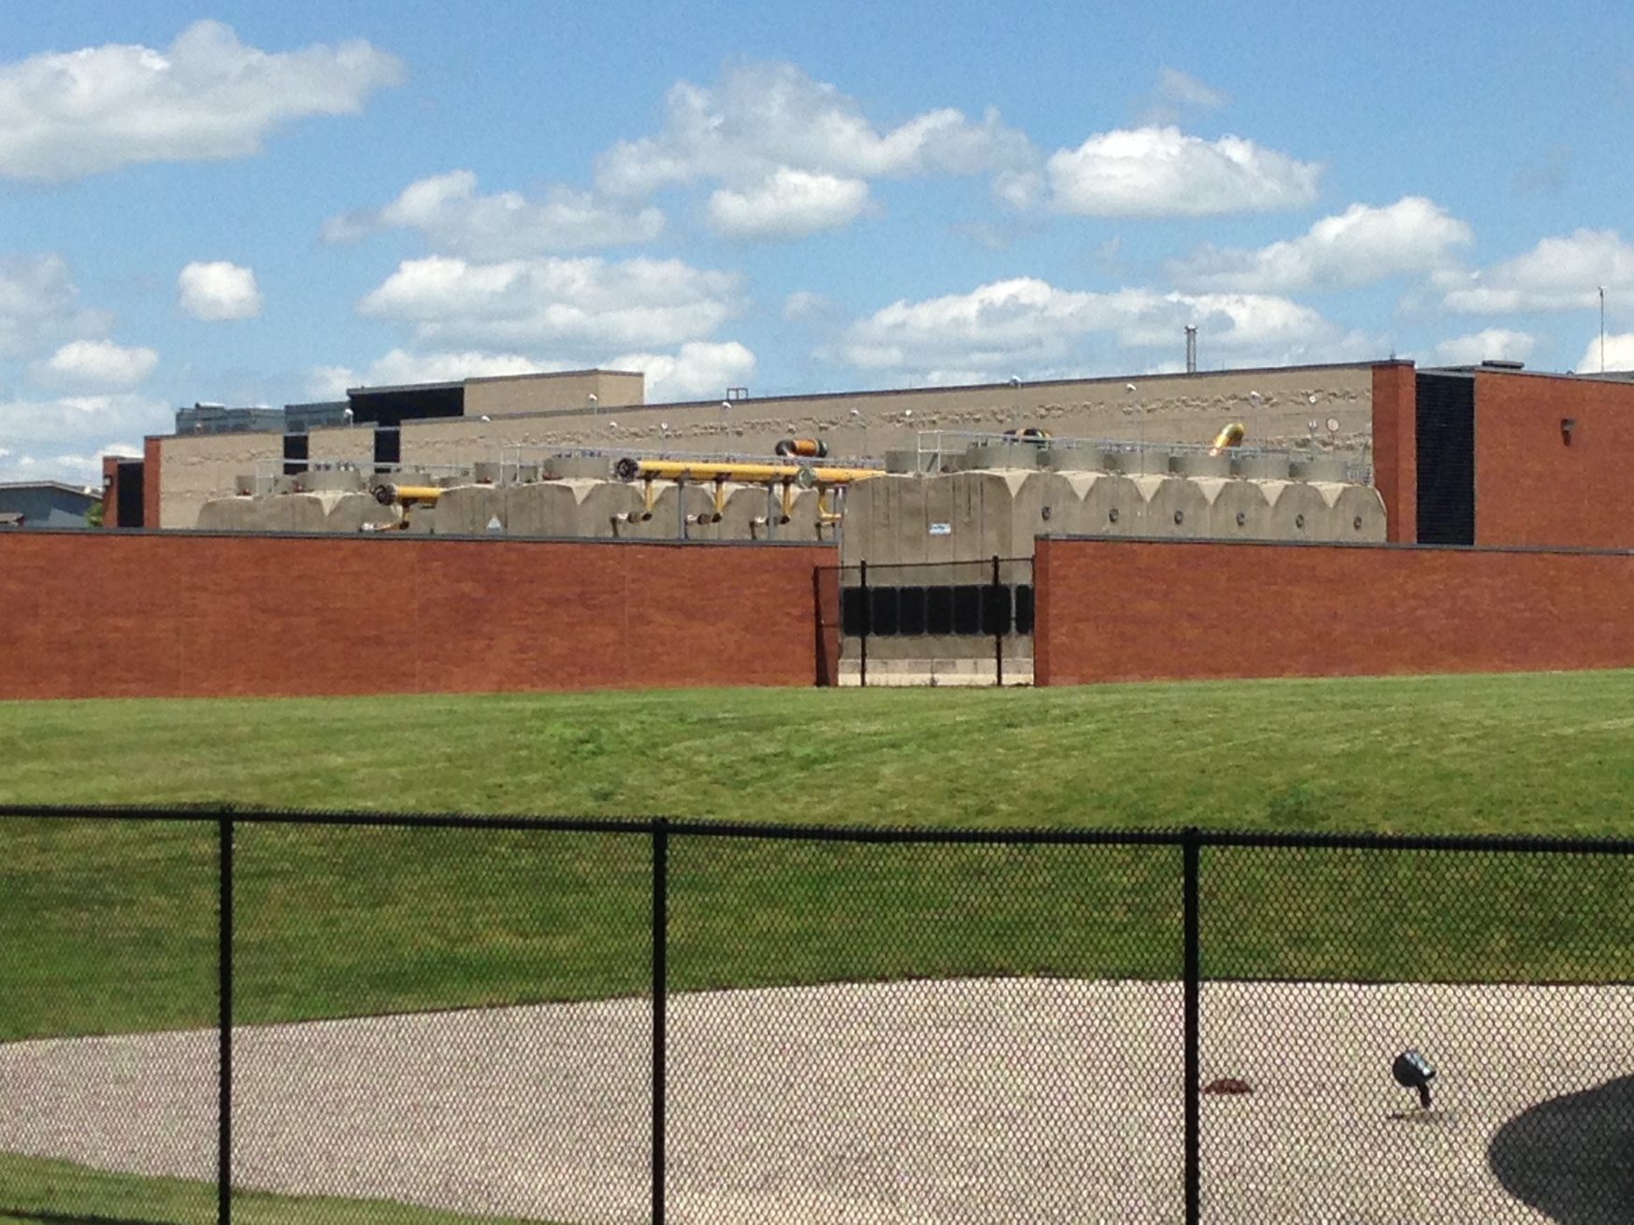
Case Study – State Farm

Slide 29
Summary

Slide 30
Delta Cooling Towers
Over 50 years of tower manufacturing experience
20-year warranty
Strong outside sales operation
World Class Service team
Made in the U.S.A. supporting global industry
Continuous innovative improvement

Slide 31
Delta Cooling Towers
Contact | Email
Eric Chapman, Regional Manager Liza Wheatley, Sales Operations Manager | echapman@deltacooling.com lwheatley@deltacooling.com

