Slide 1

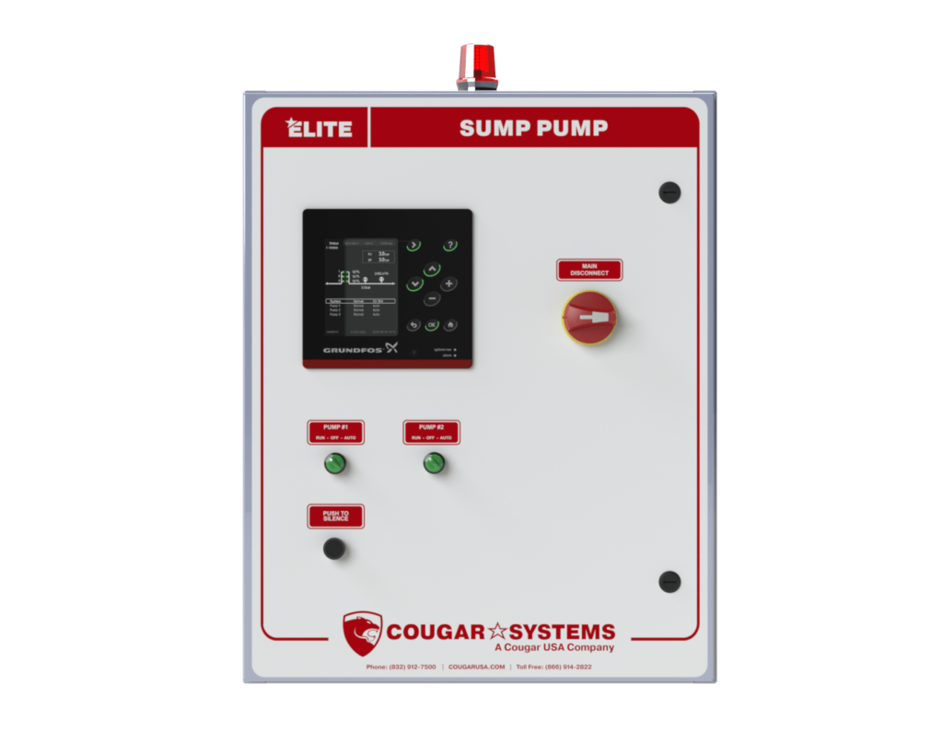
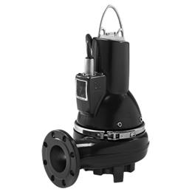
Lift Station Service

Slide 2
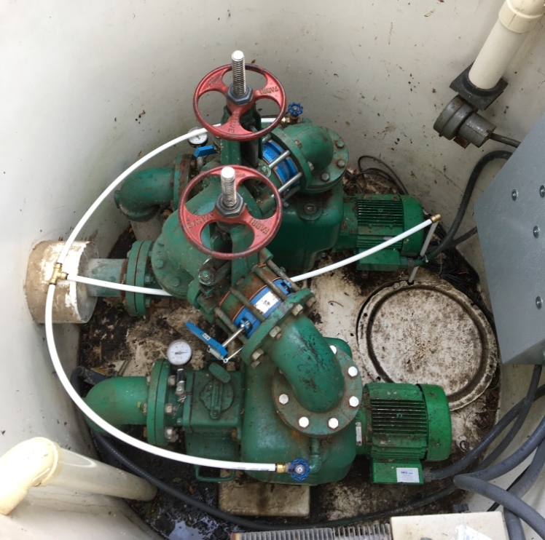
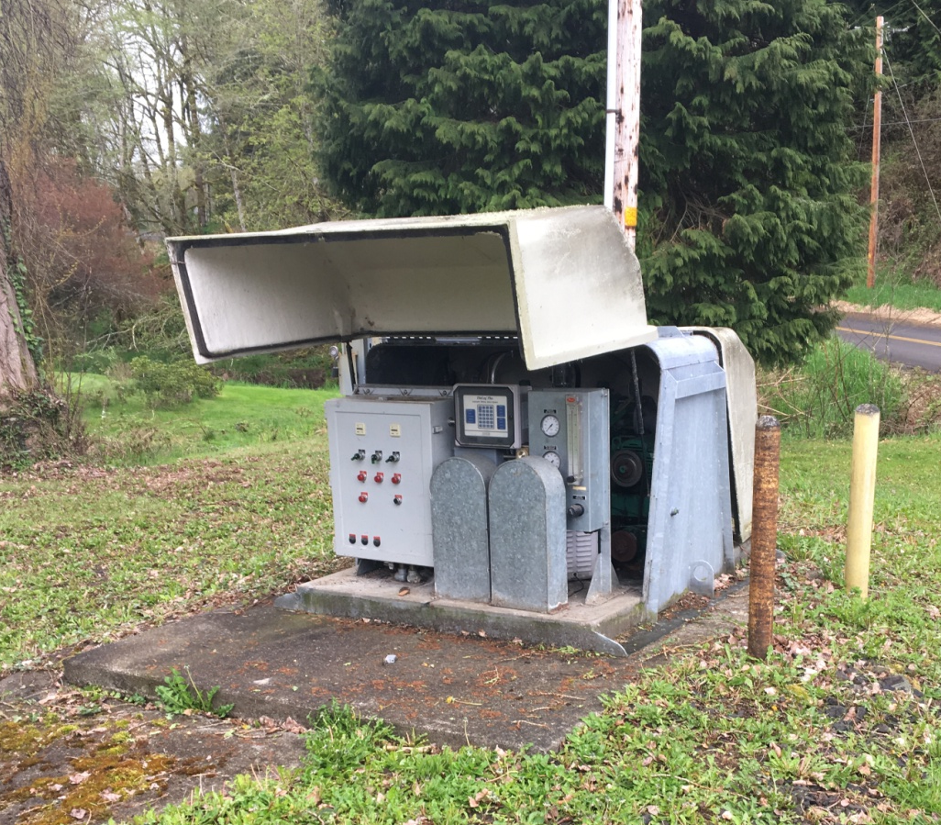
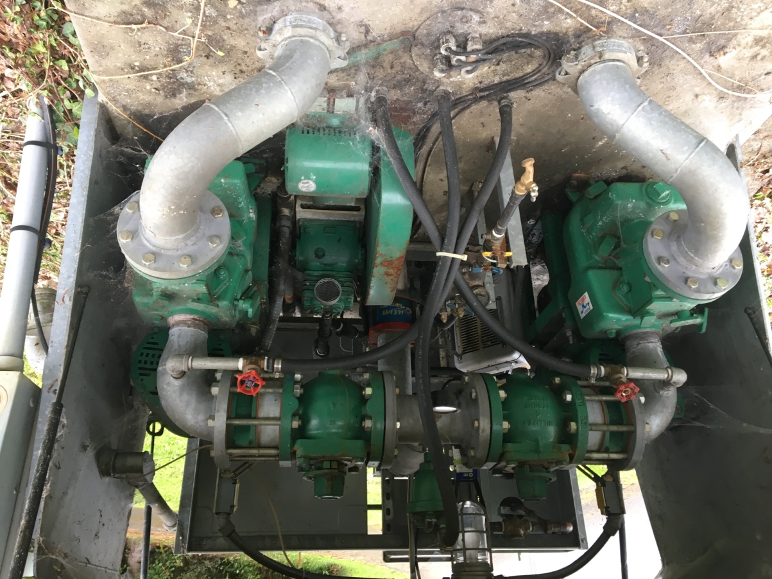
Above ground Vacuum Lift
Station

Slide 3
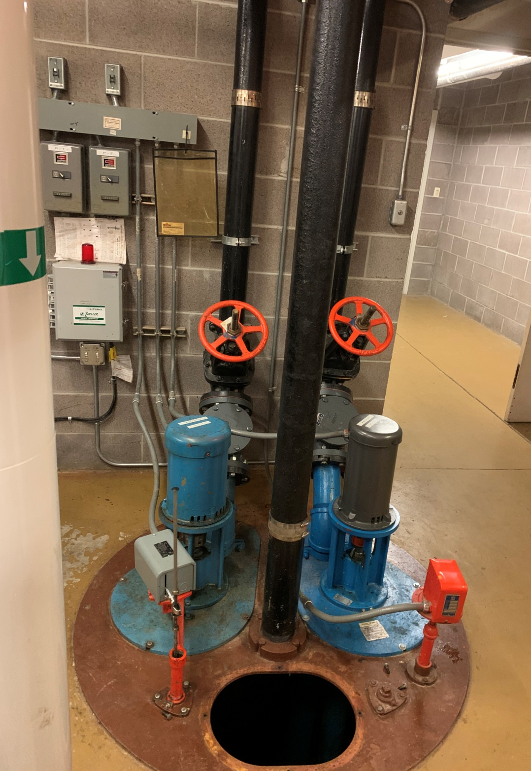
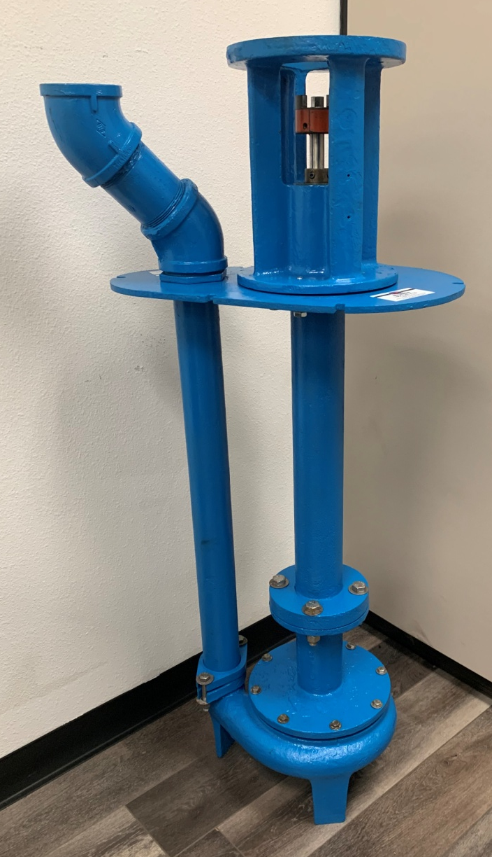
Column pumps

Slide 4
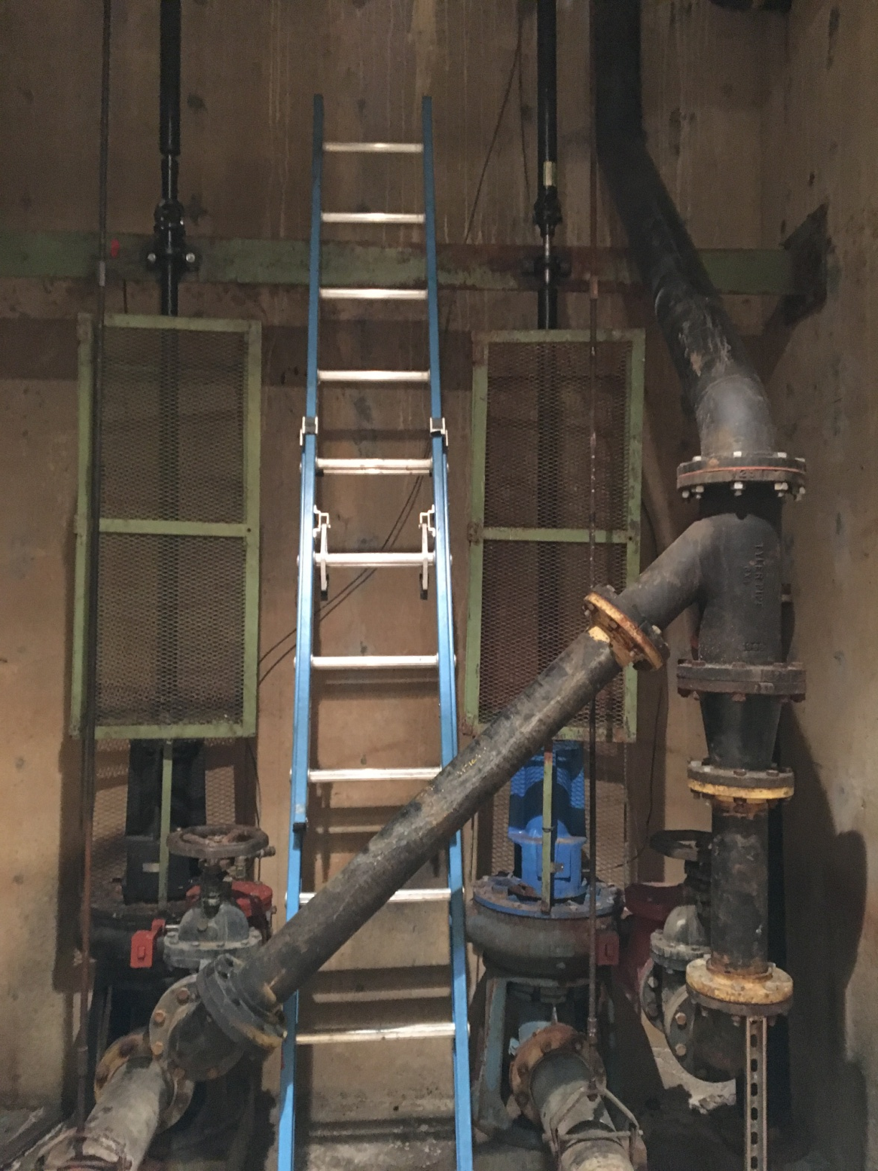
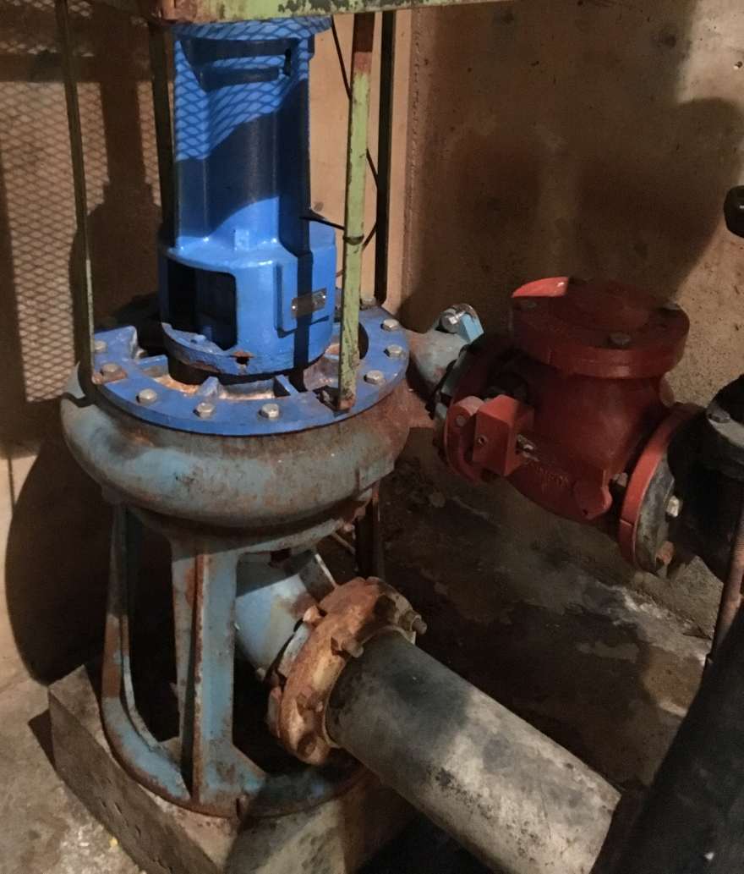
Dry well pumps

Slide 5
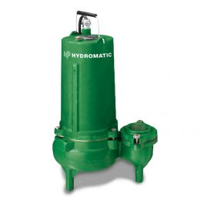
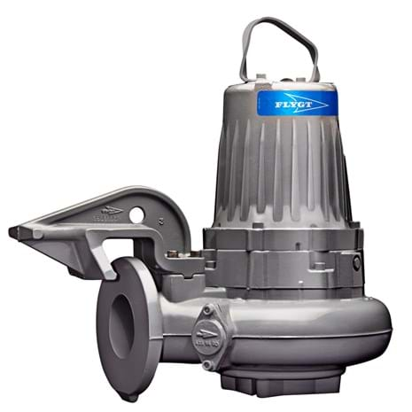
Submersible pumps
Wet Well

Slide 6
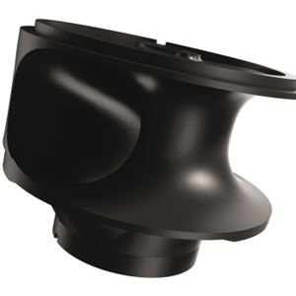
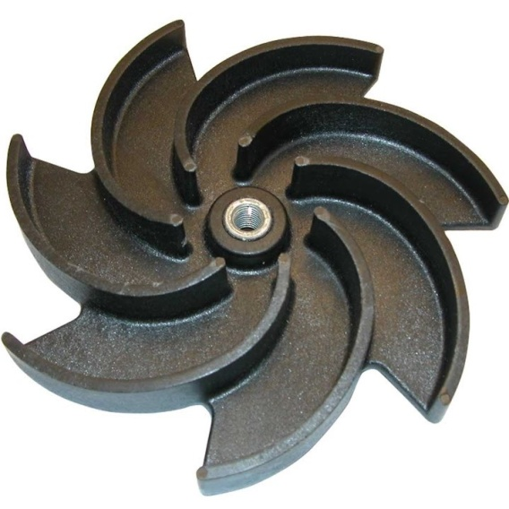
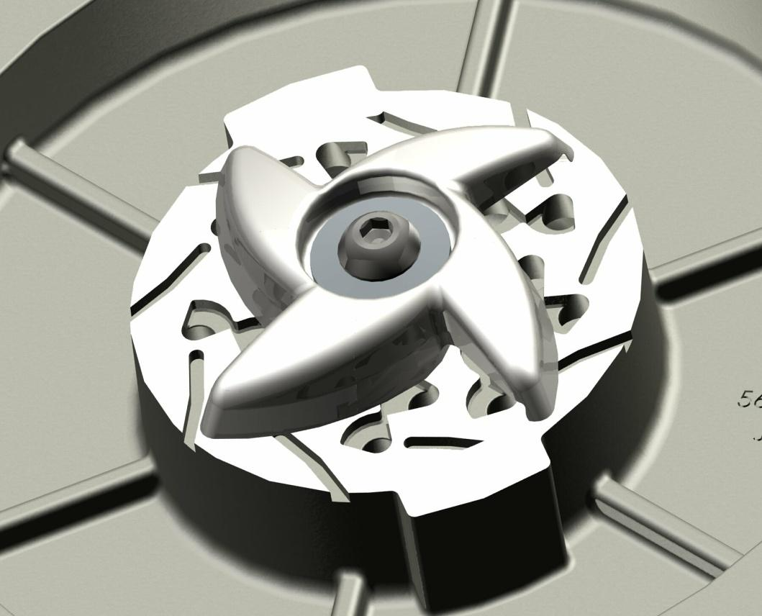
Types of submersible pumps
Non clog Vortex Grinders

Slide 7
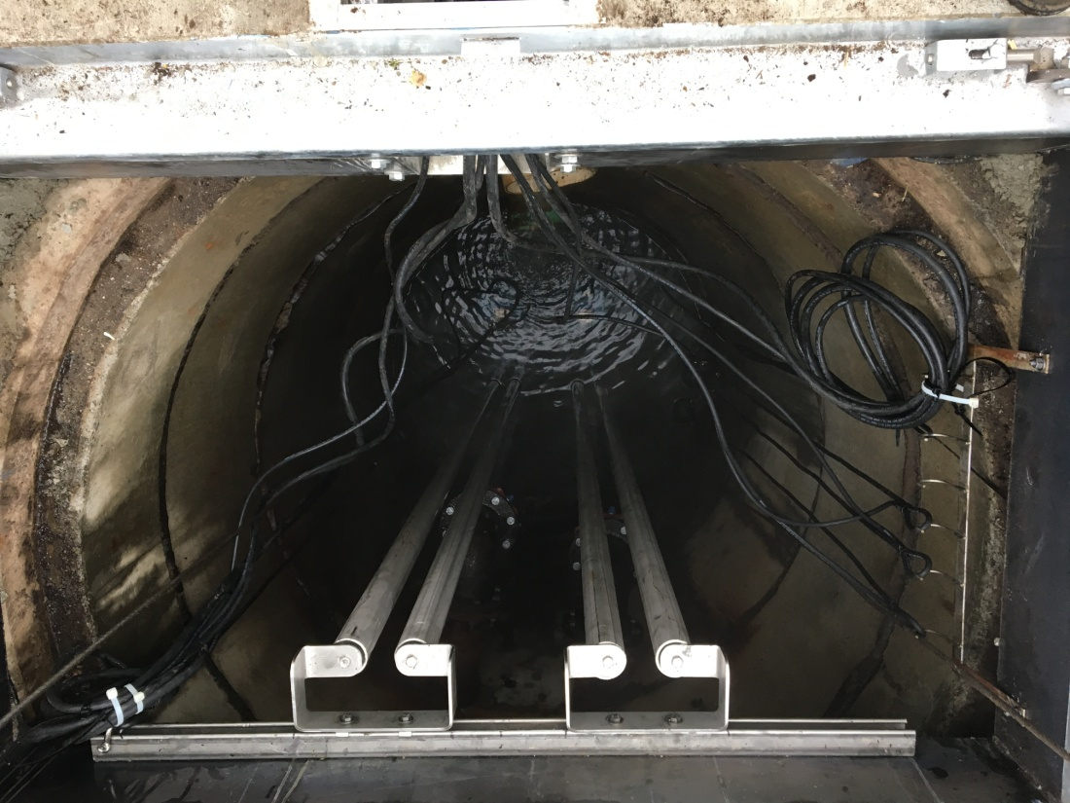
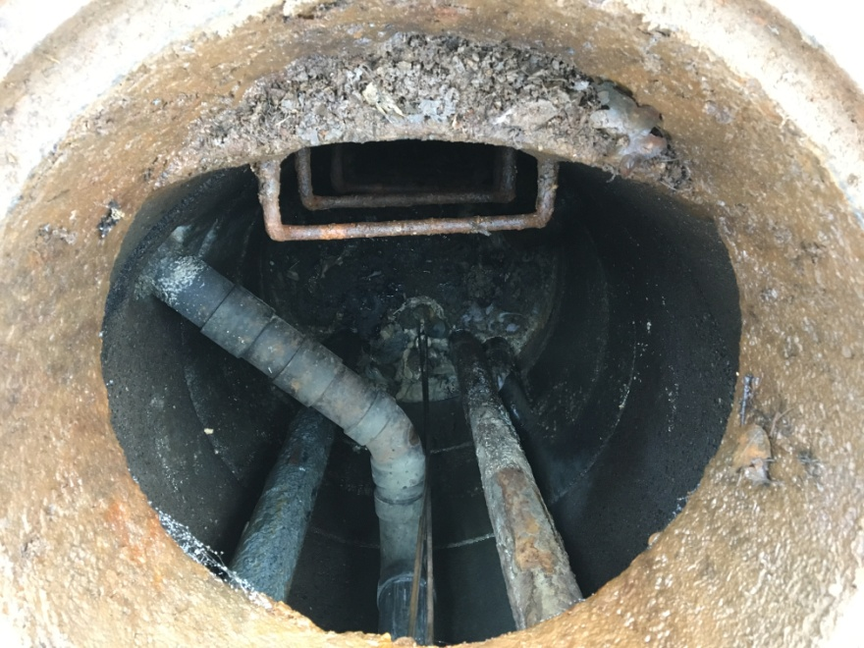
Main usages for submersible pumps
Waste water and storm water
Rail system Hard piped

Slide 8
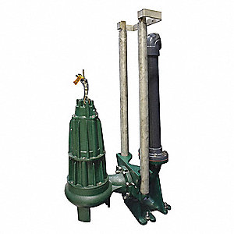
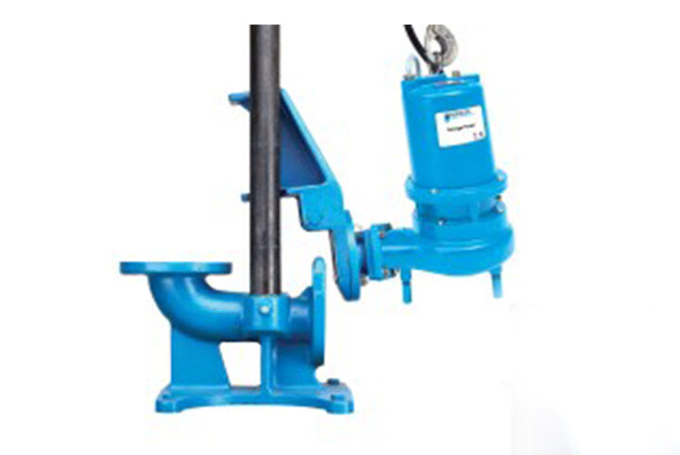

Slide 9
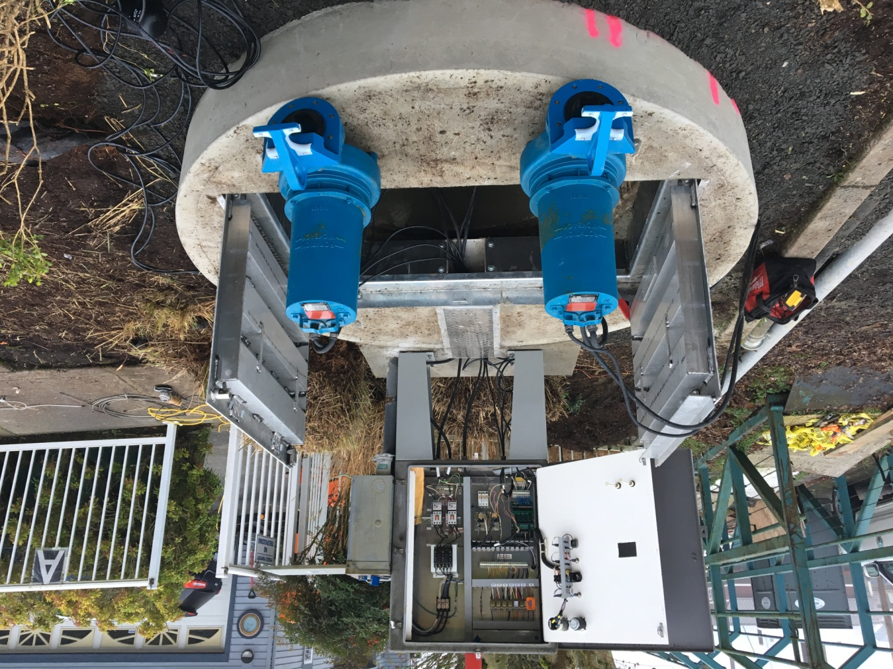
Main Components of a sump system
Pumps
Control Panel
Floats and / or transducer
Check Valves
ISO Valves
Rail System
Discharge Piping

Slide 10
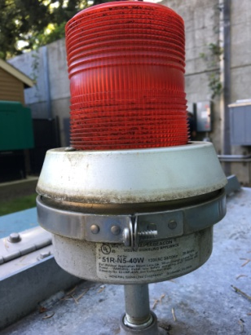
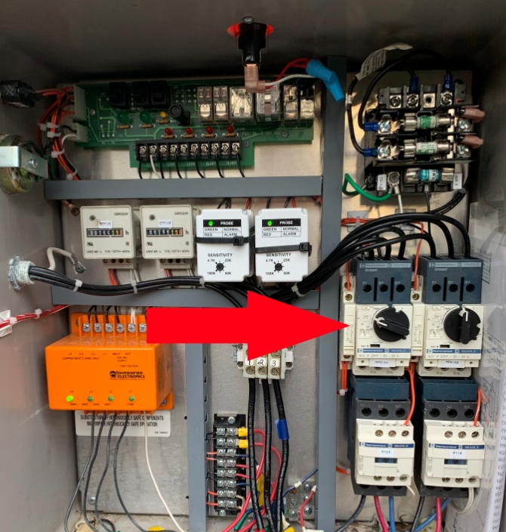
Why we would be called out to service a submersible pump
1. High Water Alarm
Compliant from customer - Water backing up
Remote monitoring – High amps, long run time
PM Service
2. Breaker Tripped
Got remote alarm
Visual inspection

Slide 11
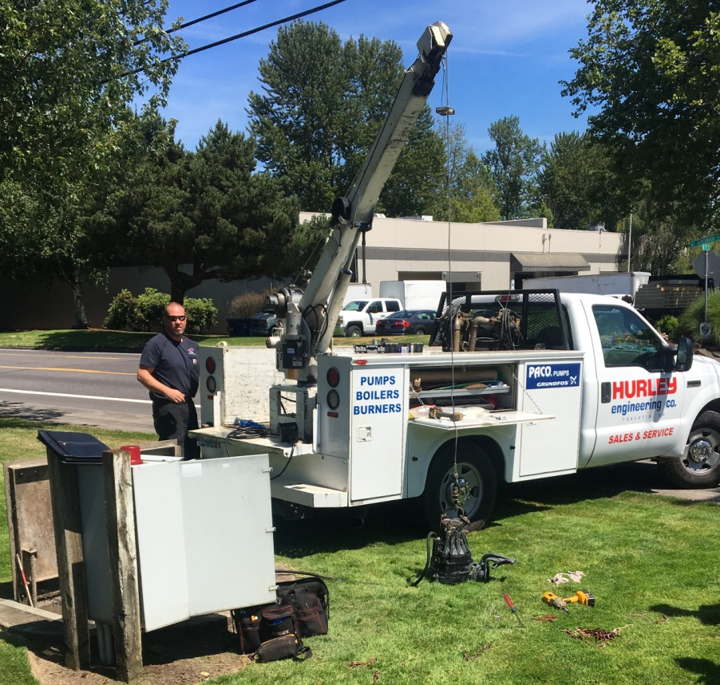

Check out the system
Visual look over the system Water level
Which Floats are tipped
Breakers and overloads
HOA Switches
Seal light and alarms
Voltage
Amps
Meg motor
Pump down
Rail system
Piping
Valves
3. Pull pump from sump
2. Check Floats

Slide 12

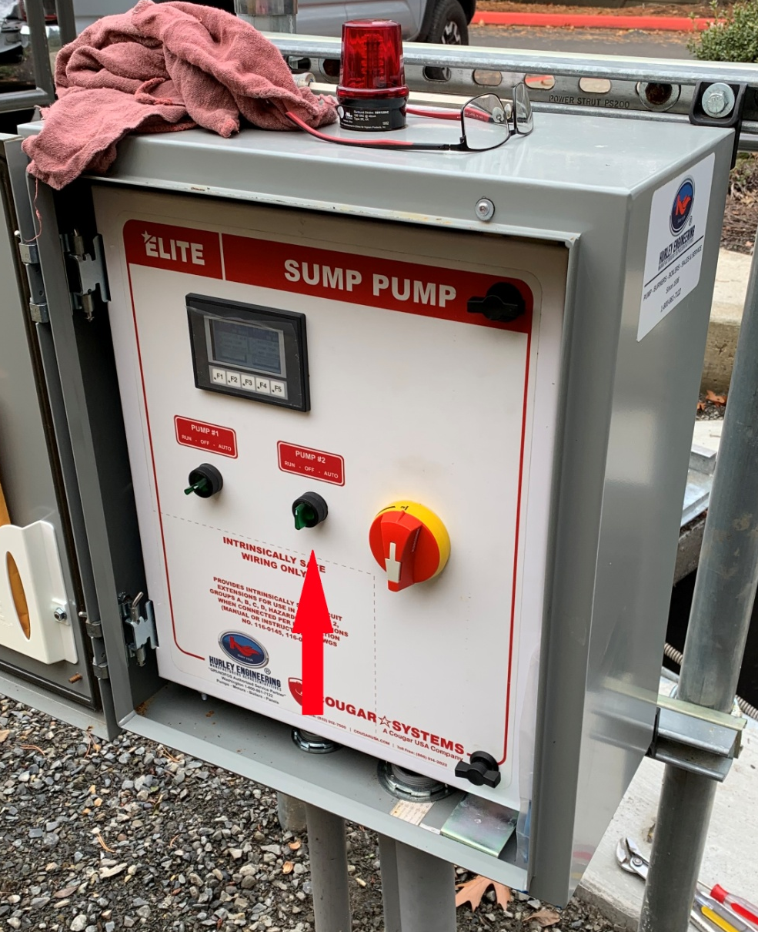
Inspect breakers, overloads, and HOA switches
Overloads set to 1.25% of full load amps of pump
Seal fail light, high temp light, other alarms

Slide 13
Check out the system
Visual look over the system Water level
Which Floats are tipped
Breakers and overloads
HOA Switches
Seal light and alarms
Voltage
Amps
Meg motor
Pump down
Rail system
Piping
Valves
3. Pull pump from sump
2. Check Floats

Slide 14
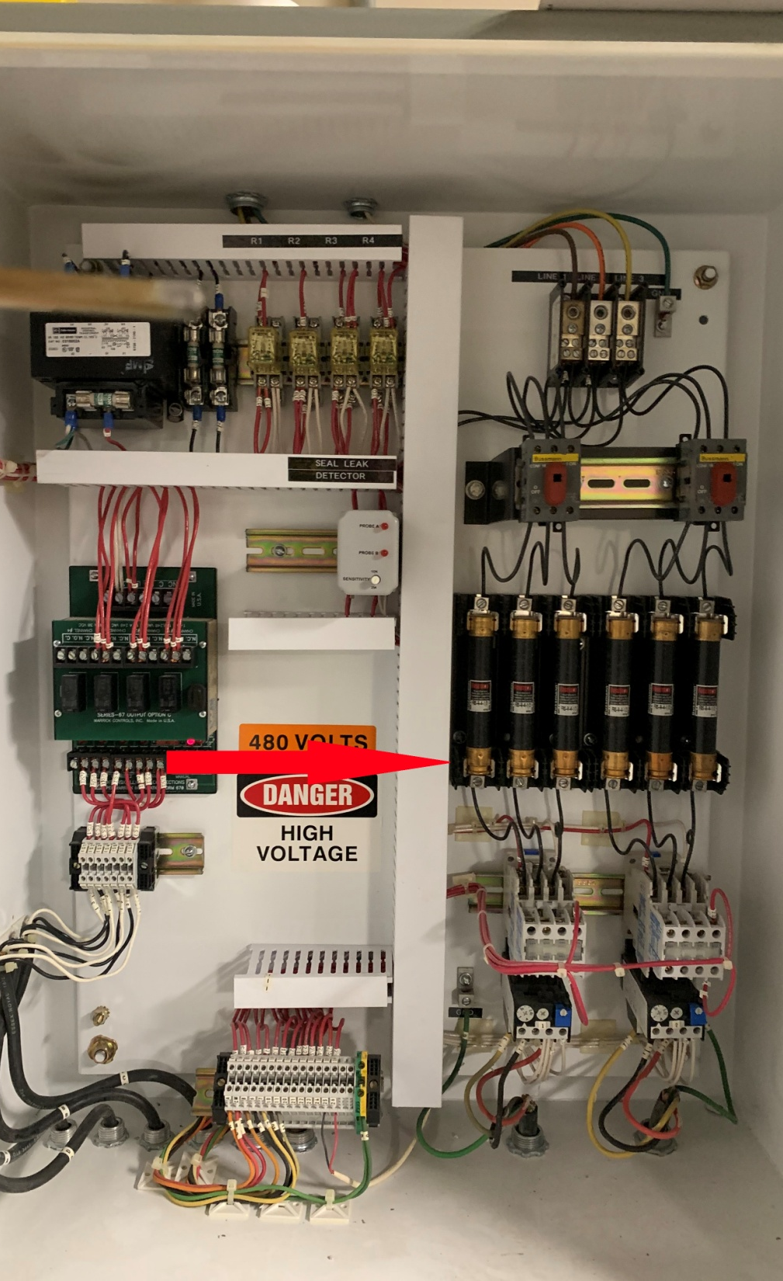
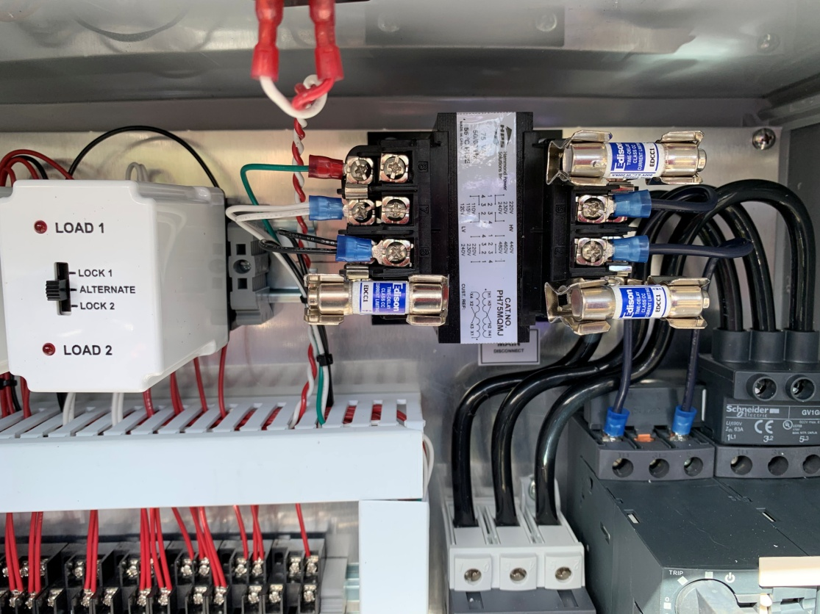
Check incoming power and fuses

Slide 15
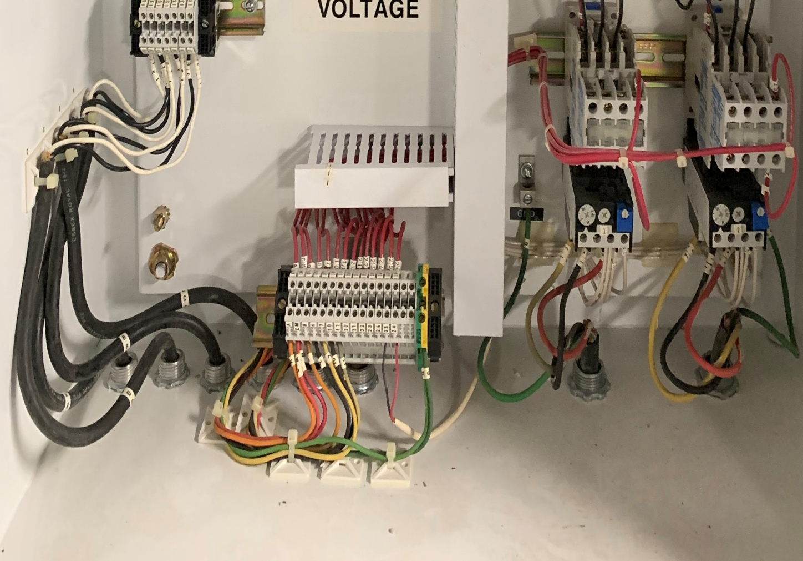
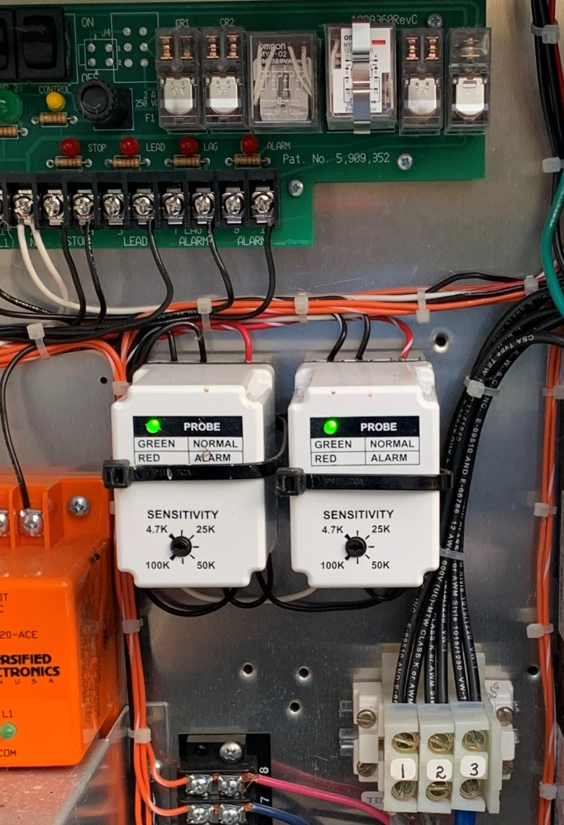
Check moisture and thermal sensors
Red and Orange – Moisture Depends on pump
Black and White – Thermal Should have low ohm .2 – 1.5

Slide 16
Check out the system
Visual look over the system Water level
Which Floats are tipped
Breakers and overloads
HOA Switches
Seal light and alarms
Voltage
Amps
Meg motor
Pump down
Rail system
Piping
Valves
3. Pull pump from sump
2. Check Floats

Slide 17
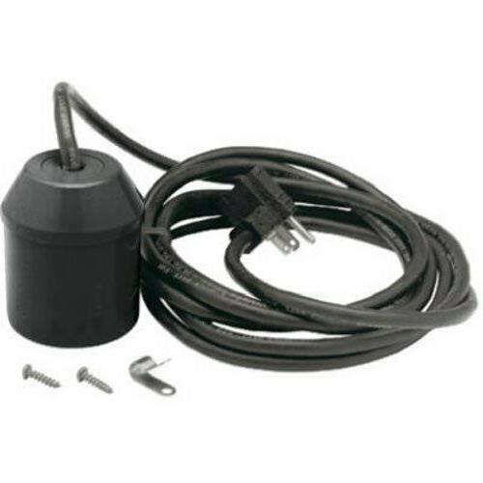
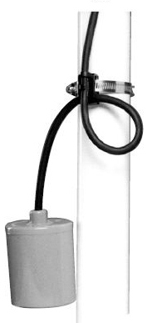
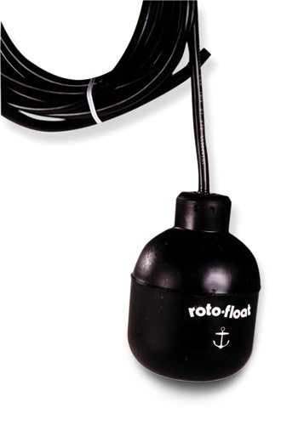

Piggy back has 110VAC plug
Float tethered to pipe
Internal weight
External weight

Slide 18
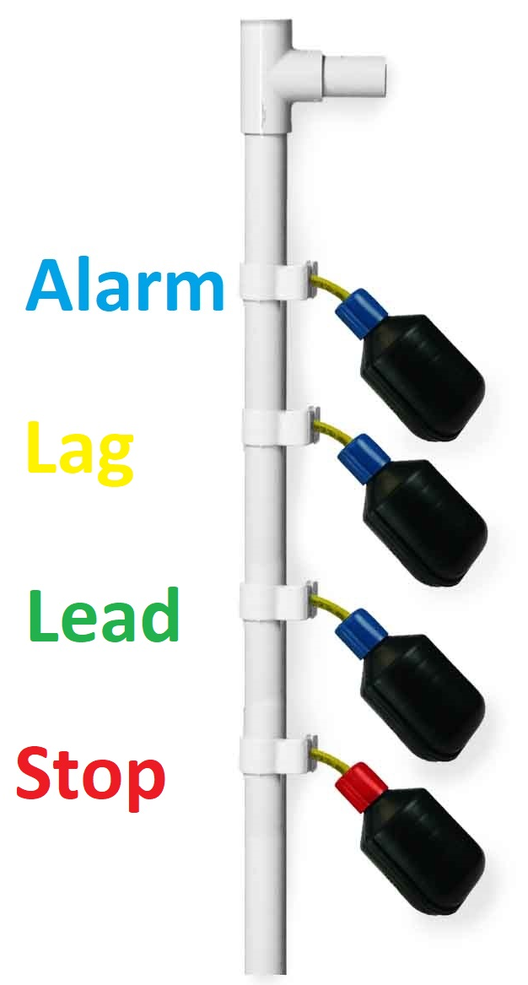

Check floats
Tip each float and check for light on controller
Ohm each float – Caution may have 110 VAC
Float down
Open
Float up
Closed
Check floats are hanging in correct order
Did pump Alternator Work
Clean all floats

Slide 19
Check out the system
Visual look over the system Water level
Which Floats are tipped
Breakers and overloads
HOA Switches
Seal light and alarms
Voltage
Amps
Meg motor
Pump down
Rail system
Piping
Valves
3. Pull pump from sump
2. Check Floats

Slide 20
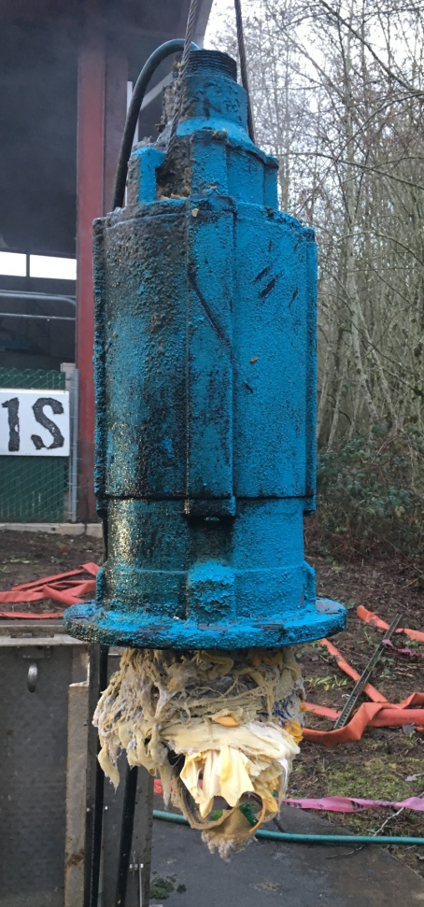
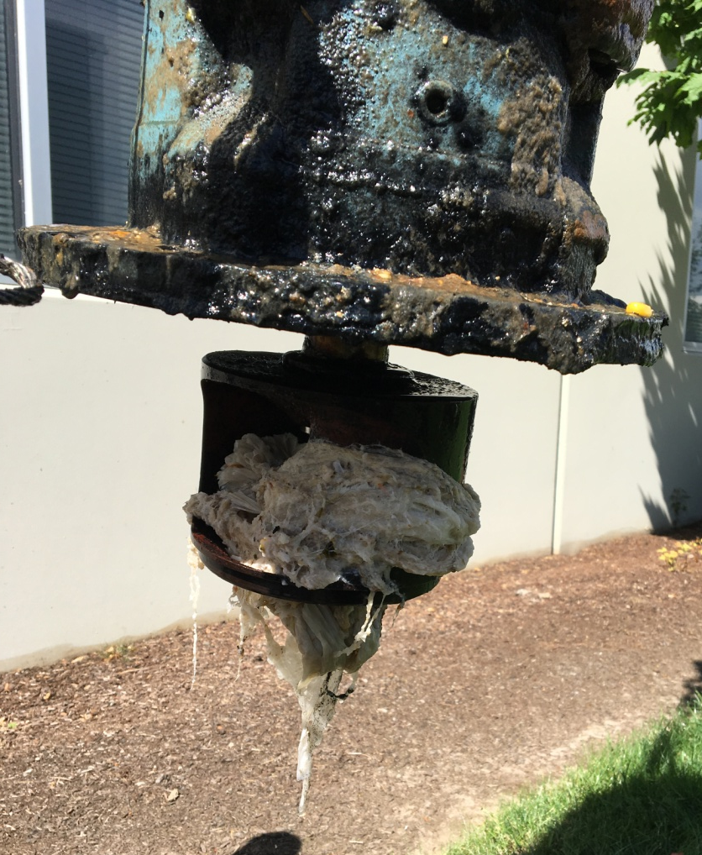
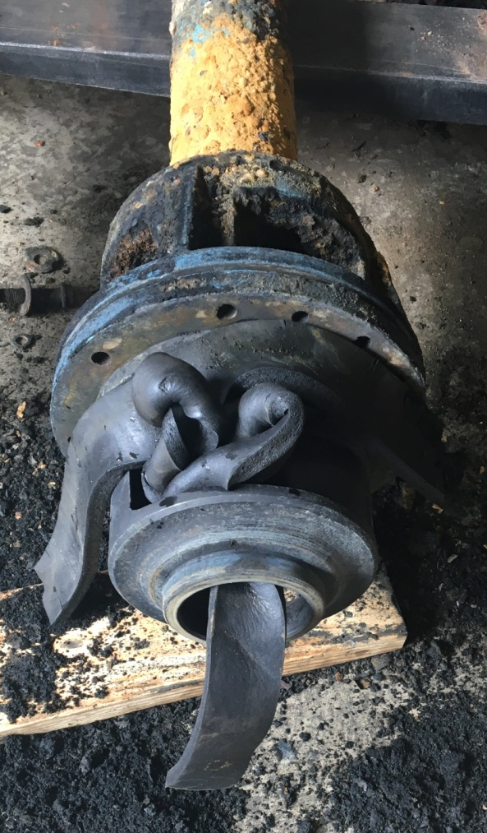
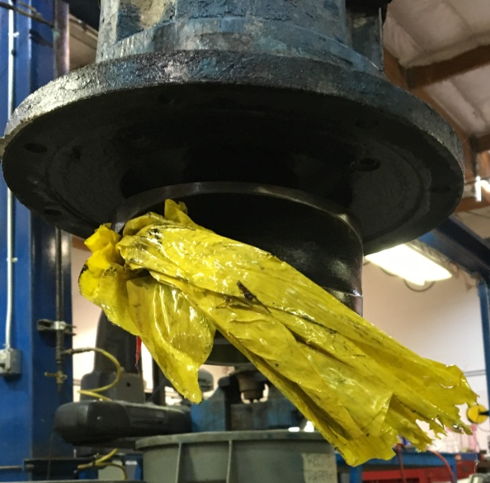
Check for clog impeller

Slide 21
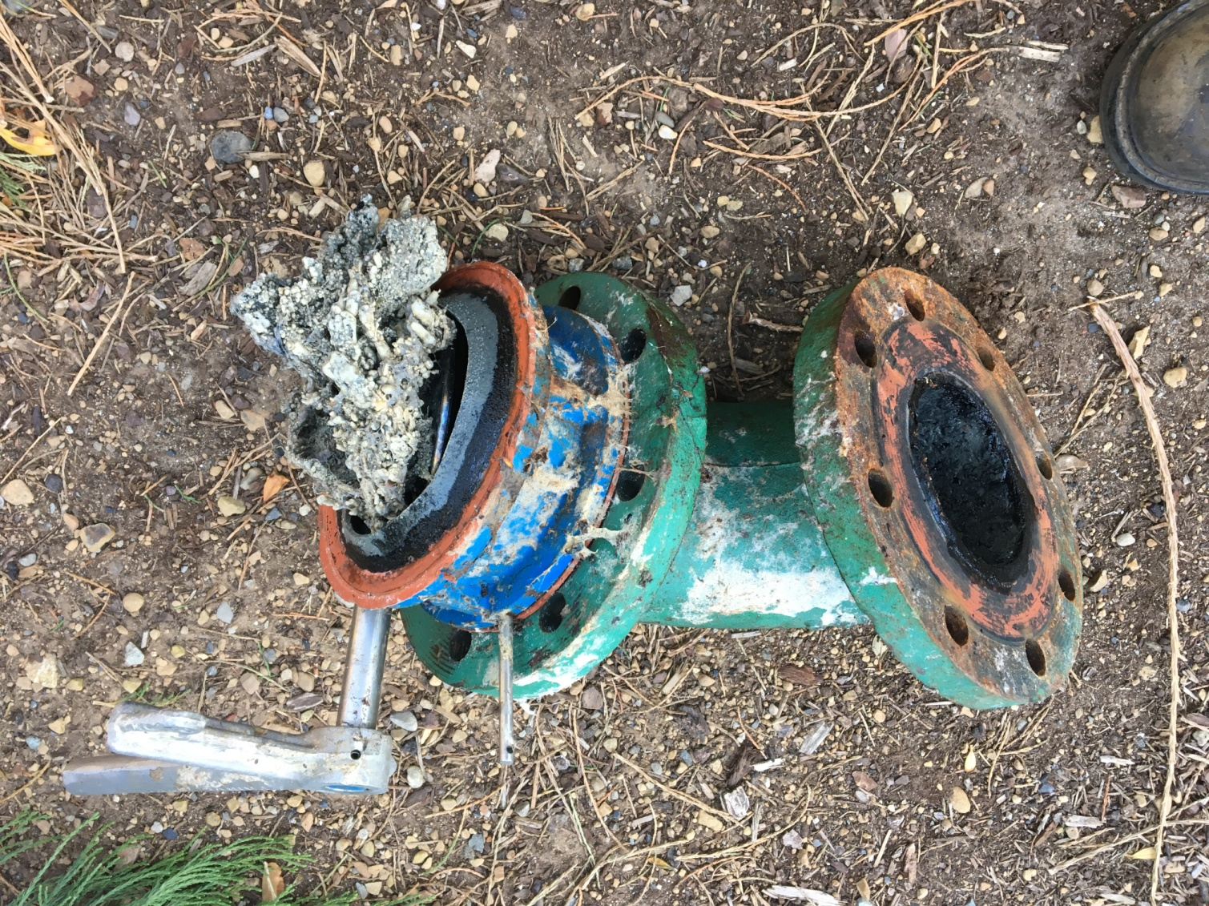
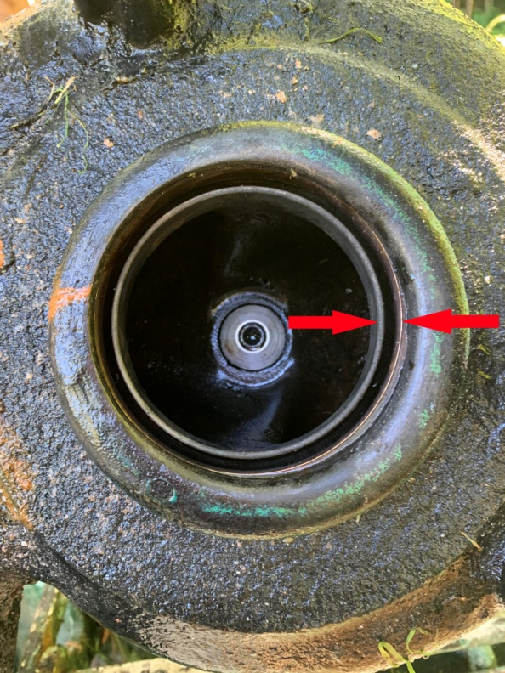
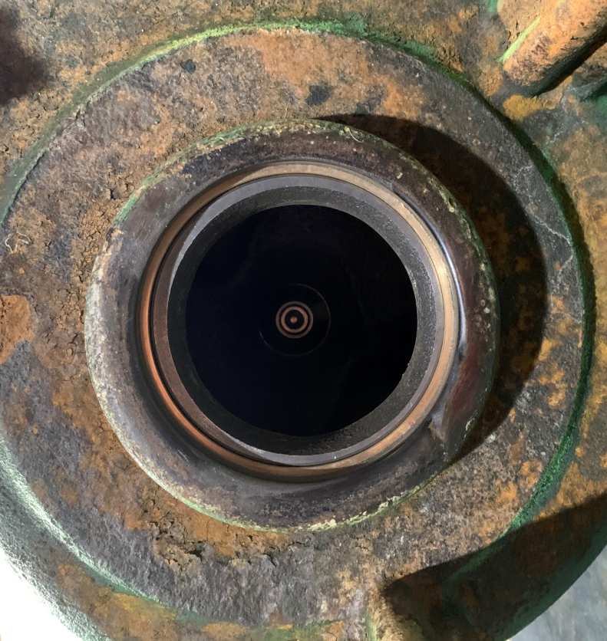
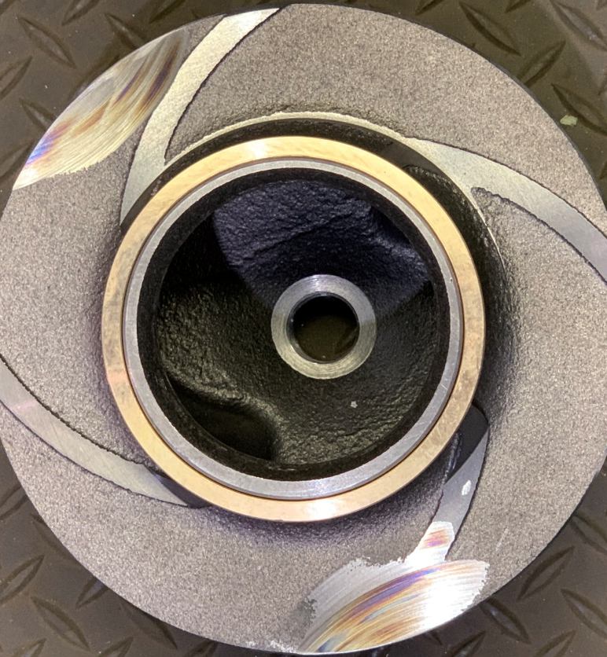
Clog could be in pipe or valves
Check impeller clearance
Will reduce flow and clog easier

Slide 22
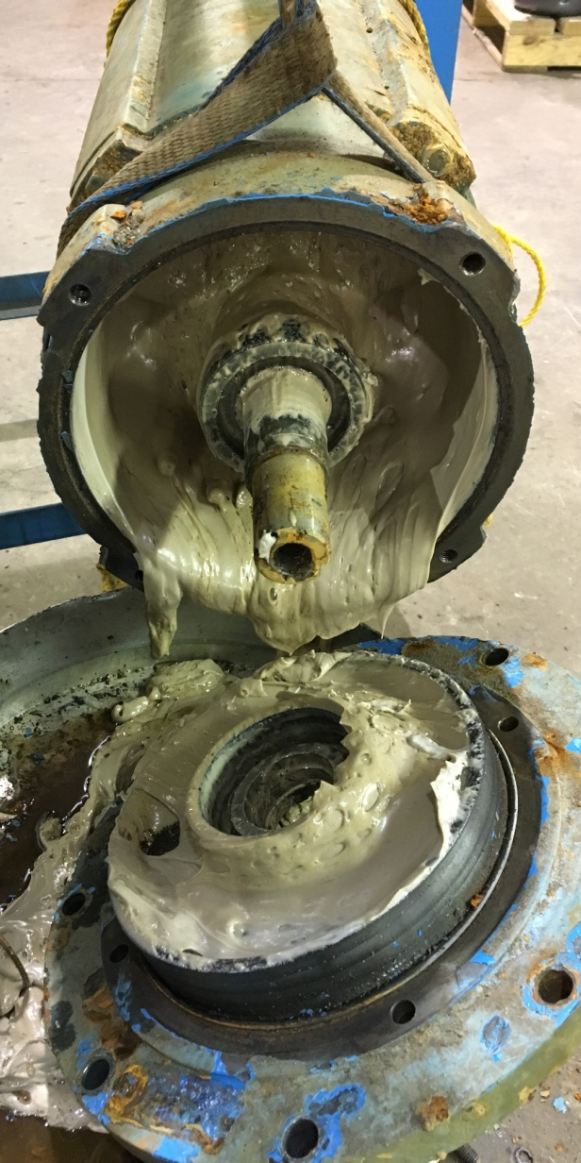
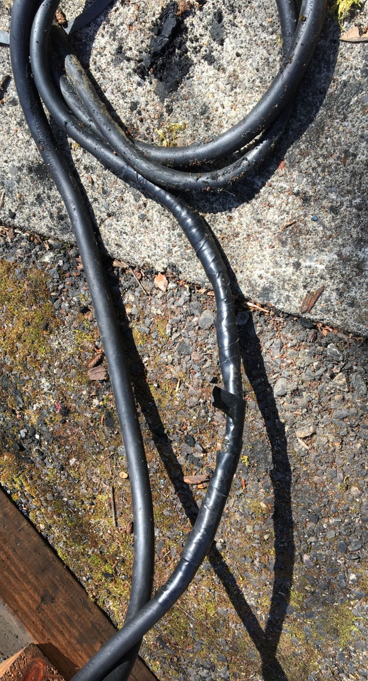
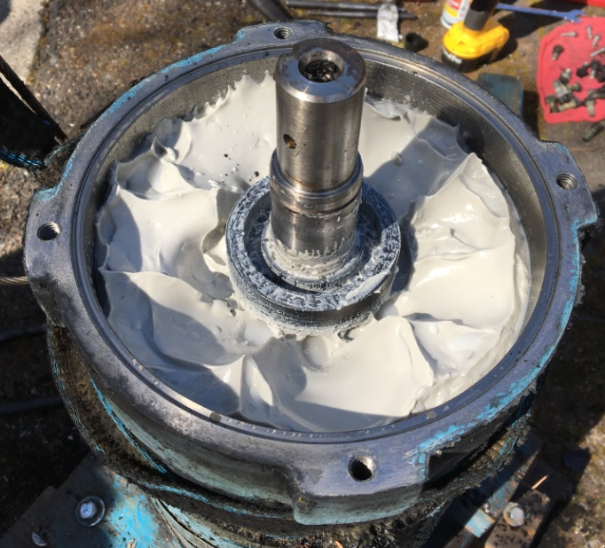
Check oil
Inspect Power cord
Verify Pump Rotation

Slide 23
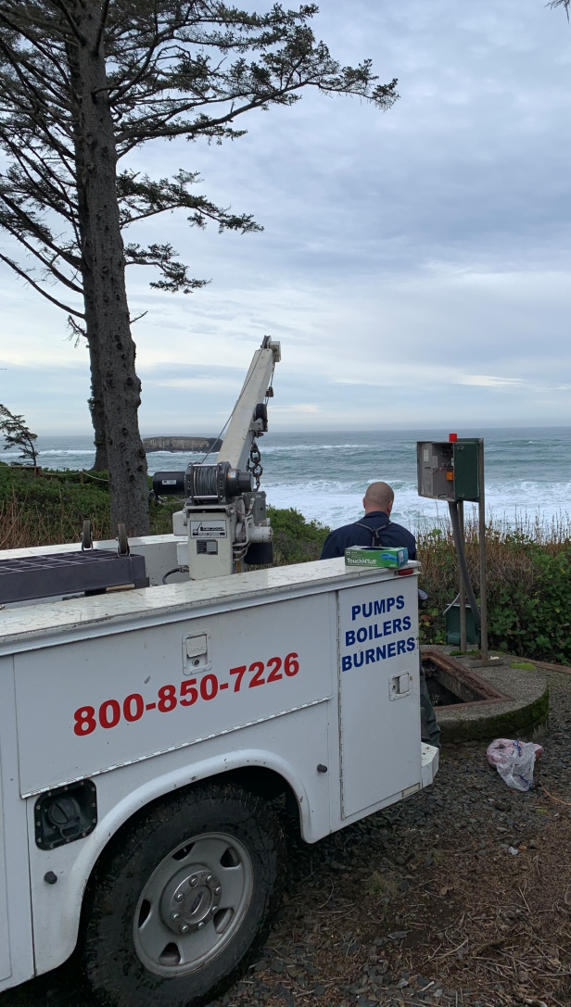
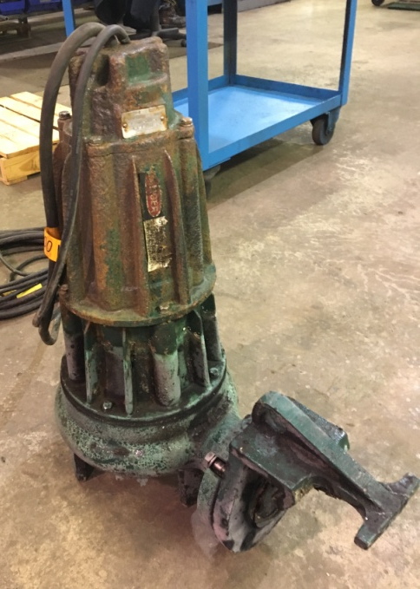
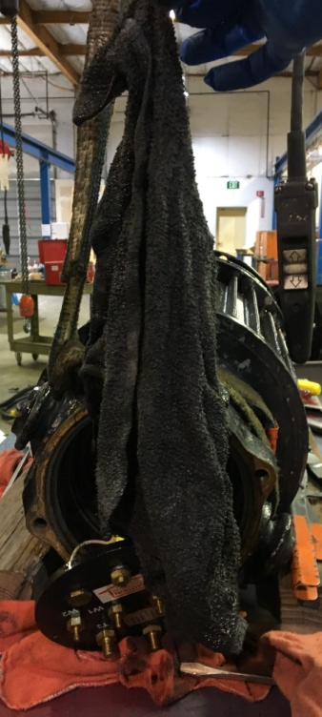
If the pump need service
Close ISO Valve
Dewire pump
Tear down and inspect pump
Replace mech seals
Replace motor bearings
Pump Seals or O rings
Pump / Motor Oil
Reinstall Pump
Rewire pump
Check rotation
Install repaired pump
Make sure not to air lock pump
Open ISO valve
Check pump down
Check Amps

Slide 24
